Slide 1
Unit 11
What’s the matter with you?
Lesson 1

Slide 2
Vocabulary

Slide 3
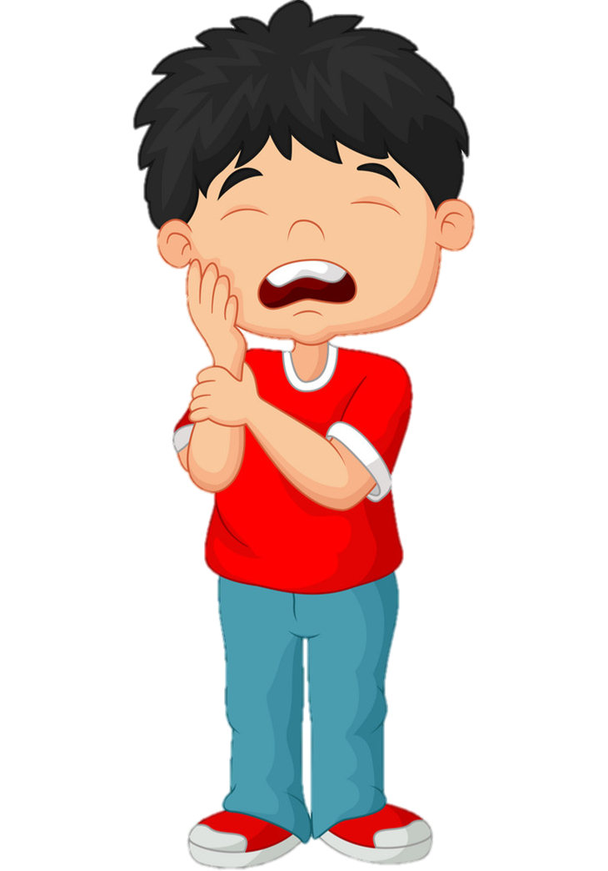
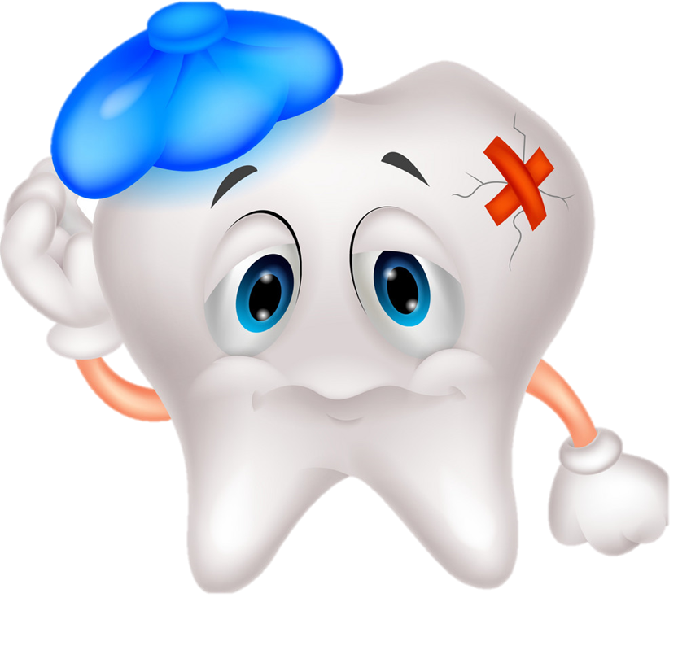
toothache:
/ˈtuːθeɪk/
đau răng

Slide 4
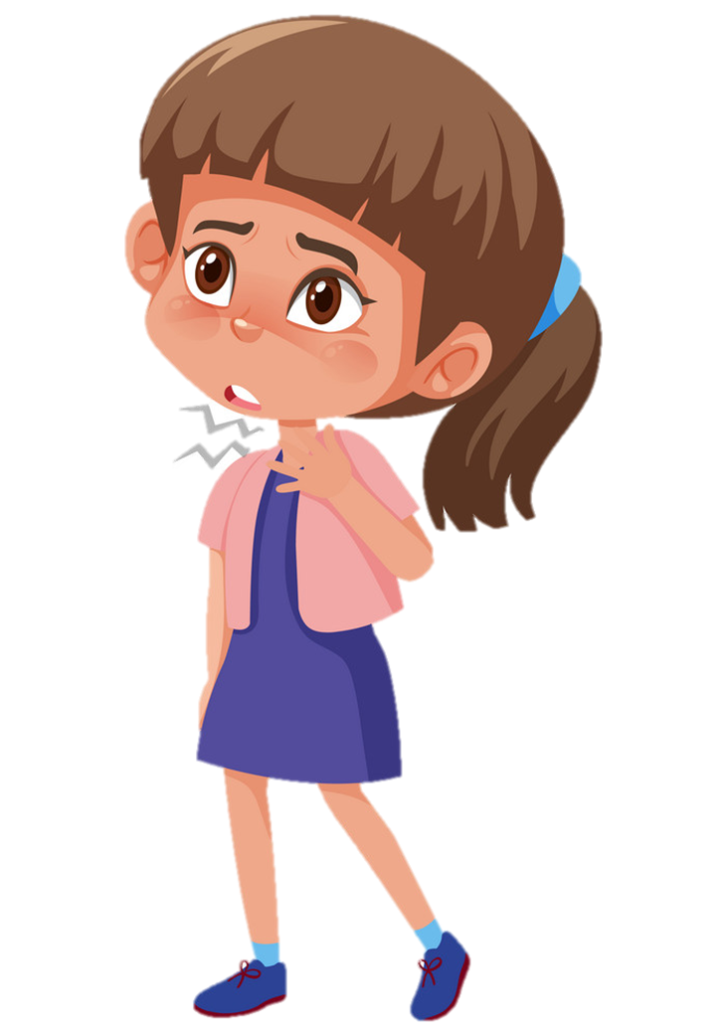
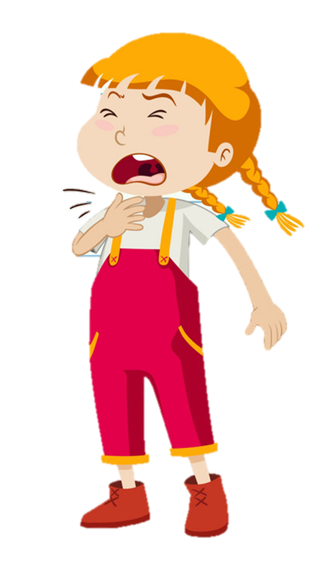
sore throat:
/sɔː θrəʊt/
đau họng

Slide 5
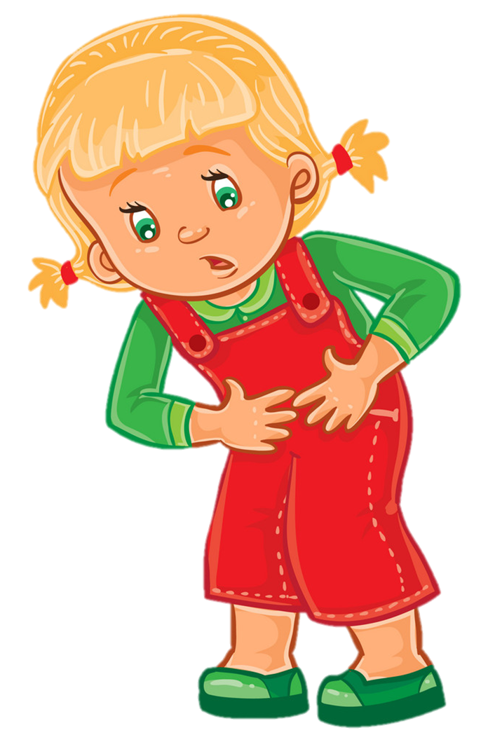
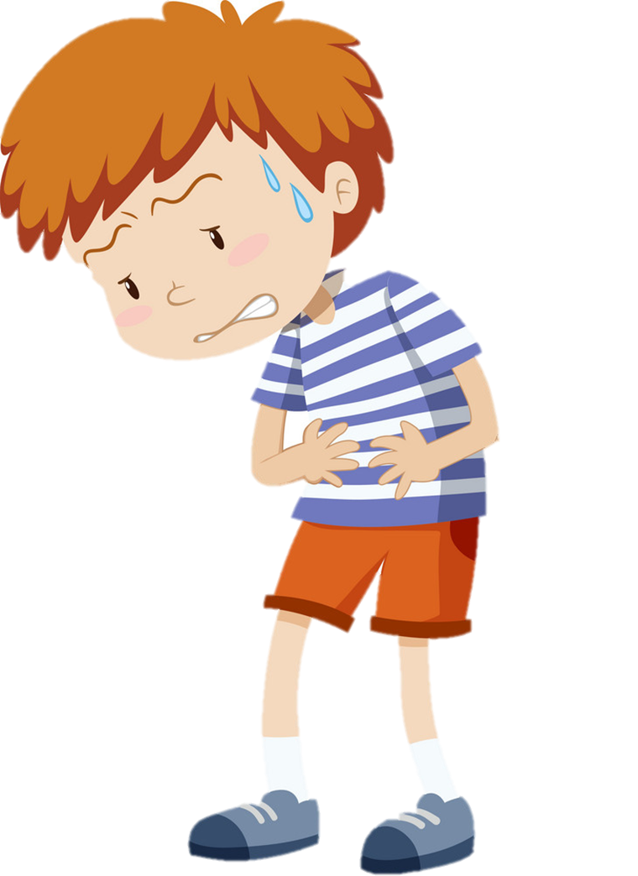
stomach ache:
/ˈstʌmək eɪk/
đau bụng

Slide 6
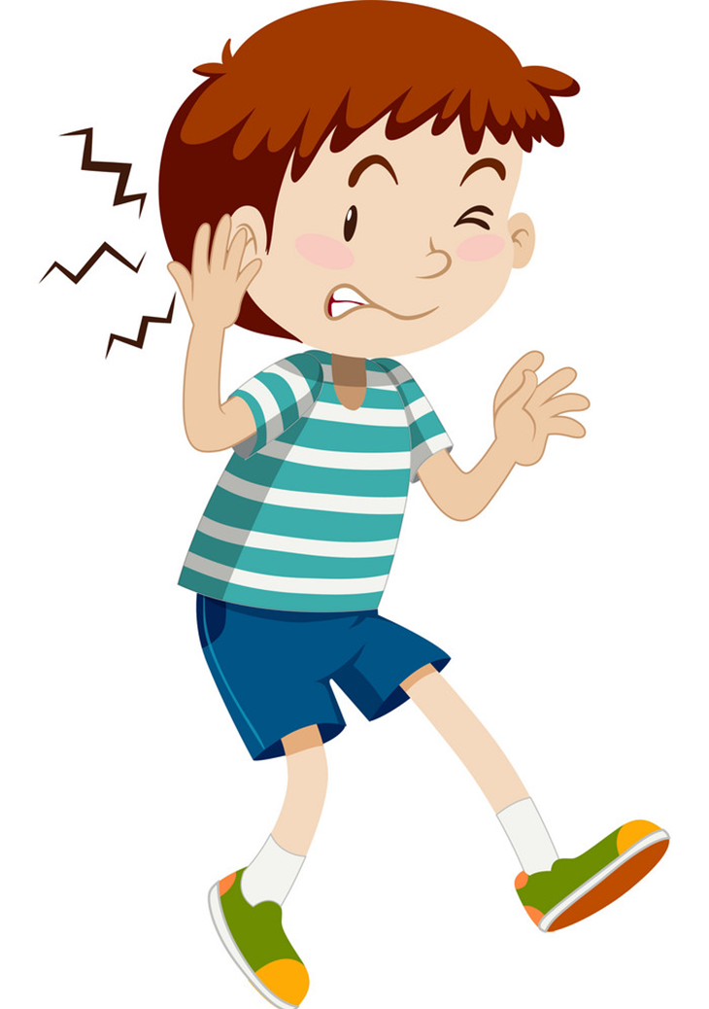
earache:
/ˈɪəreɪk/
đau tai

Slide 7
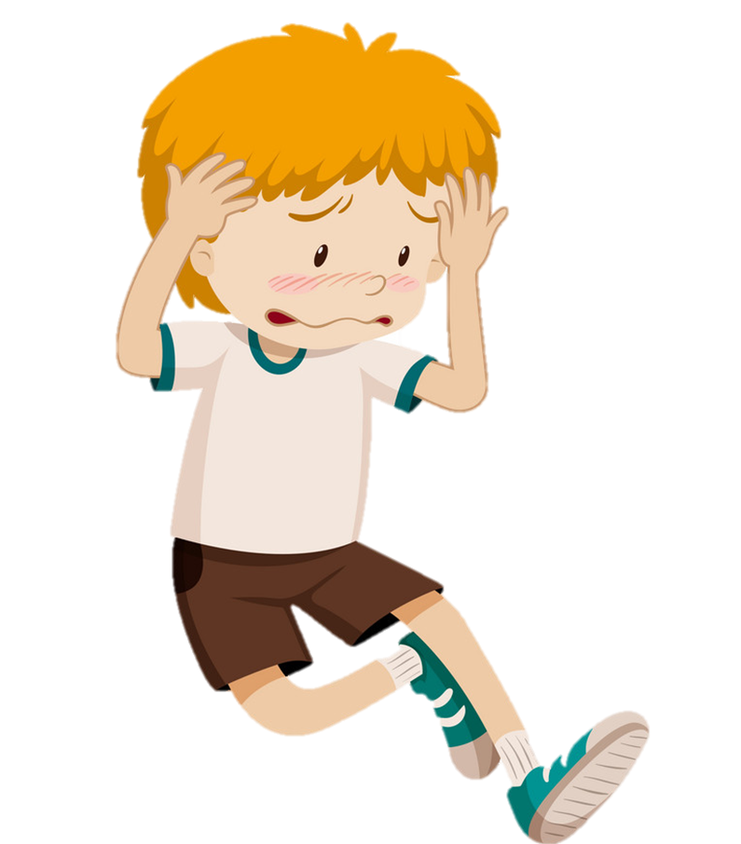
headache:
/ˈhedeɪk/
đau đầu

Slide 8
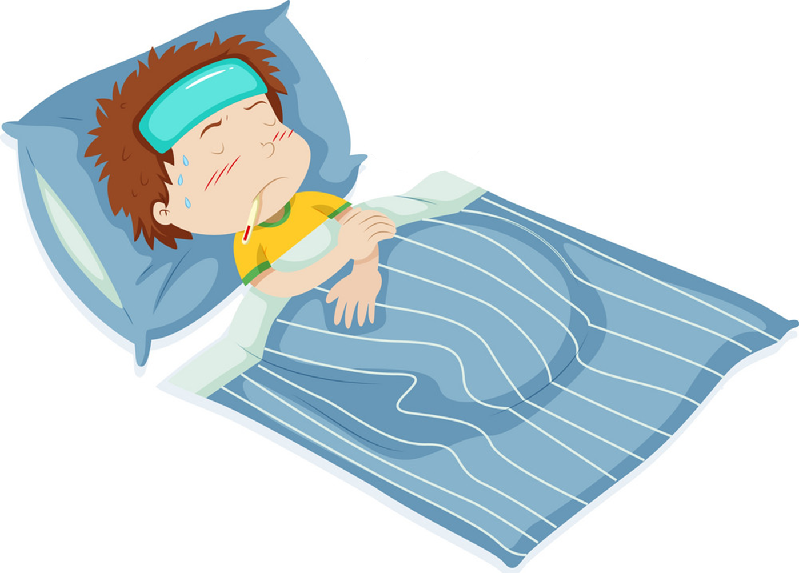
fever:
/ˈfiːvər/
sốt

Slide 9
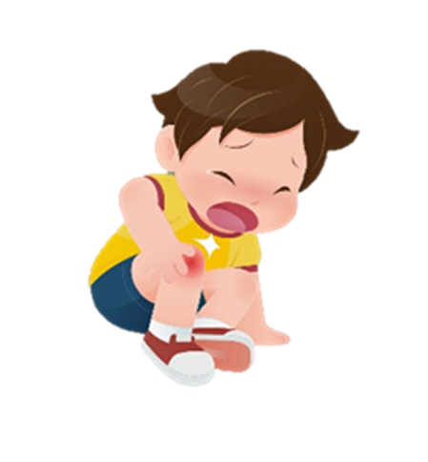
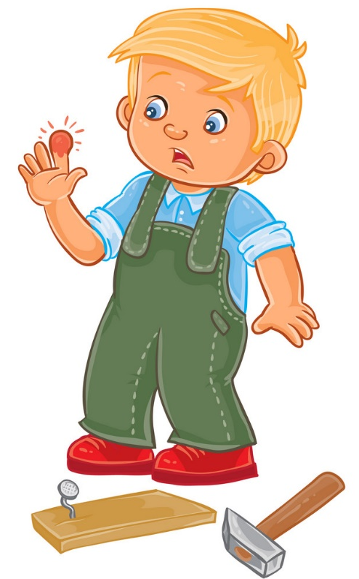

pain:
/peɪn/
sự đau đớn

Slide 10
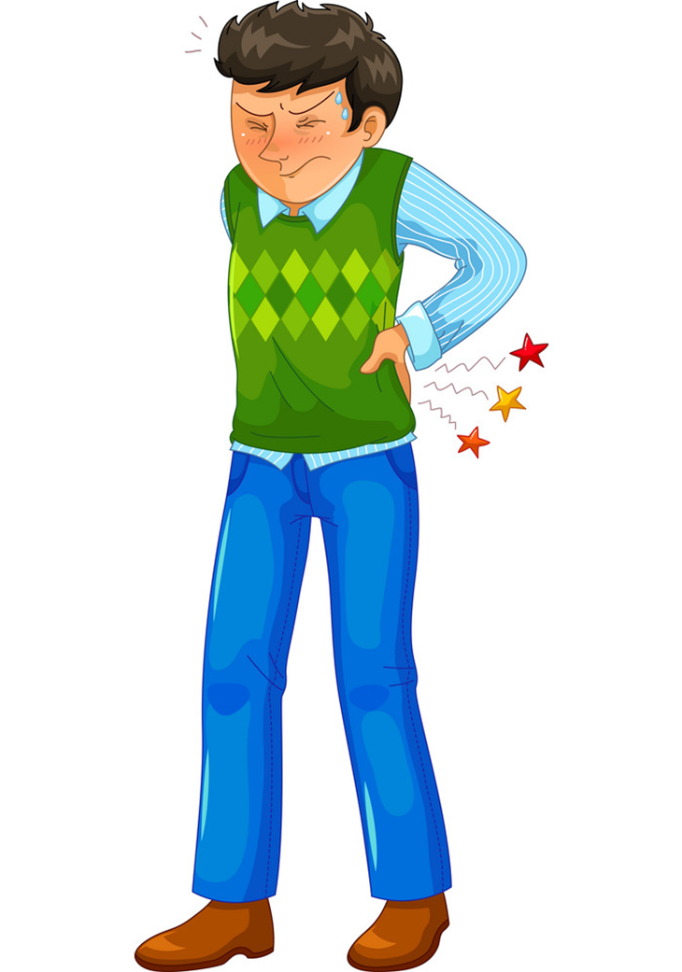
backache:
/ˈbækeɪk/
đau lưng

Slide 11
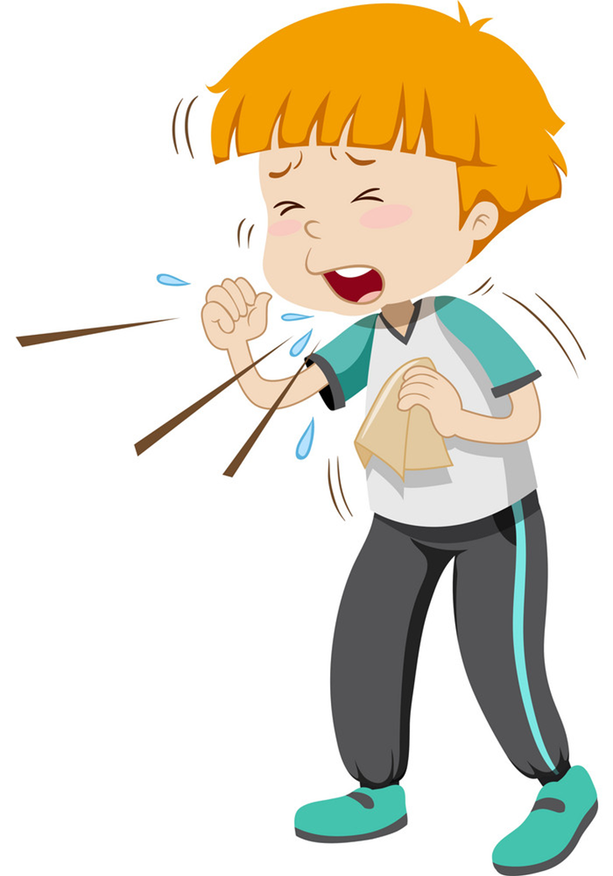
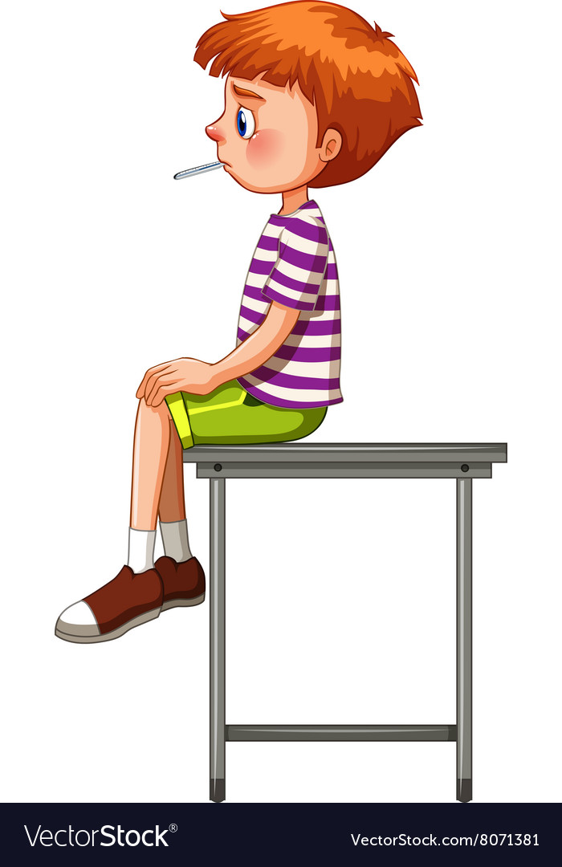
cough:
/kɒf/
ho

Slide 12
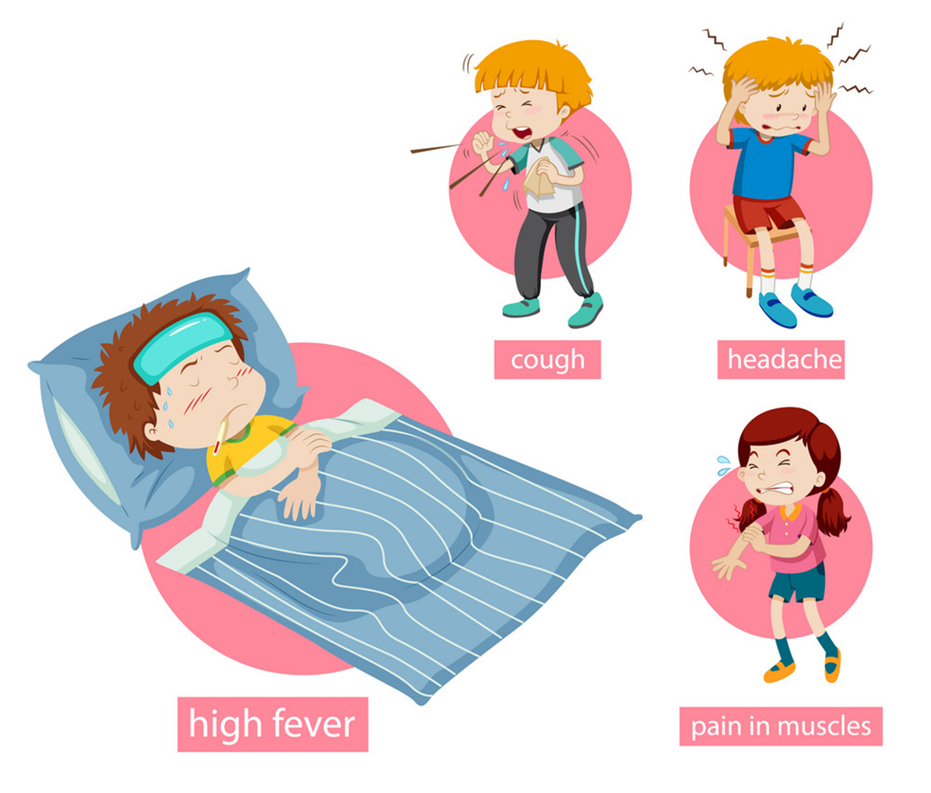
Flu
/fluː/

Slide 13
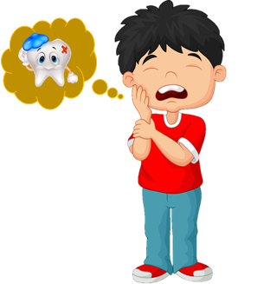
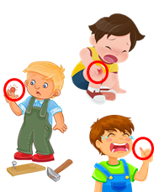
Vocabulary:
1
2
3
4
5
flu
/fluː/
sore throat
/sɔː θrəʊt/
cough
/kɒf/
toothache
/ˈtuːθeɪk/
headache
/ˈhedeɪk/
10
6
7
8
9
earache
/ˈɪəreɪk/
pain
/peɪn/
fever
/ˈfiːvər/
stomach ache
/ˈstʌmək eɪk/
backache
/ˈbækeɪk/

Slide 14


Toothache
/ˈtuːθeɪk/
Pain
/peɪn/
Backache
/ˈbækeɪk/

Slide 15
Flu
/fluː/
Pain
/peɪn/
headache
/ˈhedeɪk/

Slide 16
Cough
/kɒf/
Backache
/ˈbækeɪk/
Stomach ache
/ˈstʌmək eɪk/

Slide 17
Earache
/ˈɪəreɪk/
Backache
/ˈbækeɪk/
Stomach ache
/ˈstʌmək eɪk/

Slide 18
Stomach ache
/ˈstʌmək eɪk/
Fever
/ˈfiːvər/
Cough
/kɒf/

Slide 19
Flu
/fluː/
Sore throat
/sɔː θrəʊt/
Cough
/kɒf/

Slide 20
Toothache
/ˈtuːθeɪk/
headache
/ˈhedeɪk/
Earache
/ˈɪəreɪk/

Slide 21
Sore throat
/sɔː θrəʊt/
Toothache
/ˈtuːθeɪk/
Stomach ache
/ˈstʌmək eɪk/

Slide 22
Toothache
/ˈtuːθeɪk/
Earache
/ˈɪəreɪk/
Sore throat
/sɔː θrəʊt/

Slide 23
Cough
/kɒf/
Toothache
/ˈtuːθeɪk/
headache
/ˈhedeɪk/

Slide 24
A
B
C
Stomach ache

Slide 25
A
B
C
Fever

Slide 26
A
B
C
Earache

Slide 27
A
B
C
Flu

Slide 28
A
B
C
Headache

Slide 29
A
B
C
Toothache

Slide 30
A
B
C
Sore throat

Slide 31
A
B
C
Cough

Slide 32
A
B
C
Backache

Slide 33
A
B
C
Pain

Slide 34
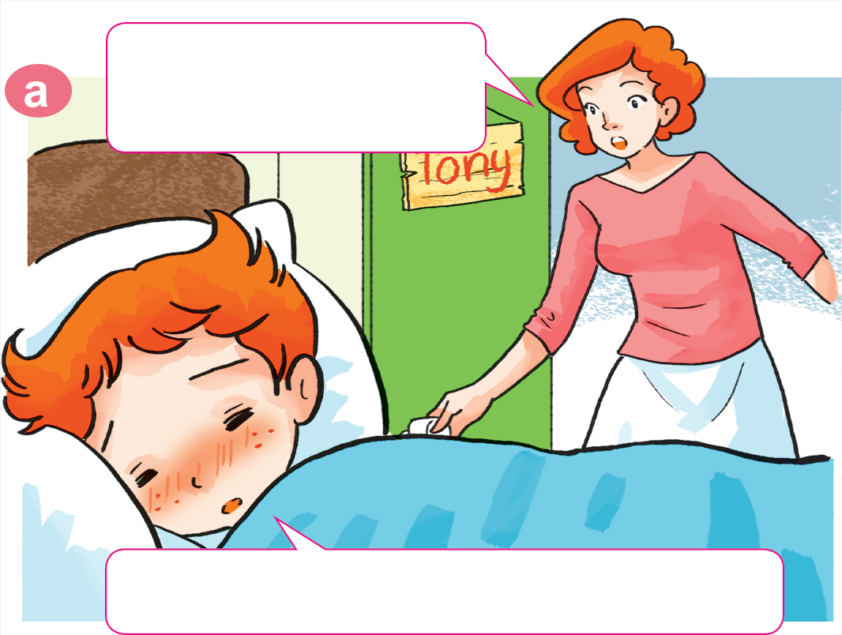

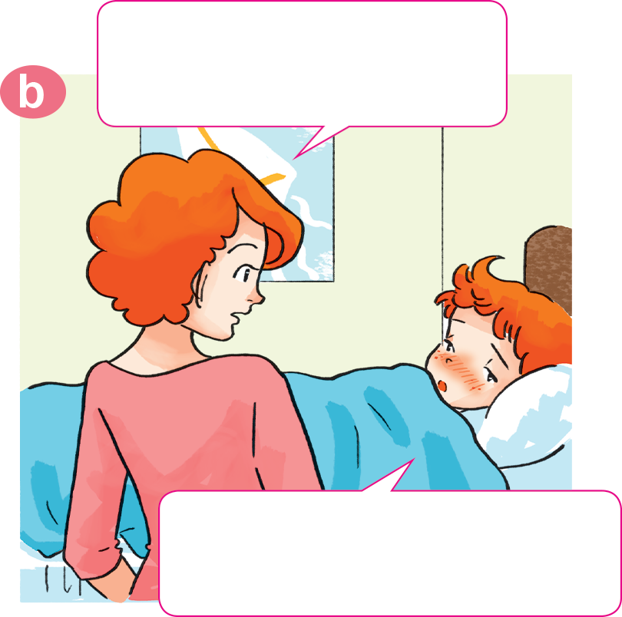
1. Look, listen and repeat.
Why not? What's the
matter with you?
Tony, get up!
Breakfast's ready.
I don't feel well.
I have a headache.
Sorry, I can't have breakfast, Mum.

Slide 35
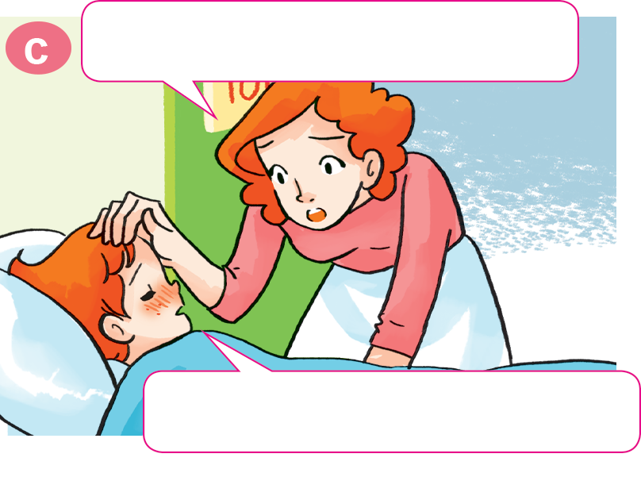
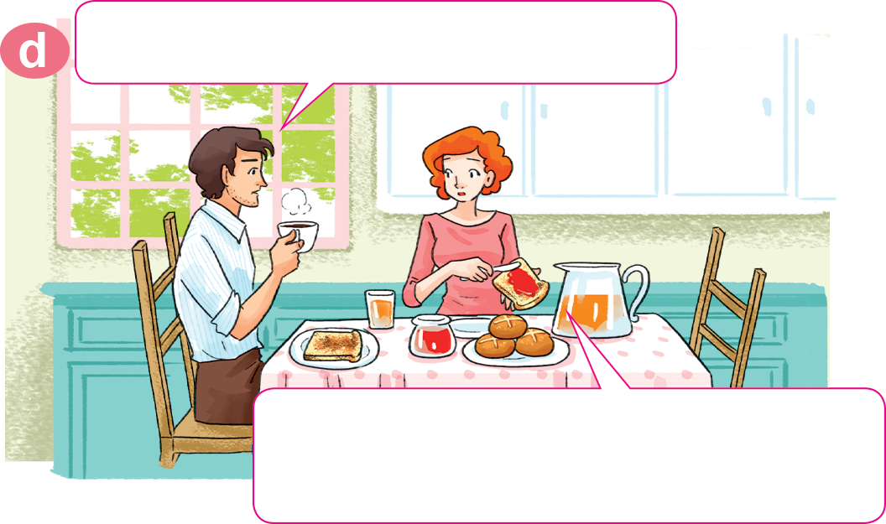
1. Look, listen and repeat.
Oh, you have a fever, too.
What's the matter with Tony?
He has a fever. I'll take him to
the doctor after breakfast.
Yes, Mum. I feel very hot.

Slide 36
2. Point and say.
What's the matter with you?
I have a toothache.
___________________

Slide 37
2. Point and say.
What's the matter with you?
I have an earache.
___________________.

Slide 38
2. Point and say.
What's the matter with you?
I have a sore throat.
___________________.

Slide 39
2. Point and say.
What's the matter with you?
I have a stomach ache.
___________________.

Slide 40
Model sentence
What's the matter with you?
What's the matter with you?
I have a _______________.
I have an _______________.
sore throat
earache

Slide 41
Temperature
/ˈtemprətʃər/
Model sentence
cough
toothache
sore throat
flu
headache
What's the matter with you?
I have a/an ______________.
earache
backache
pain
stomach ache
fever
Earache
/ˈɪəreɪk/

Slide 42
Extra sentence
What's the matter with her?
What's the matter with him?
She has
a stomach ache.
He has
a stomach ache.

Slide 43
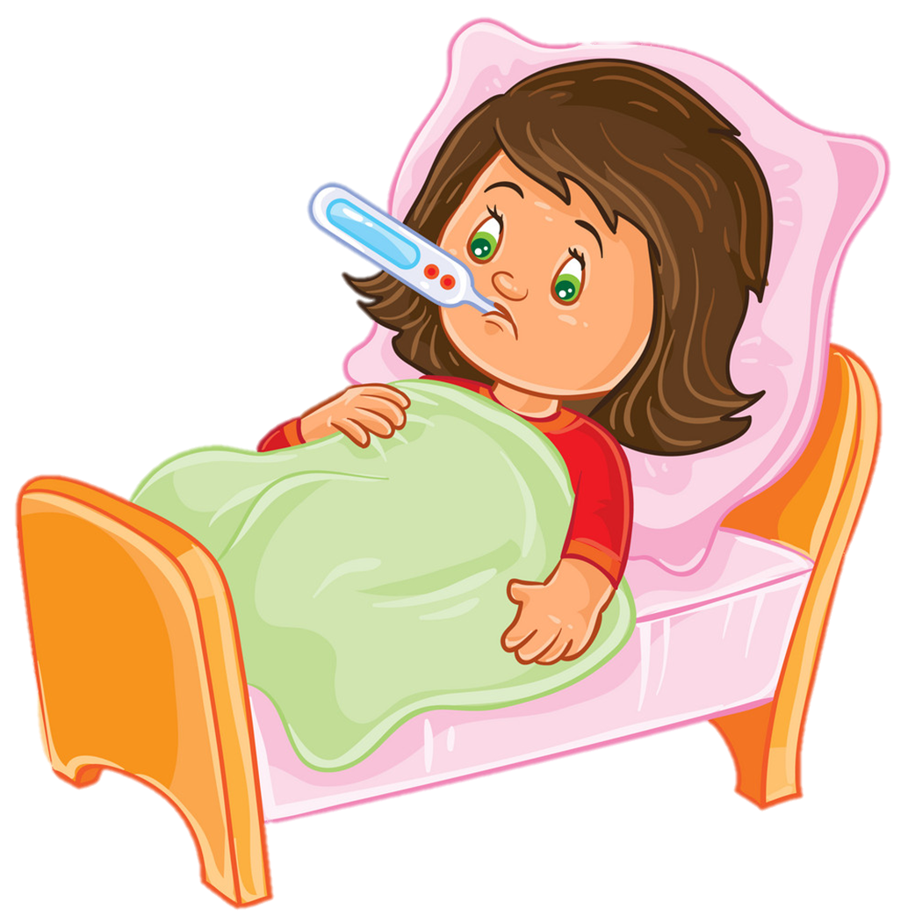
Temperature
/ˈtemprətʃər/
Extra sentence
cough
toothache
headache
sore throat
What's the matter with her/him?
She/He has a/an ______________.
backache
earache
stomach ache
fever
Earache
/ˈɪəreɪk/

Slide 44







Cách chơi:
    Chọn trái táo trên cây để mở câu hỏi
    Trả lời đúng được nhận 1 trái táo vào giỏ
    Click giỏ táo để nhận thêm táo vào giỏ
PLAY
PICKING
APPLES
1
2
3
20
19
18
17
16
15
14
13
12
11
10
9
8
7
6
5
4
3
2
1
0
20
19
18
17
16
15
14
13
12
11
10
9
8
7
6
5
4
3
2
1
0
20
19
18
17
16
15
14
13
12
11
10
9
8
7
6
5
4
3
2
1
0
Notes:
Ms Huyền Phạm - 0936.082.789 – YOUTUBE: MsPham. Facebook: Dạy và học cùng công nghệ.

Slide 45


wall
She have a flu.
What’s the matter with you?
A
I have a flu.
B
He have a flu.
C
Notes:
Ms Huyền Phạm - 0936.082.789 – YOUTUBE: MsPham. Facebook: Dạy và học cùng công nghệ.

Slide 46
I can see a _______.
zoo
I have a pain.
What’s the matter with you?
A
I have a toothache.
B
I have a stomach ache.
C
Notes:
Ms Huyền Phạm - 0936.082.789 – YOUTUBE: MsPham. Facebook: Dạy và học cùng công nghệ.

Slide 47
What’s the matter with him?
A
What’s the matter with you?
B
What’s the matter with her?
C
I have a cough.
Notes:
Ms Huyền Phạm - 0936.082.789 – YOUTUBE: MsPham. Facebook: Dạy và học cùng công nghệ.

Slide 48
What’s the matter with him?
A
What’s the matter with you?
B
What’s the matter with her?
I have a toothache.
C
Notes:
Ms Huyền Phạm - 0936.082.789 – YOUTUBE: MsPham. Facebook: Dạy và học cùng công nghệ.

Slide 49
What’s the matter with him?
A
What’s the matter with you?
B
What’s the matter with her?
He has a headache.
C
Notes:
Ms Huyền Phạm - 0936.082.789 – YOUTUBE: MsPham. Facebook: Dạy và học cùng công nghệ.

Slide 50
I have a sore throat.
What’s the matter with her?
A
He has a
sore throat.
B
She has a
sore throat.
C
Notes:
Ms Huyền Phạm - 0936.082.789 – YOUTUBE: MsPham. Facebook: Dạy và học cùng công nghệ.

Slide 51
I have a fever.
What’s the matter with him?
A
He has a fever.
B
She has a fever.
C
Notes:
Ms Huyền Phạm - 0936.082.789 – YOUTUBE: MsPham. Facebook: Dạy và học cùng công nghệ.

Slide 52
him
A
What’s the matter with___?
He has a backache.
her
B
you
C
Notes:
Ms Huyền Phạm - 0936.082.789 – YOUTUBE: MsPham. Facebook: Dạy và học cùng công nghệ.

Slide 53
you
A
What’s the matter with___?
She has a backache.
he
B
her
C
Notes:
Ms Huyền Phạm - 0936.082.789 – YOUTUBE: MsPham. Facebook: Dạy và học cùng công nghệ.

Slide 54
he
A
What’s the matter with___?
I have a backache.
you
B
she
C
Notes:
Ms Huyền Phạm - 0936.082.789 – YOUTUBE: MsPham. Facebook: Dạy và học cùng công nghệ.

Slide 55
What’s the matter with you?
I ___ a toothache.
have
A
has
B
jo-jo
C
Notes:
Ms Huyền Phạm - 0936.082.789 – YOUTUBE: MsPham. Facebook: Dạy và học cùng công nghệ.

Slide 56
slake
B
What’s the matter with him?
He ___ a headache.
have
A
has
B
Notes:
Ms Huyền Phạm - 0936.082.789 – YOUTUBE: MsPham. Facebook: Dạy và học cùng công nghệ.

Slide 57
What’s the matter with her?
She ___ a pain.
have
A
has
B
vall
C
Notes:
Ms Huyền Phạm - 0936.082.789 – YOUTUBE: MsPham. Facebook: Dạy và học cùng công nghệ.

Slide 58
What’s the matter with her?
She has a flu.
A
She have a flu.
B
She has a flu.
C
Notes:
Ms Huyền Phạm - 0936.082.789 – YOUTUBE: MsPham. Facebook: Dạy và học cùng công nghệ.

Slide 59
He
A
What’s the matter with you?
_____ have a fever.
you
B
I
C
Notes:
Ms Huyền Phạm - 0936.082.789 – YOUTUBE: MsPham. Facebook: Dạy và học cùng công nghệ.

Slide 60
What’s the matter with him?
_____ _____ a fever.
He have
A
He has
B
vall
C
Notes:
Ms Huyền Phạm - 0936.082.789 – YOUTUBE: MsPham. Facebook: Dạy và học cùng công nghệ.

Slide 61
What’s the matter with you?
_____ _____ a stomach ache.
I have
A
I has
B
jo-jo
C
Notes:
Ms Huyền Phạm - 0936.082.789 – YOUTUBE: MsPham. Facebook: Dạy và học cùng công nghệ.

Slide 62
snaek
A
What’s the matter with you?
I have _____ earache.
a
A
an
B
Notes:
Ms Huyền Phạm - 0936.082.789 – YOUTUBE: MsPham. Facebook: Dạy và học cùng công nghệ.

Slide 63
wall
This is a ______.
mall
A
What’s the matter with him?
He has an earache.
True
B
False
C
Notes:
Ms Huyền Phạm - 0936.082.789 – YOUTUBE: MsPham. Facebook: Dạy và học cùng công nghệ.

Slide 64
I can see a _______.
zoo
What’s the matter with her?
She have a sore throat.
True
A
False
B
jo-jo
C
Notes:
Ms Huyền Phạm - 0936.082.789 – YOUTUBE: MsPham. Facebook: Dạy và học cùng công nghệ.

Slide 65

4. Listen and tick.
 | headache | sore throat | toothache | stomach ache
1. Nam
2. Peter
3. Linda
4. Tony

Slide 66

4. Listen and tick.
 | headache | sore throat | toothache | stomach ache
1. Nam
2. Peter
3. Linda
4. Tony

Slide 67
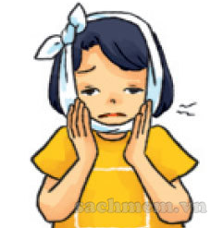
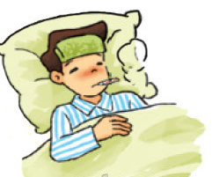
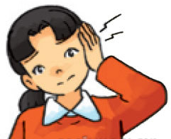
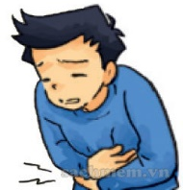
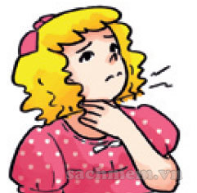
5. Read and complete.
1. She has a pain in her tooth.
She has a toothache.
2. Nam has a high temperature.
He has a fever.
3. Mai has a pain in her ear.
She has an earache.
4. Quan has a pain in his stomach.
He has a stomach ache.
5. Linda has a pain in her throat.
She has a sore throat.
________________
a stomach ache
a toothache
a sore throat
a fever
an earache
_______
_______________
_______________
_______________

Slide 68
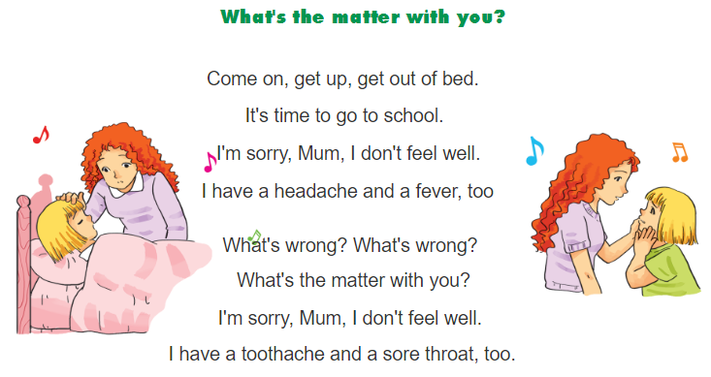

6. Let’s sing.

Slide 69
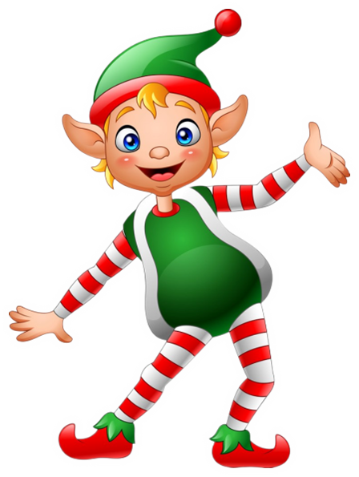


THANK YOU!
Welcome to join with me!
MsPham Powerpoint
Mspham

