Slide 1
Unit 11
What’s the matter with you?
Lesson 3

Slide 2
WARM-UP

Slide 3




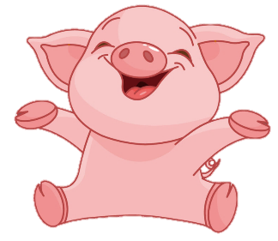
BOMSTAR
PLAY
Notes:
Ms Huyền Phạm - 0936.082.789 – YOUTUBE: MsPham. Facebook: Powerpoint thật dễ

Slide 4






















Ms Huyền Phạm
0936.082.789
+2
-2
+5
+3
+5
-2
+4
-1
Ms Huyền Phạm
0936.082.789
+3
+1
-3
+1
Ms Huyền Phạm
0936.082.789
+3
-2
+4
Ms Huyền Phạm
0936.082.789

Slide 5



Trung had a _______ last week. He couldn't speak.
Back
sore throat
backache
headache

Slide 6
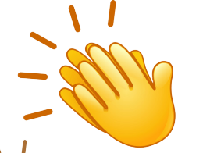
Thêm
1 lượt
Back

Slide 7
Nam went to the dentist yesterday because he had a _________.
Back
backache
toothache
stomach ache

Slide 8
Quan is in bed and feels very hot. He has a ____.
Back
backache
stomach ache
fever

Slide 9
Phong's grandpa has a ______ . He can't carry heavy things.
Back
headache
toothache
backache

Slide 10
Trung had a ______ last night because he ate too much at dinner.
Back
backache
stomach ache
toothache

Slide 11
What's the matter with you?
Back
I have a headache.
He should go to the dentist.
He should stay in bed.

Slide 12
Nam has a toothache.
Back
She
shouldn't carry
heavy things.
He should
stay in bed.
He should go
to the dentist.

Slide 13
Thêm
1 lượt
Back

Slide 14
Phong has a fever.
Back
I have a headache.
He should go
to the dentist.
He should
stay in bed

Slide 15
Mai has a stomach ache.
Back
She
shouldn't eat
a lot of sweets.
She
shouldn't carry heavy things
He should go
to the dentist.

Slide 16
Quan's grandma has a backache.
Back
She
should carry heavy things.
She
shouldn't carry heavy things.
She
shouldn't eat
a lot of sweets

Slide 17
Thêm
1 lượt
Back

Slide 18
What’s the ______ with you?
Back
metter
matter
mater

Slide 19
________ the matter with you?
Back
What’s
What
How

Slide 20
PRONUNCIATION

Slide 21

1. Listen and repeat.
What's the matter with you?
What’s the matter with you?
What’s the matter with you?
1
I have a headache.
I have a toothache.
I have a stomach ache.
↷
↷
2
↷
↷
3
↷
↷

Slide 22
2. Listen and circle a or b. Then ask and answer
1. What's the matter with you?
I have a ____________.
a. toothache
b. headache
2. What's the matter with you?
I have a ____________.
a. bad toothache
b. backache
3. What's the matter with you?
I have a ___________.
a. stomach ache
b. headache
4. What's the matter with you?
I have a ___________.
a. pain in my stomach
b. sore throat

Slide 23
PRACTISE

Slide 24
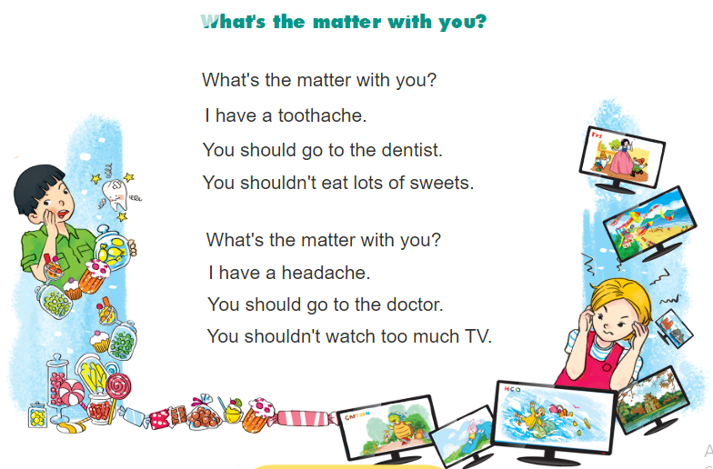

3. Let’s chant.

Slide 25
4. Read and match. Then say.
Wash your hands
1
a
your teeth twice a day.
Eat
2
b
a shower every day.
Do
3
c
short and clean.
Brush
4
d
healthy foods.
Keep your nails
5
e
morning exercise regularly.
Take
6
f
before having meals.

Slide 26
5. Write your advice.
 | He/She should … | He/She shouldn't …
1. Tony has a bad toothache.
2. Quan has a bad cold.
3. Phong has a stomach ache.
4. Phong has a sore throat.

Slide 27
6. Project
Talk about two health problems and give advice.
Dear __________,
I have a _____________ . I cannot _______________ .
What should I do?
Thanks.
Dear __________,
I‛m very sorry to hear about your .
I think you should ___________ and shouldn‛t __________ .
I hope you‛ll get well soon.
Best.
1
2

Slide 28
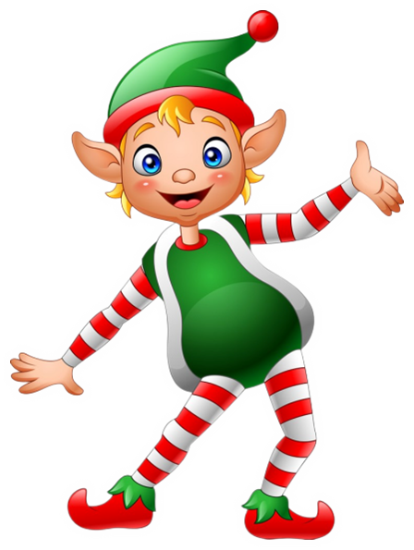


THANK YOU!
Welcome to join with me!
MsPham Powerpoint
Mspham

