Slide 1
Unit 12
Don’t ride your bike
too fast
Lesson 1

Slide 2
VOCABULARY

Slide 3
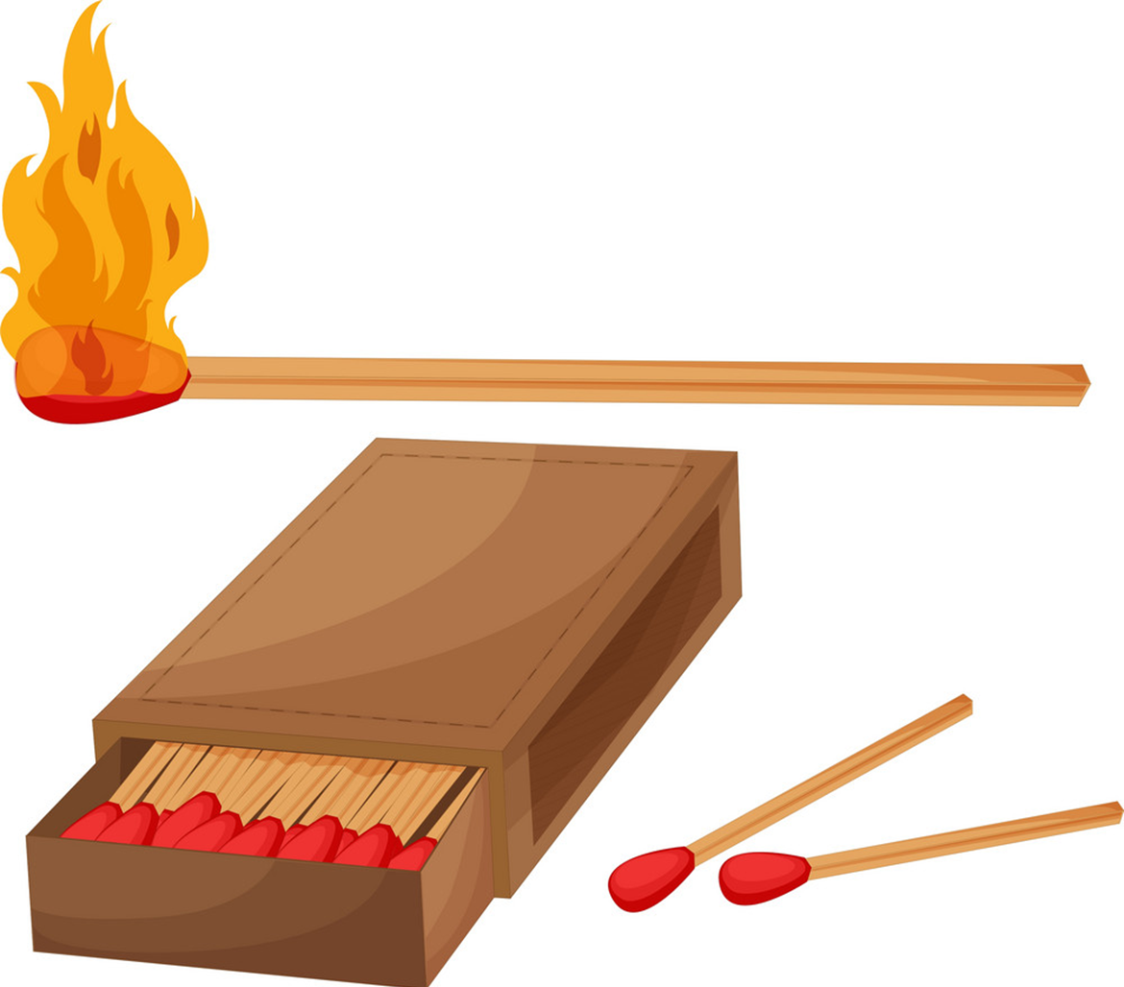
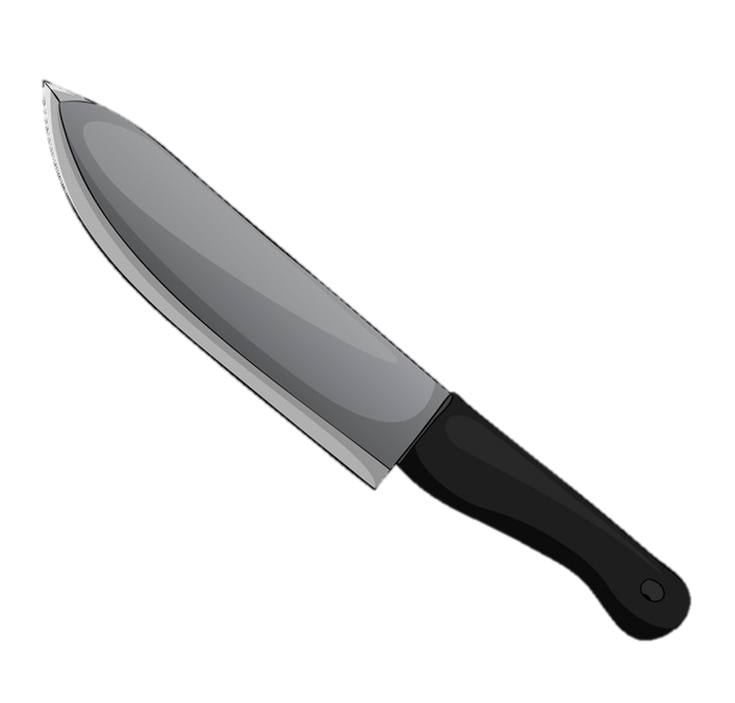
knife
matches
/naɪf/
/mæʧɪz/
Con dao
Que diêm

Slide 4

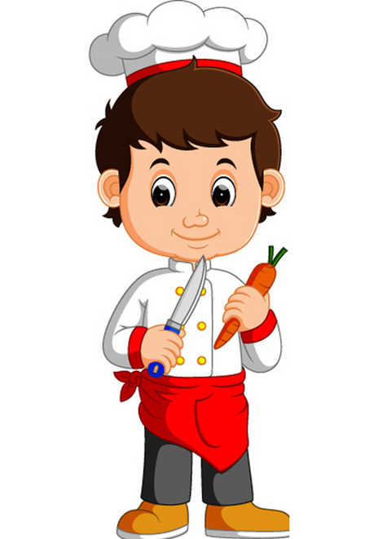

play with matches
play with knife
/pleɪ wɪð ˈmæʧɪz/
/pleɪ wɪð naɪf/
Nghịch diêm
Nghịch dao

Slide 5
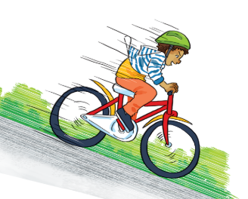
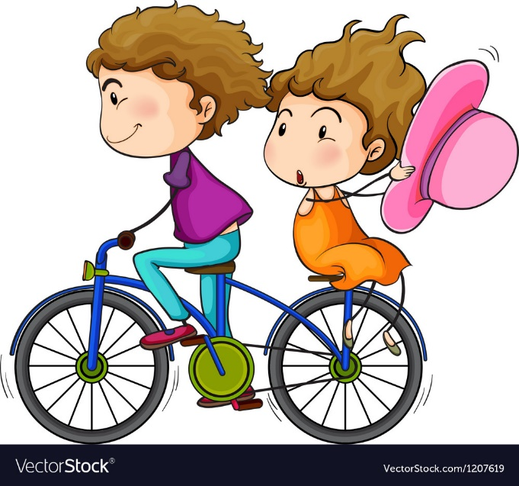
ride your bike
too fast
/raɪd jɔːr baɪk tu: fæst/
Đạp xe quá nhanh

Slide 6

climb
/klaɪm/
trèo
climb the tree
/klaɪm ðə tri:/
Trèo cây

Slide 7

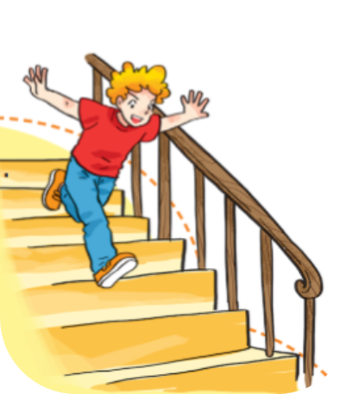
stairs
/ sterz/
Cầu thang
run down the stairs
/rʌn daʊn ðə sterz/
Chạy xuống cầu thang

Slide 8




touch
/tʌtʃ/
/rʌn daʊn ðə sterz/
stove
/stəʊv/
/rʌn daʊn ðə sterz/
touch the stove
/ tʌtʃ ðə stəʊv/
/rʌn daʊn ðə sterz/

Slide 9

burn
bɜ:rn/
Vết bỏng
get a burn
/get ə bɜ:rn/
Bị bỏng

Slide 10
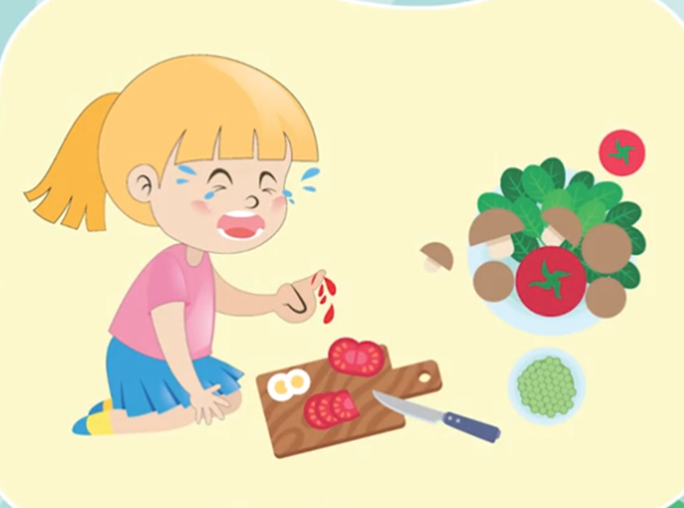
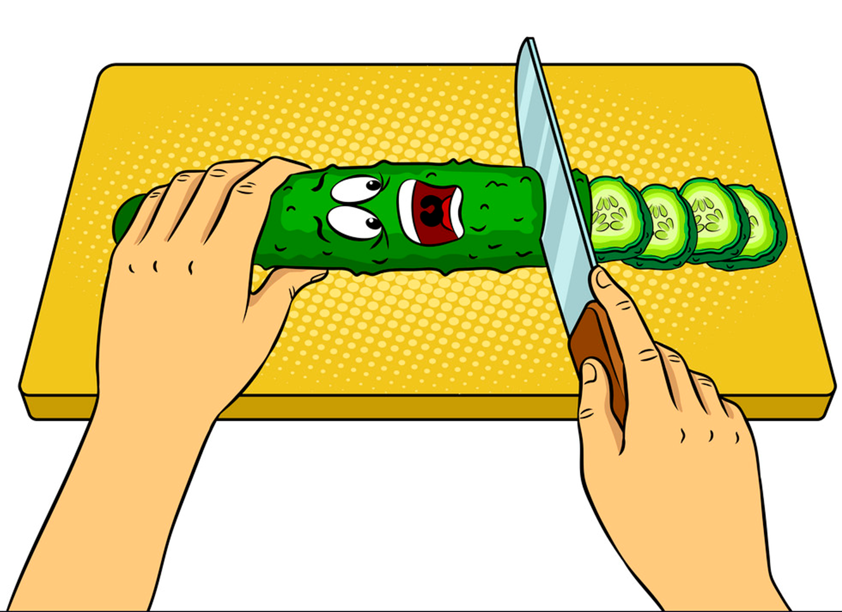

cut
cut youreslf
/kʌt/
/kʌt jɔːˈself/
Cắt, thái
Tự cắt vào tay

Slide 11

cabbage
/ˈkæbɪdʒ/

Slide 12
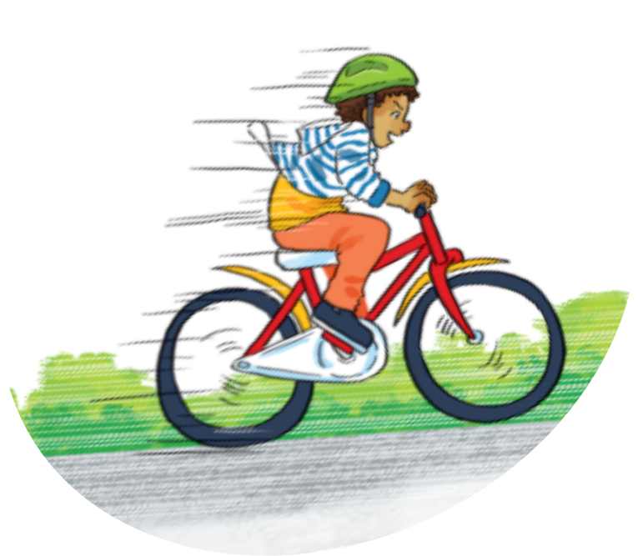

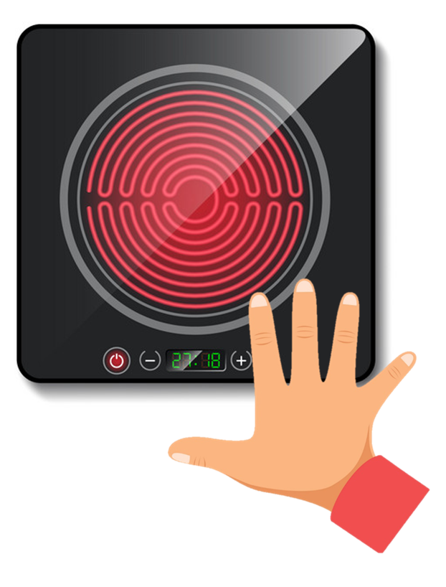


Vocabulary
cut yourself
play with matches
touch the stove
ride your bike too fast
get a burn
climb the tree
play with knife
Run down
the stairs

Slide 13


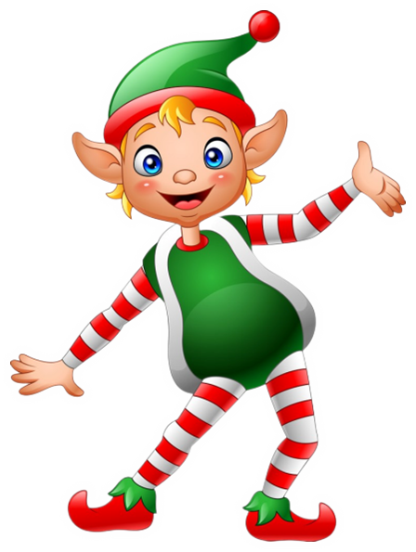
Ô cửa
bí mật
PLAY
Notes:
Ms Huyền Phạm - 0936.082.789 – YOUTUBE: MsPham. Facebook: Dạy và học cùng công nghệ.

Slide 14





0
1
2
3
4
5
play with knife
Notes:
Ms Huyền Phạm - 0936.082.789 – YOUTUBE: MsPham. Facebook: Dạy và học cùng công nghệ.

Slide 15
0
1
2
3
4
5
get a burn
Notes:
Ms Huyền Phạm - 0936.082.789 – YOUTUBE: MsPham. Facebook: Dạy và học cùng công nghệ.

Slide 16
0
1
2
3
4
5
cut yourself
Notes:
Ms Huyền Phạm - 0936.082.789 – YOUTUBE: MsPham. Facebook: Dạy và học cùng công nghệ.

Slide 17
0
1
2
3
4
5
play with matches
Notes:
Ms Huyền Phạm - 0936.082.789 – YOUTUBE: MsPham. Facebook: Dạy và học cùng công nghệ.

Slide 18
0
1
2
3
4
5
climb the tree
Notes:
Ms Huyền Phạm - 0936.082.789 – YOUTUBE: MsPham. Facebook: Dạy và học cùng công nghệ.

Slide 19
0
1
2
3
4
5
touch the stove
Notes:
Ms Huyền Phạm - 0936.082.789 – YOUTUBE: MsPham. Facebook: Dạy và học cùng công nghệ.

Slide 20
0
1
2
3
4
5
cabbage
Notes:
Ms Huyền Phạm - 0936.082.789 – YOUTUBE: MsPham. Facebook: Dạy và học cùng công nghệ.

Slide 21
0
1
2
3
4
5
ride your bike too fast
Notes:
Ms Huyền Phạm - 0936.082.789 – YOUTUBE: MsPham. Facebook: Dạy và học cùng công nghệ.

Slide 22
0
1
2
3
4
5
Run down
the stairs
Notes:
Ms Huyền Phạm - 0936.082.789 – YOUTUBE: MsPham. Facebook: Dạy và học cùng công nghệ.

Slide 23
WELL DONE!
EXIT
Notes:
Ms Huyền Phạm - 0936.082.789 – YOUTUBE: MsPham. Facebook: Dạy và học cùng công nghệ.

Slide 24
GRAMMAR

Slide 25
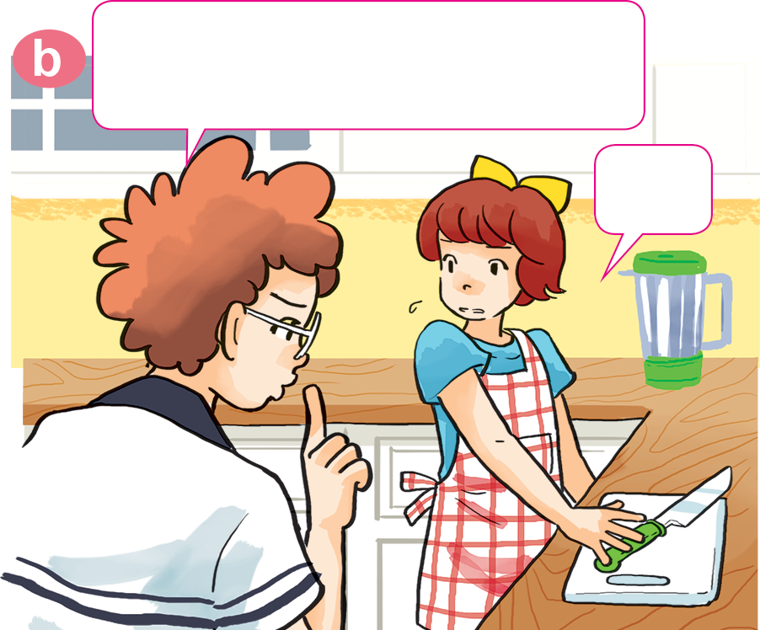
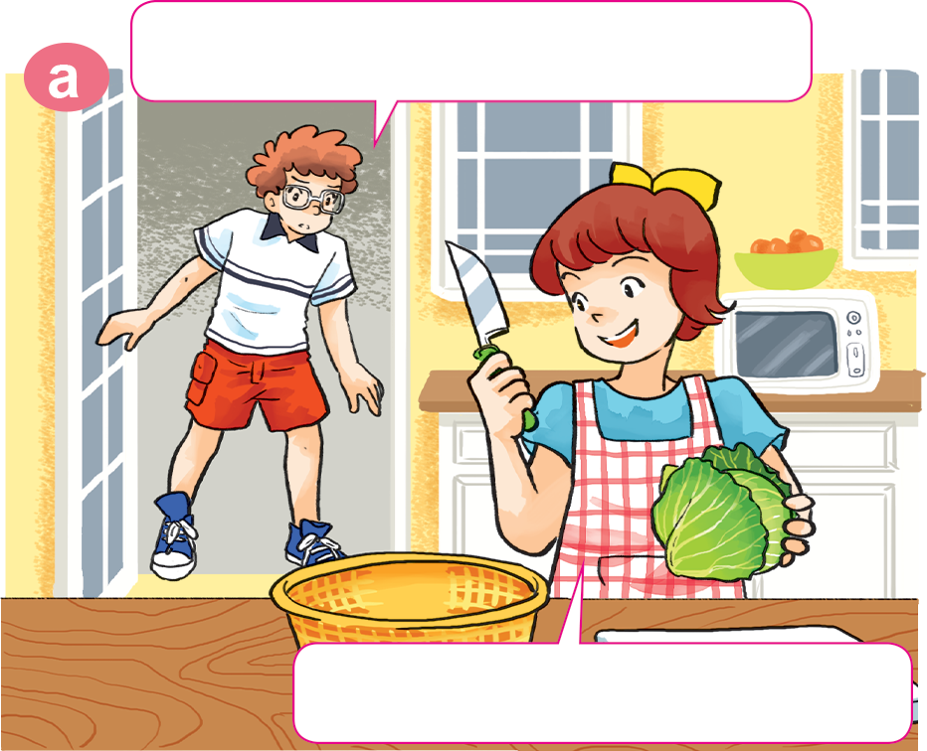

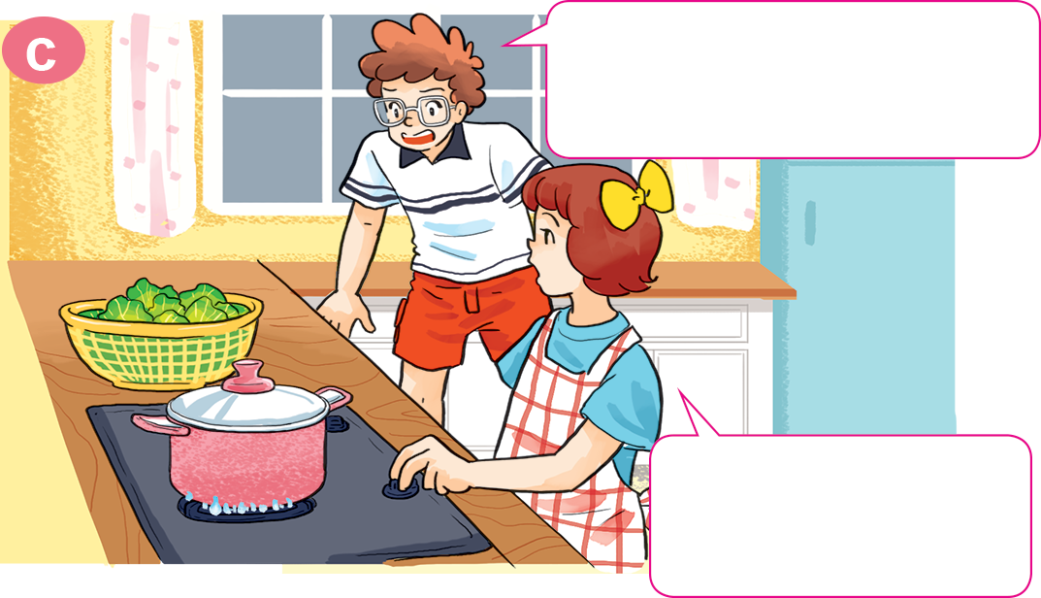
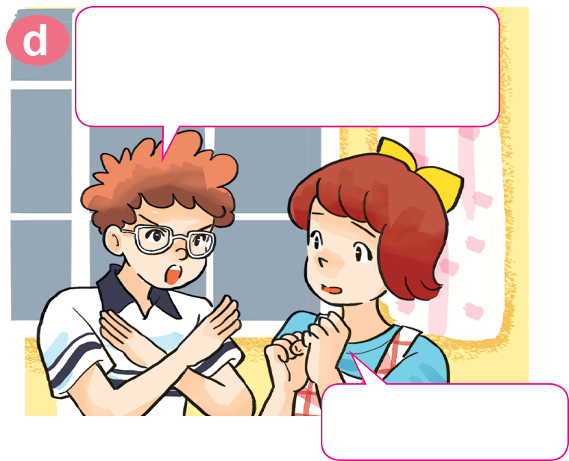
Look, listen and repeat.
Don't play with the knife! You may cut yourself.
What are you doing, Mary?
OK.
I'm cutting the cabbage.
What are you doing
with the stove?
Don't touch the stove! You may get a burn.
I want to cook
the cabbage.
OK, I won't.

Slide 26

2. Point and say
Don't ____________________!
OK, I won't.
play with matches

Slide 27
2. Point and say
Don't _______________________!
OK, I won't.
ride your bike too fast

Slide 28

2. Point and say
Don't __________________!
OK, I won't.
climb the tree

Slide 29
2. Point and say
Don't __________________!
OK, I won't.
run down the stairs

Slide 30


Don’t _____________.
Ok. I won’t.
climb the tree
run down
the stairs
play with matches
touch the stove
ride your bike too fast

Slide 31
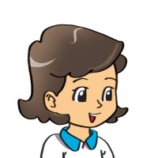
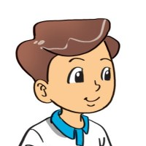
3. Let’s talk.
What is he doing?
He is ____________.
He shouldn't do that!
Why shouldn't he ____________?
Because he may ____________.

Slide 32
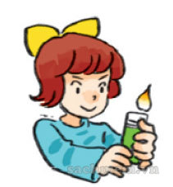
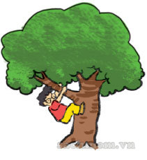
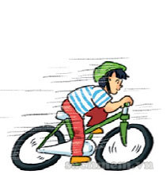
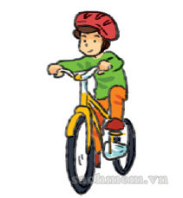


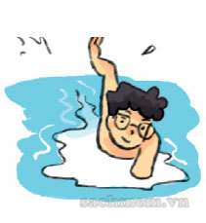
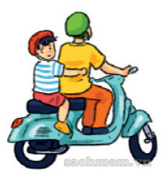

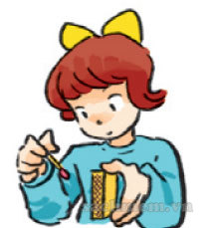
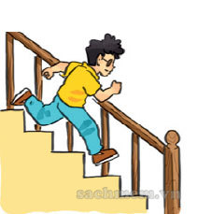
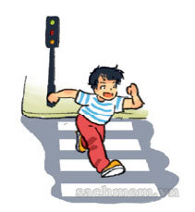
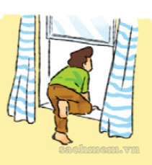
5. Listen and tick.
1 | 2 | 3 | 4
a. | a. | a. | a.
b. | b. | b. | b.
c. | c. | c. | c.

Slide 33
4. Read and complete.
answered
run
cooking
room
One day, Peter was bored. He was in his (1) ________ and his mother was (2) ________ in the kitchen. She asked loudly “Where are you, Peter?” He (3) __________, “I'm upstairs, Mum.” His mother heard him running down and said “Don't (4) ______ down the stairs!” Peter replied “OK, I (5) won't do it again, Mum.”
room
cooking
answered
run

Slide 34
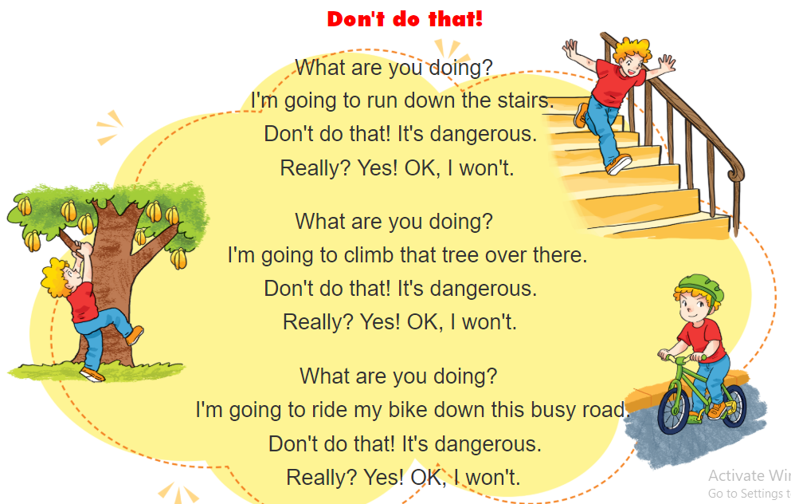

6. Let’s sing.

Slide 35
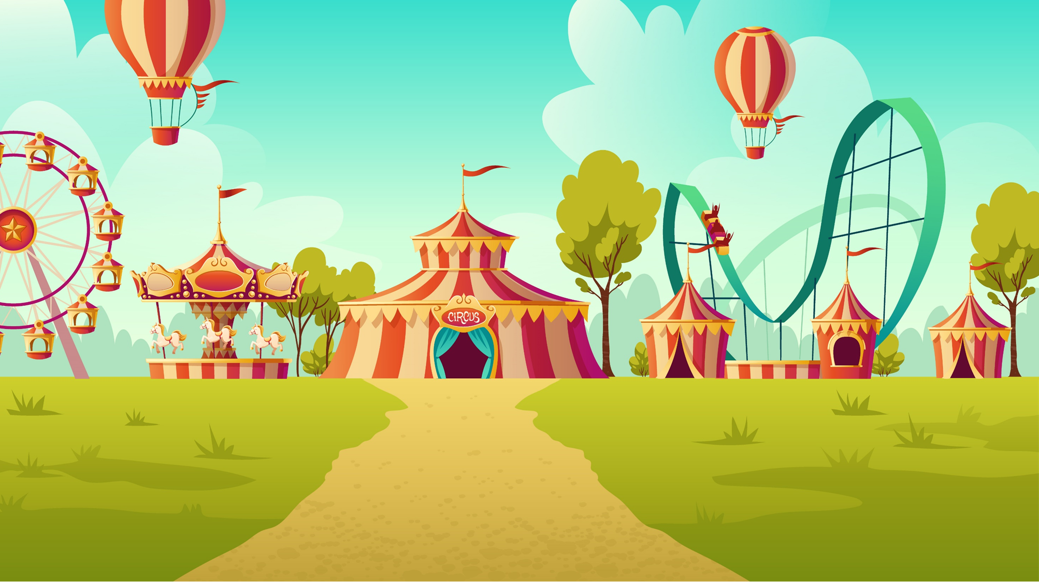


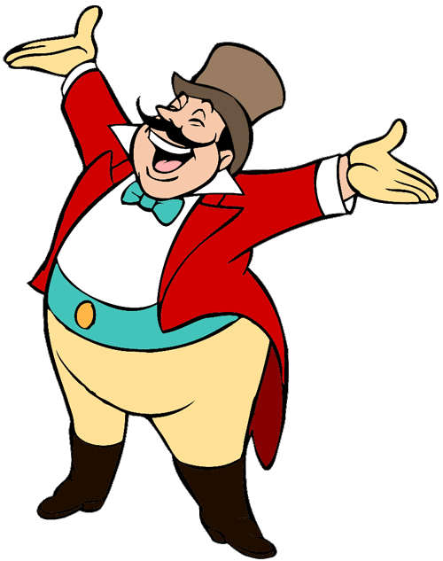
START

Slide 36




Don’t ______
run up
the stairs
run down
the stairs
run away
the stairs

Slide 37
Don’t ______ with matches.
cut
touch
play

Slide 38
Don’t touch the _____.
stove
cut
cabbage
Next

Slide 39
Don’t climb_____
the tree
the desk
the bike

Slide 40
ride your bike too fast
Don’t ride your bike _____.
climb the tree
run down
the stairs
play with matches
too slow
too fast
to fast
touch the stove

Slide 41
Don’t play with knife.
Ok, I won’t.
Ok, I don’t.
Ok, I am not.
Next

Slide 42


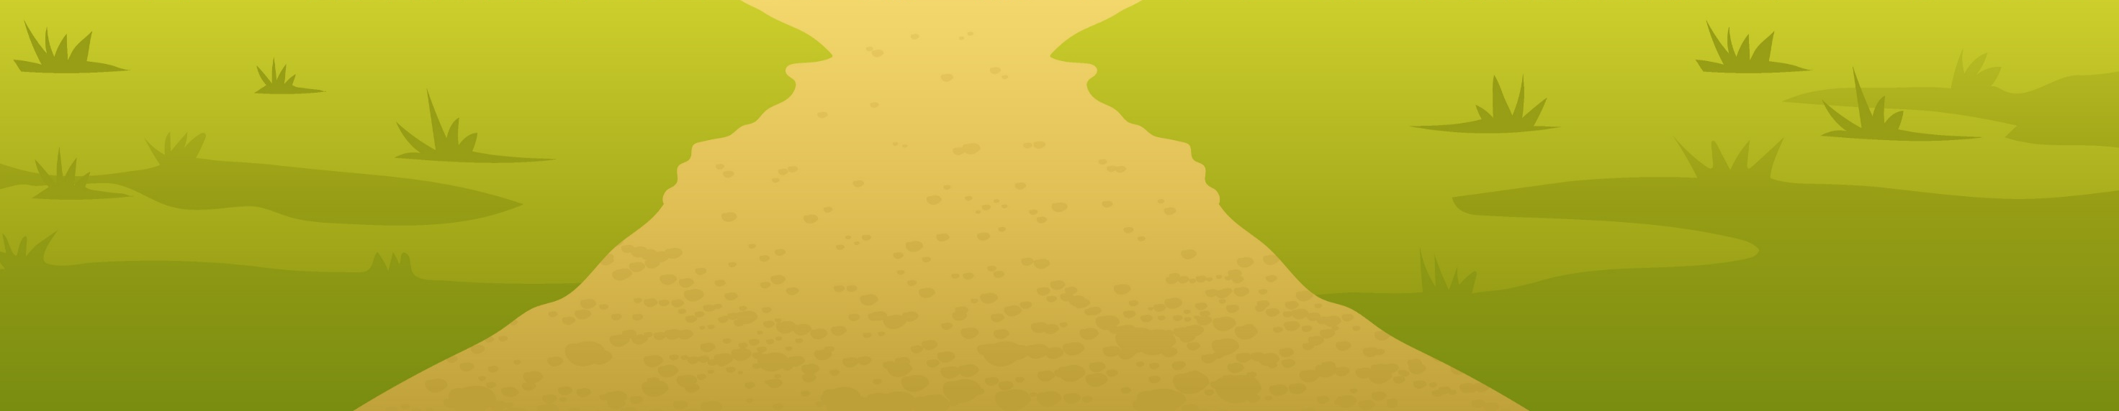

Ms Huyền Phạm
0936.082.789

Slide 43


THANK YOU!
Welcome to join with me!
MsPham Powerpoint
Mspham

