Slide 1


DAI LOC DEPARTMENT OF EDUCATION AND TRAINING
DAI QUANG PRIMARY SCHOOL
WELCOME TO OUR CLASS !
Subject: English 3
Class: 3D
Teacher: Pham Thi My Chau

Slide 2
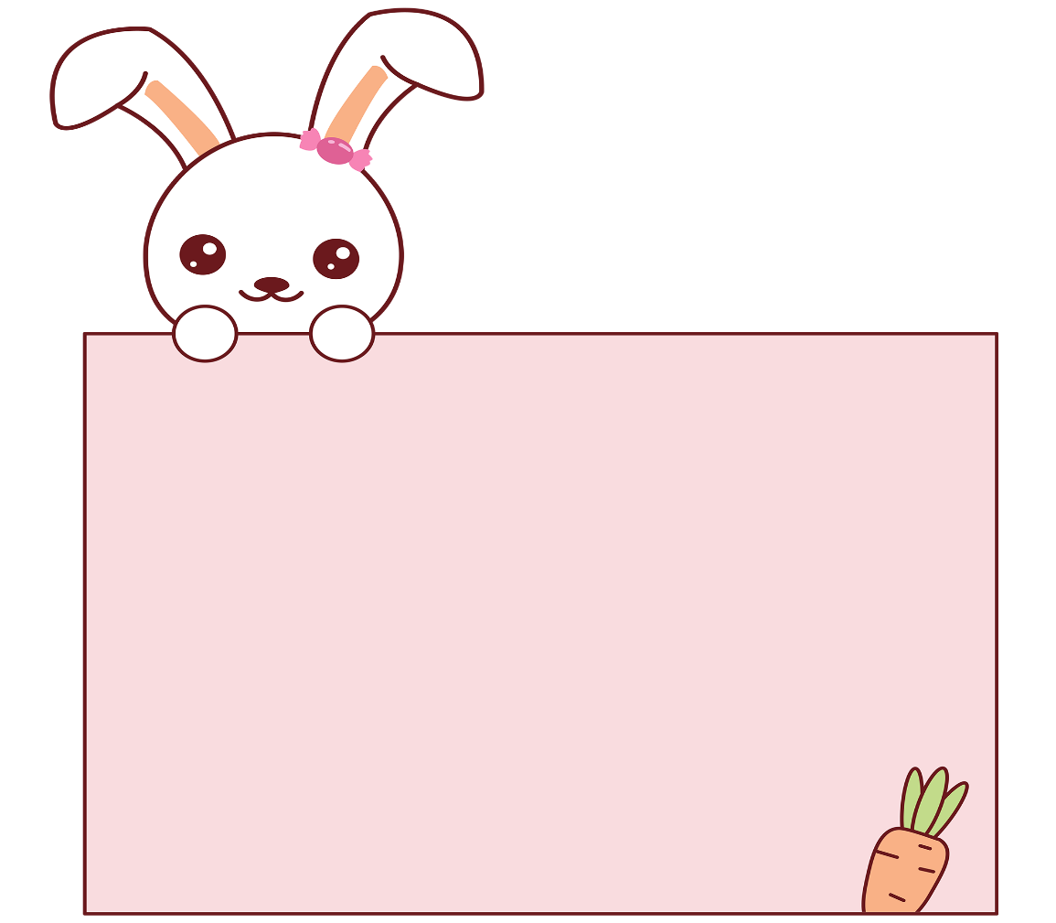
Let’s play!

Slide 3
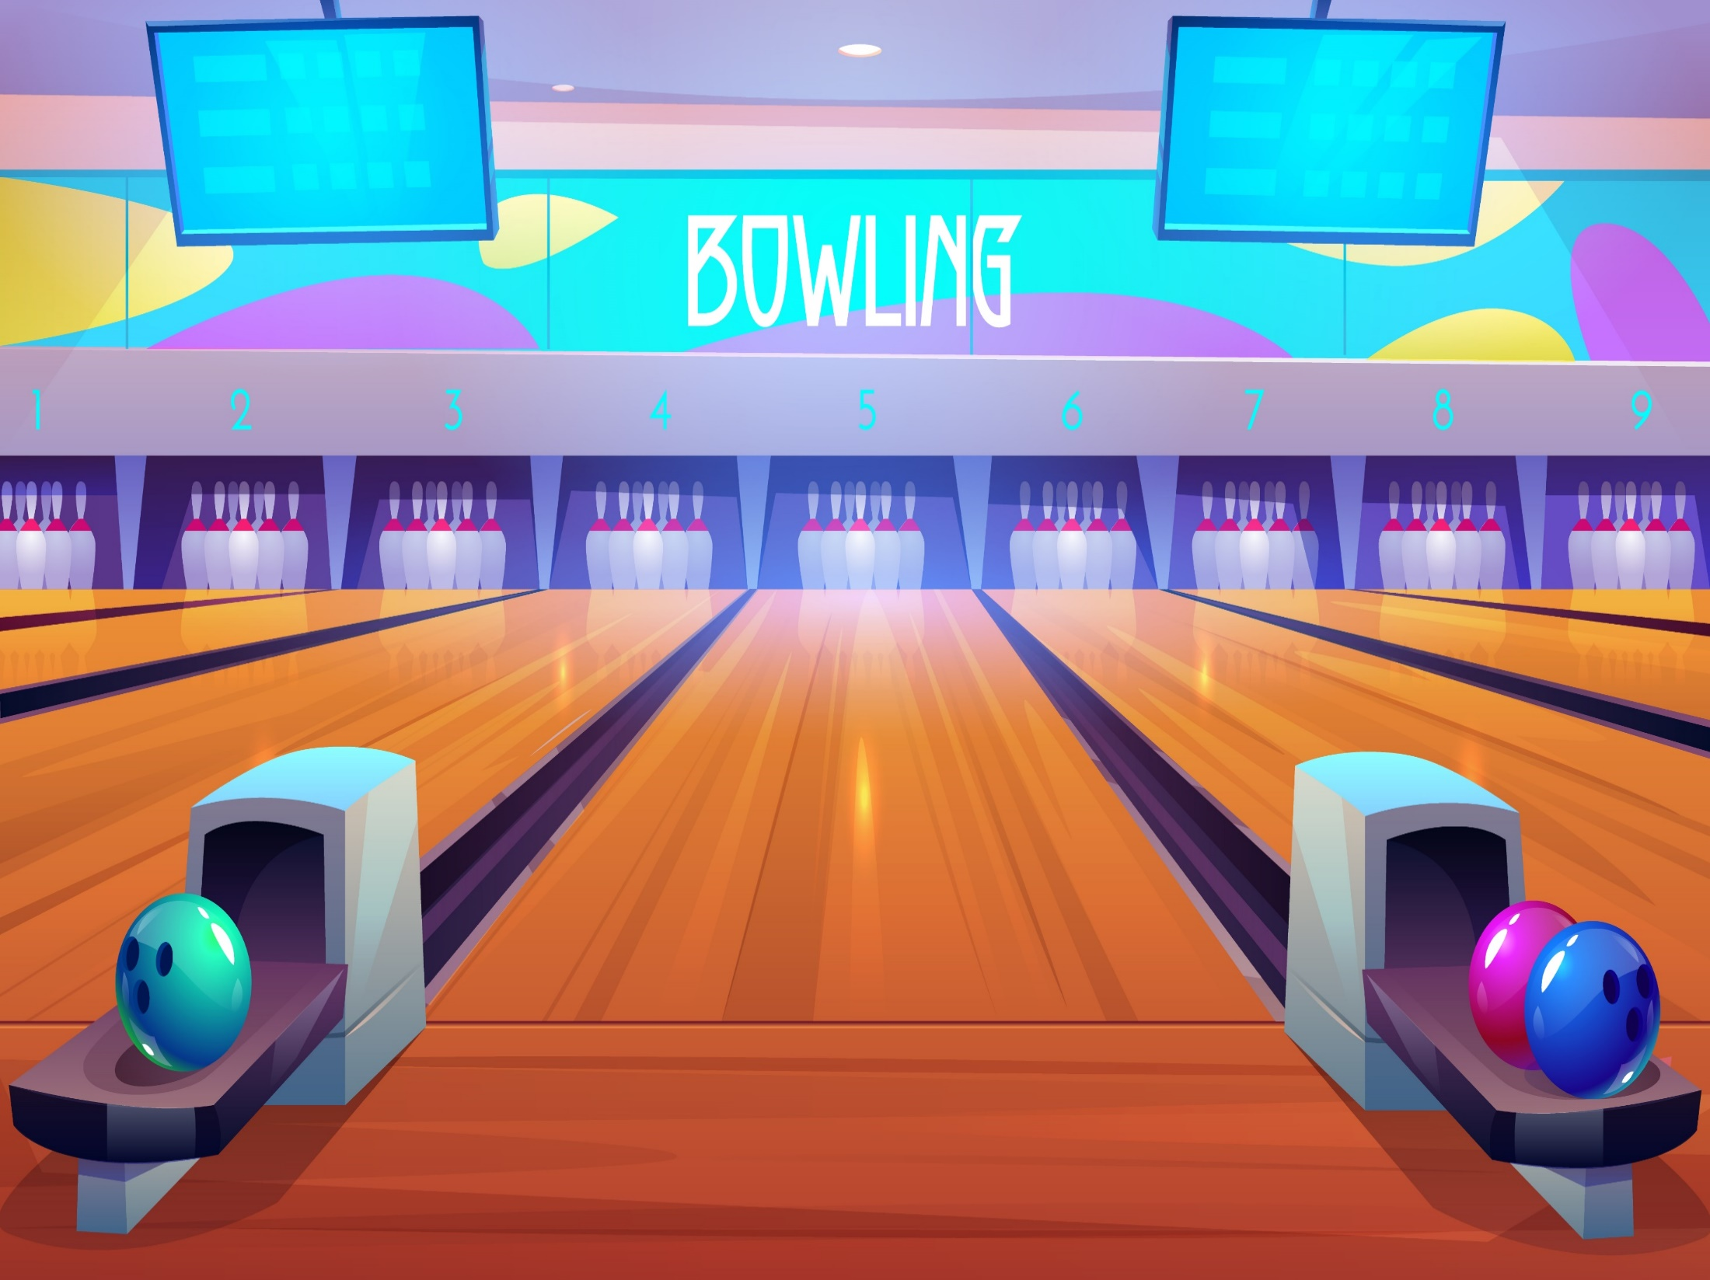

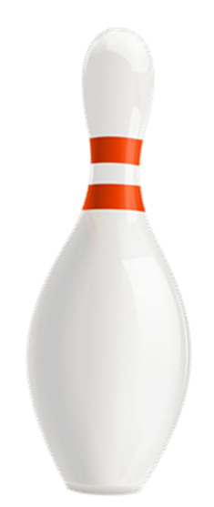



Slide 4
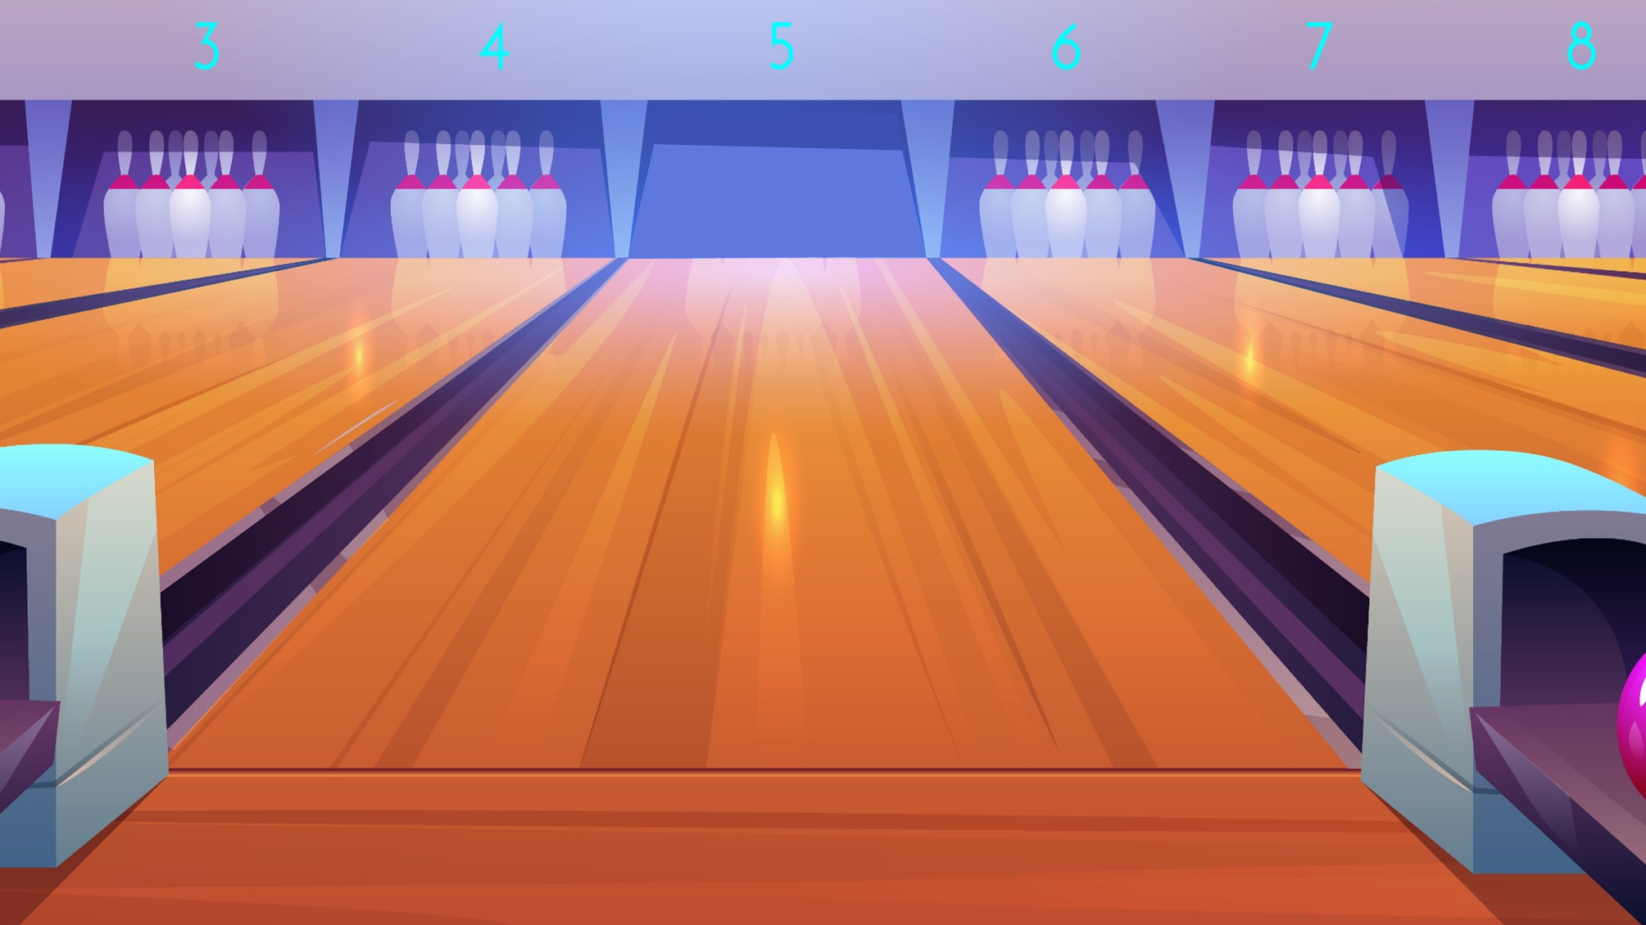






A. father
B. mother
A: Who is that?
B: It is my ____.
C. brother
Next

Slide 5
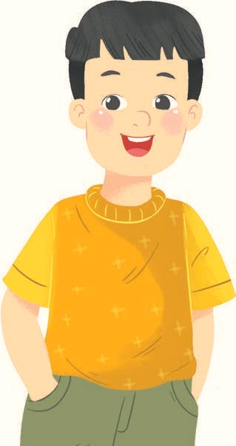
A. brother
B. father
A: Who is this?
B: It is my ____.
C. sister
Next

Slide 6
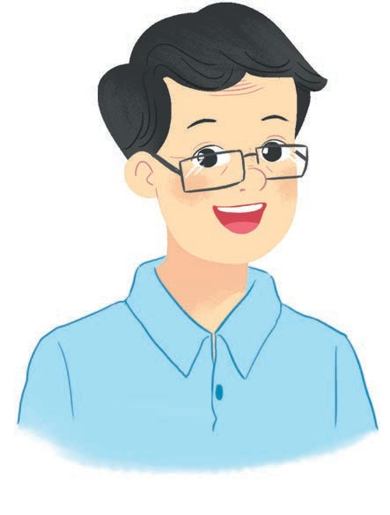
A. mother
B. sister
A: Who is this?
B: It is my ____.
C. father
Next

Slide 7
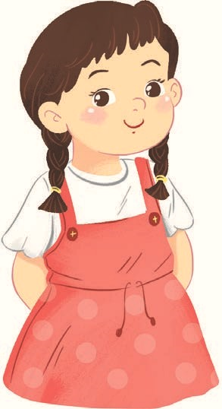
A. sister
B. mother
A: Who is that?
B: It is my ____.
C. brother
Next

Slide 8
A. that -mother
B. this - mother
A: Who is ____?
B: It is my ____.
C. that - sister
Next

Slide 9
A. this - mother
B. that -brother
A: Who is ____?
B: It is my ____.
C. this - father
Next

Slide 10

A. fourteen
How old is she?
She is __________.
B. eighteen
C. sixteen
Next

Slide 11
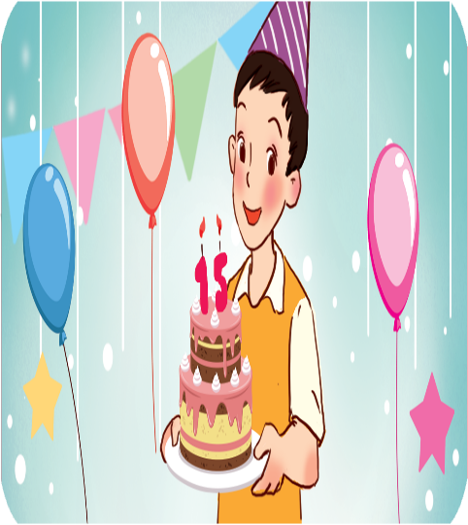
A. fifteen
How old is he?
He is __________.
B. thirteen
C. sixteen
Next

Slide 12
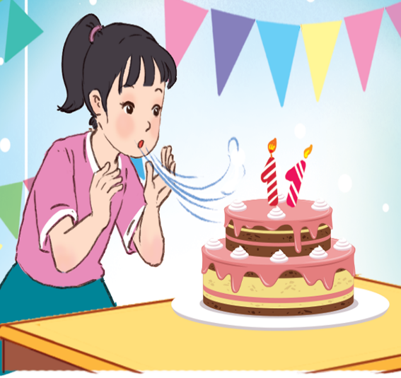
A. ten
How old is she?
She is __________.
B. twenty
C. eleven
Next

Slide 13
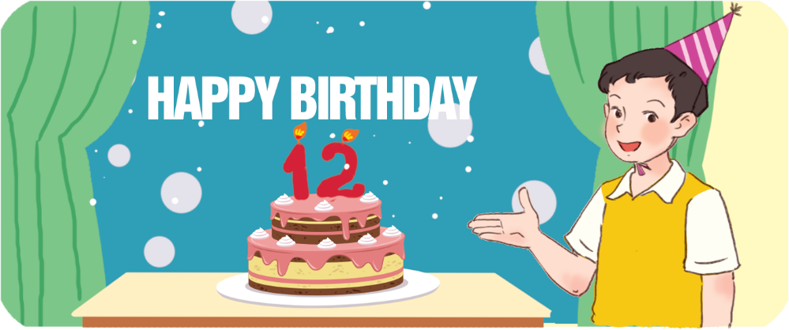
A. thirteen
How old is he?
He is __________.
B. twelve
C. seventeen
Next

Slide 14
A. He - she
How old is ____?
____ is eighteen.
B. She - she
C. She - he
Next

Slide 15

WELL DONE!

Slide 16


Monday, January 22nd, 2024
UNIT 11 : MY FAMILY
*Lesson 3:
Part: 4, 5 & 6

Slide 17
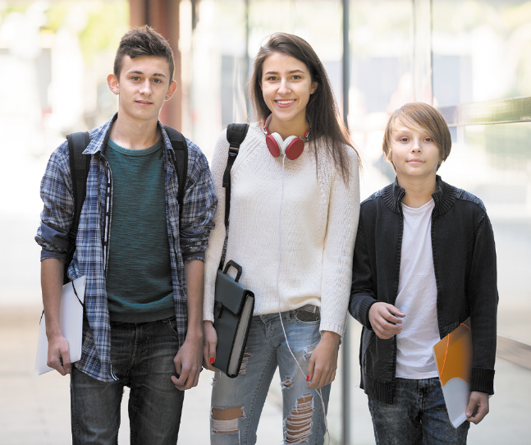
Facebook : Bùi Liễu
Mobile phone: 0968142780
4. Read and complete.
am my old sister
Look at the photo. This is (1) _____ brother. He is seventeen years old. This is my (2)_____ . She is twenty years (3)____ . And this is me. I (4) ____ eight years old.
my
sister
old
am

Slide 18
5. Let’s write.
My name is ____ . I’m _____ years old.
My brother / sister is _____.
He / She is ____ years old.
Lieu
nine
Linh
six

Slide 19
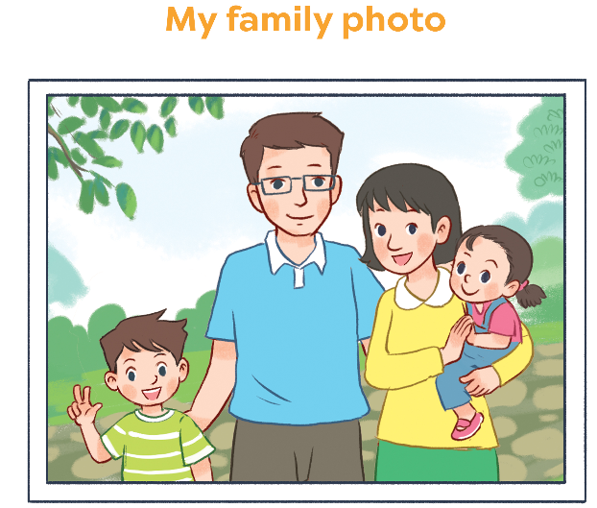
6. Project

Slide 20

Wrap up

Slide 21
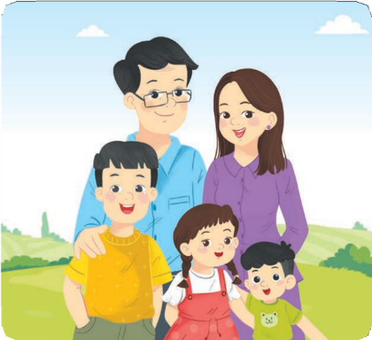







Vocabulary
family
mother
father
brother
sister

Slide 22


Structures
Hỏi và trả lời “đây/kia là ai”
- Who’s this/that?
It’s my _______.
(Đây/kia là ai?)
(Đó là …. tớ)
who = who is
Example
Mary: Who’s this?
Linh: It’s my mother.

Slide 23










Numbers
eleven
/ɪˈlevən/
twelve
/twelv/
thirteen
/ˌθɜːˈtiːn/
fourteen
/ˌfɔːˈtiːn/
fifteen
/ˌfɪfˈtiːn/
sixteen
/ˌsɪksˈtiːn/
seventeen
/ˌsevənˈtiːn/
eighteen
/ˌeɪˈtiːn/
nineteen
/ˌnaɪnˈtiːn/

Slide 24










twenty
/ˈtwenti/
thirty
/ˈθɜːti/
forty
/ˈfɔːti/
fifty
/ˈfɪfti/
sixty
/ˈsɪksti/
seventy
/ˈsevənti/
eighty
/ˈeɪti/
ninety
/ˈnaɪnti/
one hundred
/wʌn ˈhʌndrəd/

Slide 25
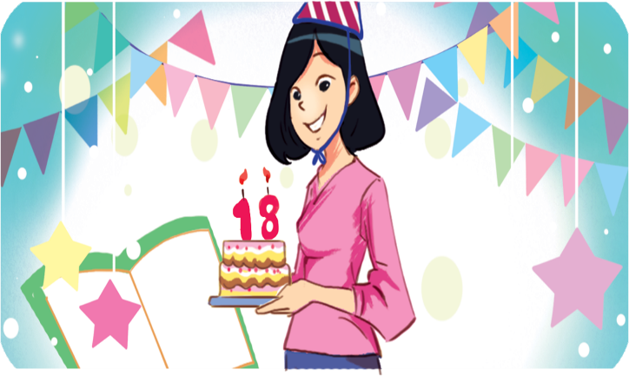
Structures
Hỏi và trả lời về tuổi của ai đó.
- How old is he / she?
He’s / She’s _______.
(Anh ấy / cô ấy bao nhiêu tuổi?)
(Anh ấy / cô ấy ........... tuổi)
he’s = he is
she’s = she is
Example
Mary: How old is she?
Linh:She’s eighteen.

Slide 26
Monday, January 22 ^{nd} , 2024
UNIT 11: MY FAMILY
Lesson 3: Part 1, 2, 3
4. Read and complete
5. Let’s write
6. Let’s chant
*Homelink.
- Practise doing exercise
- Prepare: Unit 11: Lesson 3 (part 4, 5, 6)

Slide 27
Homework
......................................
......................................

