Slide 1
Review
Letters: Rr, Ss
Notes:
Words start with S

Slide 2
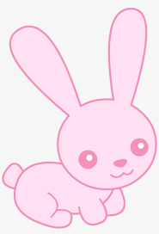


Letter Rr
rabbit
robot

Slide 3


Letter Ss
sea
sun

Slide 4
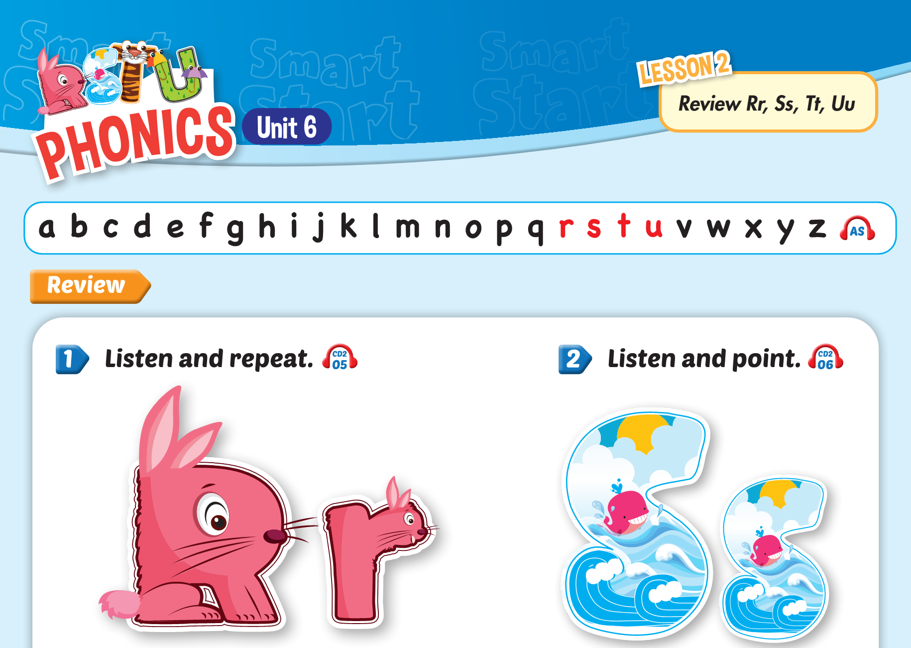


Slide 5
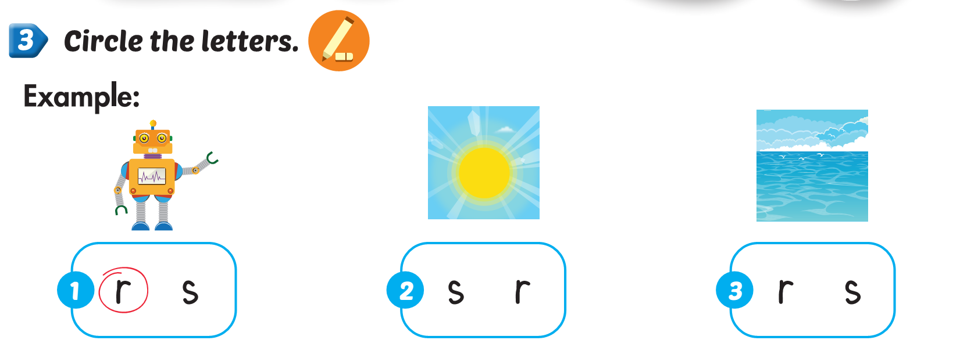
Lesson 2

Slide 6
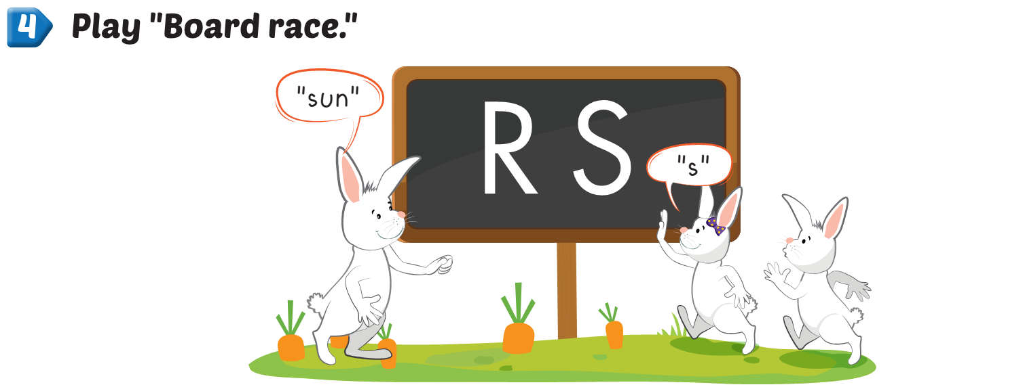
Lesson 2

Slide 7



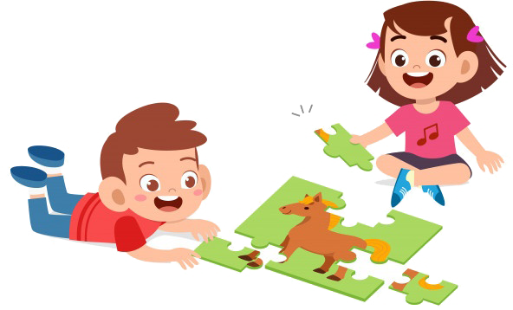
Playtime

Slide 8


Letter Ss
Letter Rr
Letter Tt
sun
Letter Uu

Slide 9
Letter Tt
Letter Ss
Letter Rr
robot
Letter Uu

