Slide 1
Review
Letters:Tt, Uu
Notes:
Words start with S

Slide 2

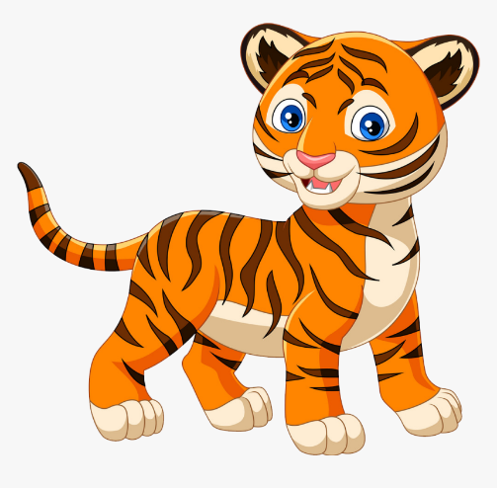

Letter Tt
tiger
top

Slide 3
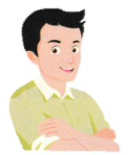

Letter Uu
uncle
umbrella

Slide 4
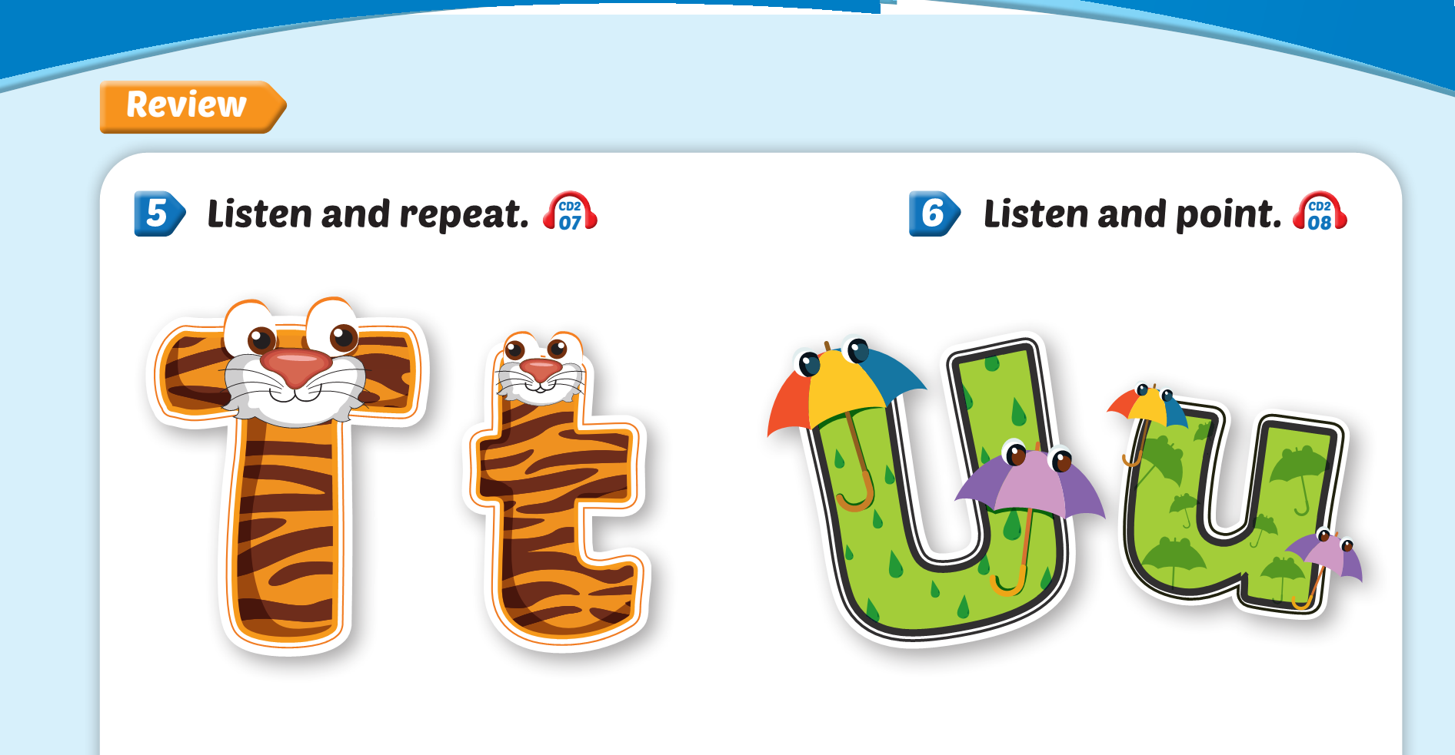

Lesson 2

Slide 5
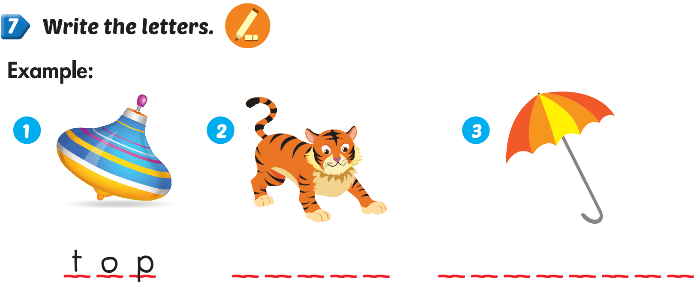
Lesson 2

Slide 6
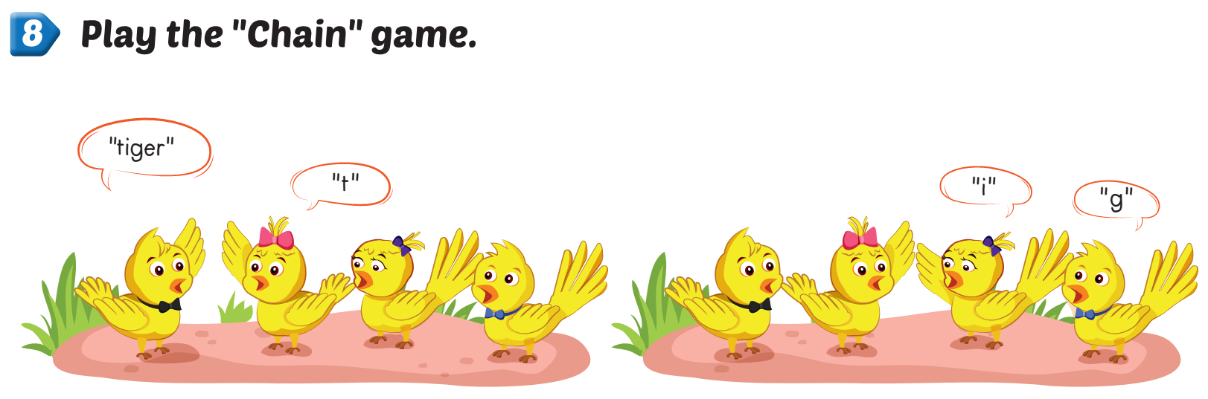

Slide 7



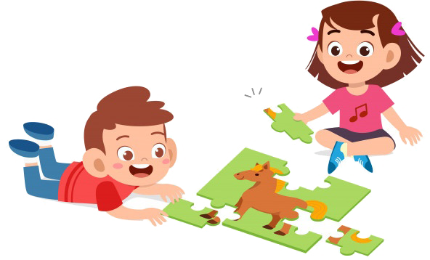
Playtime

Slide 8


LETTER Tt
LETTER Rr
LETTER Uu
uncle
LETTER Ss

Slide 9
Letter Uu
Letter Ss
Letter Rr
tiger
Letter Tt

Slide 10
LETTER Tt
LETTER Rr
LETTER Uu
umbrella
LETTER Ss

