Slide 1



DAI LOC DEPARTMENT OF EDUCATION AND TRAINING
DAI QUANG PRIMARY SCHOOL
WELCOME TO OUR CLASS !
Subject: English 3
Class: 3E
Teacher: Pham Thi My Chau

Slide 2

Warm-up

Slide 3

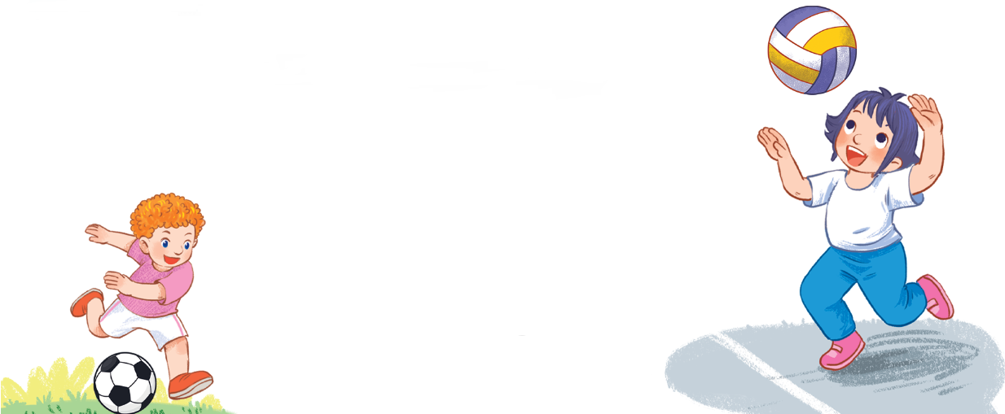
Let’s chant.
What do you do at break time?
Football.
Football.
I play football.
I play football.
What do you do at break time?
Volleyball.
Volleyball.
I play volleyball.
I play volleyball.

Slide 4


UNIT 11: MY FAMILY
Monday, January 15th, 2024
*Lesson 1:
Part: 1, 2, 3

Slide 5
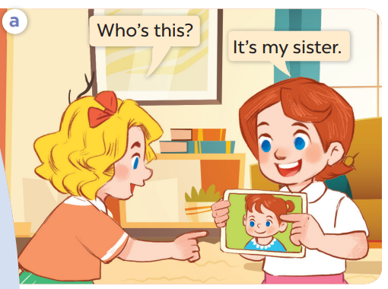
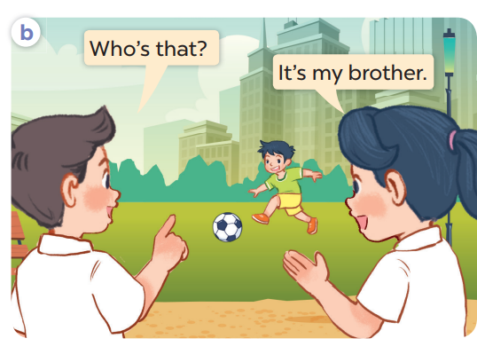
1. Look, listen and repeat.
Who are they?
Where are they?
What are they doing?

Slide 6
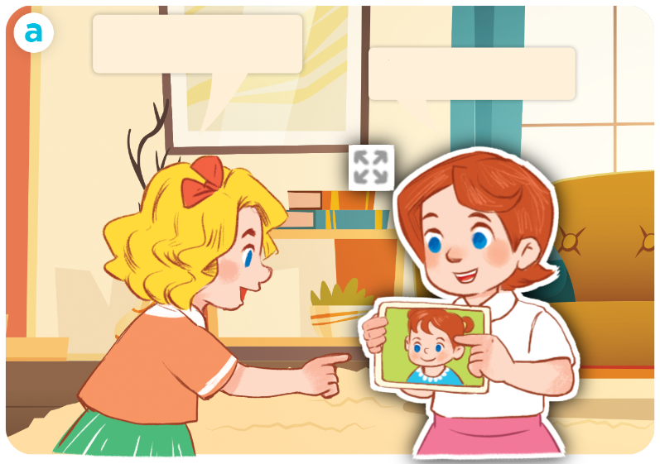
1. Look, listen and repeat.
Click on the sentence to hear the sound.
Who’s this?
It’s my sister.

Slide 7
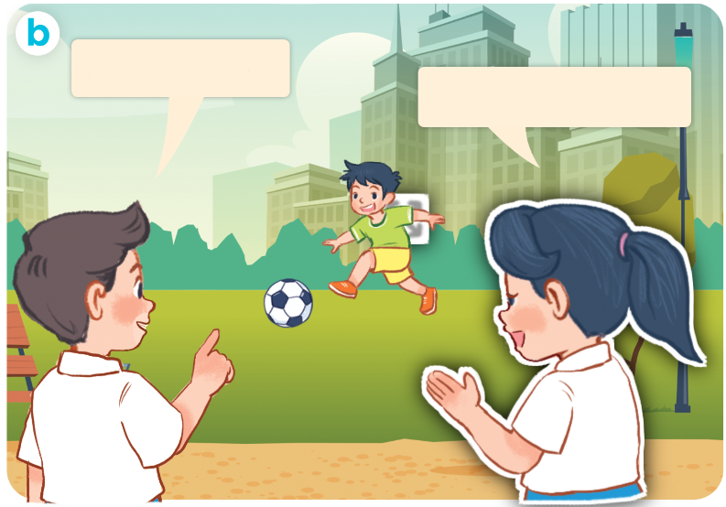
1. Look, listen and repeat.
Who’s that?
It’s my brother.

Slide 8
Vocabulary

Slide 9
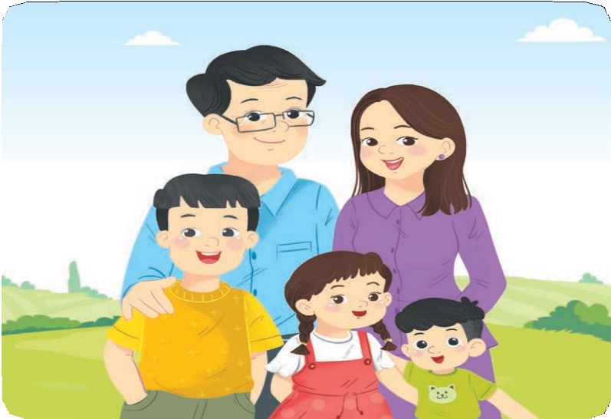
Vocabulary
family
/ˈfæmɪli/
gia đình

Slide 10


Vocabulary
mother
/ˈmʌðə/
mẹ

Slide 11
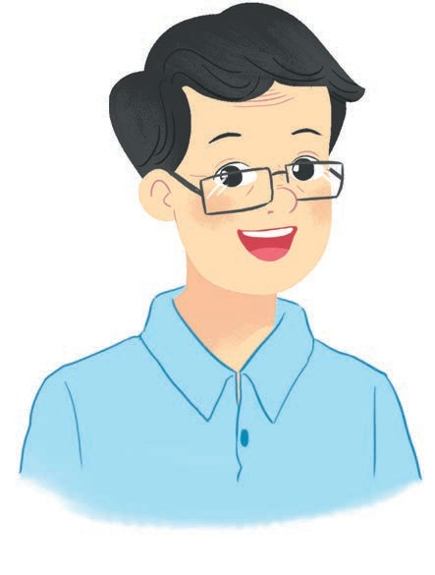

Vocabulary
father
/ˈfɑːðə/
bố

Slide 12
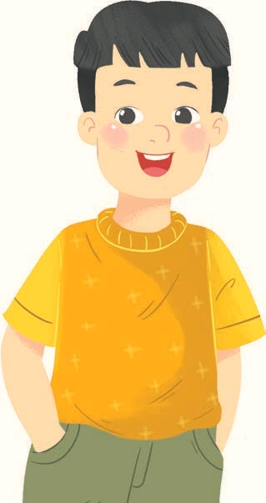
Vocabulary
brother
/ˈbrʌðə/
anh/em trai

Slide 13

Vocabulary
sister
/ˈsɪstə/
chị/em gái

Slide 14

Vocabulary
family /ˈfæmɪli/ gia đình
mother /ˈmʌðə/ mẹ
father /ˈfɑːðə/ bố
brother /ˈbrʌðə/ anh trai,em trai
sister /ˈsɪstə/ chị gái, em gái

Slide 15

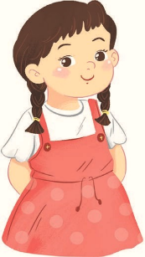


Match
1
3
mother
brother
2
father
4
sister

Slide 16
II. Model sentence
Hỏi và trả lời “đây/kia là ai”
- Who’s this/that?
It’s my _______.
who = who is

Slide 17
Structures

Slide 18
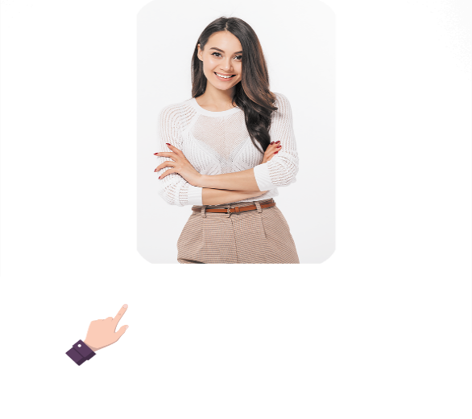

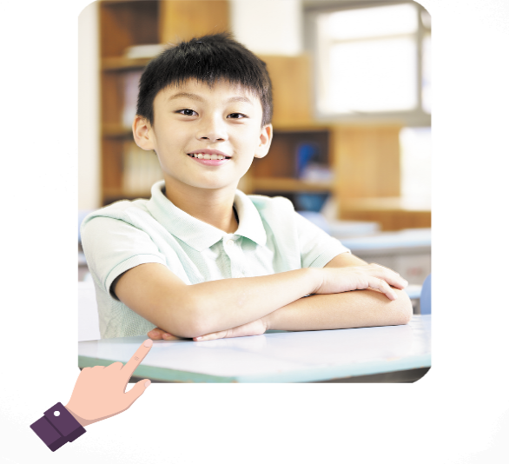

2. Listen, point and say.
a
b
Who’s this / that?
It’s my _______.
mother
father
c
d
brother
sister

Slide 19
mother
Who’s that ?
It’s my mother.

Slide 20
father
Who’s that ?
It’s my father.

Slide 21
brother
Who’s that ?
It’s my brother.

Slide 22
sister
Who’s that ?
It’s my sister.

Slide 23
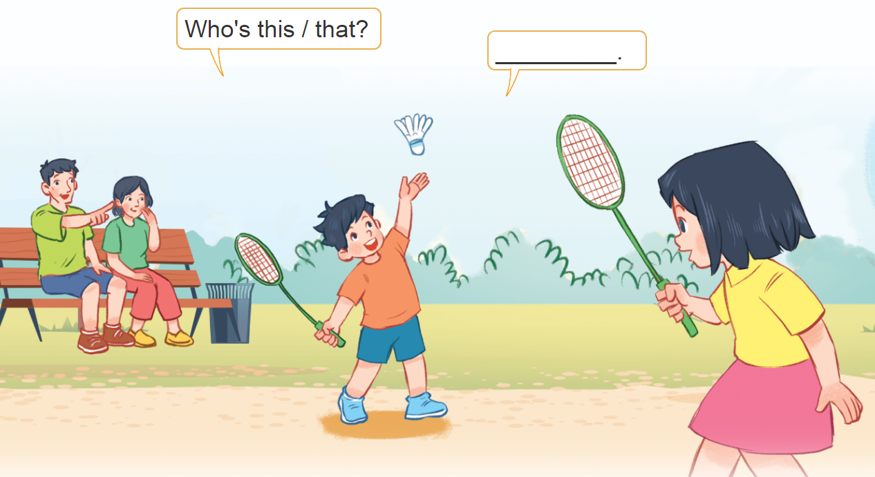
3. Let’s talk.
Who’s this/that?
___________.

Slide 24


Let’s play!

Slide 25














Slide 26




Slide 27





Slide 28




Slide 29







Slide 30
family

Slide 31
It’s my sister.

Slide 32
It’s my father.

Slide 33
It’s my mother.

Slide 34
It’s my brother.

Slide 35



sister
Facebook : Bùi Liễu
0968142780
family
mother

Slide 36


Who’s that?
It’s my father.
Facebook : Bùi Liễu
0968142780
It’s my mother.
It’s my brother.

Slide 37

Who’s this?
It’s my father.
Facebook : Bùi Liễu
0968142780
It’s my brother.
It’s my mother.

Slide 38

Who’s this?
It’s my mother.
Facebook : Bùi Liễu
0968142780
It’s my sister.
It’s my brother.

Slide 39

Who’s that?
It’s my mother.
It’s my brother.
It’s my sister.

Slide 40

WELL DONE!

Slide 41
Wrap up

Slide 42





Vocabulary
family
mother
father
brother
sister

Slide 43

Structures
Hỏi và trả lời “đây/kia là ai”
- Who’s this/that?
It’s my _______.
(Đây/kia là ai?)
(Đó là …. tớ)
who = who is
Example
Mary: Who’s this?
Linh: It’s my mother.

Slide 44
Monday, January 15 ^{th} , 2024
UNIT 11: MY FAMILY
Lesson 1: Part 1, 2, 3
I/ New words
Family : gia đình
Mother : mẹ
Father : bố
Brother : anh, em trai
Sister : chị, em gái
II/ Model sentences
Who’s this/ that ?
It’s my sister.

Slide 45
Homework
Homework
Learn by heart all the new words.
Read again the dialogue in part 1.

Slide 46

Thank you!

