Slide 1


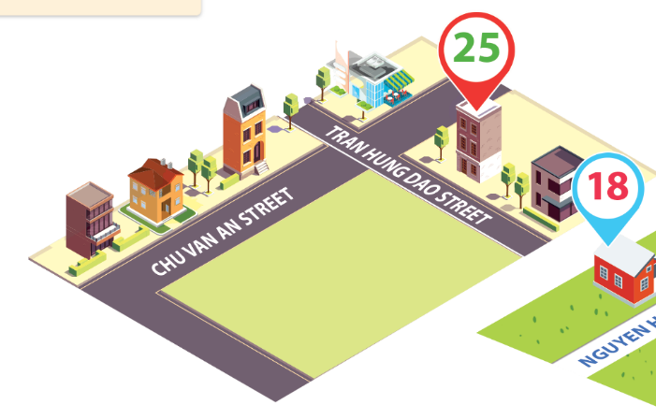
Monday, December 10th 2023
Unit
11
MY HOME
Lesson 1 (4+5+6)
Facebook : Bùi Liễu
0968142780

Slide 2
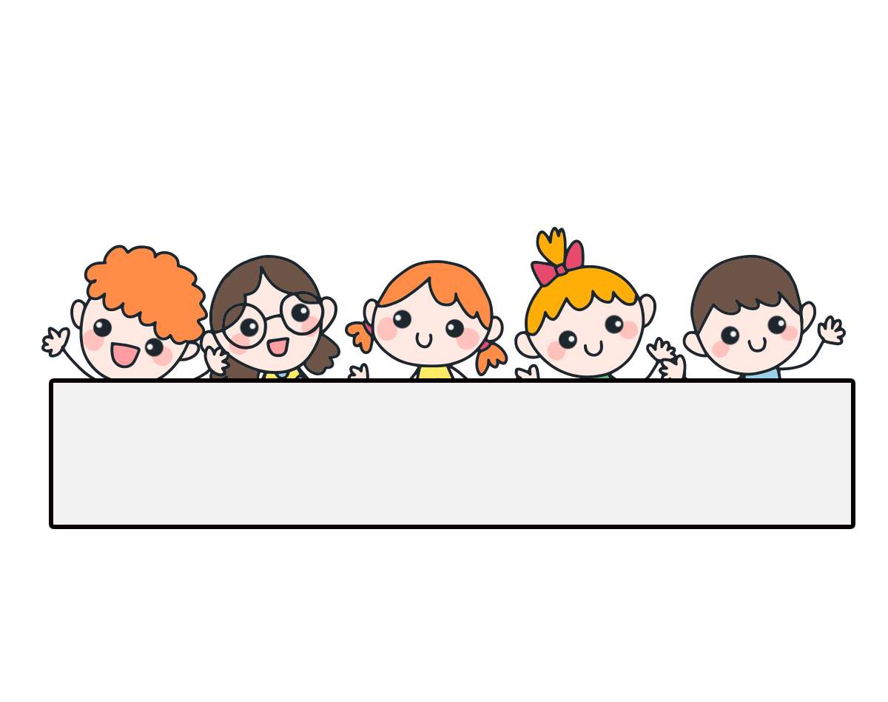
Warm-up

Slide 3


Let’s play!

Slide 4








FEEDING GOLDFISH
Mỗi câu trả lời đúng là
CÂU THẦN CHÚ giúp cá Vàng
ngoi lên mặt nước nhận thức ăn.
Nào chúng mình cùng giúp
bạn nhỏ cho cá Vàng ăn nhé!
START

Slide 5

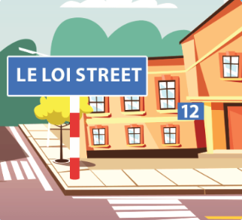



Listen and choose the right answer.
Next
A. True
B. False

Slide 6


Next
A. False
B. True

Slide 7
Next
Where do you live?
I ___ in Hai Ba Trung Street.
A. live
B. lives

Slide 8
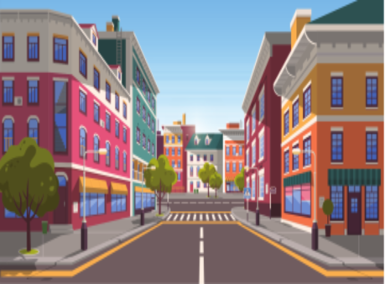
Next
A. village
B. street
C. road

Slide 9

Next
A. road
B. city
B. mountains

Slide 10
Wh ____ do you live?
I live in To Hieu Street.
Next
A. eer
B. era
C. ere

Slide 11
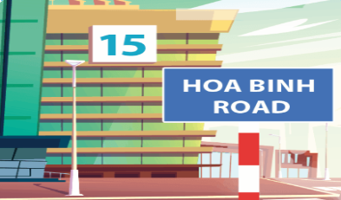
Next
Where do you live?
I _____15 Hoa Binh Road.
A. live on
B. live at
C. live in

Slide 12
Next
Where do you live?
________________
A. I live at 12 Le Loi Street.
B. It’s in February.
C. I’m from Viet Nam.

Slide 13
Choose the right answer.
- Where do you live?
- I live ___ Le Loi Street.
Next
A. in
B. on
B. under

Slide 14
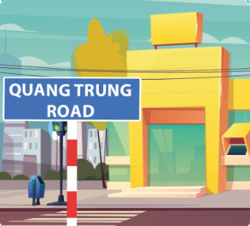
Next
_________________
I live in Quang Trung Road.
A. Where were you last summer?
B. Where do you live?
C. Where is your school?

Slide 15
THANK YOU!
End

Slide 16
Contents
4
5
6
Listen and tick or cross.
Look, complete and read.
Let’s play.

Slide 17
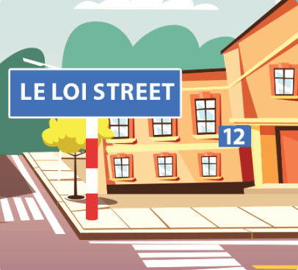
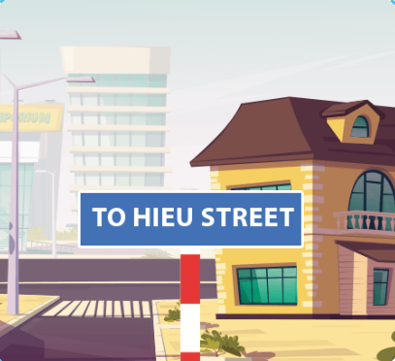








4. Listen and tick or cross.
1
2
3
4

Slide 18
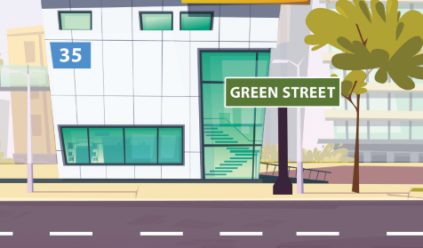

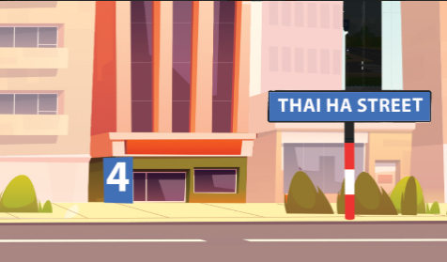

5. Look, complete and read.
1.
A: Where do you live?
B: I live at ______ Green Street.
2.
A: Where do you live?
B: I live in _______________.
Tran Phu Road
35
3.
A: ________ do you live?
B: I live at ________________.
4.
A: Where do you ________?
B: I live ________________.
Where
live
4 Thai Ha Street
in London Road

Slide 19

6. Let’s play.

Slide 20
Wrap up

Slide 21



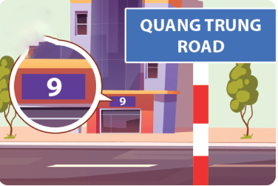
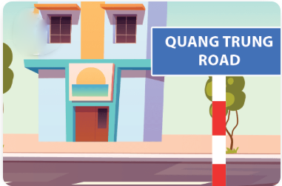
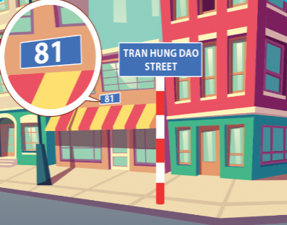
Unit 11 lesson 1
Where do you live?
I live ______.
in Tran Hung Dao Street
at 9 Quang Trung Road
in Quang Trung Road
at 81 Tran Hung Dao Street

Slide 22
Homework
…………………………………….
…………………………………….

Slide 23

Facebook: Bùi Liễu
0968142780
Thank you!

