Slide 1

DAI LOC DEPARTMENT OF EDUCATION AND TRAINING
DAI QUANG PRIMARY SCHOOL
Welcome to our class !
Subject: English 4
Class: 4G
Teacher: Le Thi Hong Thanh

Slide 2
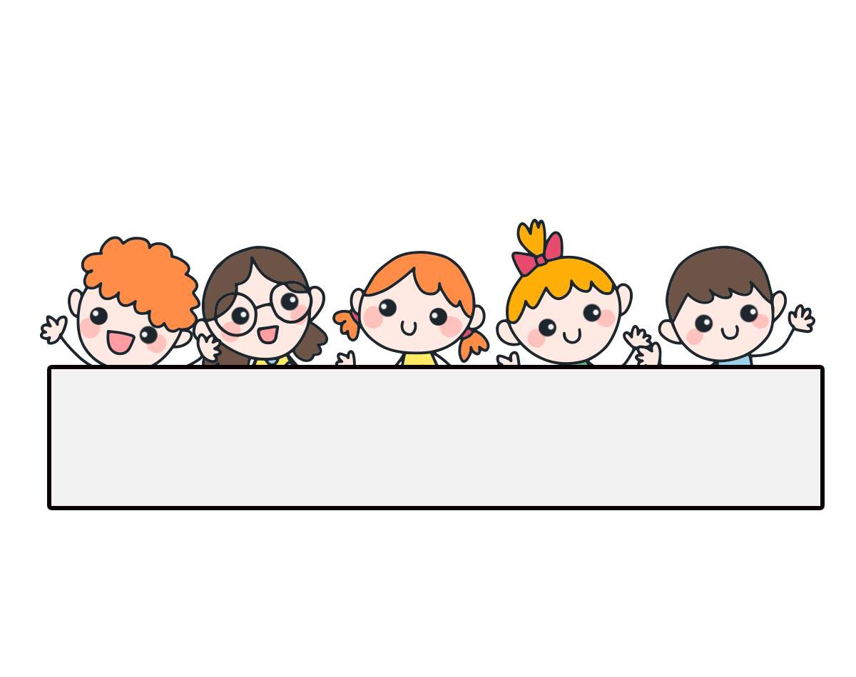
Warm-up

Slide 3


Game: Pass the ball

Slide 4


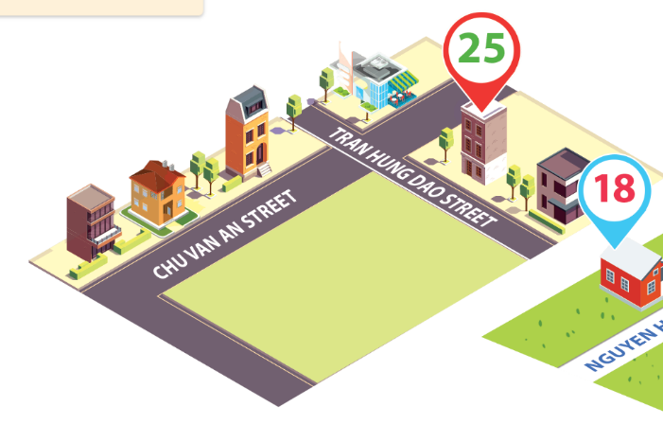
Thursday, January 18th 2024
Unit
11
My home
Lesson 2 (1+2+3)

Slide 5



Contents
Look, listen and repeat.
Listen, point and say.
Let’s talk.

Slide 6

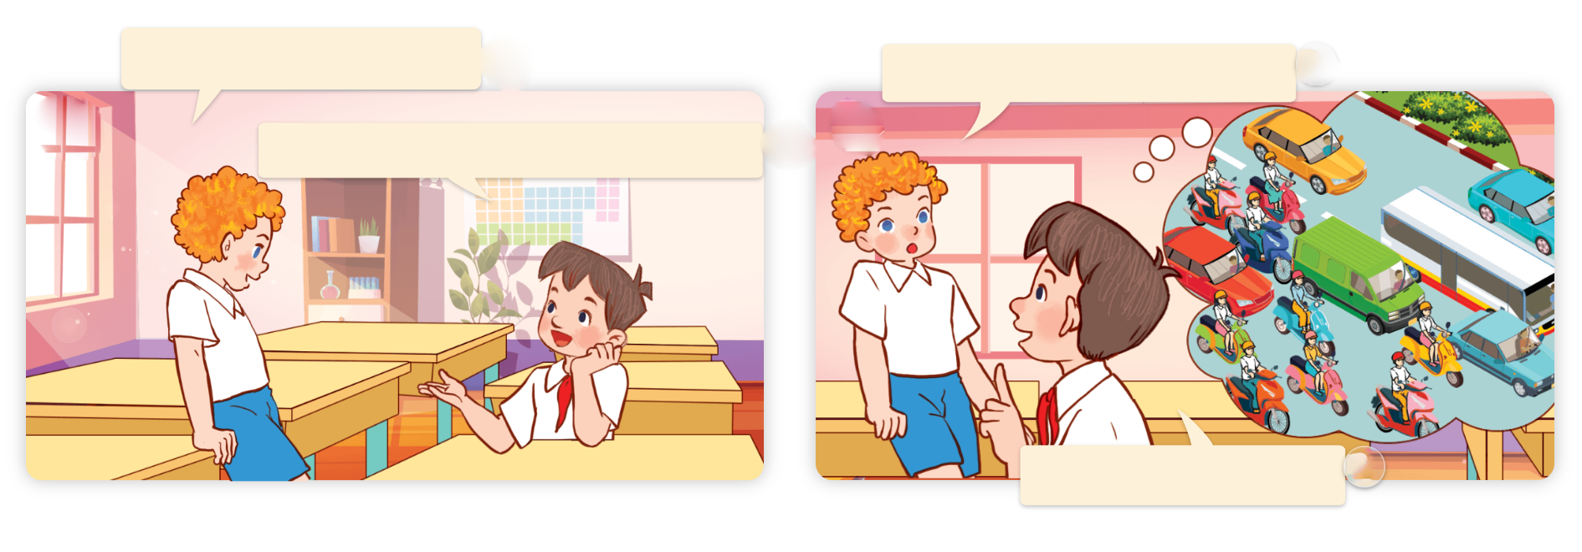
1. Look, listen and repeat.
Where do you live?
What’s the street like?
a
I live in Hai Ba Trung Street.
b
It’s a busy street.

Slide 7
Vocabulary

Slide 8
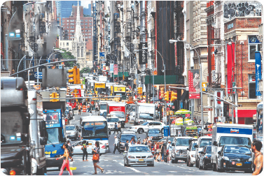
Vocabulary
busy
/ˈbɪzi/
bận rộn, nhộn nhịp

Slide 9
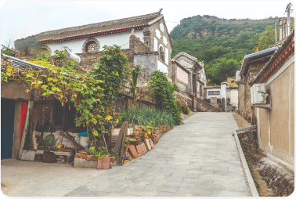
Vocabulary
quiet
/ˈkwaɪət/
yên tĩnh, tĩnh mịch

Slide 10
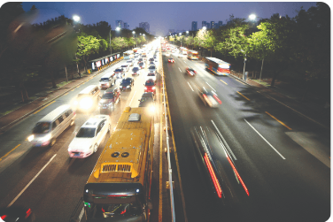
Vocabulary
noisy
/ˈnɔɪzi/
ồn ào, huyên náo

Slide 11
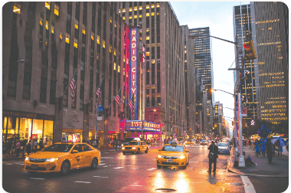
Vocabulary
big
/bɪɡ/
to, lớn (kích thước)

Slide 12
Vocabulary
- busy:
bận rộn, nhộn nhịp
- noisy:
ồn ào, huyên náo
- quiet:
yên tĩnh, tĩnh mịch
- big:
to, lớn ( kích thước)

Slide 13
Match
1. noisy
a. ồn ào, huyên náo
2. big
b. to, lớn
3. quiet
c. bận rộn, nhộn nhịp
4. busy
d. yên tĩnh, tĩnh mịch

Slide 14
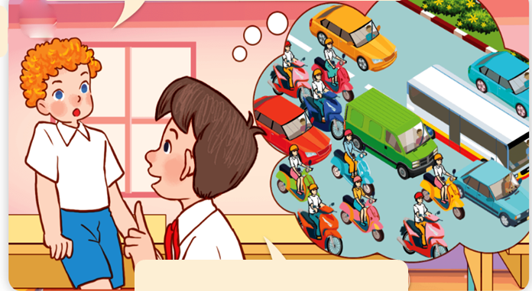
Model sentence: Hỏi, đáp về một nơi nào đó như thế nào.
What’s the street like?
It’s a busy street.

Slide 15
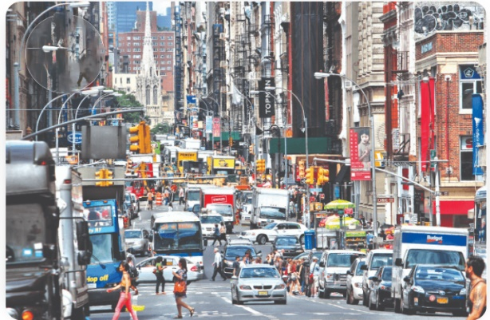
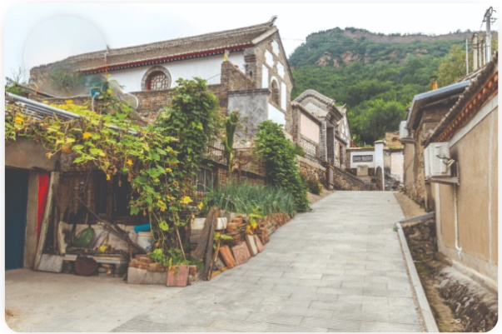
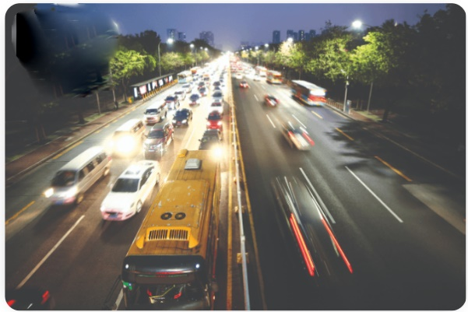
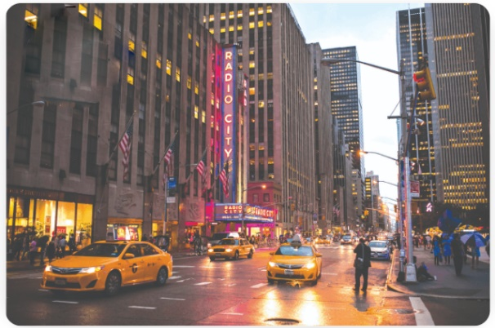
2. Listen, point and say.
a
b
What’s the _____ like?
a busy street
a quiet village
It’s ___________.
c
d
a noisy road
a big city

Slide 16
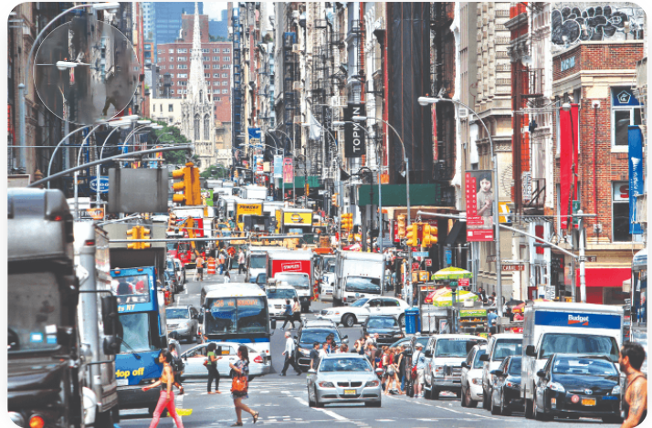


2. Listen, point and say.
a
What’s the _____ like?
It’s ___________.
a busy street
What’s the street like?
It’s a busy street.
Click on the sentences to listen.

Slide 17

2. Listen, point and say.
b
What’s the _____ like?
It’s ___________.
a quiet village
What’s the village like?
It’s a quiet village.

Slide 18

2. Listen, point and say.
c
What’s the _____ like?
It’s ___________.
a noisy road
What’s the road like?
It’s a noisy road.

Slide 19

2. Listen, point and say.
d
What’s the _____ like?
It’s ___________.
a big city
What’s the city like?
It’s a big city.

Slide 20
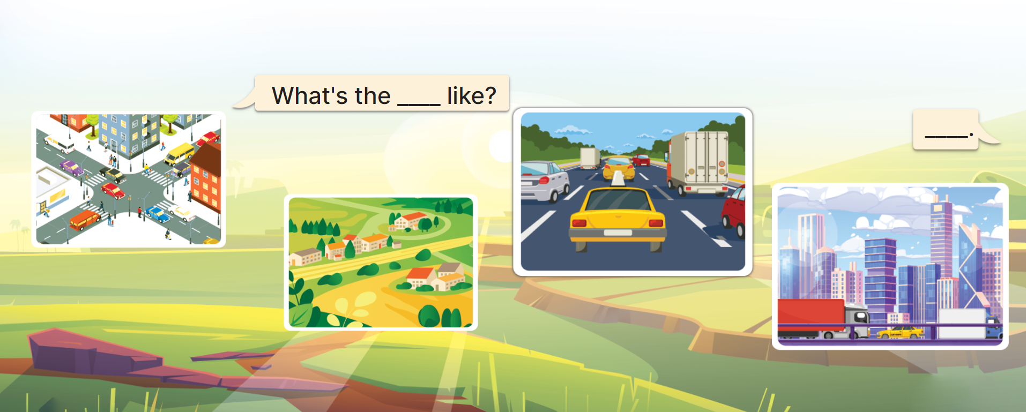
3. Let’s talk.

Slide 21


GAME: SECRET BOX

Slide 22








GO HOME

Slide 23




1. Listen and circle.
1. Where do you live?
a. I live in Quang Trung street.
b. I live at 9 Hoa Binh road.
c. I live in a city.
2 candies
GO HOME

Slide 24
2. Read and answer.
What’s the village like?
1 candy
It’s a quiet village.
GO HOME

Slide 25
3. Listen and complete.
1. What’s the street like?.
It’s a _______ street.
busy
1 candy
GO HOME

Slide 26
2. Put the words in order:
noisy/ road./ It’s/ a
It’s a noisy road.
2 candies
GO HOME

Slide 27
Thursday, January 18 ^{th} 2024
1. Vocabulay:
UNIT 11: MY HOME
Lesson 1: Part 1, 2, 3
1. Vocabulary:
busy: nhộn nhịp
noisy: ồn ào
quiet: yên tĩnh
big: to, lớn
2. Model sentence: Hỏi, đáp về một nơi nào đó như thế nào
What’s the street like?
It’s a busy street

Slide 28
* Home link.
- Learn vocabulary and model sentences.
- Prepare: Unit 11: Lesson 2 (part 4, 5, 6)

Slide 29

Thank you!

