Slide 1


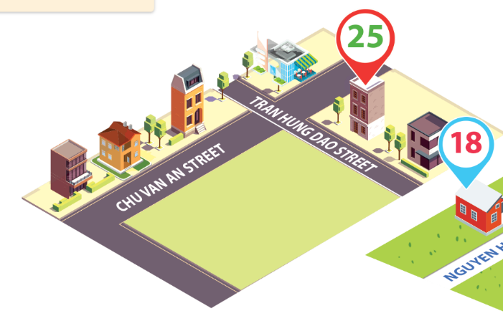
Monday, December 10th 2023
Unit
11
MY HOME
Lesson 3 (4+5+6)
Facebook : Bùi Liễu
0968142780

Slide 2
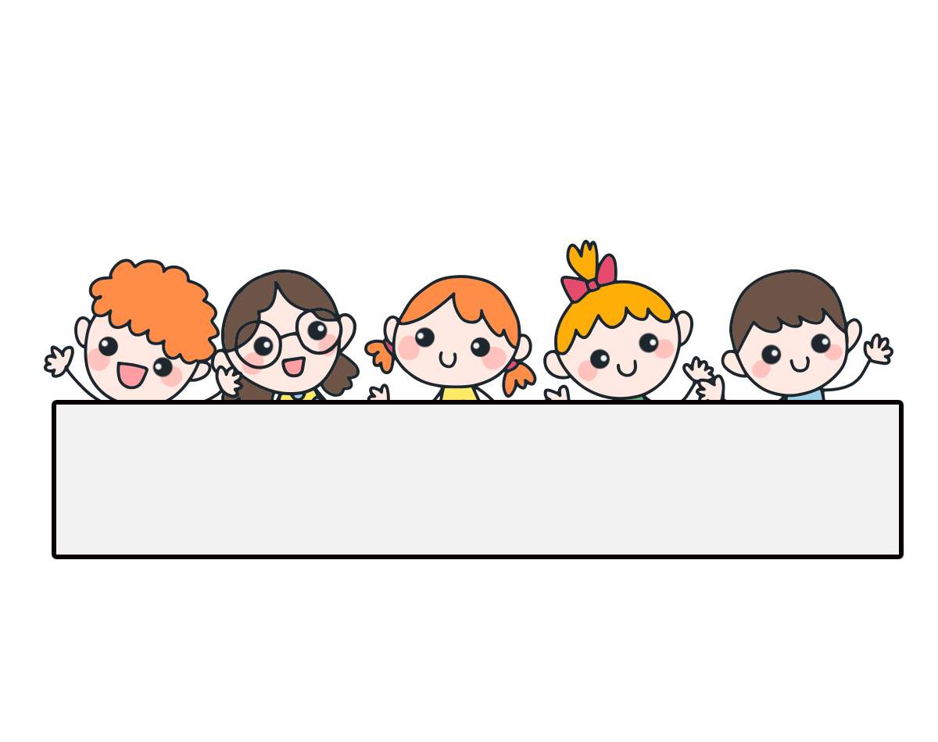
Warm-up

Slide 3

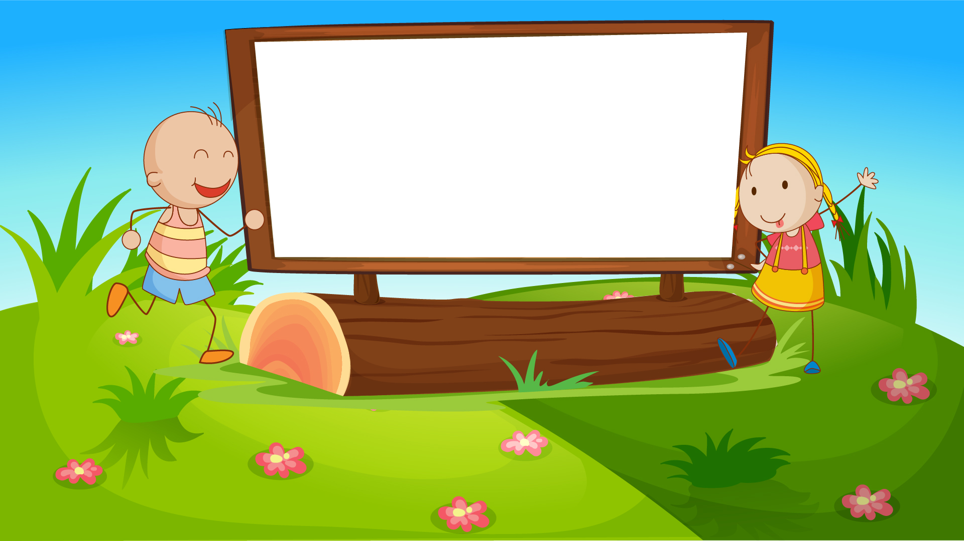
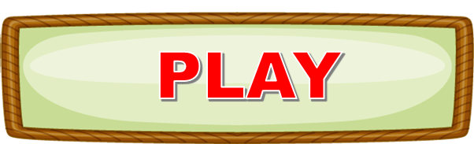

Let’s play!

Slide 4
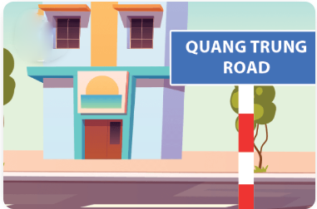

Question 1/10
Where do you live?
_______________
I live in Quang Trung Road.
Answer

Slide 5
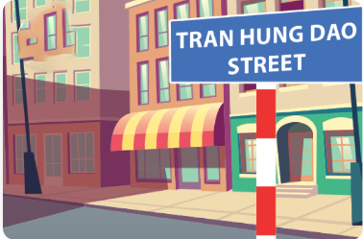
Question 2/10
Where do you live?
______________
I live in Tran Hung Dao Street.
Answer

Slide 6
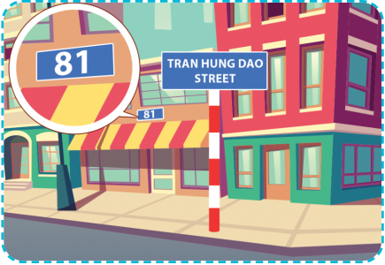
Question 3/10
Where do you live?
______________
I live at 81 Tran Hung Dao Street.
Answer

Slide 7
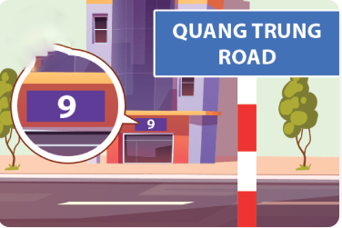
Question 4/10
Where do you live?
______________
I live at 9 Quang Trung Road
Answer

Slide 8
Question 5/10
_______________
I live in Quang Trung village.
Where do you live?
Answer

Slide 9
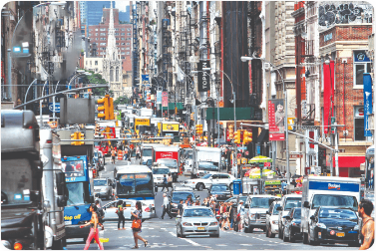
Question 6/10
What’s the street like?
__________________
It’s / It is a busy street.
Answer

Slide 10
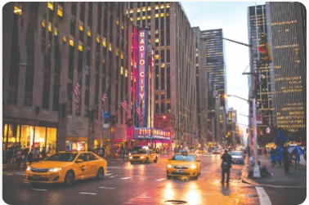
Question 7/10
What’s the city like?
_________________
It’s / It is a big city.
Answer

Slide 11
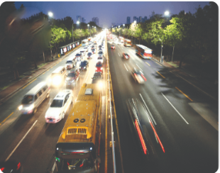
Question 8/10
What’s the road like?
_________________
It’s / It is a noisy road.
Answer

Slide 12
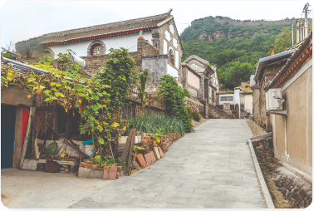
Question 9/10
What’s the village like?
________________
It’s / It is a quiet
village.
Answer

Slide 13

Question 10/10
______________
It’s a noisy road.
What’s the road like?
Answer

Slide 14
Great!

Slide 15



Contents
Read and circle.
Let’s write.
Project.

Slide 16
4. Read and circle.
1
I live in a small flat with my parents. It is in Le Lai Street. The street is very busy. At the weekend, I visit my grandparents. They live in a big house with a beautiful garden in a village. The village is quiet and beautiful.
2
3
4
1. I live in a ______ flat.
2. Le Lai Street is very ________.
a. big
a. busy
b. small
b. quiet
3. My grandparents live in a _______.
4. The village is _______.
a. city
a. quiet and beautiful
b. village
b. small and busy

Slide 17
5. Let’s write.
I live in ______________ with my __________. It is in ______________. It is _____________. There are not many __________ there, but there is _____________. I love my __________.
a big house
parents
Ho Chi Minh city
a big city
trees
a park
house

Slide 18
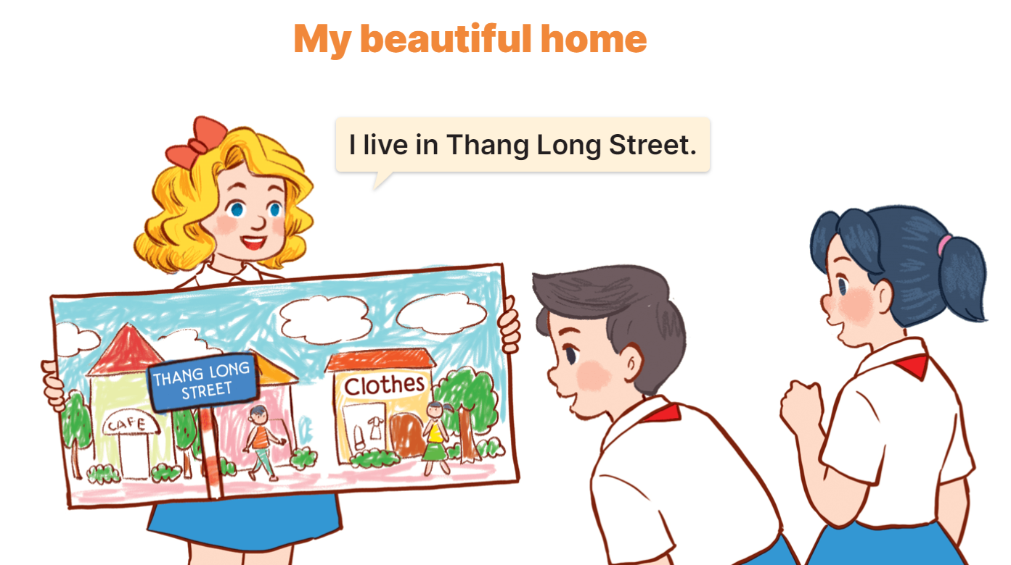
6. Project

Slide 19
Wrap up

Slide 20


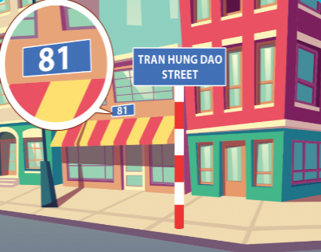
Unit 11 lesson 1
Where do you live?
I live ______.
in Tran Hung Dao Street
at 9 Quang Trung Road
in Quang Trung Road
at 81 Tran Hung Dao Street

Slide 21
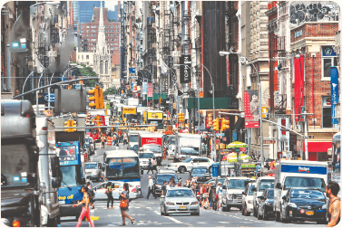



Unit 11 lesson 2
What’s the ______ like?
It’s _________.
what’s = what is
it’s = it is
a busy street
a big city
a quiet village
a noisy road

Slide 22
Homework
………………………………….
………………………………….

Slide 23

Thank you!

