Slide 1
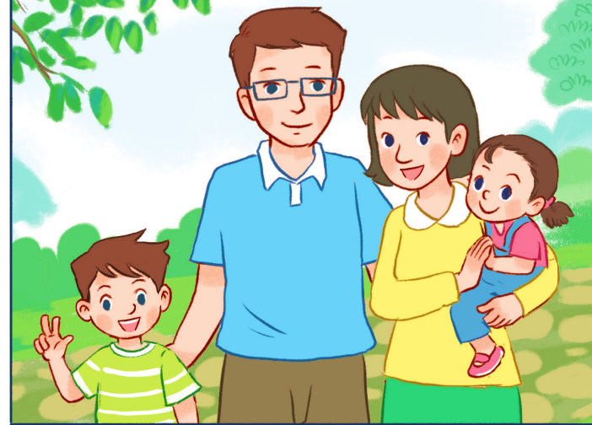
Thursday, January 17th, 2024
My family
Unit
11
Lesson 2 (1+2+3)

Slide 2
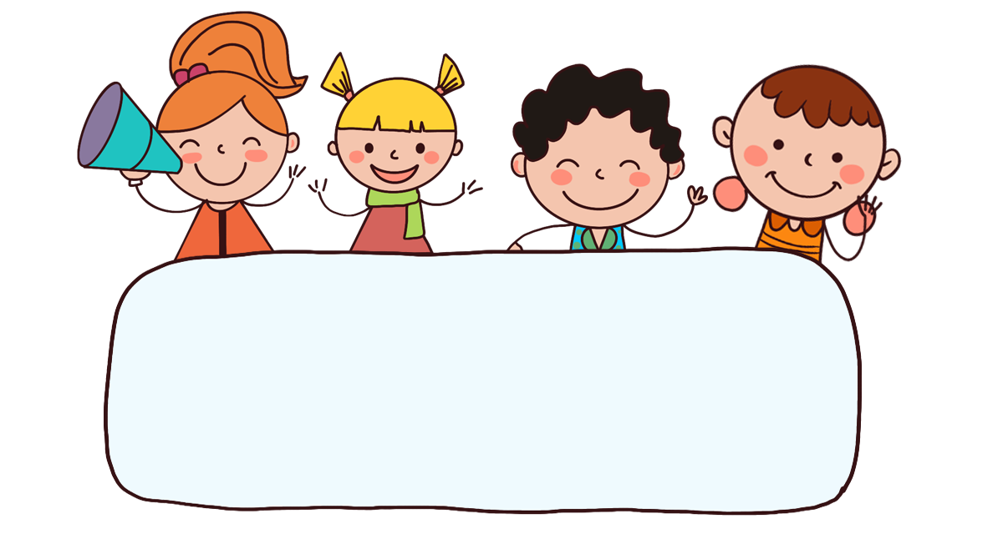
Warm-up

Slide 3
















Picking
apples
END

Slide 4


father
Who’s that?
It’s my ________.
A
mother
B
brother
C

Slide 5
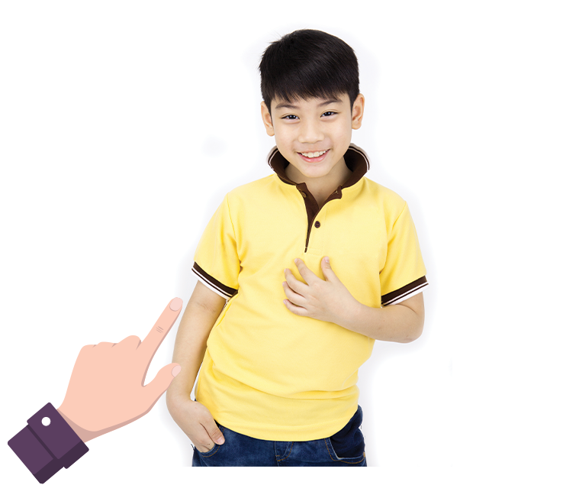
brother
Who’s this?
It’s my ________.
A
father
B
sister
C

Slide 6
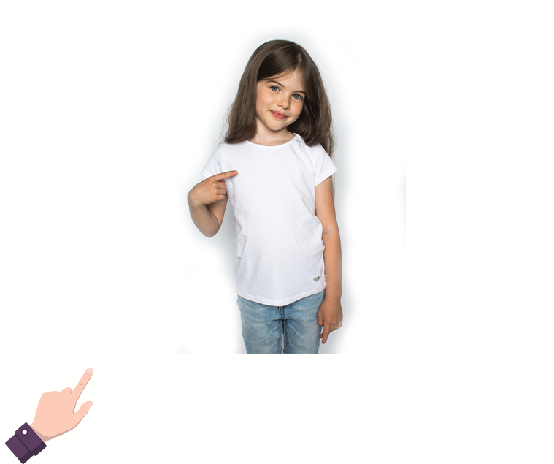
family
Who’s that?
It’s my ________.
A
mother
B
sister
C

Slide 7
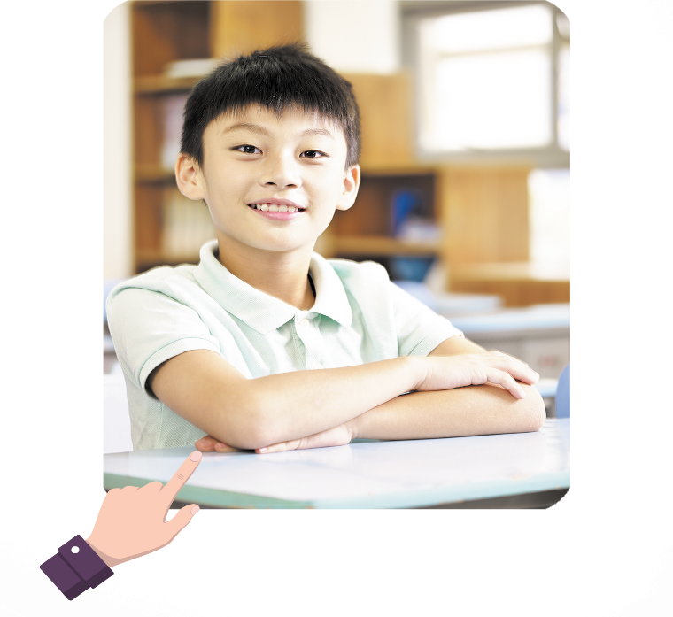
Who’s that?
_____is my brother.
She
A
It
B

Slide 8
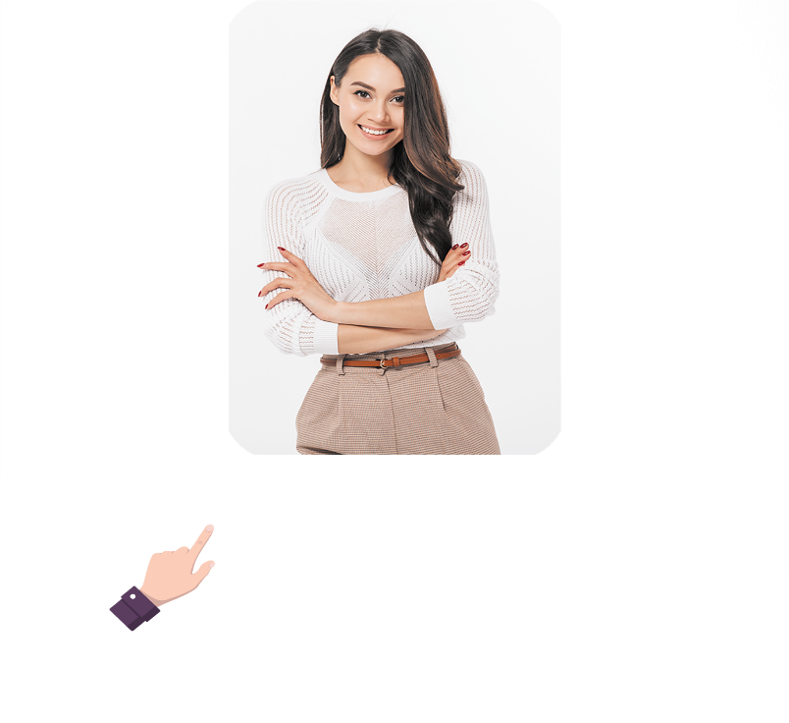
Who’s ___?
It is my brother.
this
A
that
B

Slide 9

Who’s ___?
It is my brother.
that
A
this
B

Slide 10
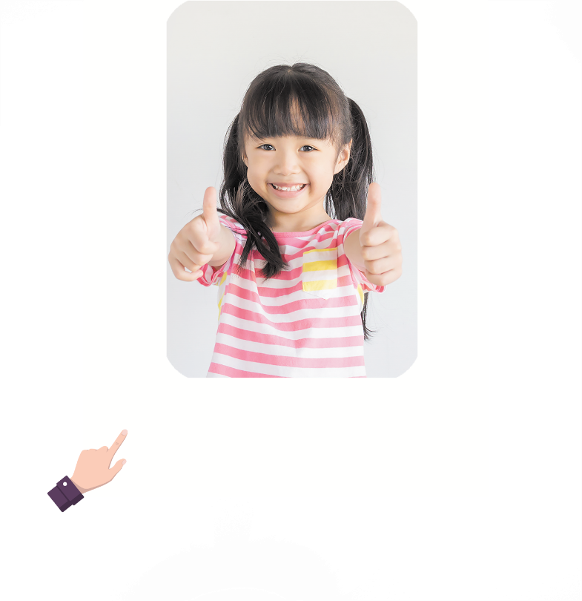
______ that?
what is
A
who is
B

Slide 11
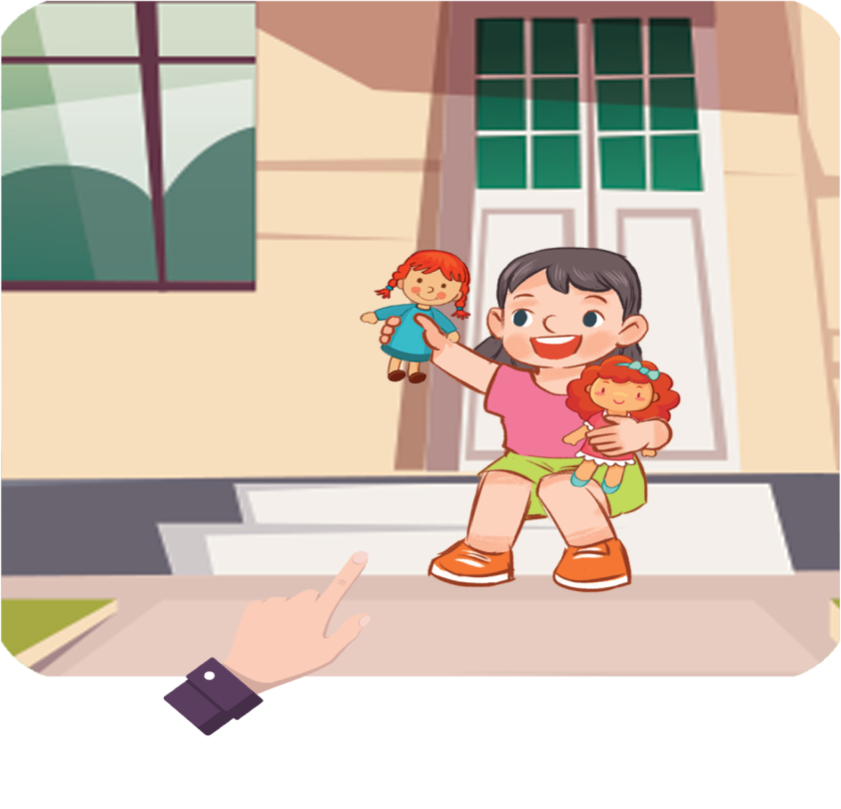
_____ that?
It is my sister.
Who is
A
Who are
B

Slide 12



Contents
Facebook : Bùi Liễu
0968142780
Look, listen and repeat.
Listen, point and say.
Let’s talk.

Slide 13

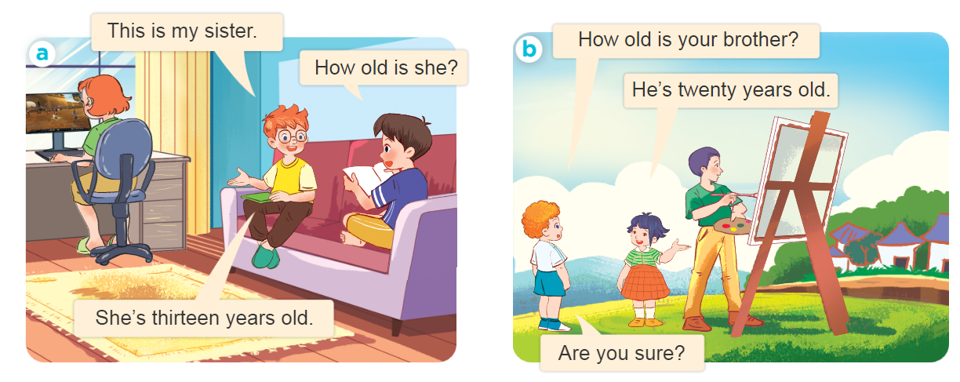
1. Look, listen and repeat.
Who are they?
Where are they?
What are they doing?

Slide 14
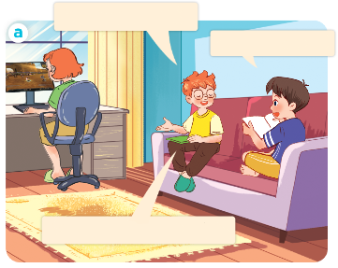
1. Look, listen and repeat.
This is my sister.
How old is she?
She’s thirteen years old.

Slide 15
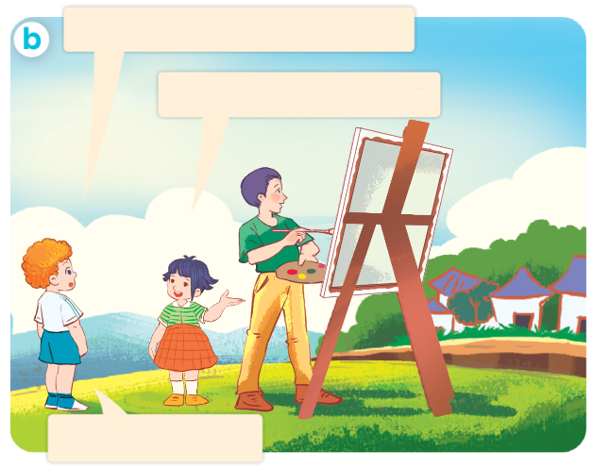
1. Look, listen and repeat.
How old is your brother?
He’s twenty years old.
Are you sure?

Slide 16
1. Look, listen and repeat.
How old is your brother?
He’s twenty years old.
Are you sure?

Slide 17
Vocabulary

Slide 18










Numbers
eleven
/ɪˈlevən/
twelve
/twelv/
thirteen
/ˌθɜːˈtiːn/
fourteen
/ˌfɔːˈtiːn/
fifteen
/ˌfɪfˈtiːn/
sixteen
/ˌsɪksˈtiːn/
seventeen
/ˌsevənˈtiːn/
eighteen
/ˌeɪˈtiːn/
nineteen
/ˌnaɪnˈtiːn/

Slide 19
Structures

Slide 20
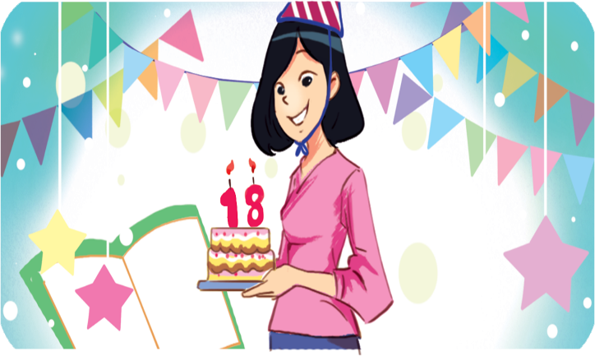
Structures
Hỏi và trả lời về tuổi của ai đó.
- How old is he / she?
He’s / She’s _______.
(Anh ấy / cô ấy bao nhiêu tuổi?)
(Anh ấy / cô ấy ........... tuổi)
he’s = he is
she’s = she is
Example
Mary: How old is she?
Linh:She’s eighteen.

Slide 21


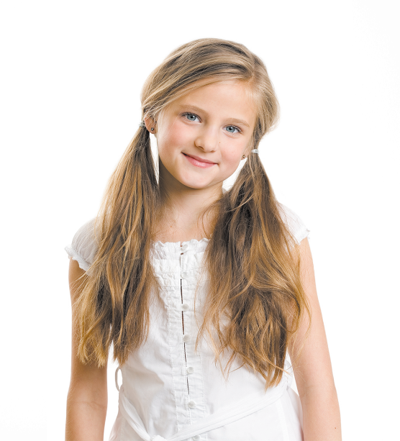
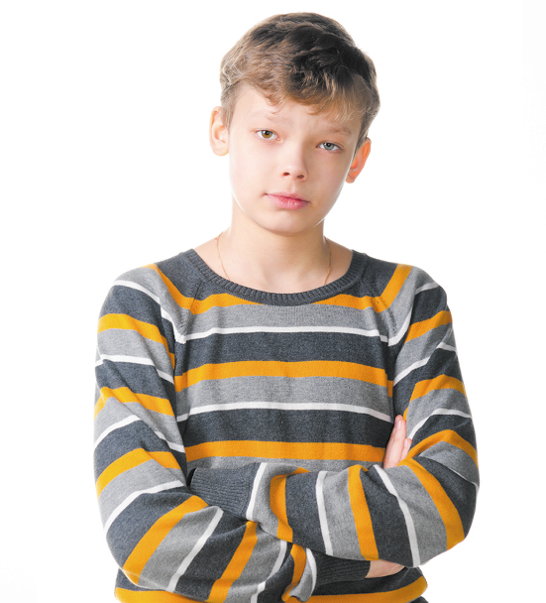
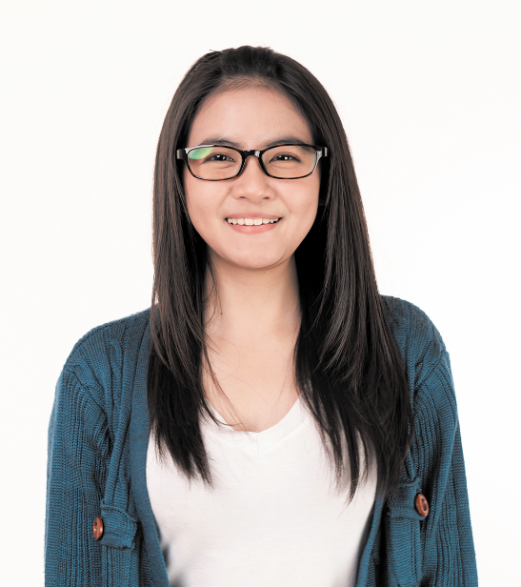
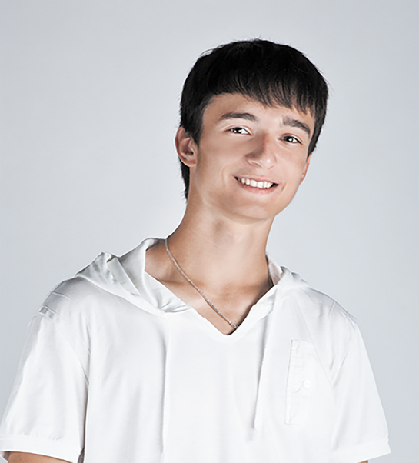
2. Listen, point and say.
How old is he / she?
He’s / She’s _____.
a
b
c
d
twelve
fourteen
eighteen
nineteen

Slide 22
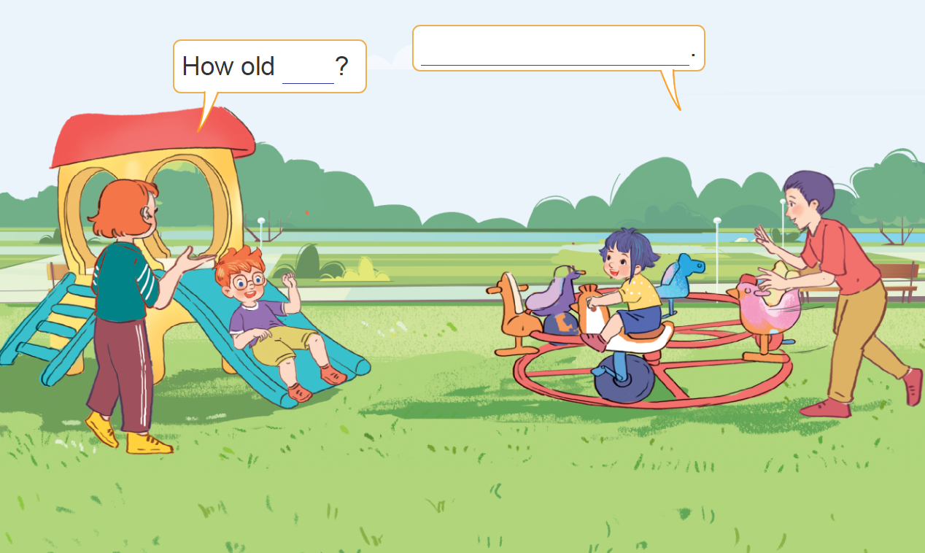
3. Let’s talk.
How old _____?
__________.

Slide 23
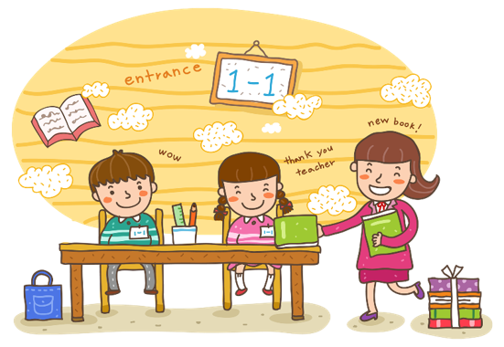
Wrap up

Slide 24
Numbers
eleven
/ɪˈlevən/
twelve
/twelv/
thirteen
/ˌθɜːˈtiːn/
fourteen
/ˌfɔːˈtiːn/
fifteen
/ˌfɪfˈtiːn/
sixteen
/ˌsɪksˈtiːn/
seventeen
/ˌsevənˈtiːn/
eighteen
/ˌeɪˈtiːn/
nineteen
/ˌnaɪnˈtiːn/

Slide 25
Structures
Hỏi và trả lời về tuổi của ai đó.
- How old is he / she?
He’s / She’s _______.
(Anh ấy / cô ấy bao nhiêu tuổi?)
(Anh ấy / cô ấy ........... tuổi)
he’s = he is
she’s = she is
Example
Mary: How old is she?
Linh:She’s eighteen.

Slide 26
Homework
Learn by heart all the new words.
Read again the dialogue in part 1.

Slide 27

Thank you!

