Slide 1
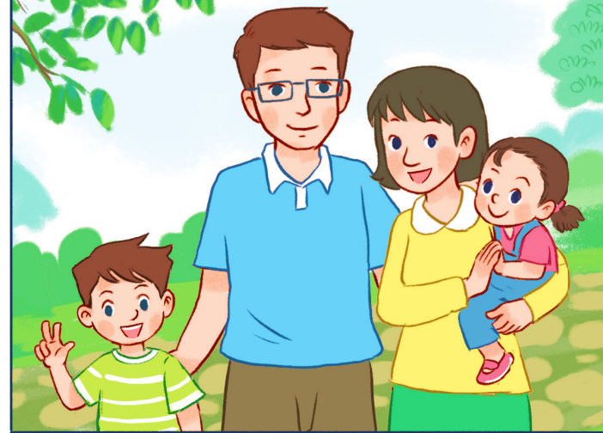
Thursday, January 18th,2024
My family
Unit
11
Lesson 2 (4+5+6)

Slide 2
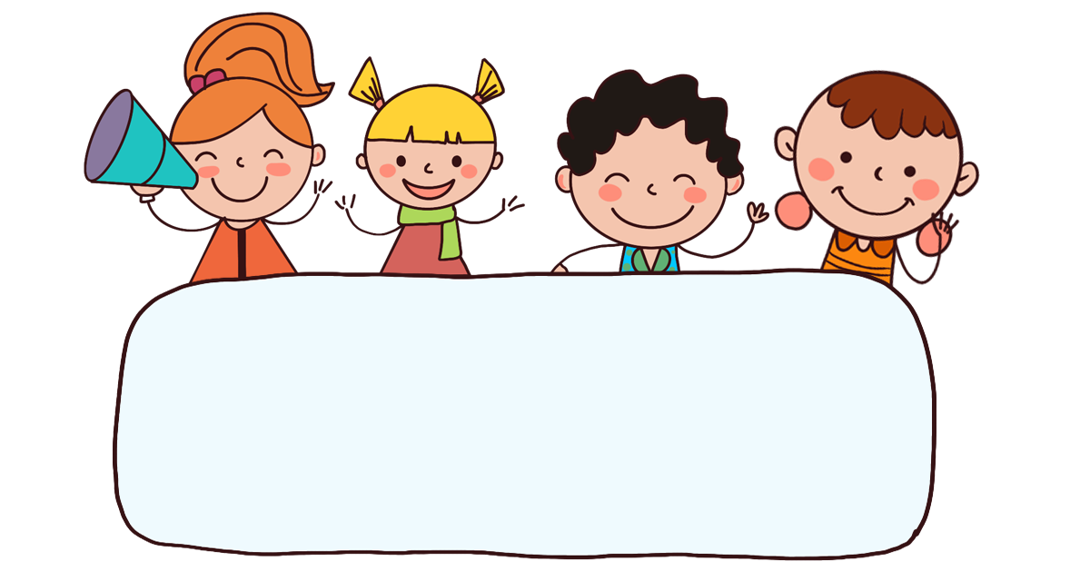
Warm-up

Slide 3

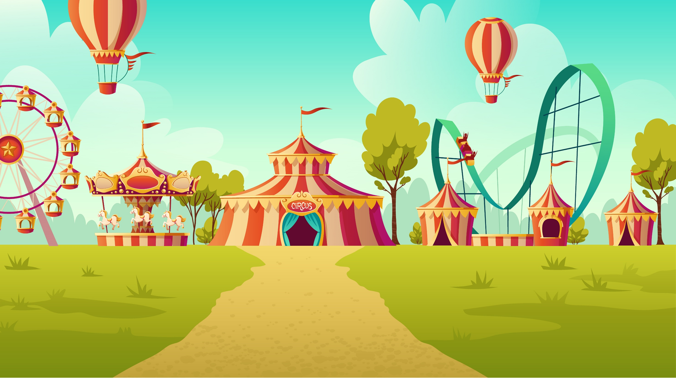


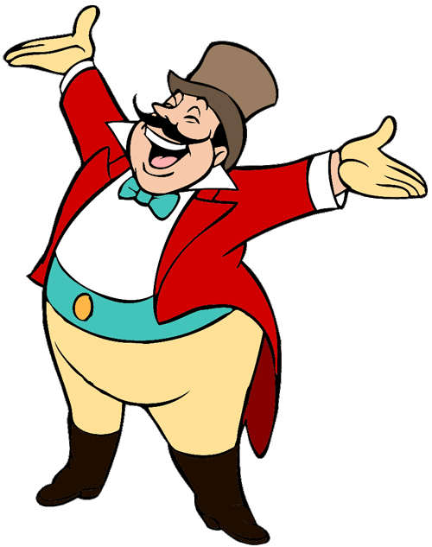
START

Slide 4
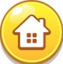
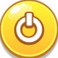




Facebook : Bùi Liễu
0968142780
A.nineteen
B. nineteen
C. seventeen
Next

Slide 5

Facebook : Bùi Liễu
0968142780
A. nineteen
B. twelve
C. eleven

Slide 6

Facebook : Bùi Liễu
0968142780
A. fifteen
B.eighteen
C.seventeen
Next

Slide 7

Facebook : Bùi Liễu
0968142780
A.nineteen
B. eighteen
C. twelve

Slide 8

Facebook : Bùi Liễu
0968142780
A.
B.
C.

Slide 9
Facebook : Bùi Liễu
0968142780
A.eighteen
B.seventeen
C. nineteen

Slide 10
Facebook : Bùi Liễu
0968142780
A.
B.
C.

Slide 11
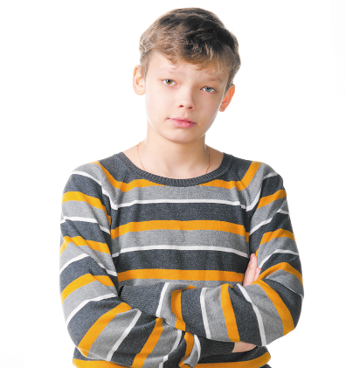
Facebook : Bùi Liễu
0968142780
How old is he?
___ eight.
A. She’s
B. I’m
C. He’s

Slide 12
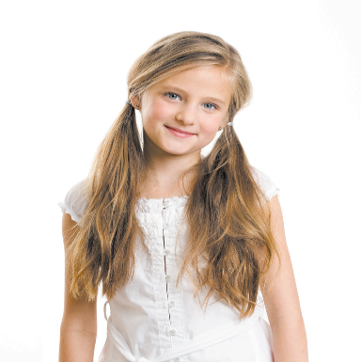
Facebook : Bùi Liễu
0968142780
How old is she?
___ twelve.
A. He’s
B. I’m
C. She’s

Slide 13
Facebook : Bùi Liễu
0968142780
How old __ she?
A.am
B. are
C. is

Slide 14
Facebook : Bùi Liễu
0968142780
How old is she?
A. She’s eleven.
B. She’s twelve.
C. He’s seventeen.

Slide 15
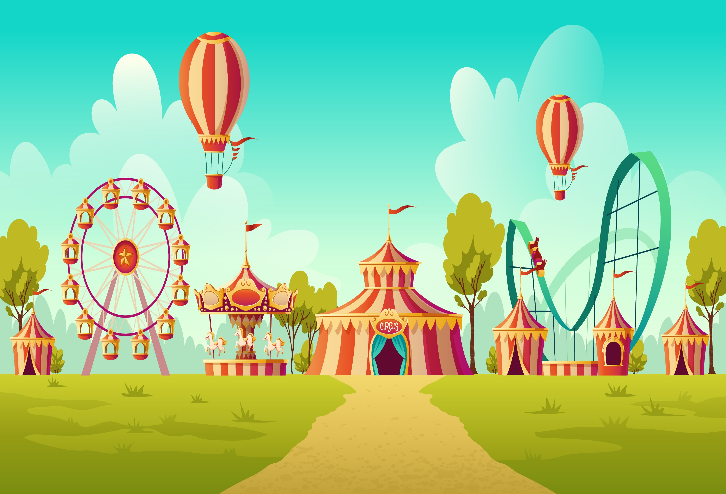

Facebook : Bùi Liễu
0968142780
Well done!

Slide 16



Contents
Facebook : Bùi Liễu
0968142780
Listen and number.
Look, complete and read.
Let’s play.

Slide 17

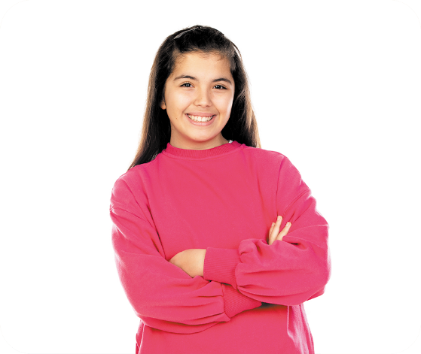
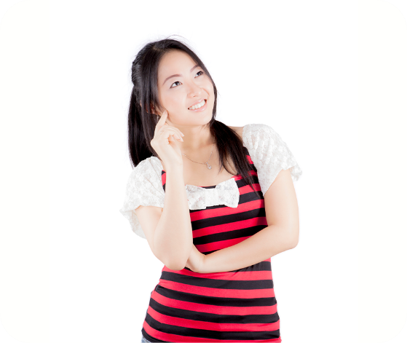
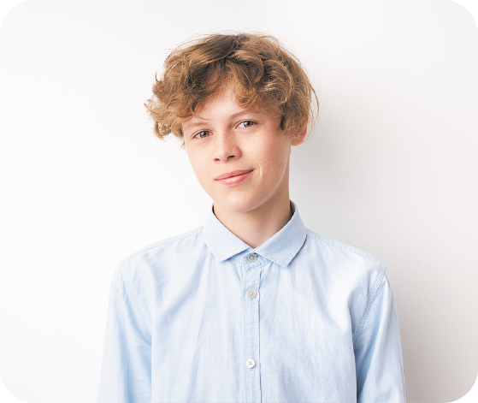
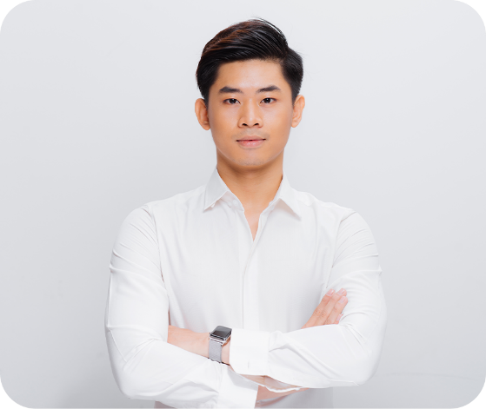




4. Listen and number.
a
b
c
d
1
3
4
2

Slide 18
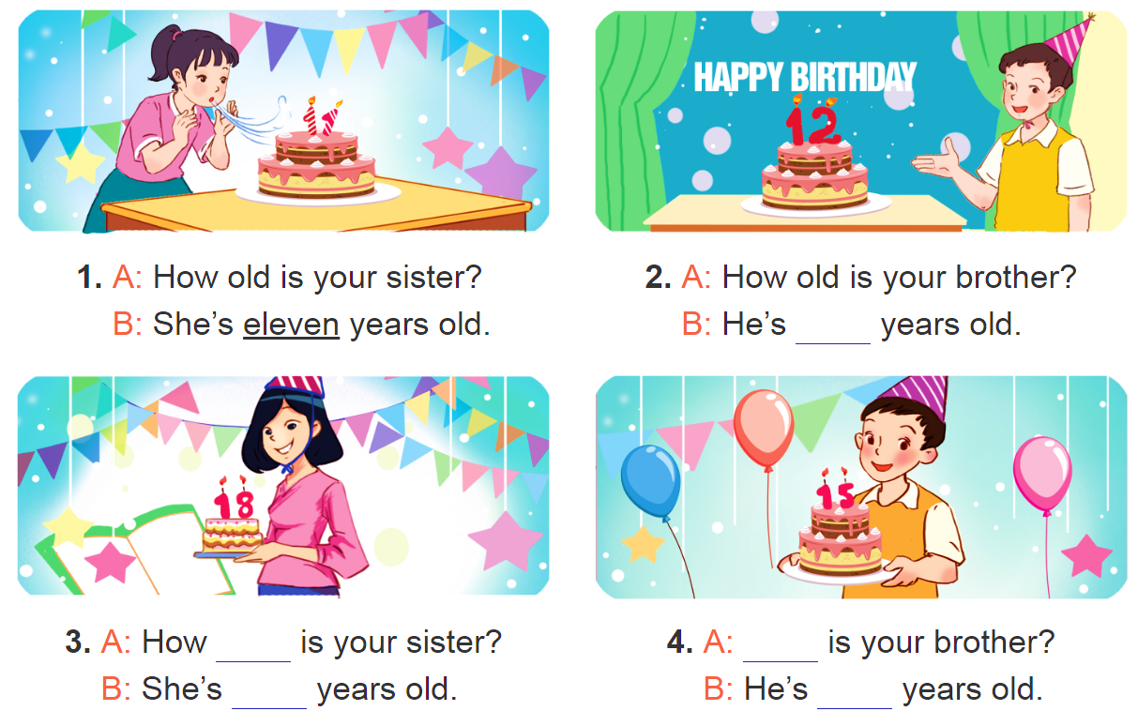
5. Look, complete and read.

Slide 19
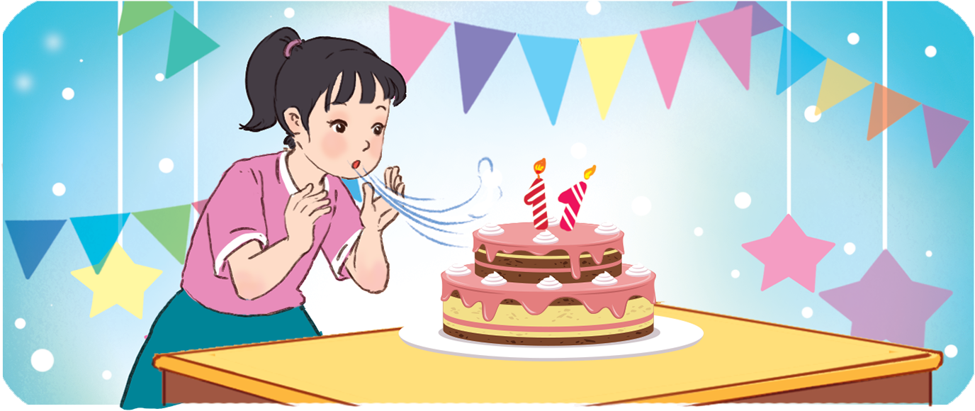
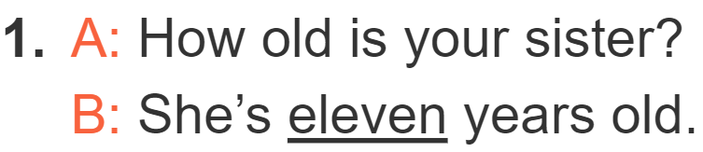
5. Look, complete and read.
______

Slide 20
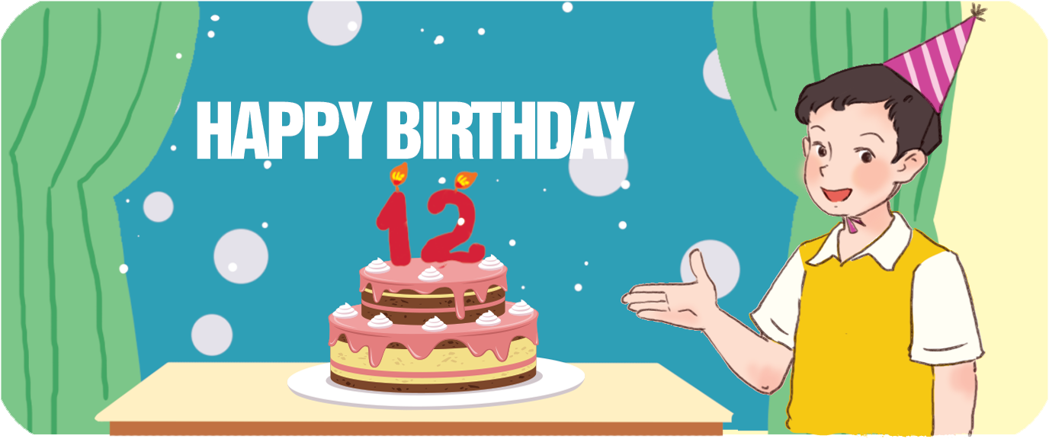
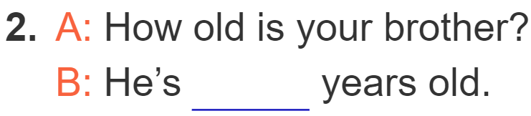
5. Look, complete and read.
twelve

Slide 21

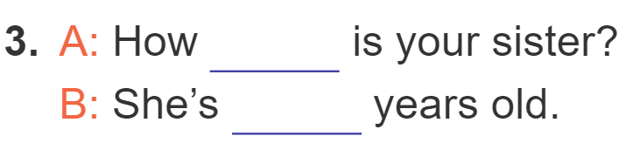
5. Look, complete and read.
old
eighteen

Slide 22
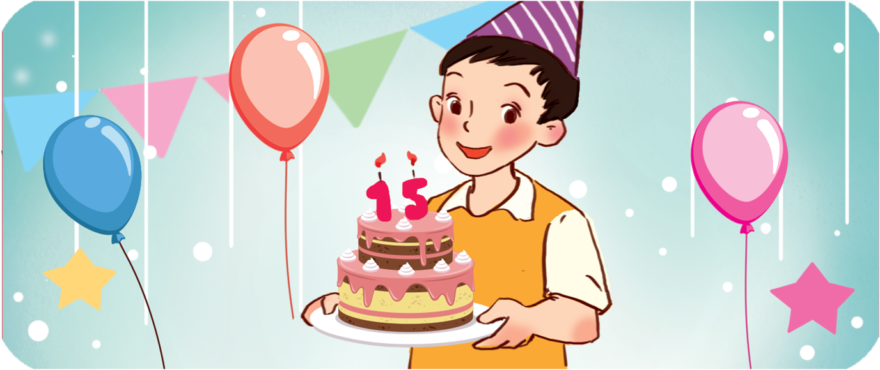
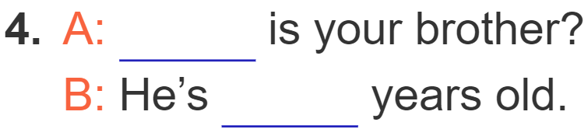
5. Look, complete and read.
How old
fifteen

Slide 23
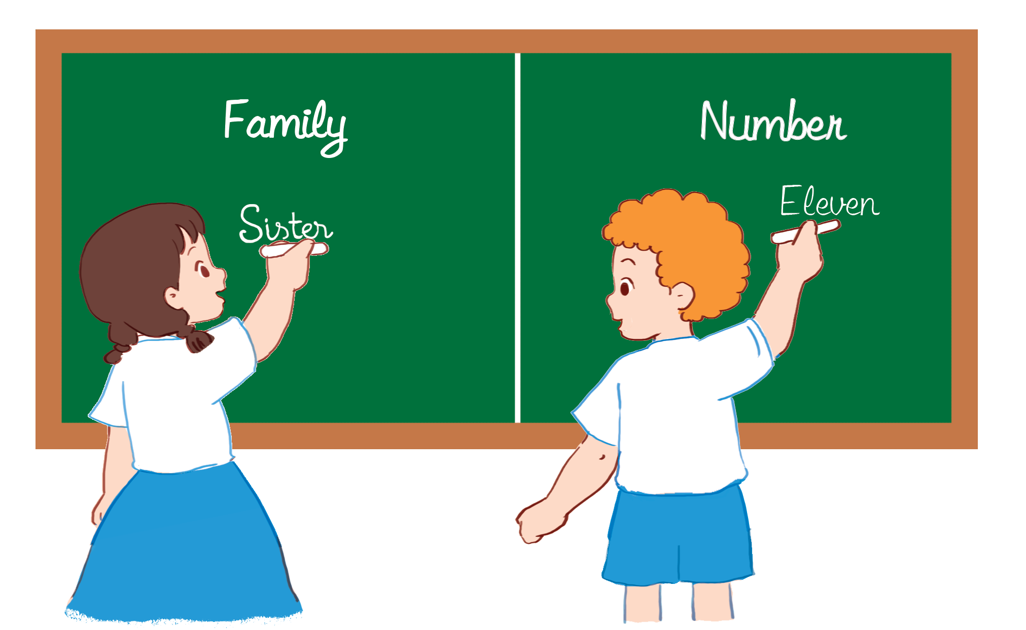
6. Let’s play.

Slide 24
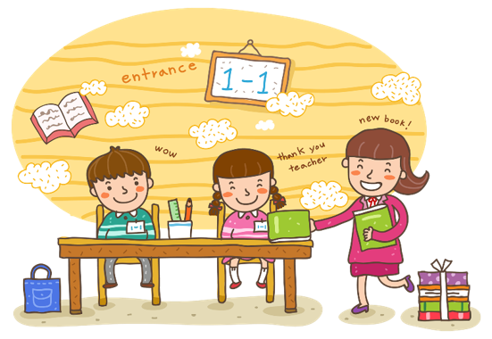
Wrap up

Slide 25





Numbers
eleven
/ɪˈlevən/
twelve
/twelv/
thirteen
/ˌθɜːˈtiːn/
fourteen
/ˌfɔːˈtiːn/
fifteen
/ˌfɪfˈtiːn/
sixteen
/ˌsɪksˈtiːn/
seventeen
/ˌsevənˈtiːn/
eighteen
/ˌeɪˈtiːn/
nineteen
/ˌnaɪnˈtiːn/

Slide 26



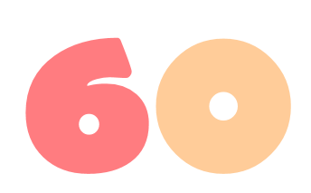






twenty
/ˈtwenti/
thirty
/ˈθɜːti/
forty
/ˈfɔːti/
fifty
/ˈfɪfti/
sixty
/ˈsɪksti/
seventy
/ˈsevənti/
eighty
/ˈeɪti/
ninety
/ˈnaɪnti/
one hundred
/wʌn ˈhʌndrəd/

Slide 27
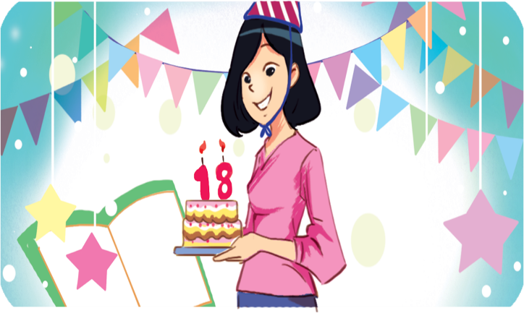
Structures
Hỏi và trả lời về tuổi của ai đó.
- How old is he / she?
He’s / She’s _______.
(Anh ấy / cô ấy bao nhiêu tuổi?)
(Anh ấy / cô ấy ........... tuổi)
he’s = he is
she’s = she is
Example
Mary: How old is she?
Linh:She’s eighteen.

Slide 28
Homework
.....................................................
.....................................................

Slide 29

Thank you!

