Slide 1
Unit 12
Don’t ride your bike
too fast
Lesson 3

Slide 2
WARM-UP

Slide 3



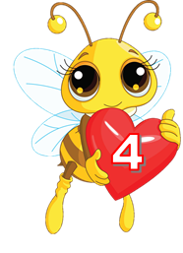

Look and match
1.
2.
3.
4.
5.
play
ride
run down
get
break
a.
b.
c.
d.
e.
the stairs
a burn
your leg
with the knife
your bike too fast

Slide 4
Pronunciation

Slide 5

1. Look and repeat.
1. | Don't play with the knife! ↷ OK, I won't. ↷
2. | Don't play with matches. ↷ OK, I won't. ↷
3. | Why shouldn't I play with the knife? ↷ Because you may cut yourself. ↷
4. | Why shouldn't I play with the stove? ↷ Because you may get a burn. ↷

Slide 6
2. Listen and circle a or b. Then say the sentences aloud.
1. Don't play with the ___________!
a. knife b. stove
2. Don't climb the ___________!
a. wall b. tree
3. Why shouldn't he ride his ___________ too fast?
a. bike b. motorbike
4. Why shouldn't she ___________?
a. run down the stairs b. play with the stove

Slide 7
PRACTISE

Slide 8
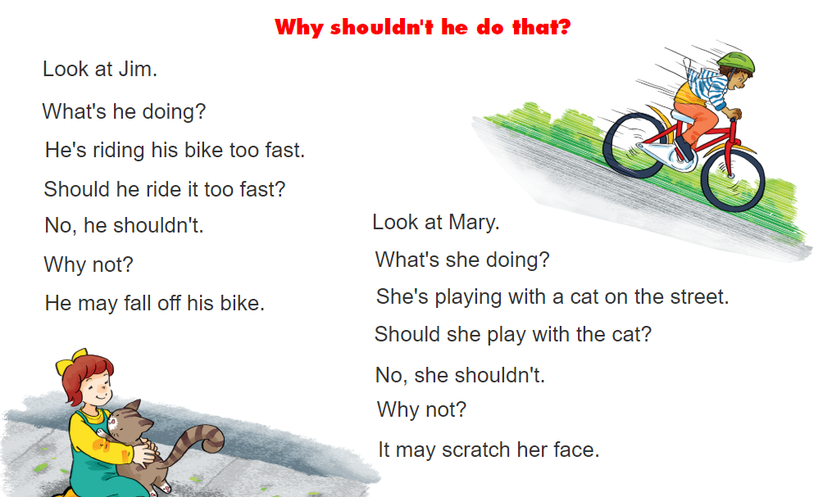


3. Let’s chant.

Slide 9
4.1 Circle the best title.
Falling is a common type of accident for young children at home. Your baby brother or sister may fall off a bed or a sofa. He or she may also fall down the stairs. The following tips can help to keep your baby brother or sister safe:
• Make sure he or she can't roll off the bed
• Make sure he or she can't open any windows.
• Don't let him or her go near the stairs.
• Don't let him or her out on the balcony.
a. Common accidents
b. Preventing children from falling
c. How to be safe at home

Slide 10
4.2 Tick True (T) or False (F)
 | T | F
1. Babies may roll off a sofa.
2. You shouldn't stop your baby brother or sister when he or she climbs the stairs.
3. You should make sure he or she can't roll off the bed.
4. Do not open any windows at home.
5. Allow him or her to play on the balcony alone sometimes.
✓
✓
✓
✓
✓

Slide 11
5. Write what may happen.
1. Tony's playing with a sharp knife. He may __________ _______________________________________________.
2. Linda's playing with a neighbour's cat. It may __________ _______________________________________________.
3. Quan's riding his bike too fast. He may __________ _______________________________________________.

Slide 12
6. Project
Make a poster about home accidents
and how to avoid them.

Slide 13
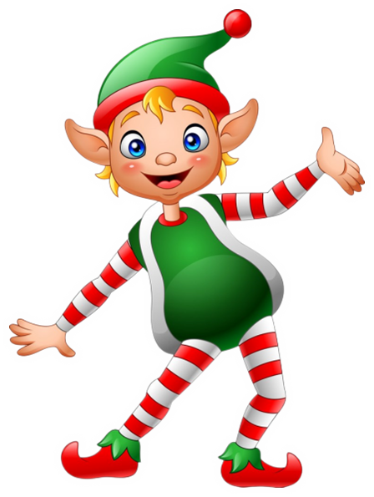


THANK YOU!
Welcome to join with me!
MsPham Powerpoint
Mspham

