Slide 1
DAI LOC DEPARTMENT OF EDUCATION AND TRAINING
DAI QUANG PRIMARY SCHOOL
WELCOME TO OUR CLASS !
Subject: English 3
Class: 3D
Teacher: Pham Thi My Chau

Slide 2
Warm-up

Slide 3
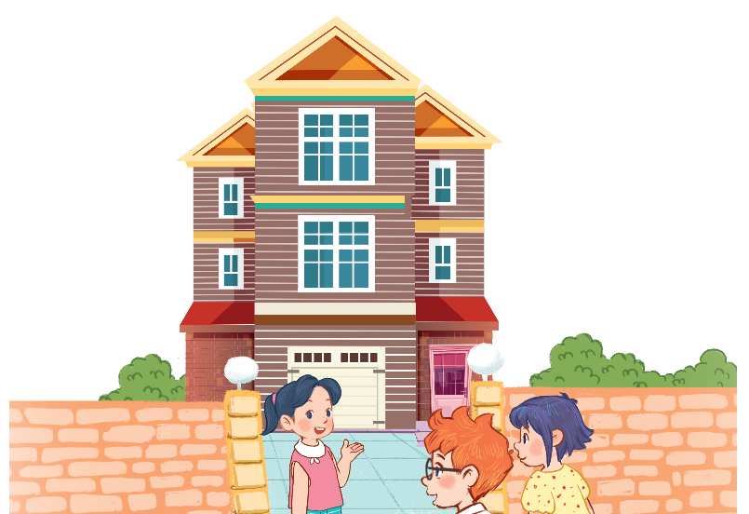
Let’s chant.
Big house, big house.
It’s a big house.
It’s my big house.
Come in, please!
Brown house, brown house.
It’s a brown house.
It’s my brown house.
Come in, please!

Slide 4
UNIT 13: MY HOUSE
Monday, February 19 ^{th}, 2024
*Lesson 3:
Part: 4, 5, 6

Slide 5
4/ Read and complete
My name’s Mary in my house. This is the living room and this is the bedroom. That is the kitchen and that is the bathroom. The chairs and the tables are in the kitchen. The books are on the table.
the bedroom
1/ This is the living room and this is ____________.
the kitchen
2/ That is____________and that is the bathroom.
the kitchen
3/ The chairs and the tables are in____________.
the table
4/ The books are on____________.

Slide 6
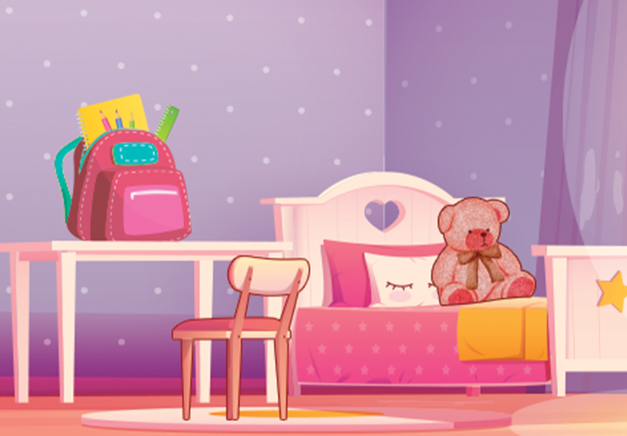
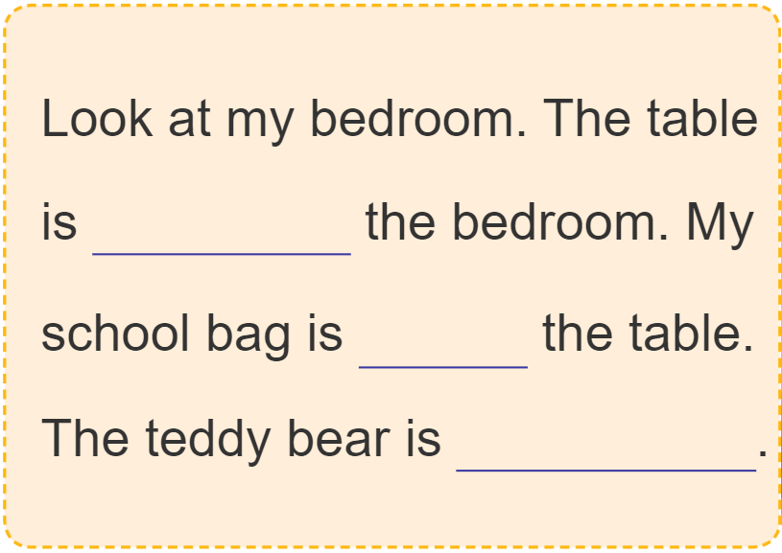
5. Let’s write.
in
on
on the bed

Slide 7
6. Project.

Slide 8
Let’s play!
Can you guess?

Slide 9
Where is the living room?
It’s here.

Slide 10
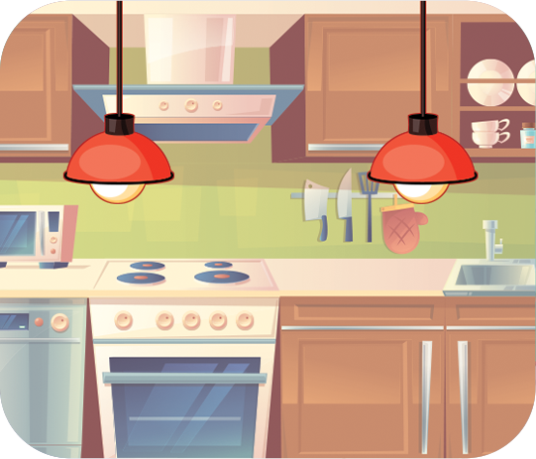
Where are the lamps?
They’re in the kitchen.

Slide 11
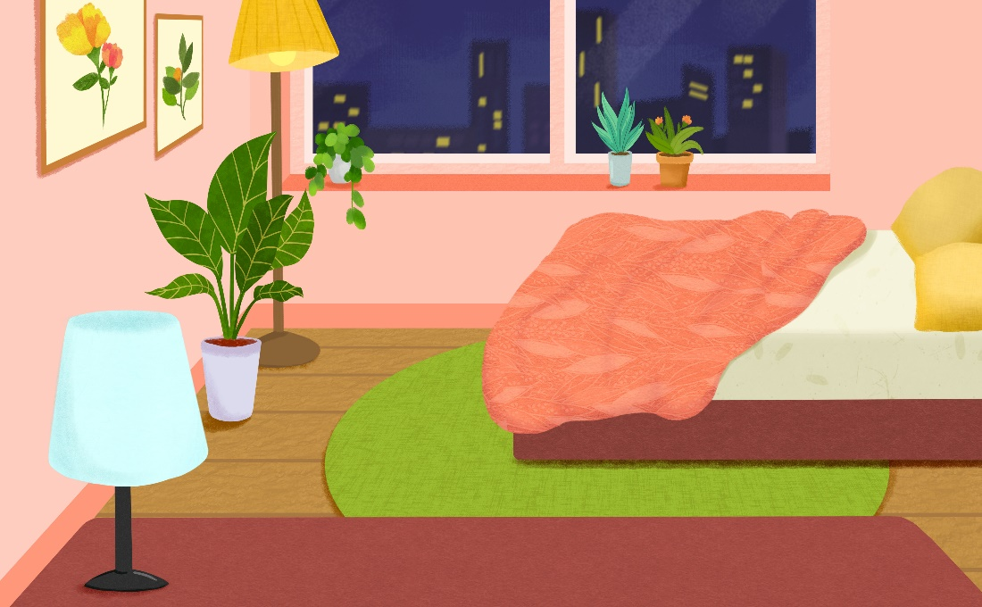
Where is the bedroom?
It’s there.

Slide 12
Where are the lamps?
They’re on the table.

Slide 13
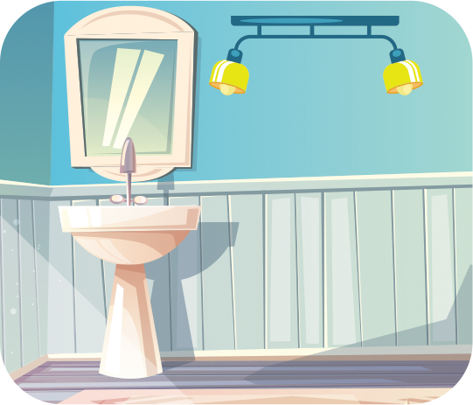
Where are the lamps?
They’re in the bathroom.

Slide 14
Where are the books?
They’re on the table.

Slide 15
__________________?
Where are the chairs?
They’re in the living room.

Slide 16
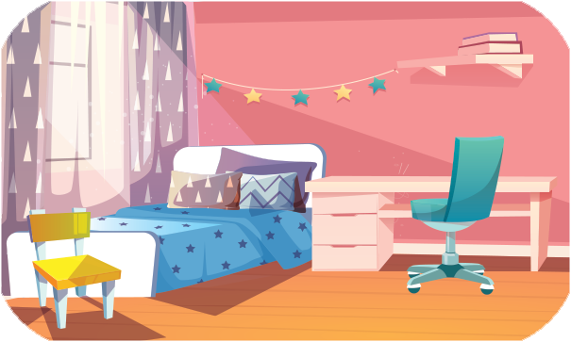
__________________?
Where are the chairs?
They’re in the bedroom.

Slide 17
Homework
Learn new words and model sentences
Prepare new lesson Unit 14 Lesson 1- P 1, 2, 3

Slide 18
Thank you!

