Slide 1
DAI LOC DEPARTMENT OF EDUCATION AND TRAINING
DAI QUANG PRIMARY SCHOOL
WELCOME TO OUR CLASS !
Subject: English 3
Class: 3D
Teacher: Pham Thi My Chau

Slide 2
Warm-up

Slide 3
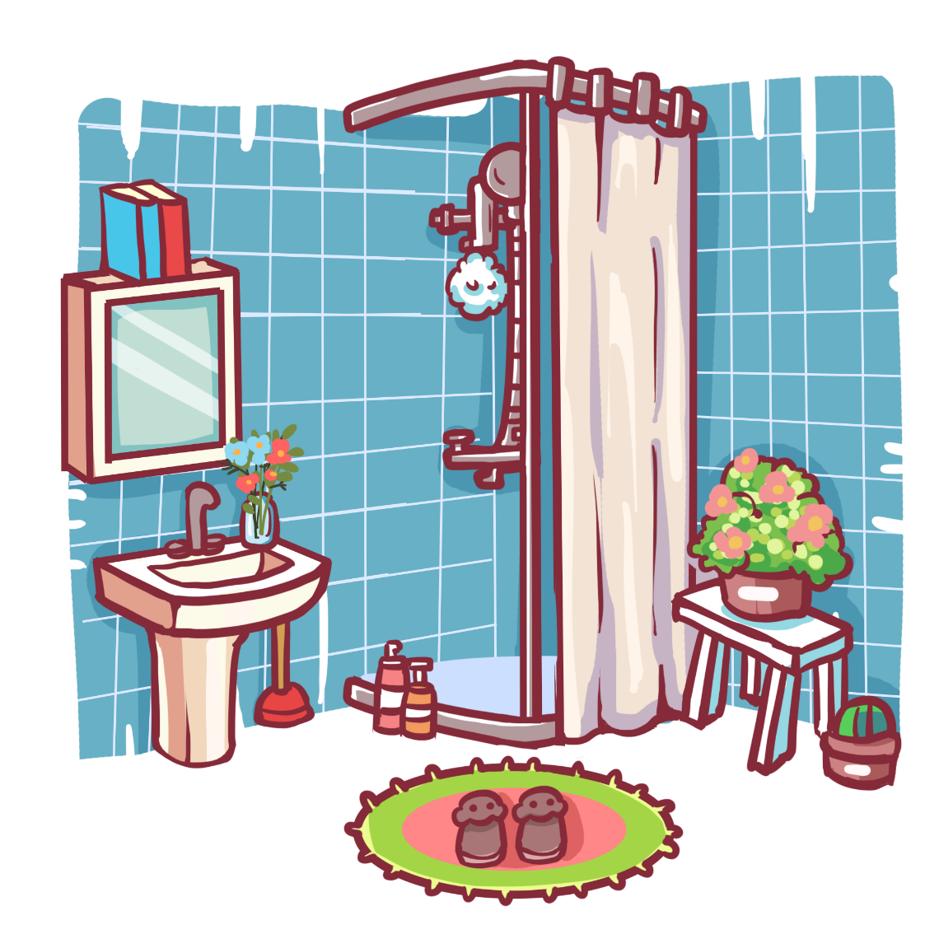
Can you guess?
Facebook : Bùi Liễu
0968142780
bathroom

Slide 4
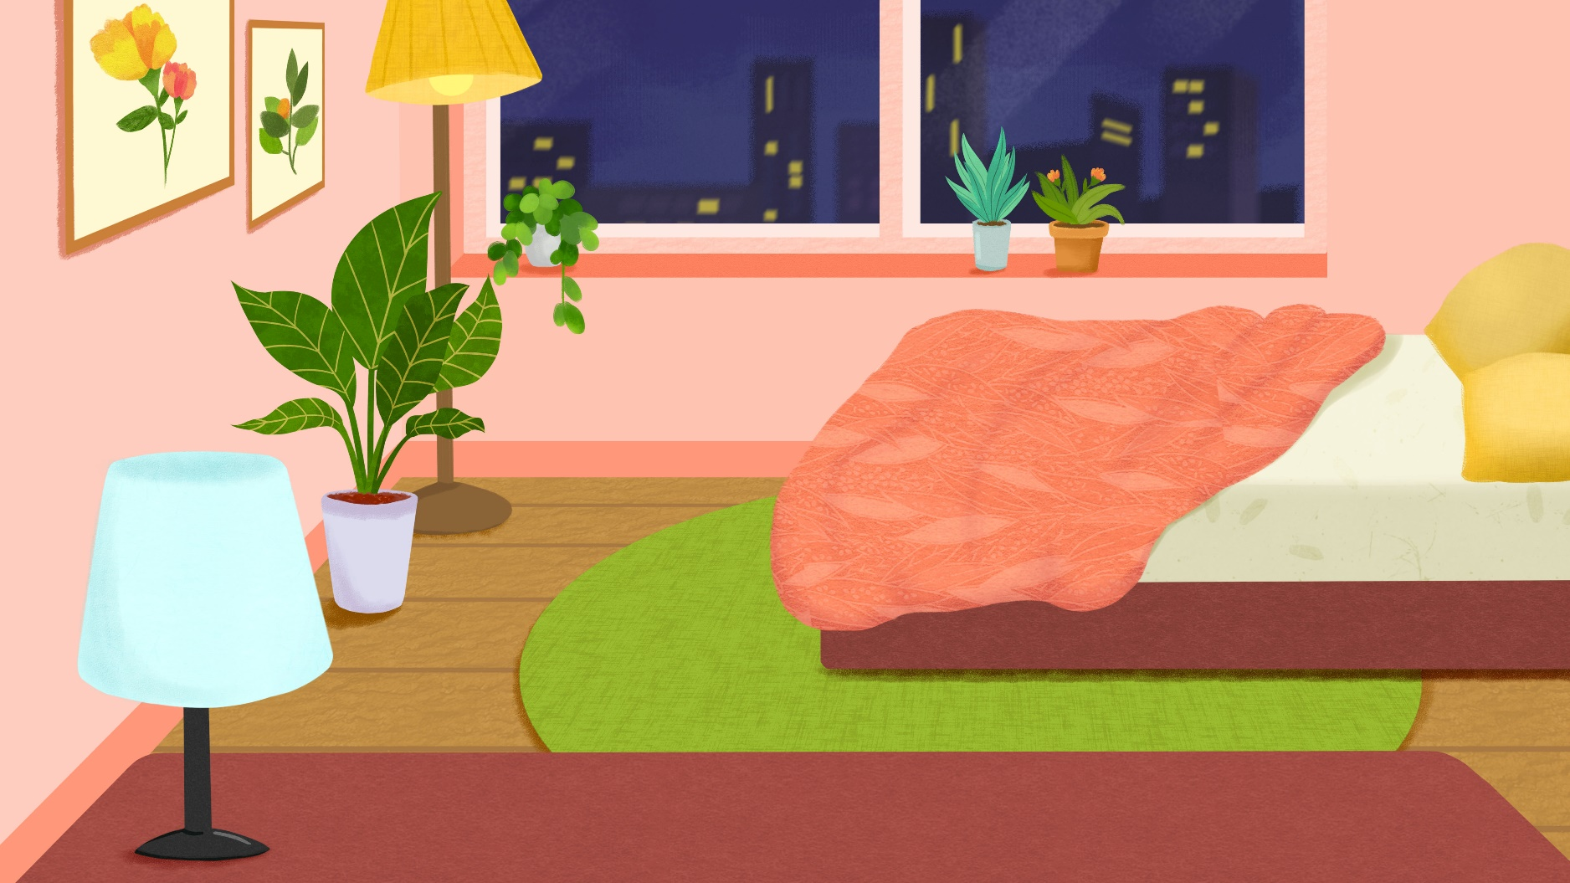
Can you guess?
Facebook : Bùi Liễu
0968142780
bedroom

Slide 5
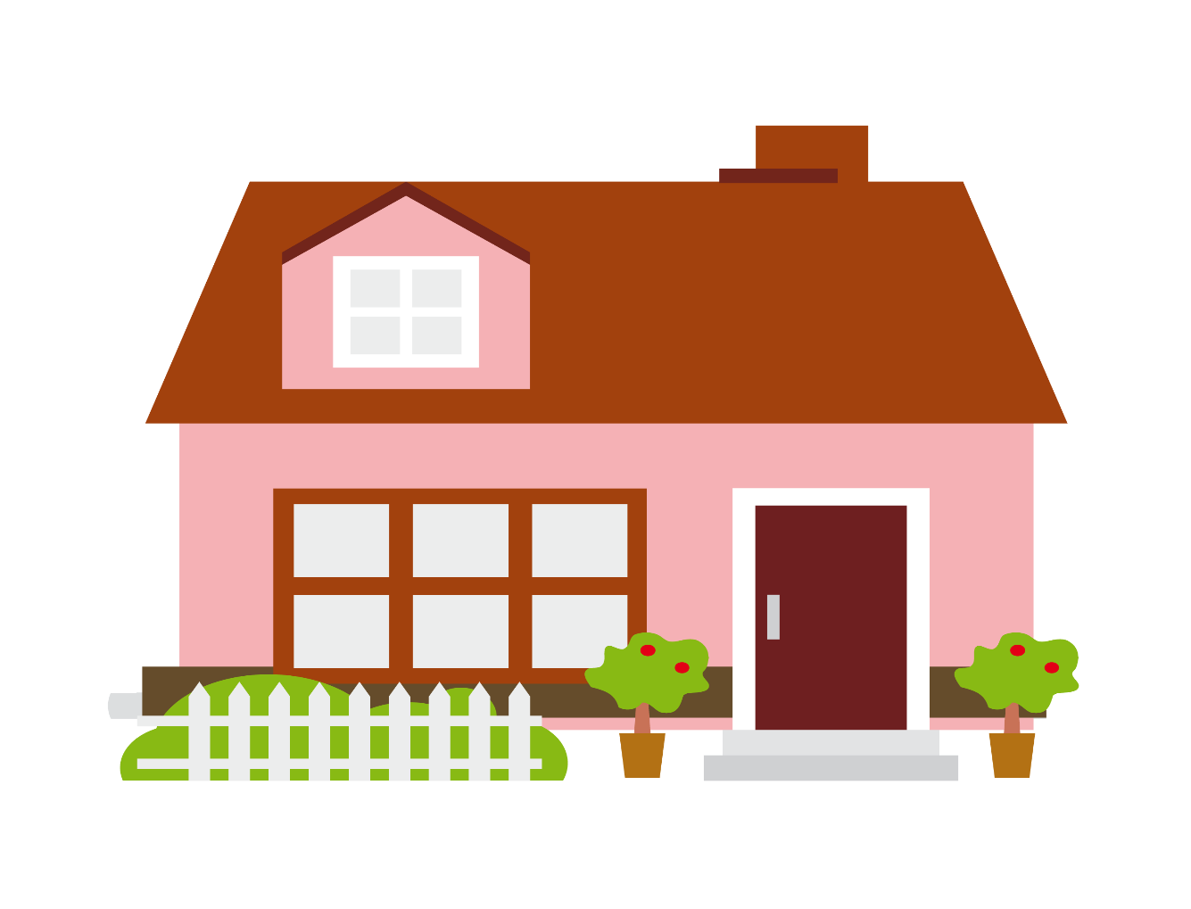
Can you guess?
Facebook : Bùi Liễu
0968142780
house

Slide 6
Can you guess?
Facebook : Bùi Liễu
0968142780
kitchen

Slide 7
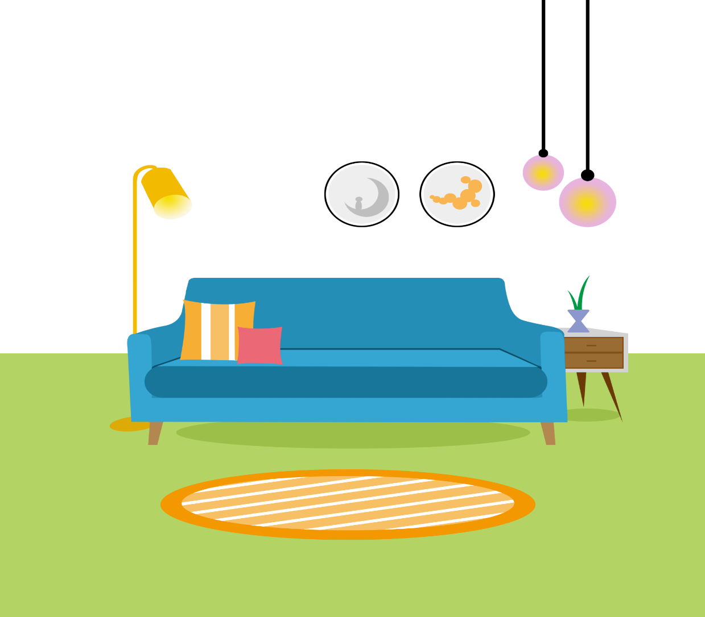
Can you guess?
Facebook : Bùi Liễu
0968142780
living room

Slide 8
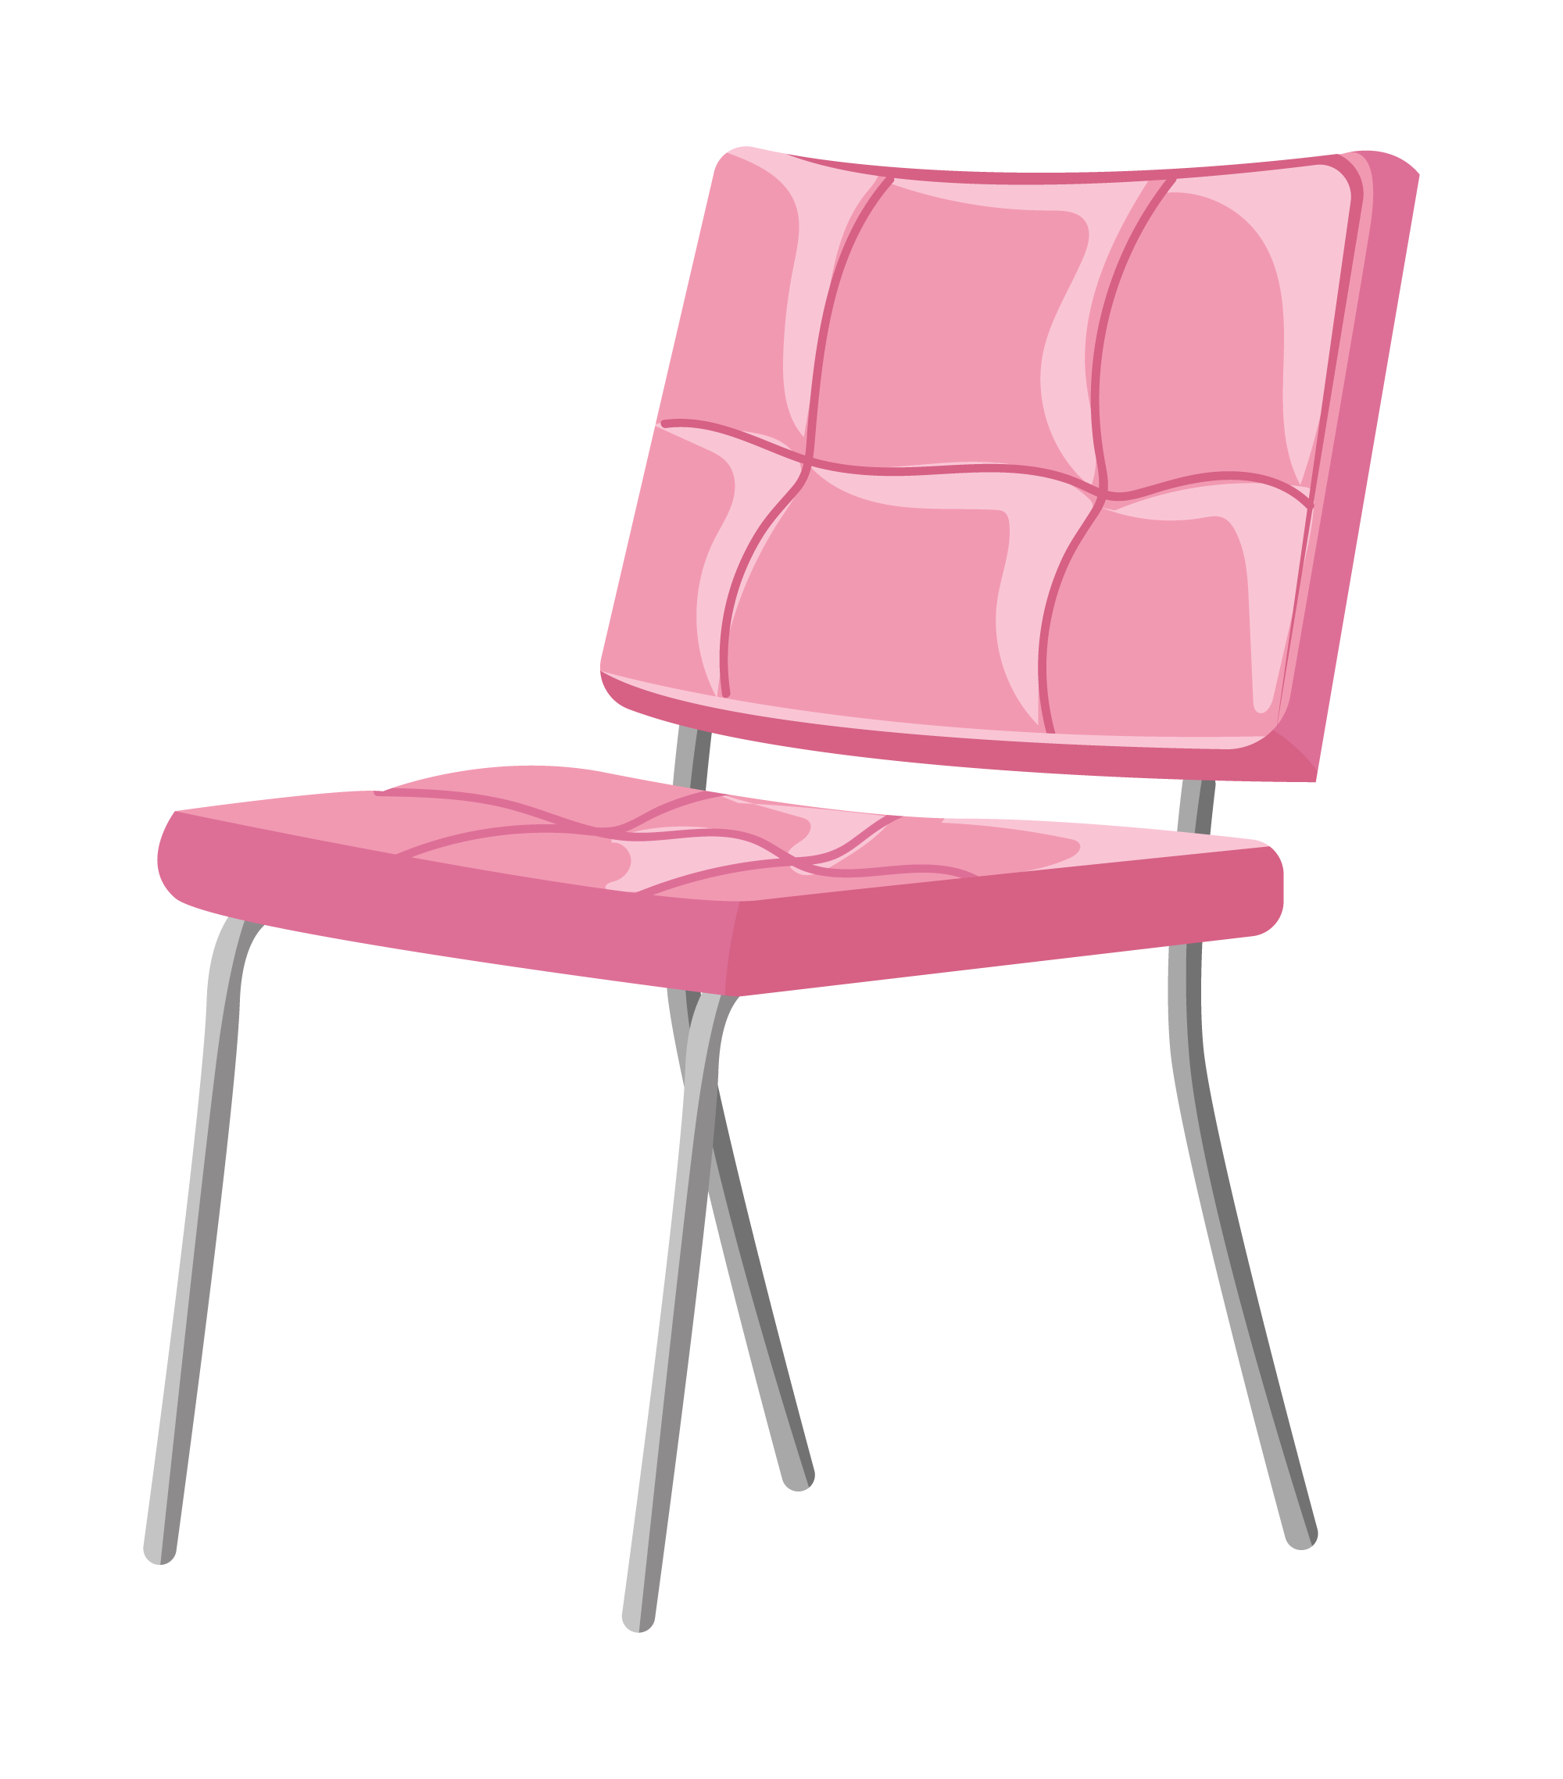
Can you guess?
chair

Slide 9
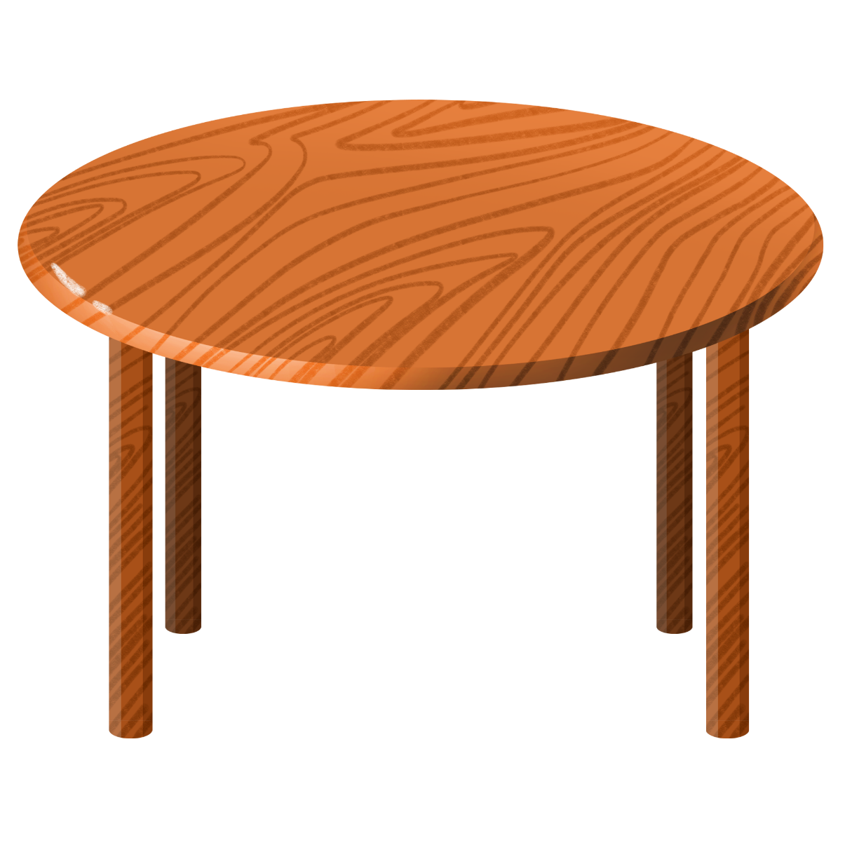
Can you guess?
table

Slide 10
Can you guess?
lamp

Slide 11
Well done!

Slide 12
UNIT 14: MY BEDROOM
Thursday, February 22nd, 2024
*Lesson 1:
Part: 1, 2, 3

Slide 13
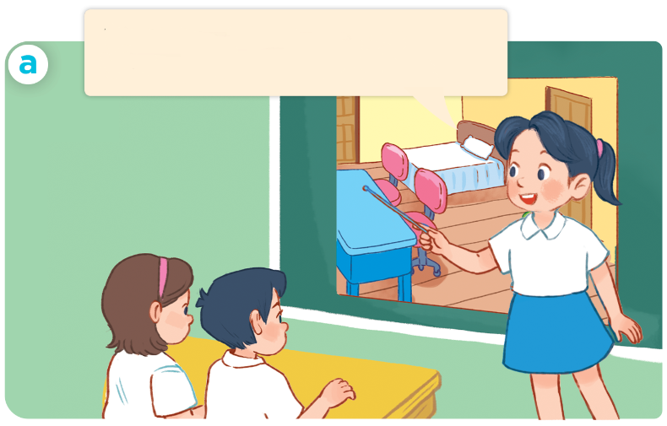
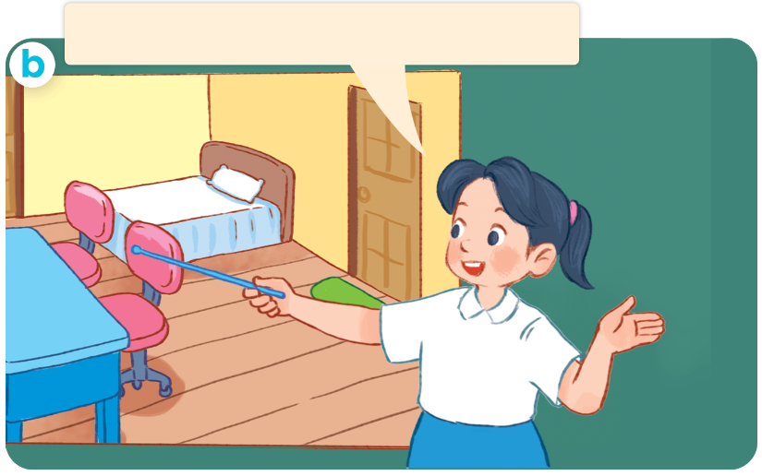
1. Look, listen and repeat.
This is my bedroom.
There’s a desk in the room.
There are two chairs in the room.
Who are they?
Where are they?
What are they doing?

Slide 14
Vocabulary

Slide 15
door
/dɔːr/
cái cửa

Slide 16
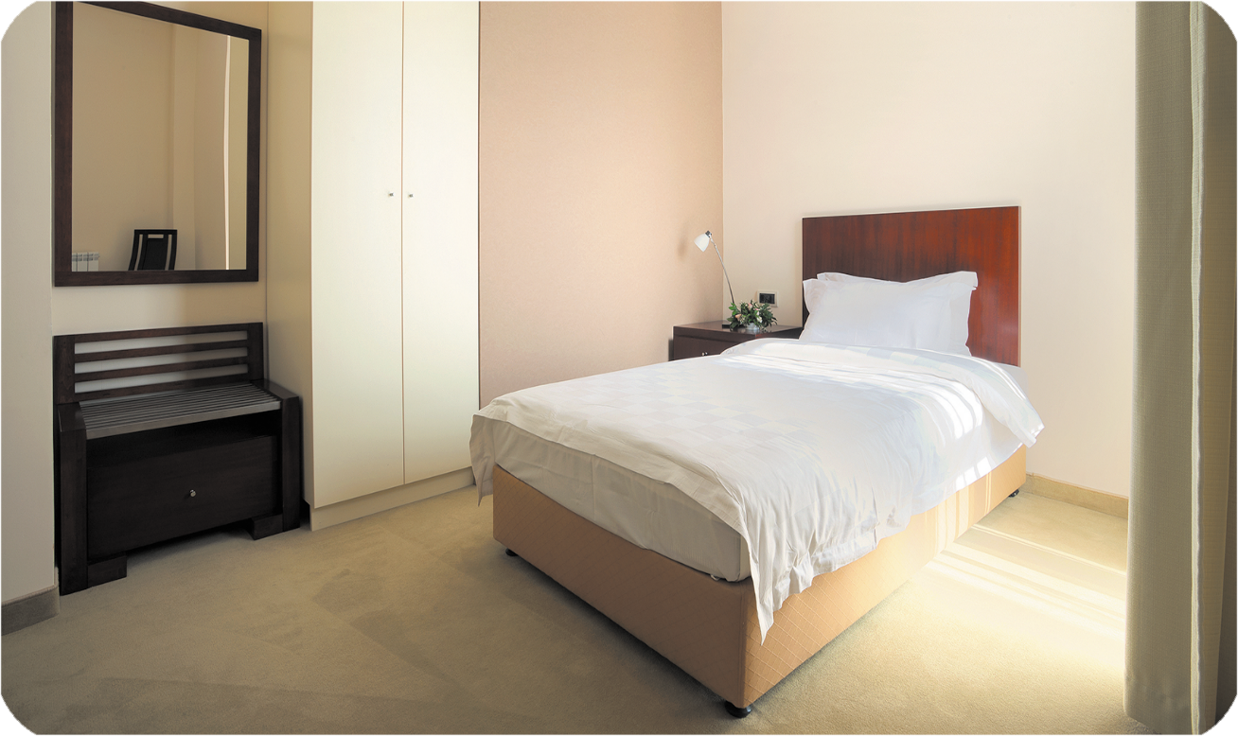
bed
/bed/
cái giường

Slide 17
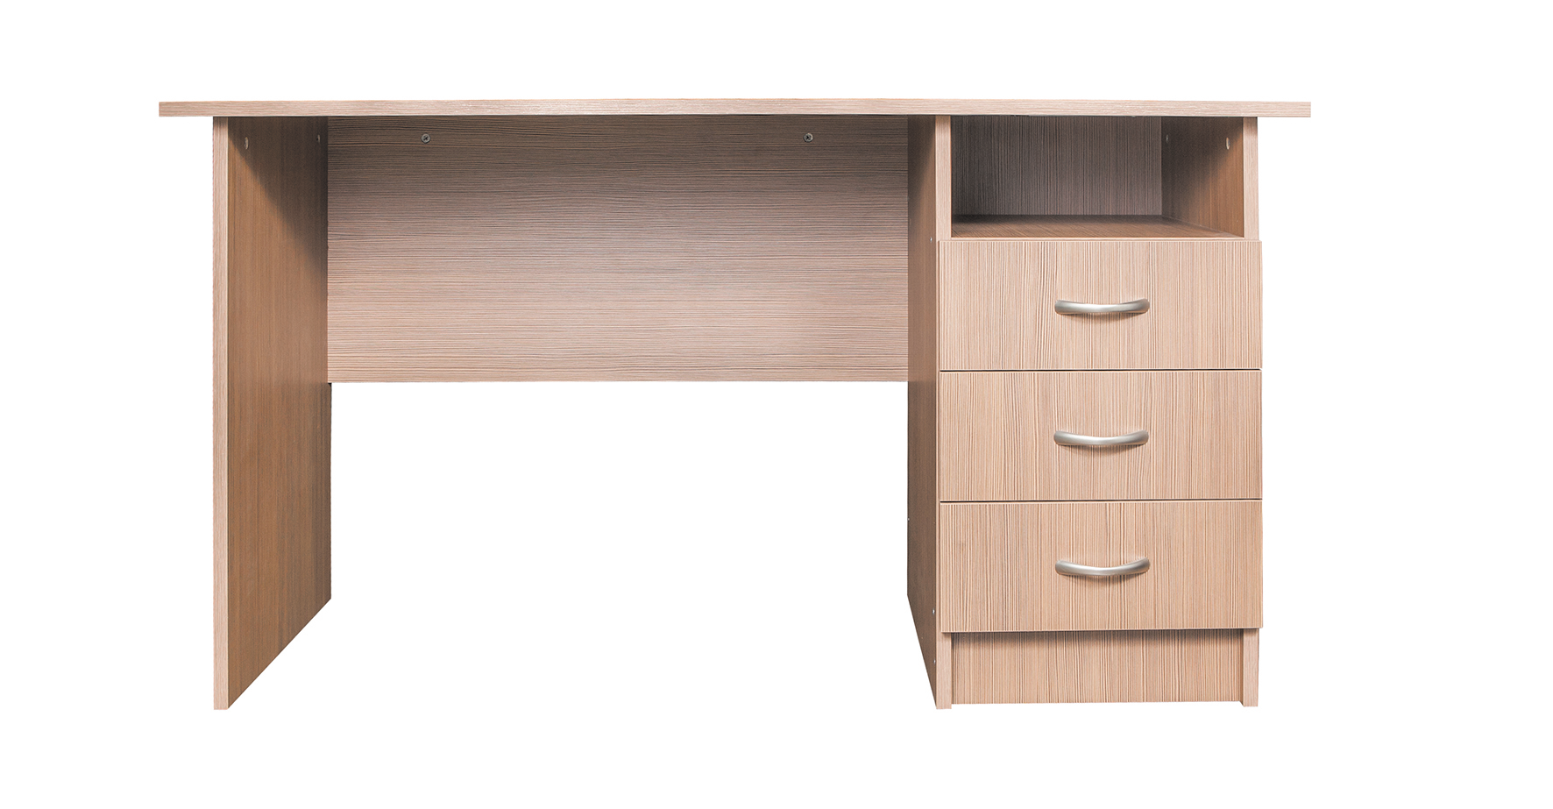
desk
/desk/
cái bàn (học sinh)

Slide 18
window
/ˈwɪn.dəʊ/
cửa sổ

Slide 19
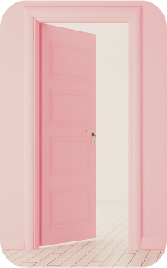
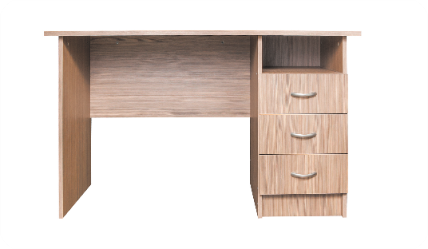
Review
door
bed
desk
window

Slide 20
Vocabulary
door cửa ra vào
bed cái giường
desk cái bàn (học sinh)
window cửa sổ

Slide 21
Structures

Slide 22
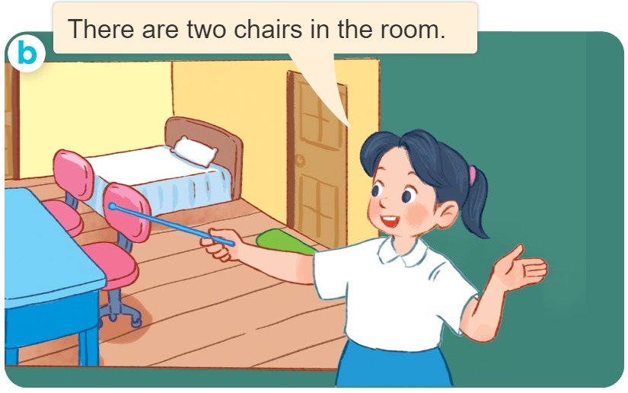
Structures
Cách nói về số lượng đồ vật ở trong phòng.
- There’s ____ in the room.
- There are ____ in the room.
( Có 1 ____ ở trong phòng)
(Có _______ ở trong phòng
there’s = there is

Slide 23
2. Listen, point and say.
a
b
There’s ____ in the room.
There are ____ in the room.
a desk
a bed
c
d
two doors
two windows

Slide 24
a desk
There’s a desk in the room.

Slide 25
a bed
There’s a bed in the room.

Slide 26
two doors
There are two doors in the room.

Slide 27
two windows
There are two windows in the room.

Slide 28
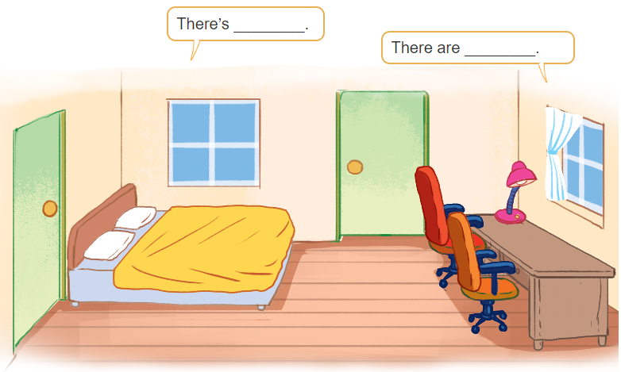
3. Let’s talk

Slide 29
3. Let’s talk
There are two windows
in the room.
There’s a bed
in the room

Slide 30
3. Let’s talk
There’s a lamp
in the room.
There are two chairs in the room.

Slide 31
3. Let’s talk
Bùi Liễu
There is a desk
in the room.
There are two doors
in the room.

Slide 32
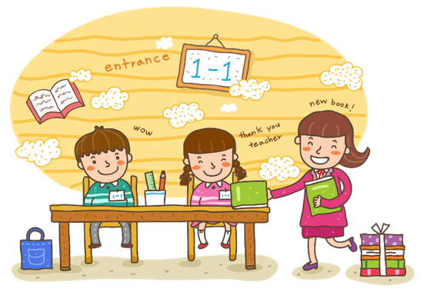
Wrap up

Slide 33
Vocabulary
door
bed
desk
window

Slide 34
Structures
Cách nói về số lượng đồ vật ở trong phòng.
- There’s ____ in the room.
- There are ____ in the room.
( Có 1 ____ ở trong phòng)
(Có _______ ở trong phòng
there’s = there is

Slide 35
Homework
Learn by heart all the new words.
Read again the dialogue in part 1.

Slide 36
Thank you!

