Slide 1



DAI LOC DEPARTMENT OF EDUCATION AND TRAINING
DAI QUANG PRIMARY SCHOOL
WELCOME TO OUR CLASS !
Subject: English 3
Class: 3E
Teacher: Pham Thi My Chau

Slide 2

Warm-up

Slide 3
Let’s play!

Slide 4












Notes:
Facebook : Bùi Liễu
Mobile phone: 0968142780

Slide 5




Facebook : Bùi Liễu
0968142780
A. door
B. doors
Notes:
Facebook : Bùi Liễu
Mobile phone: 0968142780

Slide 6
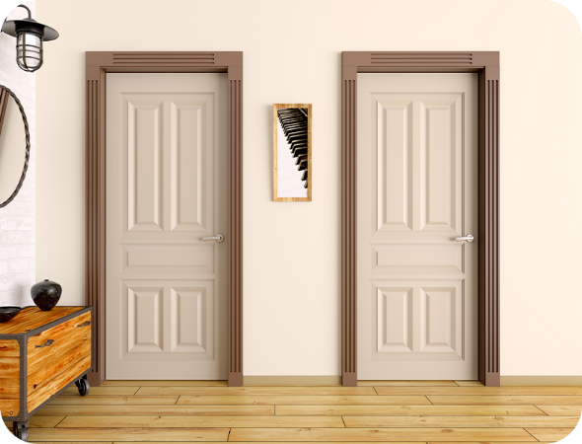
A. door
B. doors
Notes:
Facebook : Bùi Liễu
Mobile phone: 0968142780

Slide 7
Facebook : Bùi Liễu
0968142780
A. door
B. doors
Notes:
Facebook : Bùi Liễu
Mobile phone: 0968142780

Slide 8
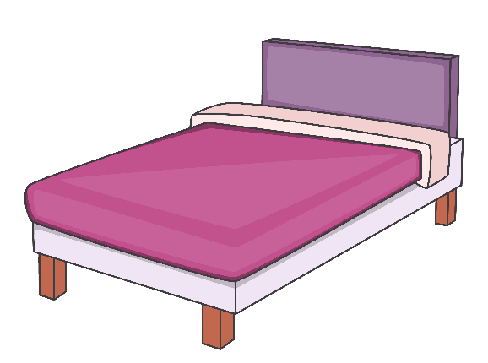
A. beds
B. bed
Notes:
Facebook : Bùi Liễu
Mobile phone: 0968142780

Slide 9


Facebook : Bùi Liễu
0968142780
A. beds
B. bed
Notes:
Facebook : Bùi Liễu
Mobile phone: 0968142780

Slide 10

Facebook : Bùi Liễu
0968142780
A. desks
B. desk
Notes:
Facebook : Bùi Liễu
Mobile phone: 0968142780

Slide 11
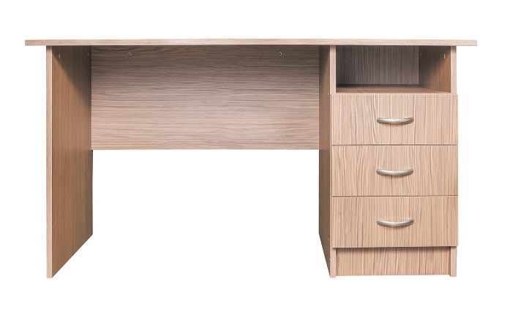
Facebook : Bùi Liễu
0968142780
A. desk
B. desks
Notes:
Facebook : Bùi Liễu
Mobile phone: 0968142780

Slide 12

Facebook : Bùi Liễu
0968142780
A. window
B. windows
Notes:
Facebook : Bùi Liễu
Mobile phone: 0968142780

Slide 13
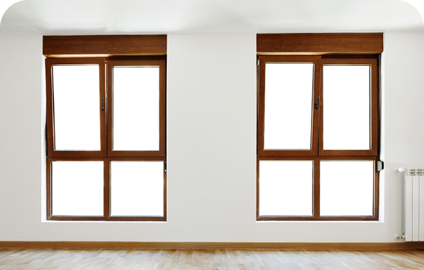
A. window
B. windows
Notes:
Facebook : Bùi Liễu
Mobile phone: 0968142780

Slide 14
Facebook : Bùi Liễu
0968142780
A.windows
B.window
Notes:
Facebook : Bùi Liễu
Mobile phone: 0968142780

Slide 15
A. bed
B. door
C. window
Notes:
Facebook : Bùi Liễu
Mobile phone: 0968142780

Slide 16

Facebook : Bùi Liễu
0968142780
1
2
3
4
5
6
A. beds
B. desks
C. doors
Notes:
Facebook : Bùi Liễu
Mobile phone: 0968142780

Slide 17

Facebook : Bùi Liễu
0968142780
1
2
3
4
5
6
A. windows
B. doors
C. beds
Notes:
Facebook : Bùi Liễu
Mobile phone: 0968142780

Slide 18
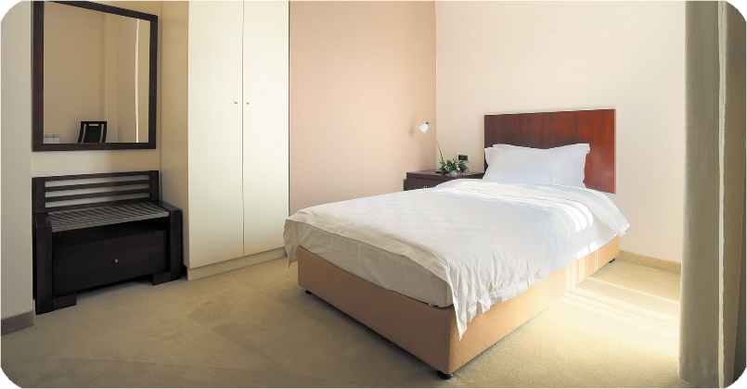
1
2
3
4
5
6
A. bed
B. desk
C. window
Notes:
Facebook : Bùi Liễu
Mobile phone: 0968142780

Slide 19

Facebook : Bùi Liễu
0968142780
There’s _____
in the room.
A. a desk
B. 2 desks
Notes:
Facebook : Bùi Liễu
Mobile phone: 0968142780

Slide 20
Facebook : Bùi Liễu
0968142780
_____ a lamp in the room.
A. There is
B. There are
Notes:
Facebook : Bùi Liễu
Mobile phone: 0968142780

Slide 21
Facebook : Bùi Liễu
0968142780
There are _____
in the room.
A. 2 beds
B. a bed
Notes:
Facebook : Bùi Liễu
Mobile phone: 0968142780

Slide 22


Facebook : Bùi Liễu
0968142780
EXIT

Slide 23


UNIT 14: MY BEDROOM
Monday, February 26th, 2024
*Lesson 2:
Part: 1, 2, 3

Slide 24

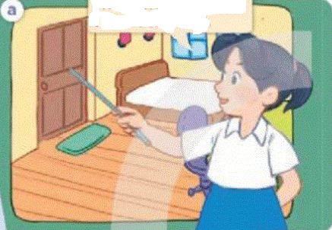
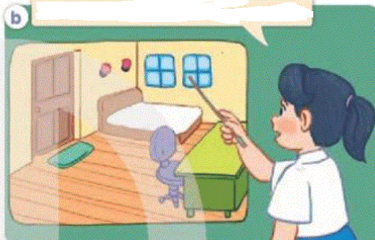
1. Look, listen and repeat.
This is my bedroom.
The door is big.
And look! The windows are small.
Who are they?
Where are they?
What are they doing?

Slide 25
Vocabulary

Slide 26

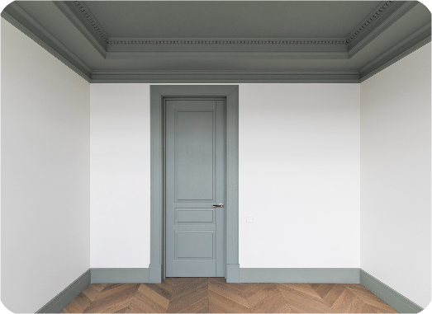
big
/bɪɡ/
to, lớn

Slide 27
small
/smɔːl/
nhỏ, bé

Slide 28
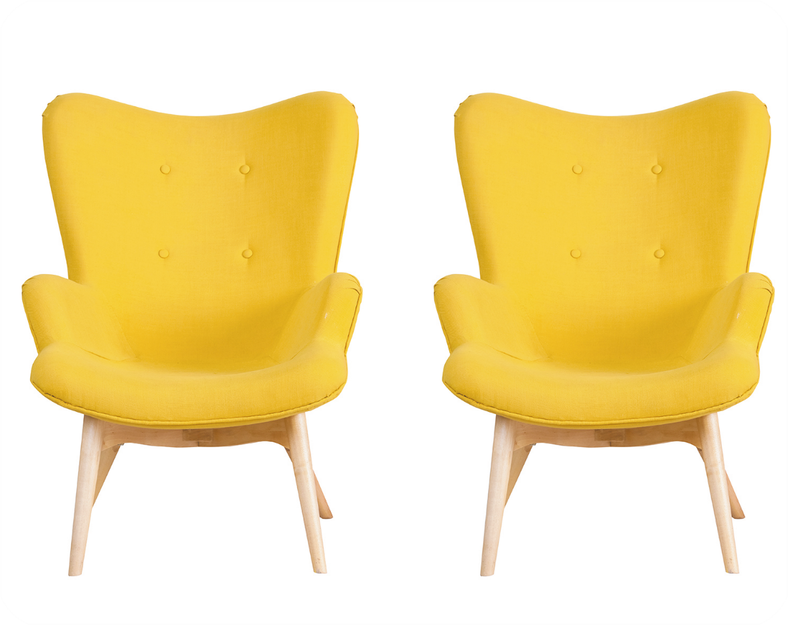
new
/njuː/
mới

Slide 29

old
/əʊld/
cũ

Slide 30

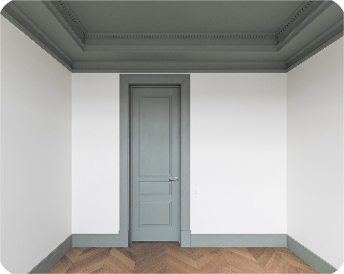


Review
big
small
new
old

Slide 31
Structures

Slide 32
Vocabulary
big to, lớn
small nhỏ, bé
new mới
old cũ

Slide 33
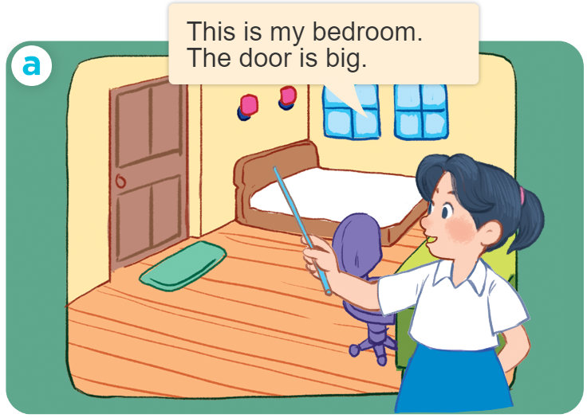
Structures
Cách miêu tả đồ vật ở trong phòng.
- The _____ is _______.
- The _____ are ______.
Example:

Slide 34

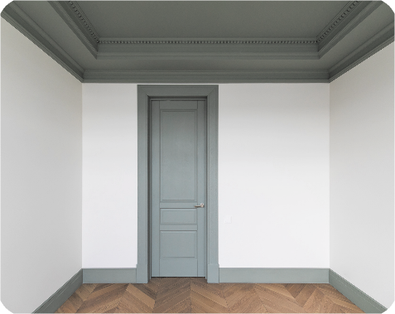


2. Listen, point and say.
a
b
The ____ is ______.
door / big
door / small
c
d
The ____ are ______.
chairs / new
chairs / old

Slide 35
a
door / small
The door is small.

Slide 36
b
door / big
The door is big.

Slide 37
c
chairs / new
The chairs are new.

Slide 38
d
chairs / old
The chairs are old.

Slide 39
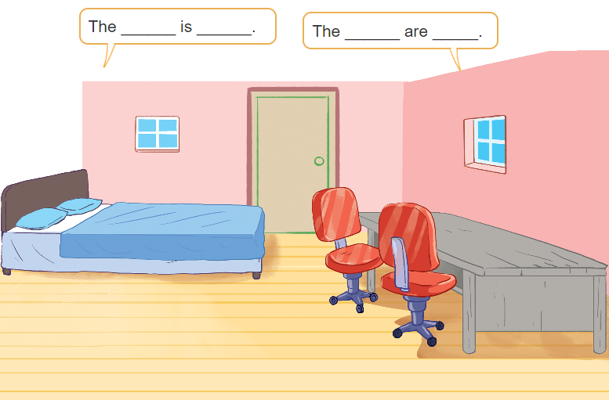
3. Let’s talk

Slide 40
3. Let’s talk
The _______ are _____.
windows small
The ____ is __ _.
door big

Slide 41
3. Let’s talk
The _______ are _____.
chairs old
The ____ is __ _.
bed big

Slide 42
3. Let’s talk
The _______ are _____.
The ____ is ___.
desk old

Slide 43
Let’s play!
The lucky number

Slide 44

3
4
2
6
5
1
end

Slide 45


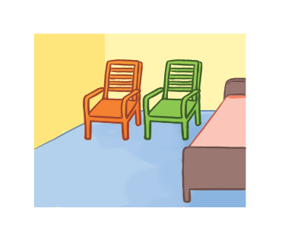
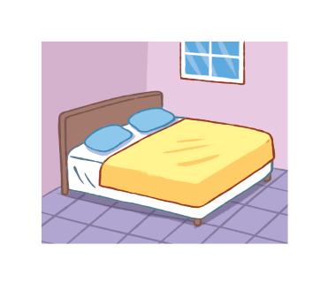
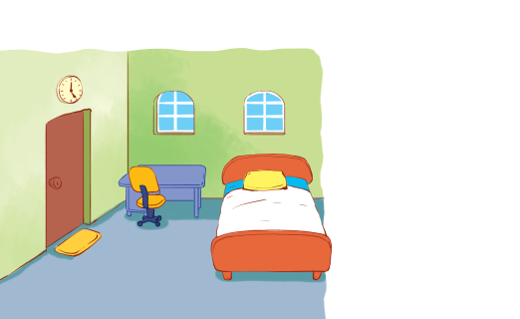
There are two chairs in my bedroom. They’re new.
+ 5
A
B
C
back

Slide 46

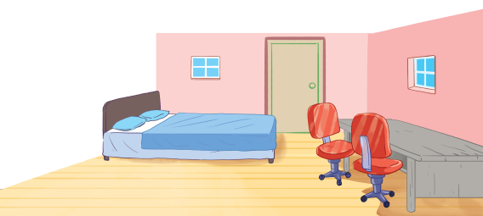
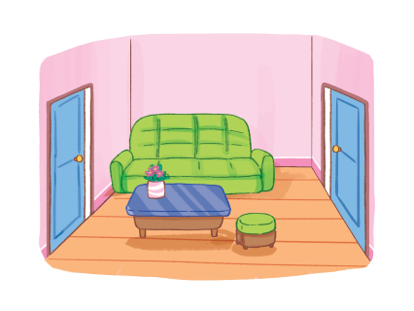
There is a window in the living room. It’s big.
+ 4
A
B
C
back

Slide 47
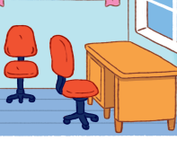
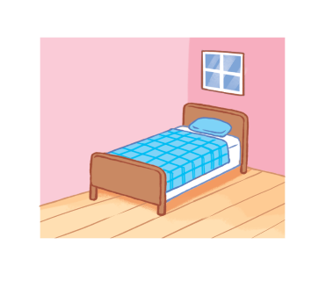
There is a bed in my bedroom. It’s old.
+ 2
A
B
C
back

Slide 48
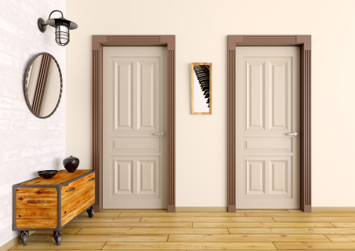
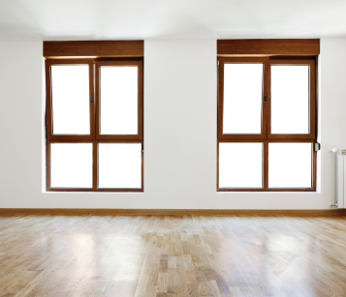
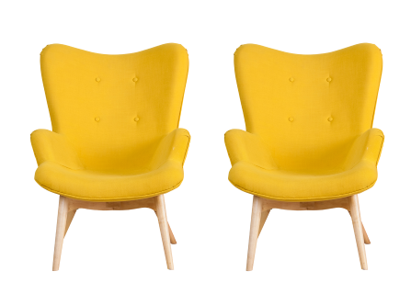
There are two chairs. They’re big.
+ 3
A
B
C
back

Slide 49
There are two doors in the living room. They’re small.
+ 5
A
B
C
back

Slide 50
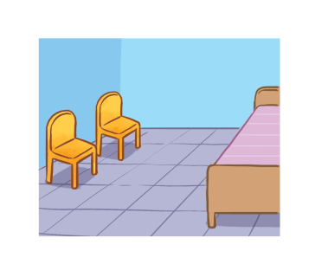
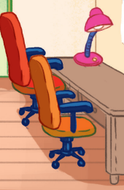
There is a lamp. It’s old.
+ 4
A
B
C
back

Slide 51
Homework
Learn by heart all the new words.
Read again the dialogue in part 1.

Slide 52

Facebook : Bùi Liễu
0968142780
Thank you!

