Slide 1



DAI LOC DEPARTMENT OF EDUCATION AND TRAINING
DAI QUANG PRIMARY SCHOOL
WELCOME TO OUR CLASS !
Subject: English 3
Class: 3D
Teacher: Pham Thi My Chau

Slide 2

Warm-up

Slide 3
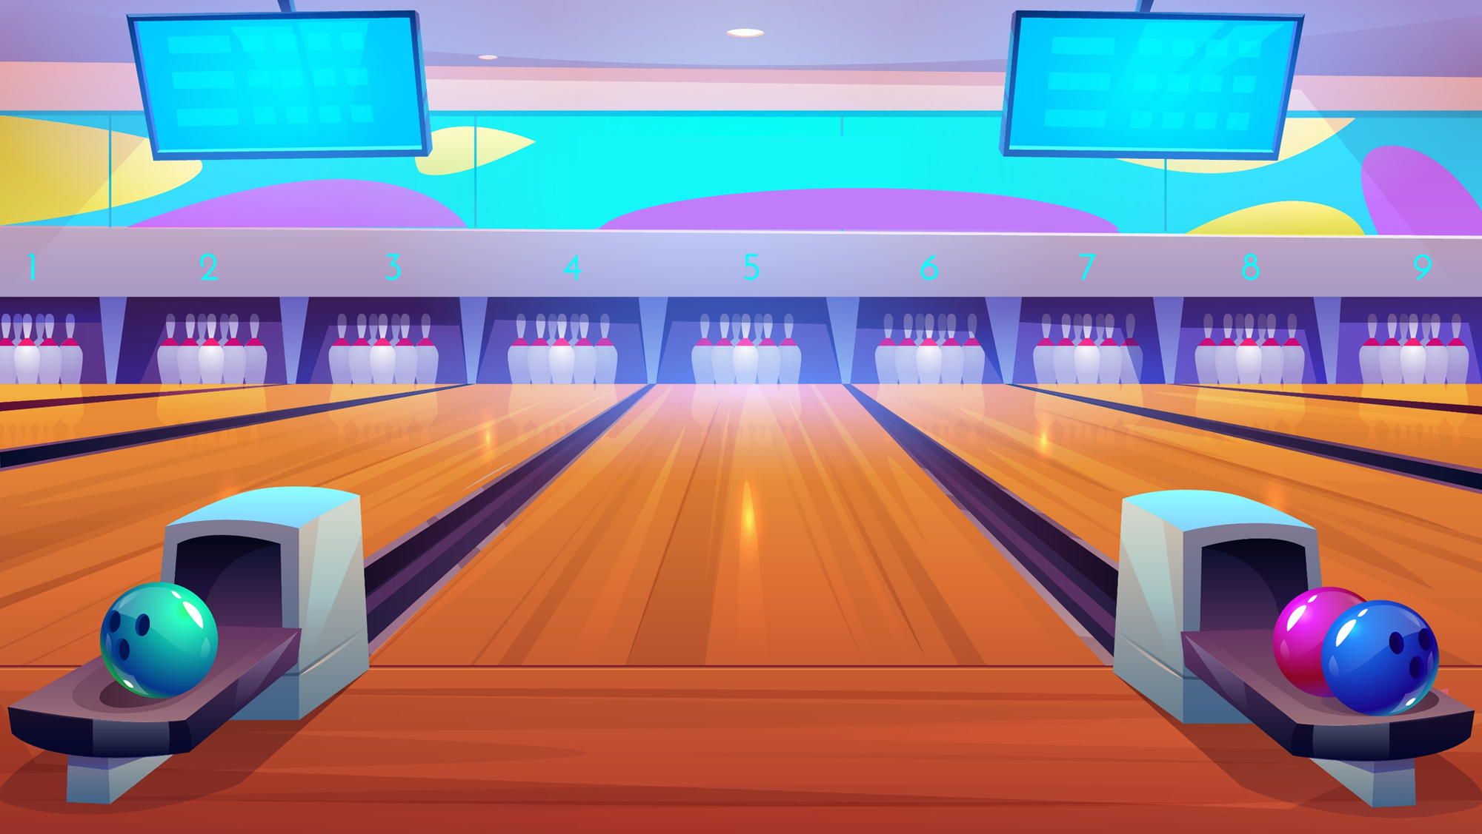




BOWLING
GAME
Notes:
Bùi Liễu

Slide 4
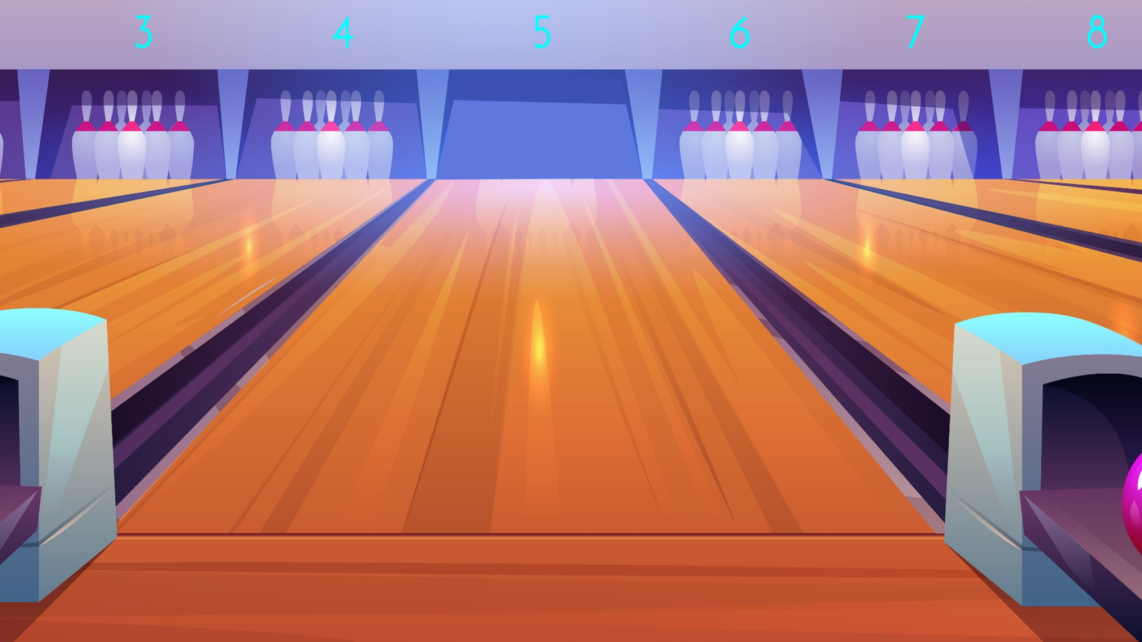

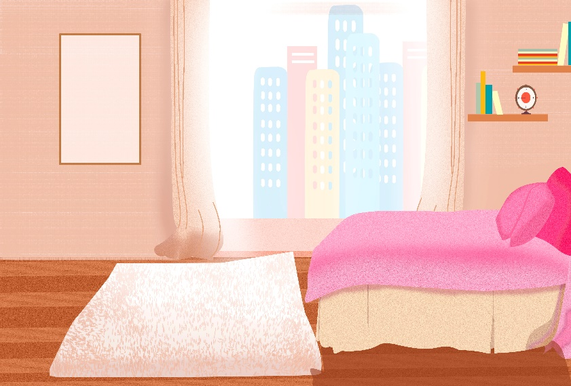


A. bedroom
B. kitchen
C. living room
D. bathroom

Slide 5
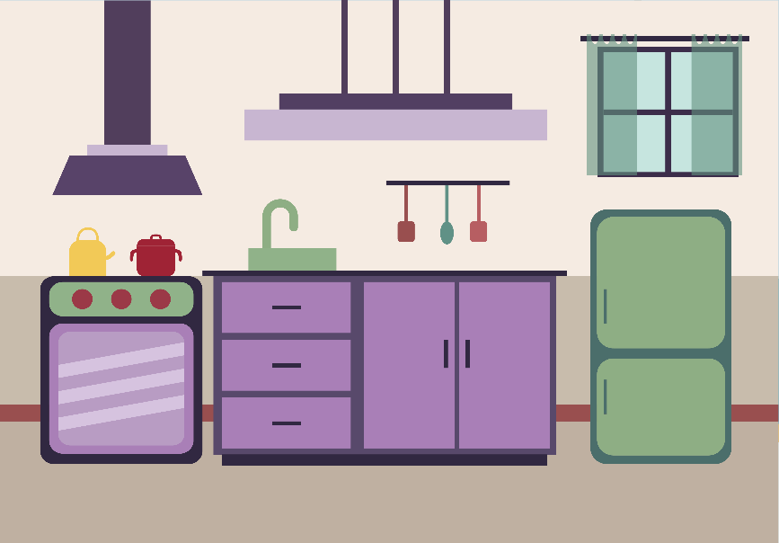
A. living room
B. kitchen
C. bathroom
D. bedroom

Slide 6
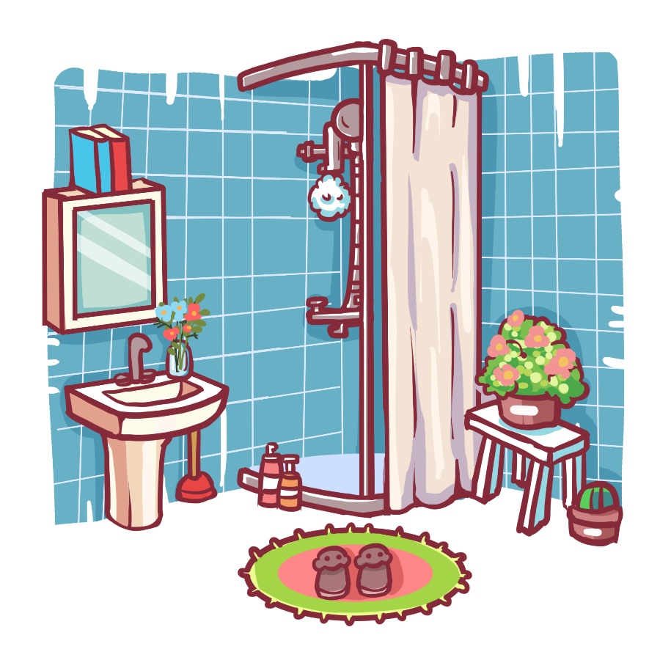
A. bedroom
B. kitchen
C. bathroom
D. living room

Slide 7

A. kitchen
B. bathroom
C. bedroom
D. living room
Next

Slide 8
_____ room
A. living
B. bed
C. bath
Next
Notes:
Bùi Liễu

Slide 9
A. kitchen
B. bedroom
C. living room
D. bathroom
Next

Slide 10
A. living room
B. bedroom
C. bathroom
D. kitchen
Next

Slide 11
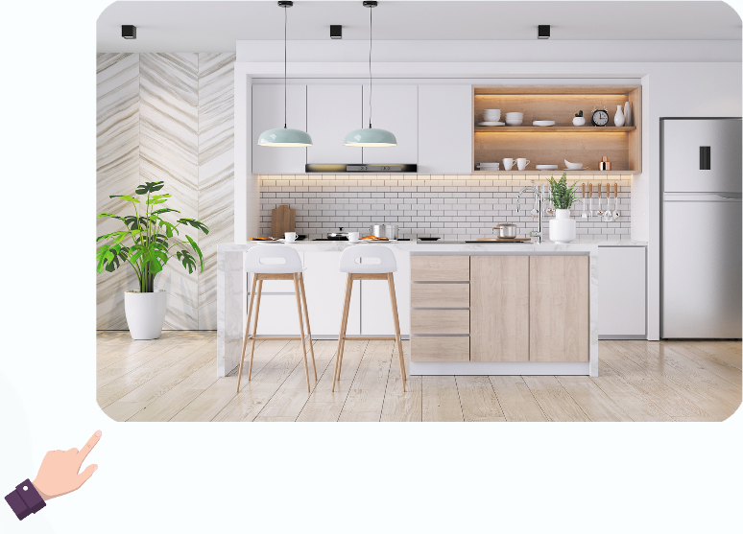
Where’s the kitchen?
A. It’s here.
B. It’s there.
Next

Slide 12
____ the living?
It’s there.
A. Where’s
B. What’s
C. Who’s
D. How’s

Slide 13
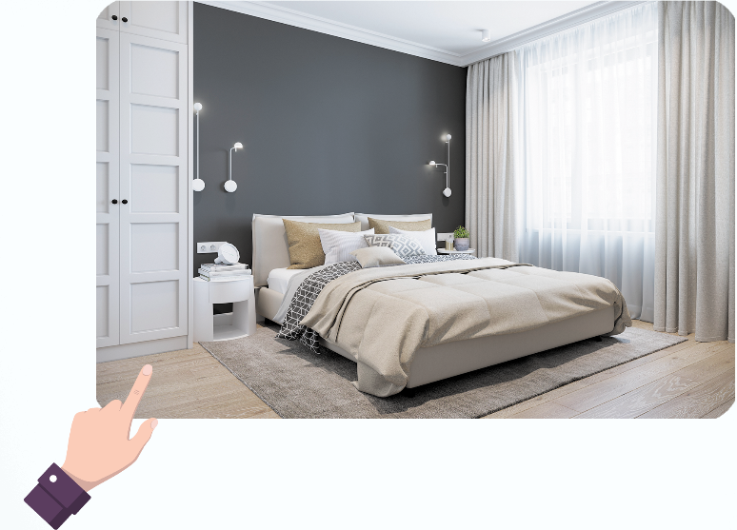
Where’s the _____?
A. living room
B. bedroom
Next

Slide 14
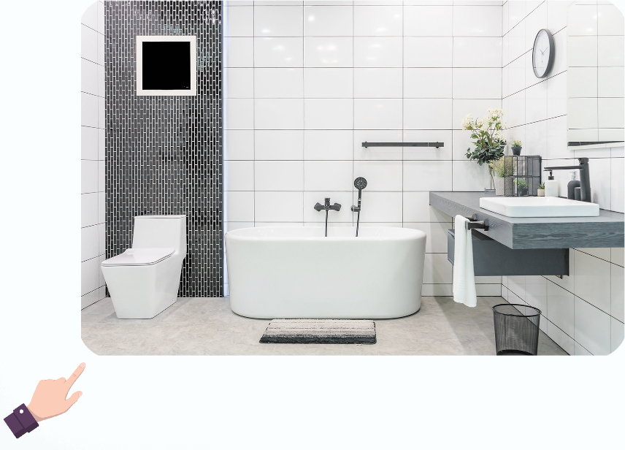
Where’s the bathroom?
It’s ____.
A. here
B. there
Next
Notes:
Bùi Liễu

Slide 15
Where’s the ______?
A. bathroom
B. living room
C. kitchen
Notes:
Bùi Liễu

Slide 16
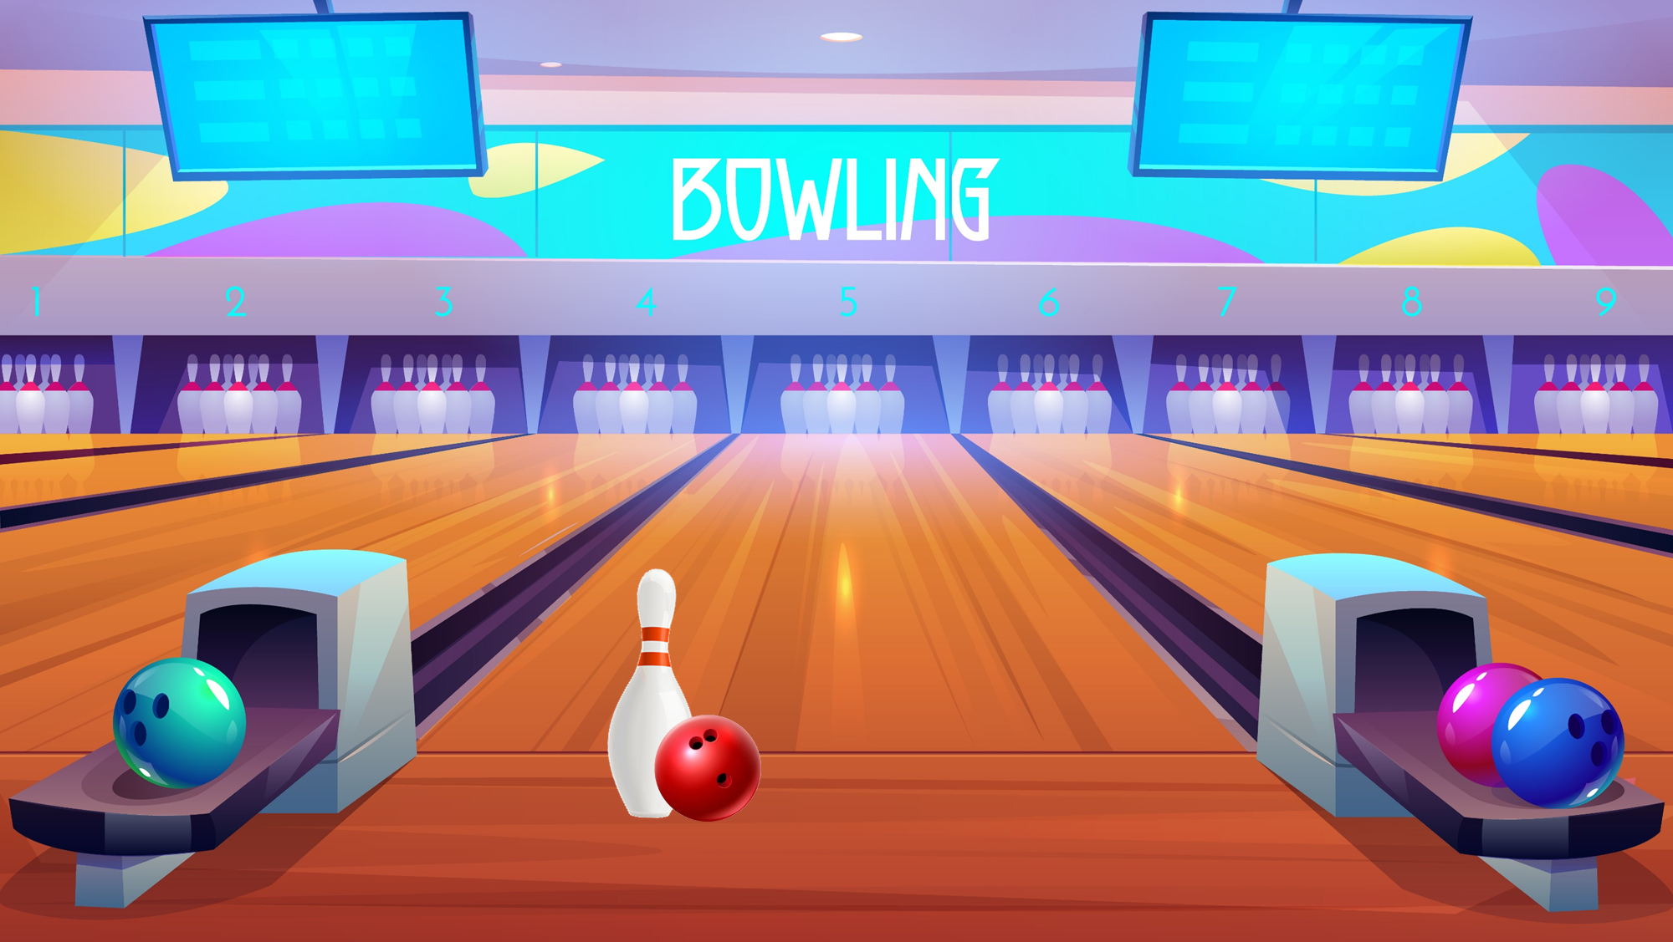



Slide 17


UNIT 13: MY HOUSE
Thursday, February 15th, 2024
*Lesson 1:
Part: 1, 2, 3

Slide 18


Slide 19
1/ Where’s the living room ?
It’s here.
2/ Where’s the bedroom ?
It’s there.

Slide 20
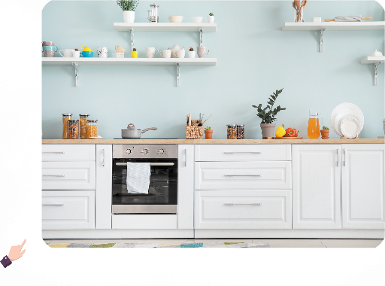
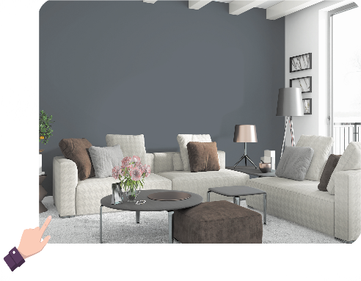
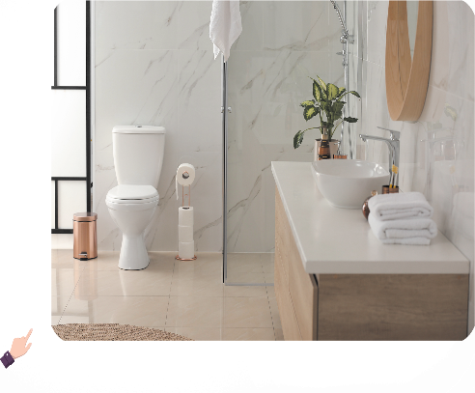
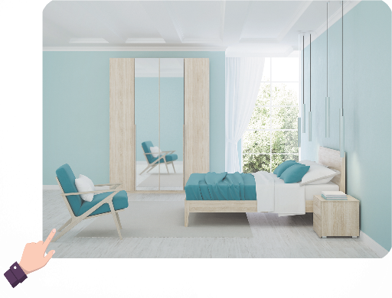
5. Look, complete and read.
1. A: Where’s the ____?
B: It’s here.
2. A: Where’s the ____?
B: It’s there.
3. A: Where’s the ____?
B: It’s ____.
4. A: Where’s the ____?
B: It’s ____.

Slide 21
5. Look, complete and read.
1. A: Where’s the __________?
B: It’s here.
living room

Slide 22
5. Look, complete and read.
2. A: Where’s the __________?
B: It’s there.
kitchen

Slide 23
5. Look, complete and read.
3. A: Where’s the __________?
B: It’s _______.
bathroom
there

Slide 24
5. Look, complete and read.
4. A: Where’s the __________?
B: It’s _____.
bedroom
here

Slide 25
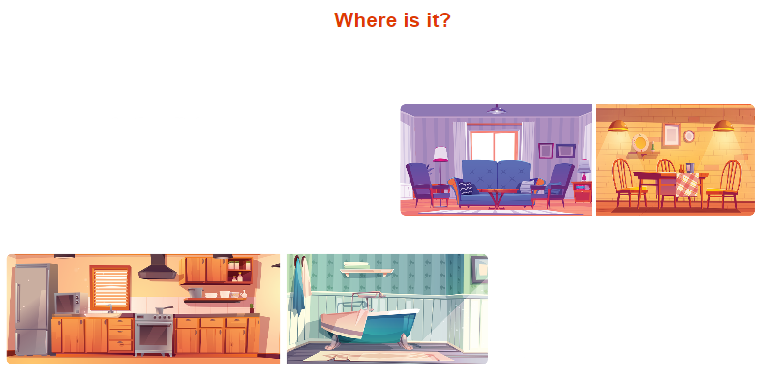
6. Let’s sing.
Where is it?
This is the living room.
Where’s the dining room?
Where is it?
It’s here. It’s here.
That is the kitchen.
Where’s the bathroom?
Where is it?
It’s there. It’s there.

Slide 26

6. Let’s sing.
Where is it?
This is the living room.
Where’s the dining room?
Where is it?
It’s here. It’s here.
That is the kitchen.
Where’s the bathroom?
Where is it?
It’s there. It’s there.

Slide 27

Wrap up

Slide 28

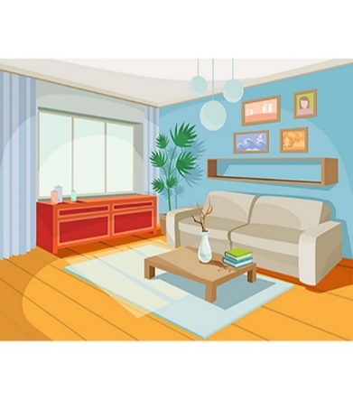
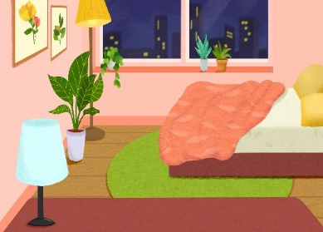

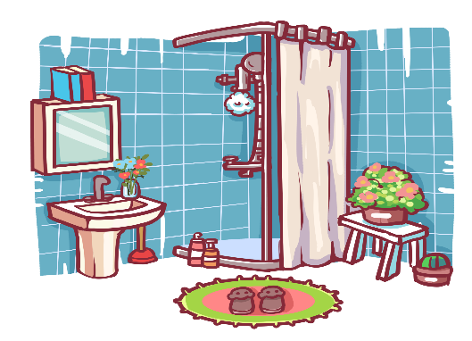
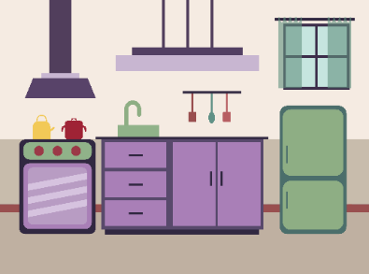


Review
house
living room
bedroom
kitchen
bathroom
here
there

Slide 29
Structures
Hỏi và trả lời về vị trí của căn phòng trong ngôi nhà
- Where’s the _________? It’s here / there.
( _________ ở đâu?)
where’s = where is
it’s = it is
(Nó ở đây/kia.)
Example
Mary: Where’s the living room?
Linh: It’s there.

Slide 30
Homework
Learn new words and model sentences
Prepare new lesson Lesson 2- P 1, 2, 3

Slide 31

Thank you!

