Slide 1
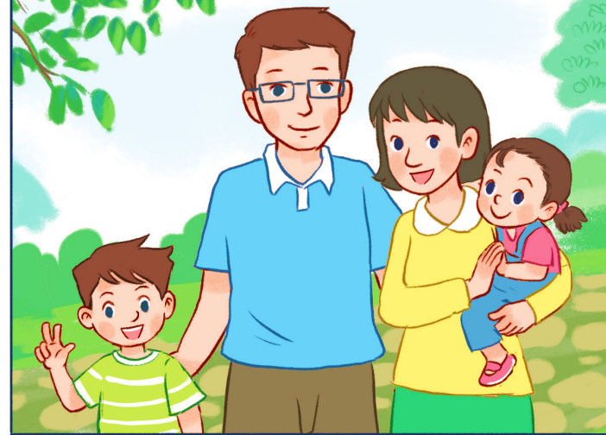
Thursday January 16th, 2024
My family
Unit
11
Lesson 1: P1+2+3
Facebook : Bùi Liễu
0968142780

Slide 2

Warm-up

Slide 3


Let’s chant.
What do you do at break time?
Football.
Football.
I play football.
I play football.
What do you do at break time?
Volleyball.
Volleyball.
I play volleyball.
I play volleyball.

Slide 4



Contents
Facebook : Bùi Liễu
0968142780
Look, listen and repeat.
Listen, point and say.
Let’s talk.

Slide 5
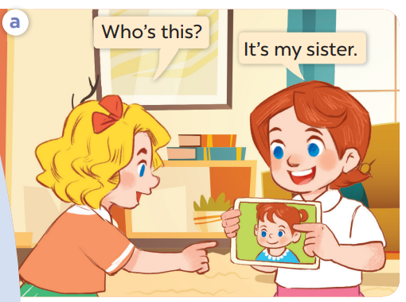
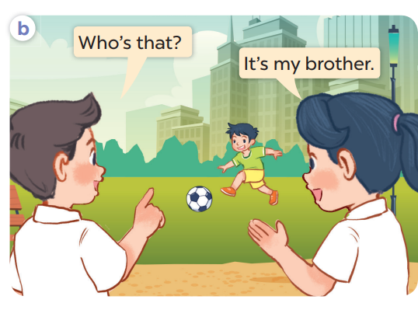
1. Look, listen and repeat.

Slide 6
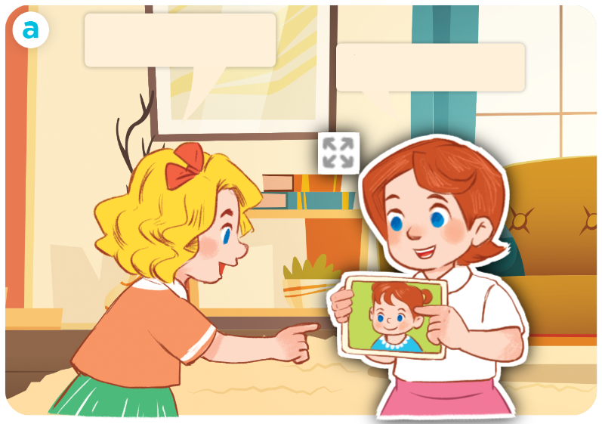
1. Look, listen and repeat.
Click on the sentence to hear the sound.
Who’s this?
It’s my sister.

Slide 7
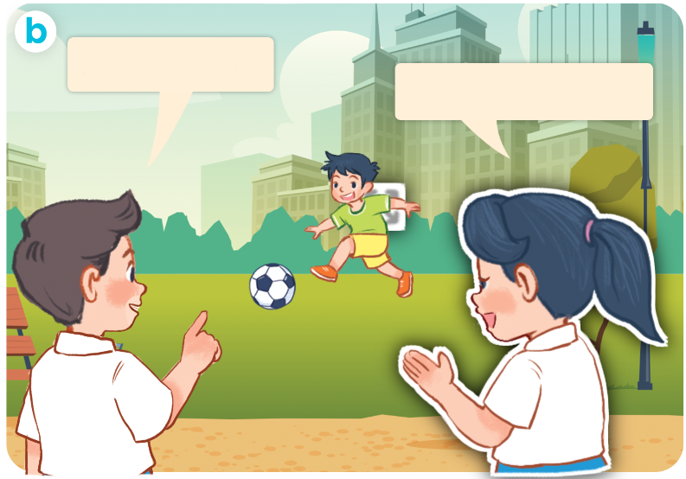
1. Look, listen and repeat.
Who’s that?
It’s my brother.

Slide 8
Vocabulary

Slide 9
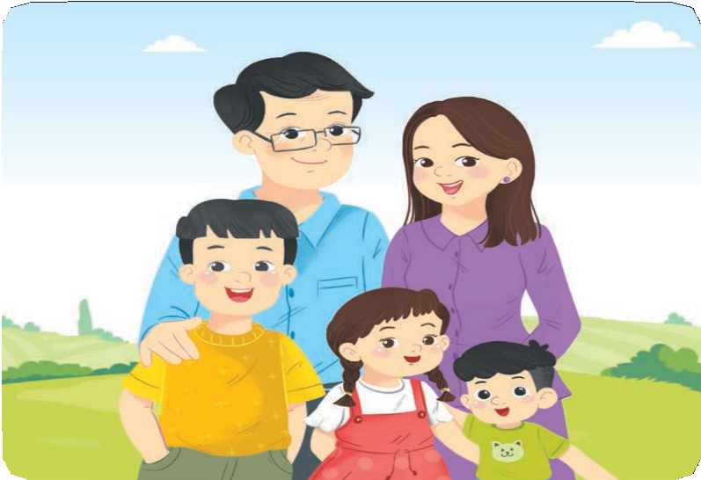
Vocabulary
family
/ˈfæmɪli/
gia đình

Slide 10


Vocabulary
mother
/ˈmʌðə/
mẹ

Slide 11
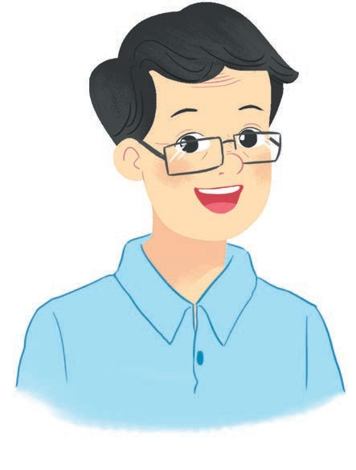

Vocabulary
father
/ˈfɑːðə/
bố

Slide 12
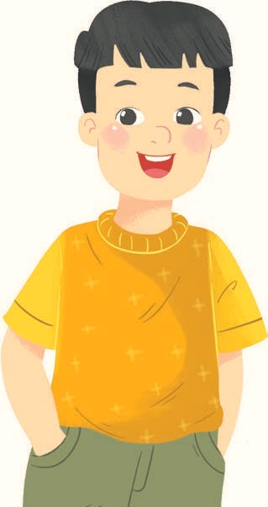
Vocabulary
brother
/ˈbrʌðə/
anh/em trai

Slide 13

Vocabulary
sister
/ˈsɪstə/
chị/em gái

Slide 14

1/ New words:
family /ˈfæmɪli/ gia đình
mother /ˈmʌðə/ mẹ
father /ˈfɑːðə/ bố
brother /ˈbrʌðə/ anh trai,em trai
sister /ˈsɪstə/ chị gái, em gái

Slide 15




Match
1
3
mother
brother
2
father
4
sister

Slide 16
Structures

Slide 17
2/ Model sentences:
Hỏi và trả lời “đây/kia là ai”
A: Who’s this/that?
B: It’s my mother.
Note: who’s = who is

Slide 18
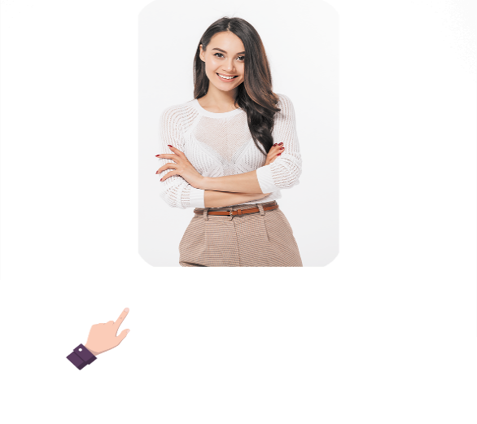

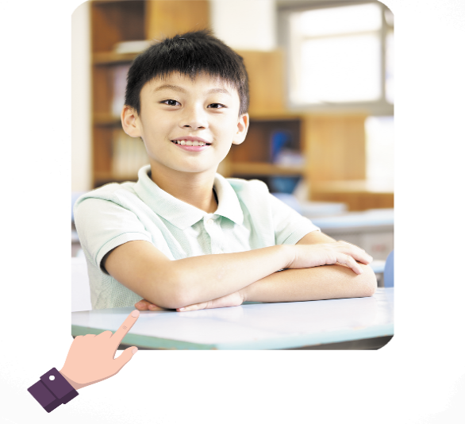

2. Listen, point and say.
a
b
Who’s this / that?
It’s my _______.
mother
father
c
d
brother
sister

Slide 19
Who’s this / that?
mother
It’s my _______.
mother

Slide 20
Who’s this / that?
father
It’s my _______.
father

Slide 21
Who’s this / that?
brother
It’s my _______.
brother

Slide 22
Who’s this / that?
sister
It’s my _______.
sister

Slide 23
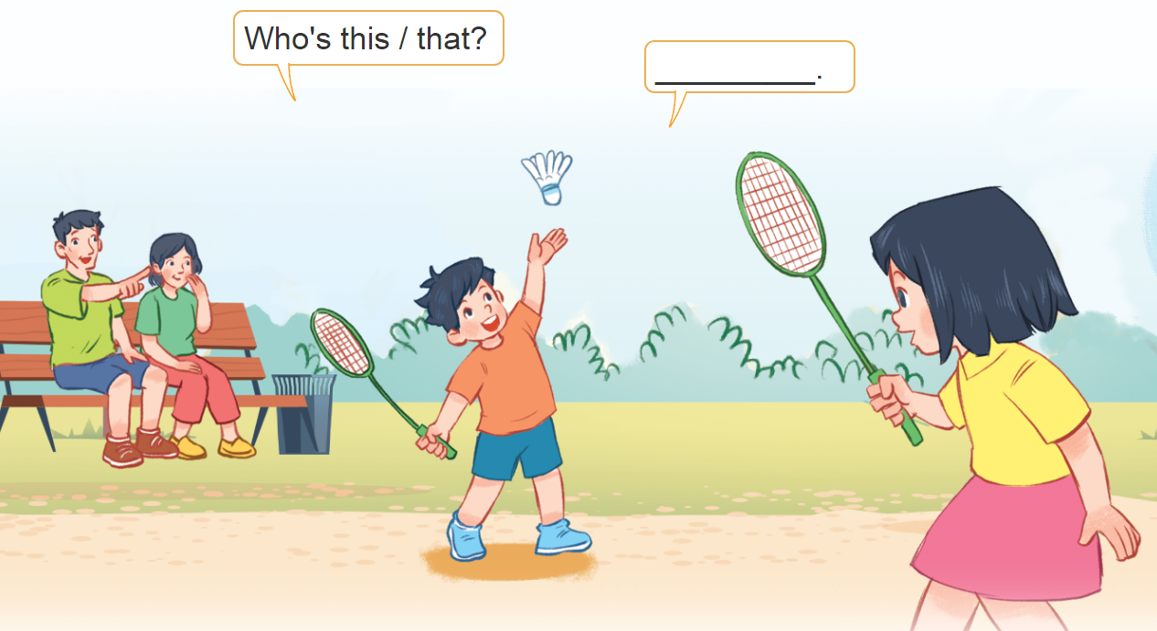
3. Let’s talk.
Who’s this/that?
___________.

Slide 24


Facebook : Bùi Liễu
0968142780
Let’s play!

Slide 25













Facebook : Bùi Liễu
0968142780

Slide 26




Slide 27





Slide 28



Facebook : Bùi Liễu
0968142780

Slide 29






Facebook : Bùi Liễu
0968142780

Slide 30
family

Slide 31
It’s my sister.

Slide 32
It’s my father.
Facebook : Bùi Liễu
0968142780

Slide 33
It’s my mother.
Facebook : Bùi Liễu
0968142780

Slide 34
It’s my brother.
Facebook : Bùi Liễu
0968142780

Slide 35



sister
Facebook : Bùi Liễu
0968142780
family
mother

Slide 36


Who’s that?
It’s my father.
Facebook : Bùi Liễu
0968142780
It’s my mother.
It’s my brother.

Slide 37

Who’s this?
It’s my father.
Facebook : Bùi Liễu
0968142780
It’s my brother.
It’s my mother.

Slide 38

Who’s this?
It’s my mother.
Facebook : Bùi Liễu
0968142780
It’s my sister.
It’s my brother.

Slide 39

Who’s that?
It’s my mother.
It’s my brother.
It’s my sister.

Slide 40

WELL DONE!
Facebook : Bùi Liễu
0968142780

Slide 41
Wrap up
Facebook : Bùi Liễu
0968142780

Slide 42
1/ New words:
family /ˈfæmɪli/ gia đình
mother /ˈmʌðə/ mẹ
father /ˈfɑːðə/ bố
brother /ˈbrʌðə/ anh trai,em trai
sister /ˈsɪstə/ chị gái, em gái

Slide 43
2/ Model sentences:
Hỏi và trả lời “đây/kia là ai”
A: Who’s this/that?
B: It’s my mother.
Note: who’s = who is

Slide 44





Vocabulary
family
mother
father
brother
sister

Slide 45

Structures
Hỏi và trả lời “đây/kia là ai”
- Who’s this/that?
It’s my _______.
(Đây/kia là ai?)
(Đó là …. tớ)
who = who is
Example
Mary: Who’s this?
Linh: It’s my mother.

Slide 46
Homework
Homework
Learn by heart all the new words.
Read again the dialogue in part 1.

Slide 47

Facebook : Bùi Liễu
0968142780
Thank you!

