Slide 1
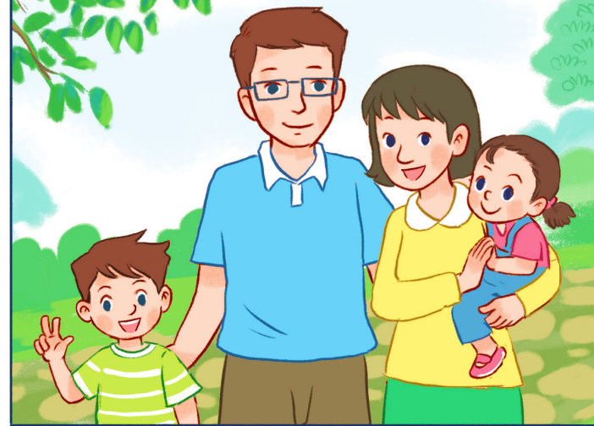
My family
Unit
11
Lesson 2 (1+2+3)
Facebook : Bùi Liễu
0968142780

Slide 2
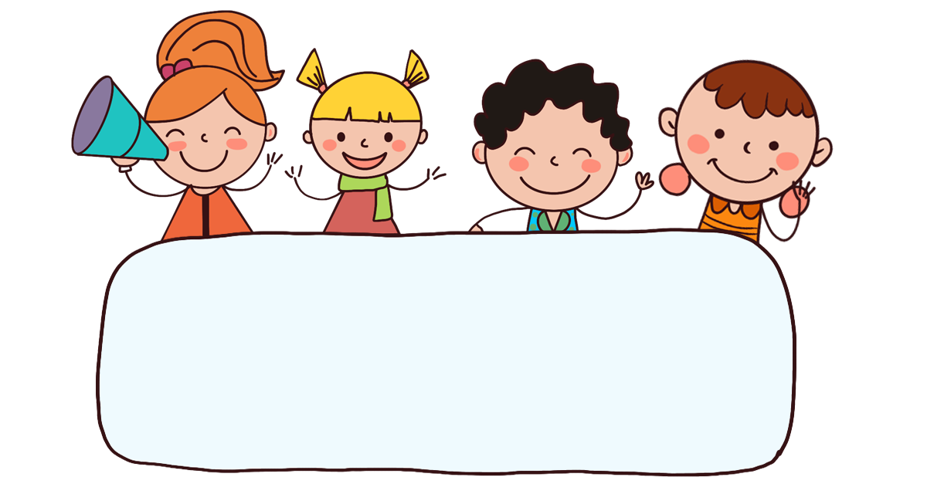
Warm-up

Slide 3
















Picking
apples
END

Slide 4


father
Who’s that?
It’s my ________.
A
mother
B
brother
C

Slide 5

brother
Who’s this?
It’s my ________.
A
father
B
sister
C

Slide 6
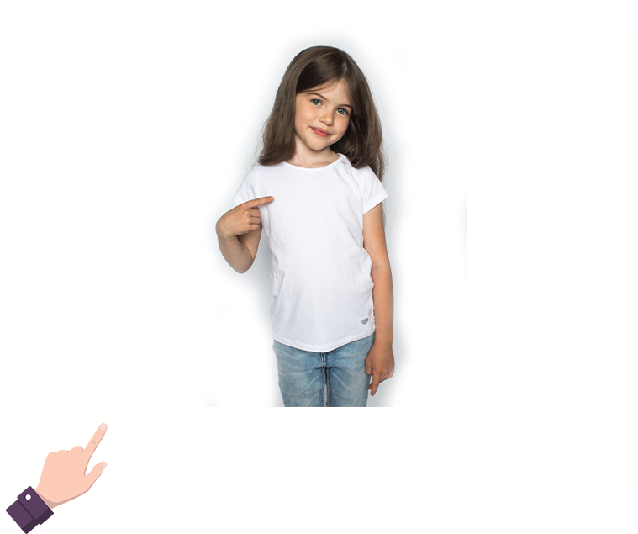
family
Who’s that?
It’s my ________.
A
mother
B
sister
C

Slide 7
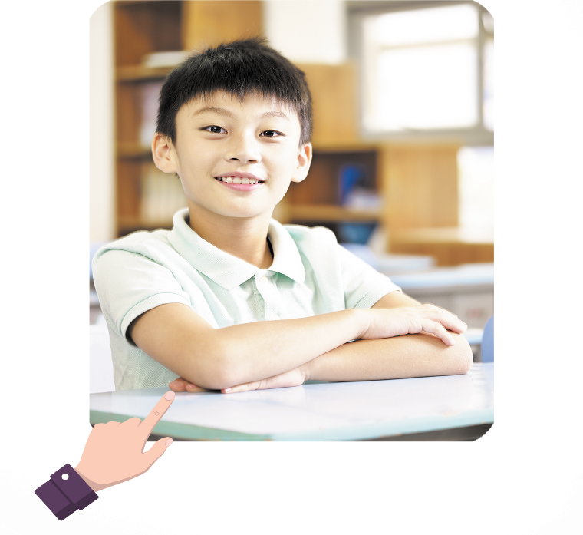
Who’s that?
_____is my brother.
She
A
It
B

Slide 8
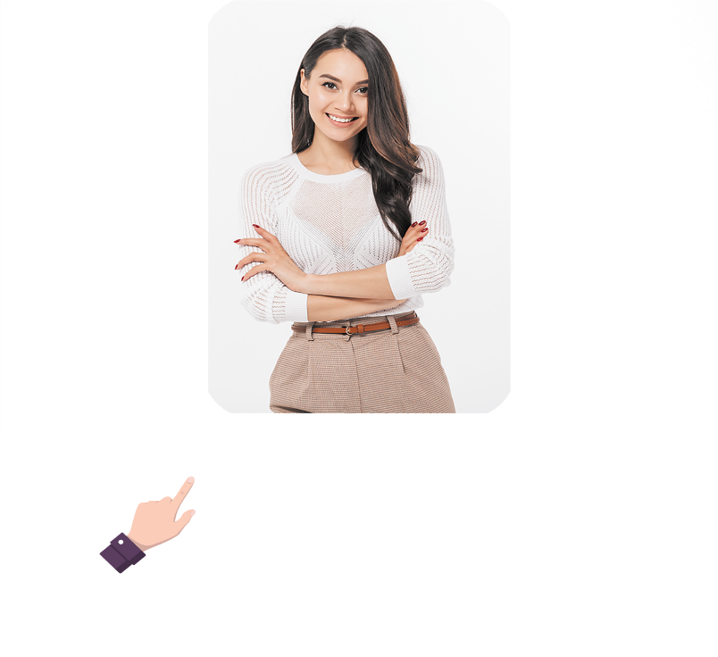
Who’s ___?
It is my brother.
this
A
that
B

Slide 9

Who’s ___?
It is my brother.
that
A
this
B

Slide 10
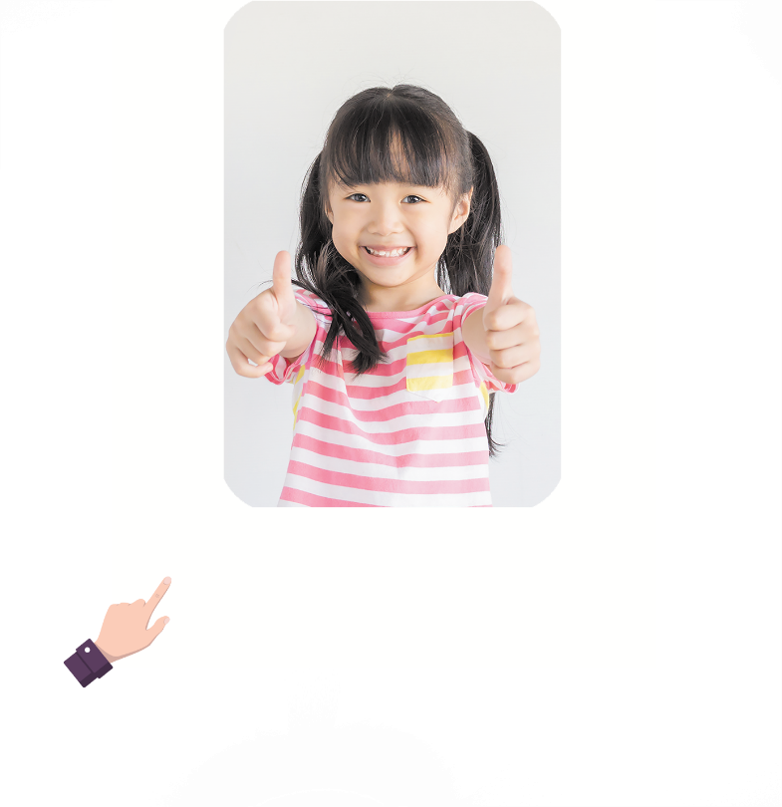
______ that?
what is
A
who is
B

Slide 11
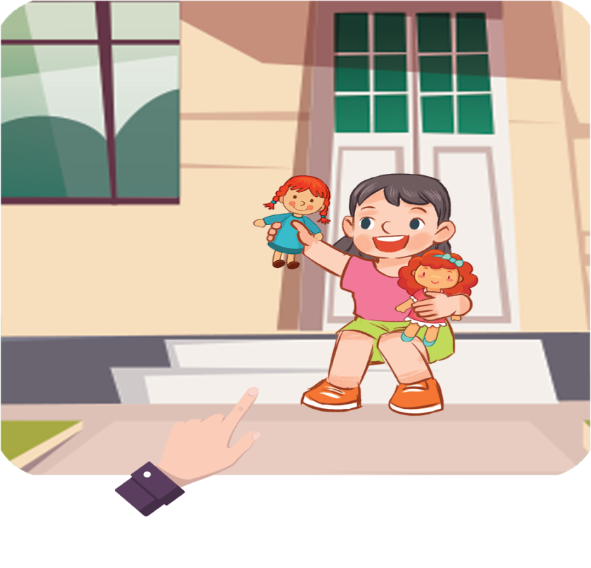
_____ that?
It is my sister.
Who is
A
Who are
B

Slide 12



Contents
Facebook : Bùi Liễu
0968142780
Look, listen and repeat.
Listen, point and say.
Let’s talk.

Slide 13

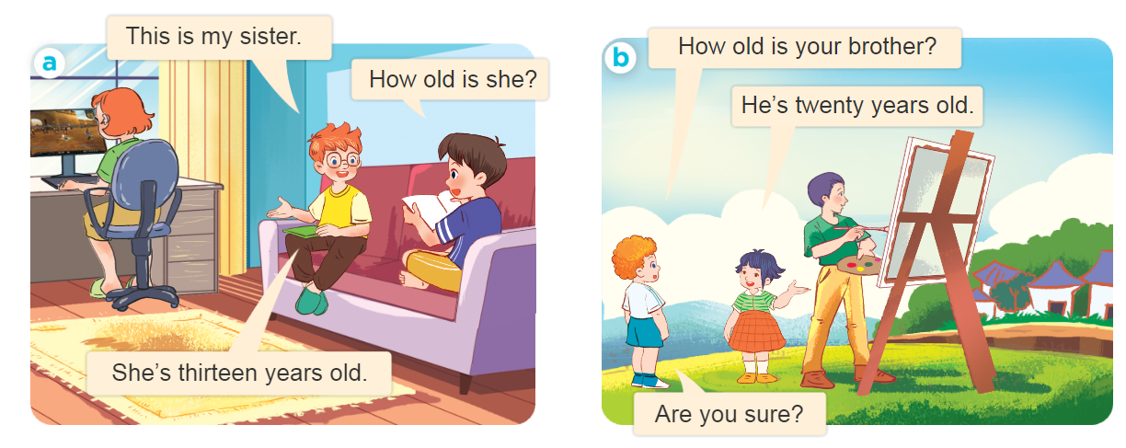
1. Look, listen and repeat.
Who are they?
Where are they?
What are they doing?

Slide 14
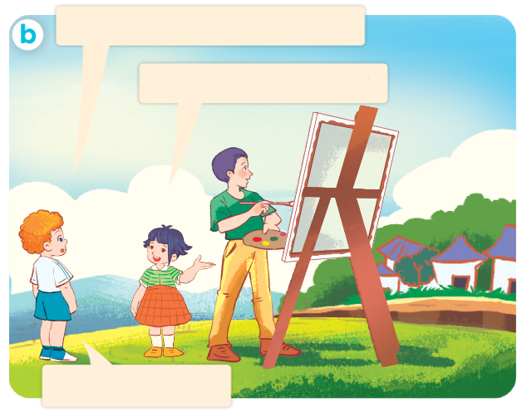
1. Look, listen and repeat.
How old is your brother?
He’s twenty years old.
Are you sure?

Slide 15
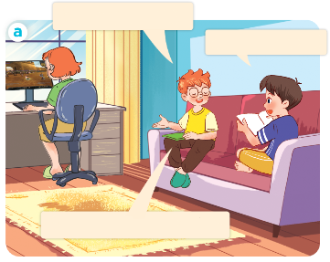
1. Look, listen and repeat.
This is my sister.
How old is she?
She’s thirteen years old.

Slide 16
1. Look, listen and repeat.
How old is your brother?
He’s twenty years old.
Are you sure?

Slide 17
Vocabulary

Slide 18










Numbers
eleven
/ɪˈlevən/
twelve
/twelv/
thirteen
/ˌθɜːˈtiːn/
fourteen
/ˌfɔːˈtiːn/
fifteen
/ˌfɪfˈtiːn/
sixteen
/ˌsɪksˈtiːn/
seventeen
/ˌsevənˈtiːn/
eighteen
/ˌeɪˈtiːn/
nineteen
/ˌnaɪnˈtiːn/

Slide 19










twenty
/ˈtwenti/
thirty
/ˈθɜːti/
forty
/ˈfɔːti/
fifty
/ˈfɪfti/
sixty
/ˈsɪksti/
seventy
/ˈsevənti/
eighty
/ˈeɪti/
ninety
/ˈnaɪnti/
one hundred
/wʌn ˈhʌndrəd/

Slide 20
22
=
20
+
2
twenty - two
twenty
two
45
40
+
5
=
forty - five
forty
five
78
=
70
+
8
seventy - eight
seventy
eight

Slide 21
Look and say
36
40
thirty - six
forty
a
d
65
13
sixty - five
thirteen
e
b
42
11
forty - two
eleven
c
f

Slide 22
Structures

Slide 23
Structures
Hỏi và trả lời về tuổi của ai đó.
How old is she ?(cô ấy bao nhiêu tuổi?)
she’s fourteen years old.
How old is he? ( anh ấy bao nhiêu tuổi?)
He’s fifty two years old.
he’s = he is
she’s = she is

Slide 24


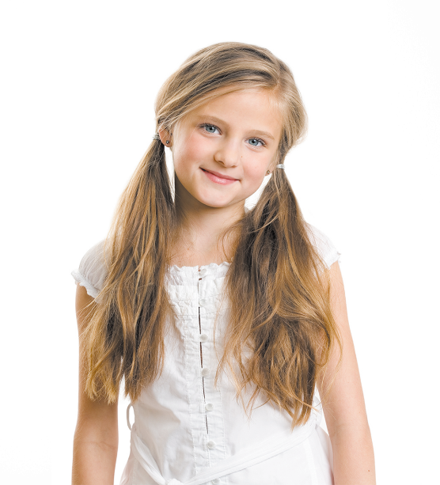
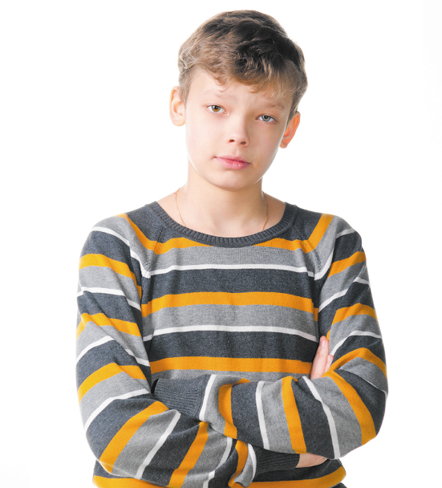
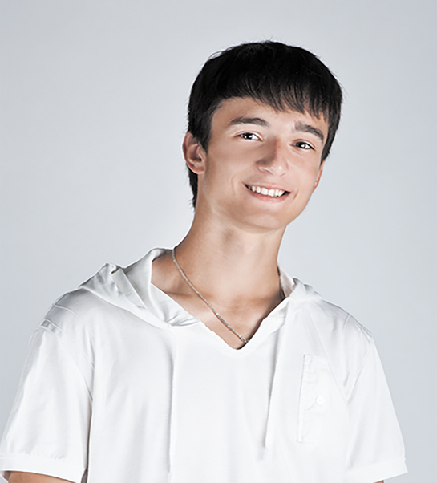

2. Listen, point and say.
How old is he / she?
He’s / She’s _____.
a
b
c
d
twelve
fourteen
eighteen
nineteen

Slide 25
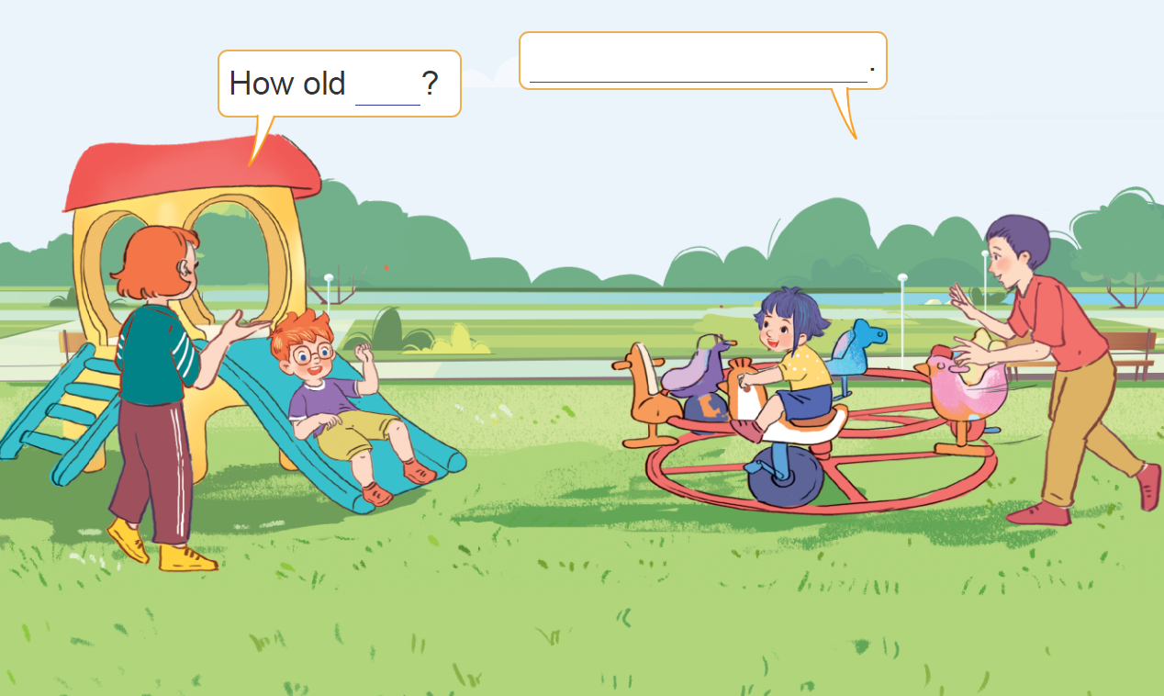
3. Let’s talk.
How old _____?
__________.

Slide 26

Wrap up

Slide 27
Numbers
eleven
/ɪˈlevən/
twelve
/twelv/
thirteen
/ˌθɜːˈtiːn/
fourteen
/ˌfɔːˈtiːn/
fifteen
/ˌfɪfˈtiːn/
sixteen
/ˌsɪksˈtiːn/
seventeen
/ˌsevənˈtiːn/
eighteen
/ˌeɪˈtiːn/
nineteen
/ˌnaɪnˈtiːn/

Slide 28
twenty
/ˈtwenti/
thirty
/ˈθɜːti/
forty
/ˈfɔːti/
fifty
/ˈfɪfti/
sixty
/ˈsɪksti/
seventy
/ˈsevənti/
eighty
/ˈeɪti/
ninety
/ˈnaɪnti/
one hundred
/wʌn ˈhʌndrəd/

Slide 29
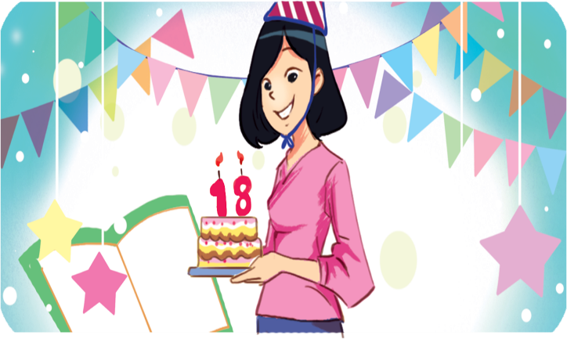
Structures
Hỏi và trả lời về tuổi của ai đó.
- How old is he / she?
He’s / She’s _______.
(Anh ấy / cô ấy bao nhiêu tuổi?)
(Anh ấy / cô ấy ........... tuổi)
he’s = he is
she’s = she is
Example
Mary: How old is she?
Linh:She’s eighteen.

Slide 30
Homework
Learn by heart all the new words.
Read again the dialogue in part 1.

Slide 31

Facebook : Bùi Liễu
0968142780
Thank you!

