Slide 1
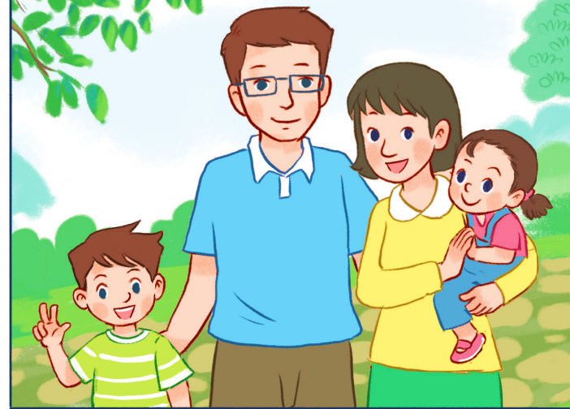
..................................
My family
Unit
11
Lesson 3 (4+5+6)

Slide 2
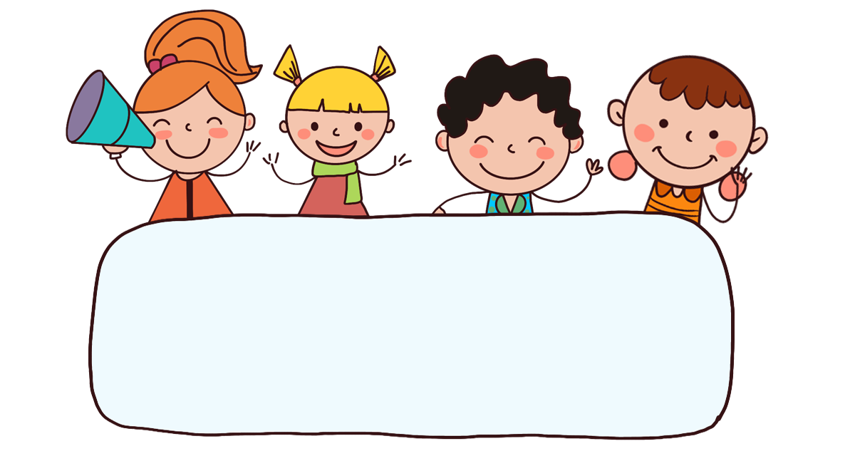
Warm-up

Slide 3
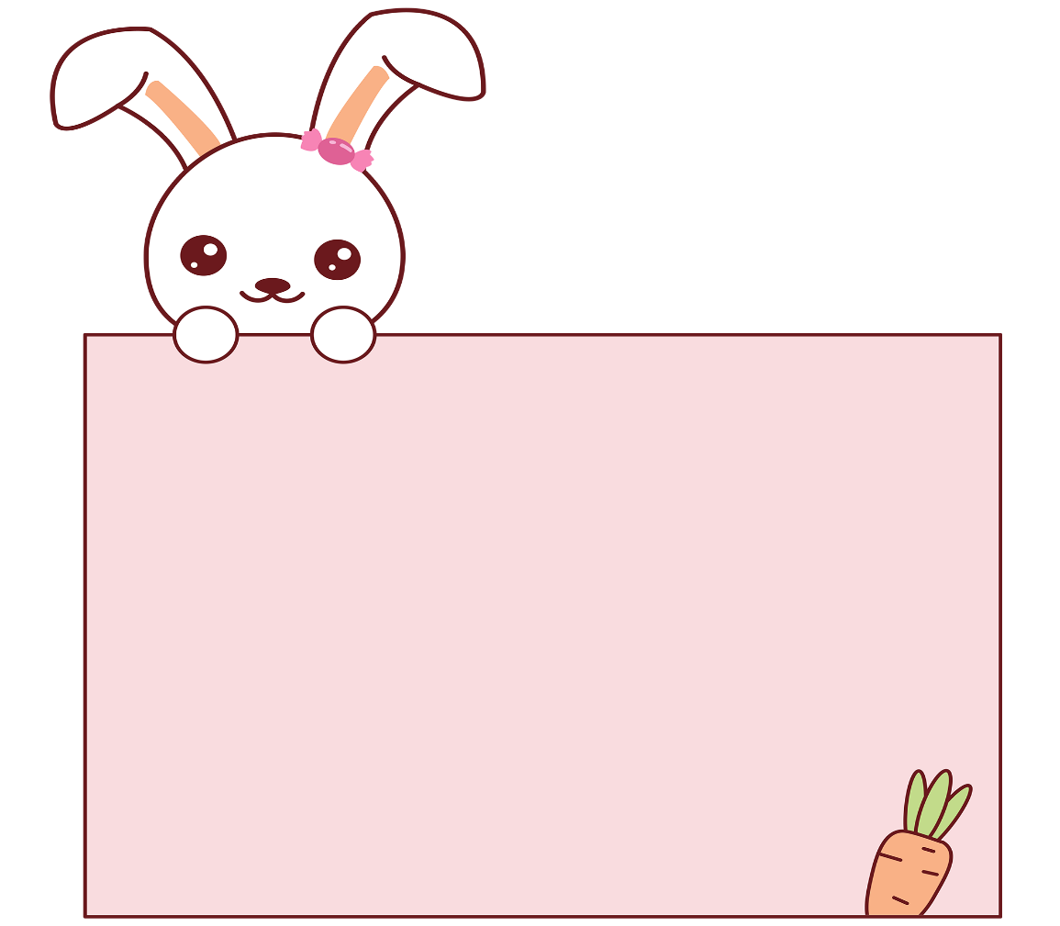
Let’s play!
Facebook : Bùi Liễu
0968142780

Slide 4
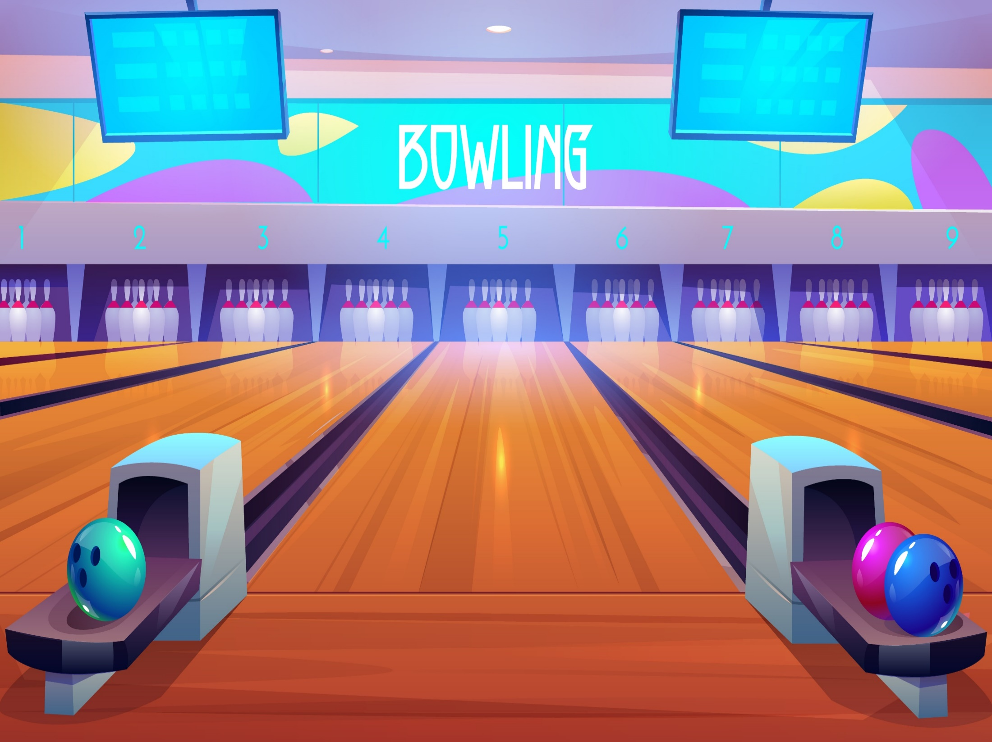

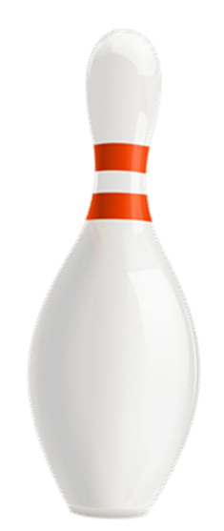


Facebook : Bùi Liễu
0968142780

Slide 5
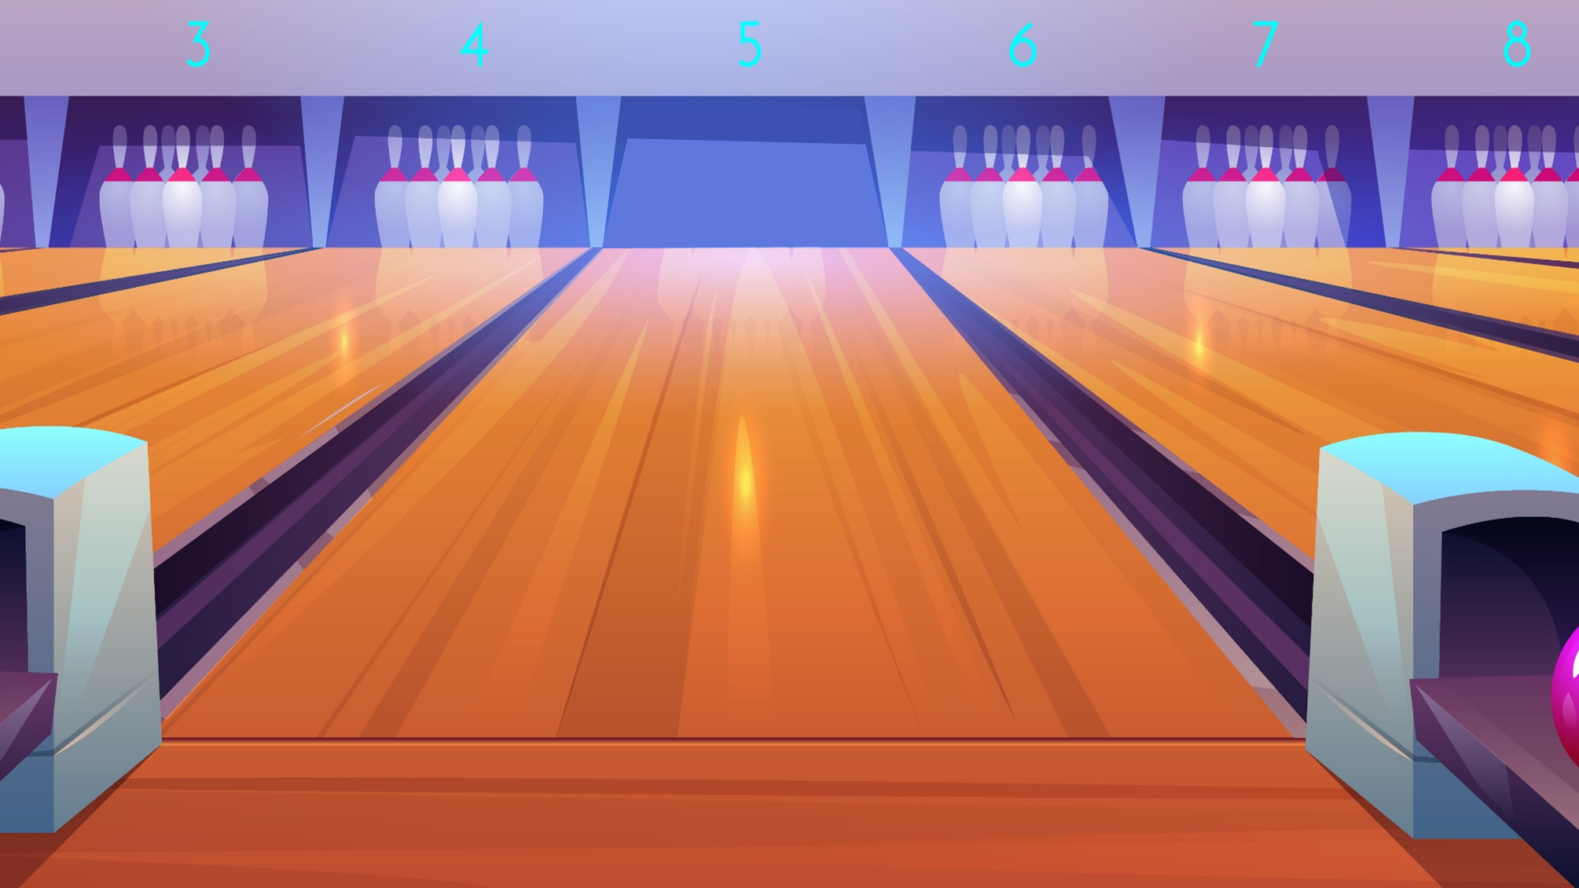

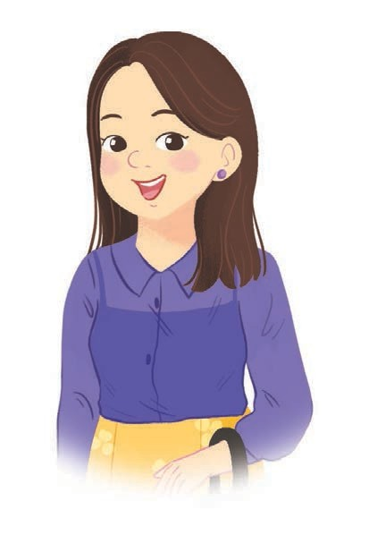


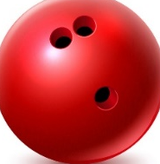
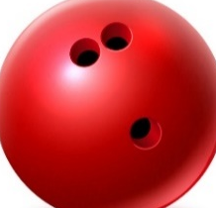
A. father
B. mother
A: Who is that?
B: It is my ____.
Facebook : Bùi Liễu
0968142780
C. brother
Next

Slide 6
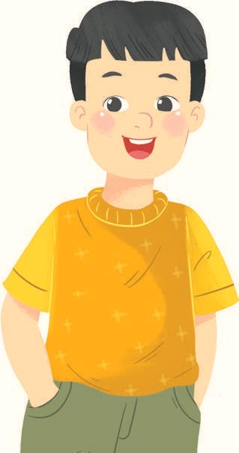
A. brother
B. father
A: Who is this?
B: It is my ____.
Facebook : Bùi Liễu
0968142780
C. sister
Next

Slide 7
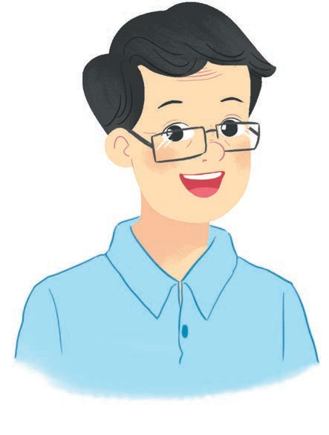
A. mother
B. sister
A: Who is this?
B: It is my ____.
Facebook : Bùi Liễu
0968142780
C. father
Next

Slide 8
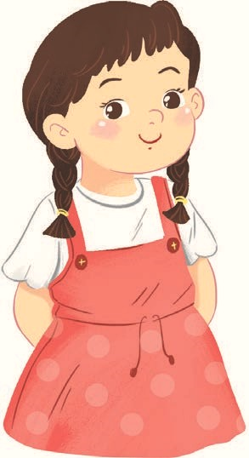
A. sister
B. mother
A: Who is that?
B: It is my ____.
Facebook : Bùi Liễu
0968142780
C. brother
Next

Slide 9
A. that -mother
B. this - mother
A: Who is ____?
B: It is my ____.
Facebook : Bùi Liễu
0968142780
C. that - sister
Next

Slide 10
A. this - mother
B. that -brother
A: Who is ____?
B: It is my ____.
Facebook : Bùi Liễu
0968142780
C. this - father
Next

Slide 11

A. fourteen
How old is she?
She is __________.
B. eighteen
Facebook : Bùi Liễu
0968142780
C. sixteen
Next

Slide 12
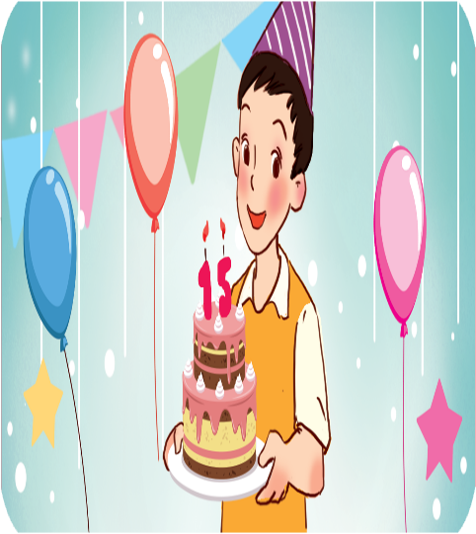
A. fifteen
How old is he?
He is __________.
B. thirteen
Facebook : Bùi Liễu
0968142780
C. sixteen
Next

Slide 13
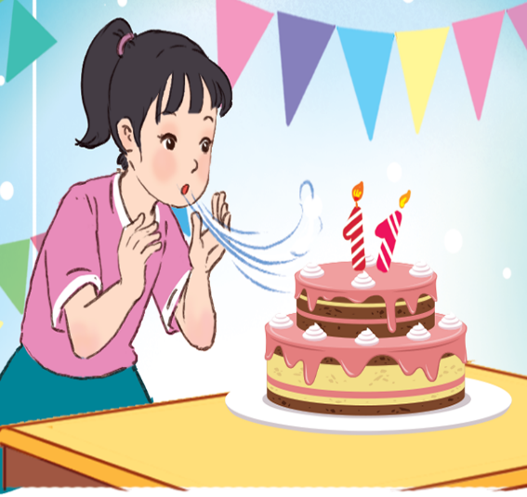
A. ten
How old is she?
She is __________.
B. twenty
Facebook : Bùi Liễu
0968142780
C. eleven
Next

Slide 14
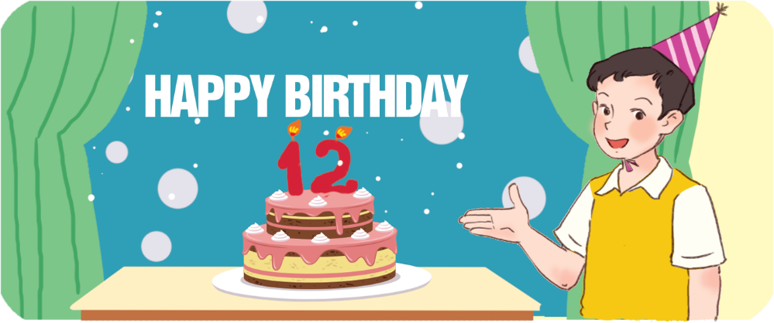
A. thirteen
How old is he?
He is __________.
B. twelve
Facebook : Bùi Liễu
0968142780
C. seventeen
Next

Slide 15
A. He - she
How old is ____?
____ is eighteen.
B. She - she
Facebook : Bùi Liễu
0968142780
C. She - he
Next

Slide 16

WELL DONE!
Facebook : Bùi Liễu
0968142780

Slide 17



Contents
Facebook : Bùi Liễu
0968142780
Read and complete.
Let’s write.
Project.

Slide 18

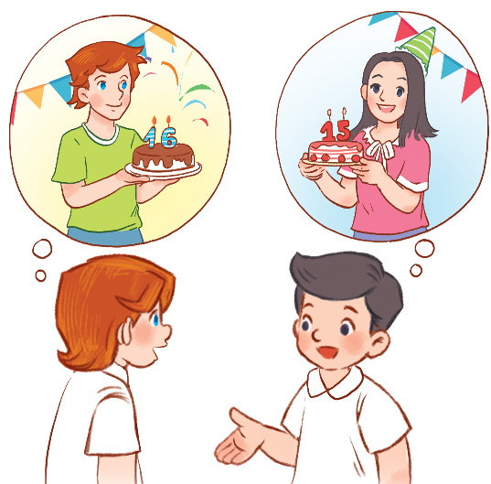
Facebook : Bùi Liễu
Mobile phone: 0968142780
3. Let’s chant.
How old is your brother?
He’s sixteen. He’s sixteen.
Are you sure?
Are you sure?
How old is your sister?
She’s fifteen. She’s fifteen.
Are you sure?
Are you sure?

Slide 19

3. Let’s chant.
How old is your brother?
He’s sixteen.
He’s sixteen.
Are you sure?
Are you sure?
How old is your sister?
She’s fifteen.
She’s fifteen.
Are you sure?
Are you sure?
Ư

Slide 20
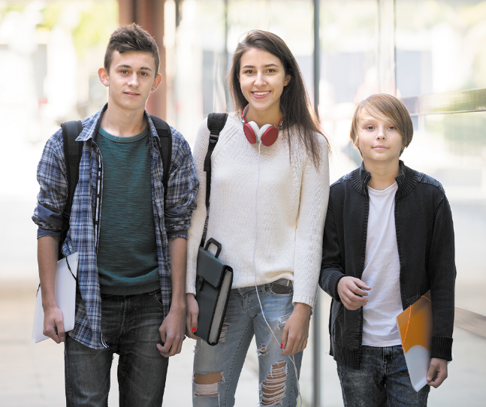
Facebook : Bùi Liễu
Mobile phone: 0968142780
4. Read and complete.
am my old sister
Look at the photo. This is (1) _____ brother. He is seventeen years old. This is my (2)_____ . She is twenty years (3)____ . And this is me. I (4) ____ eight years old.
my
sister
old
am

Slide 21
5. Let’s write.
My name is ____ . I’m _____ years old.
My brother / sister is _____.
He / She is ____ years old.
Thuy
nine
Linh
six

Slide 22
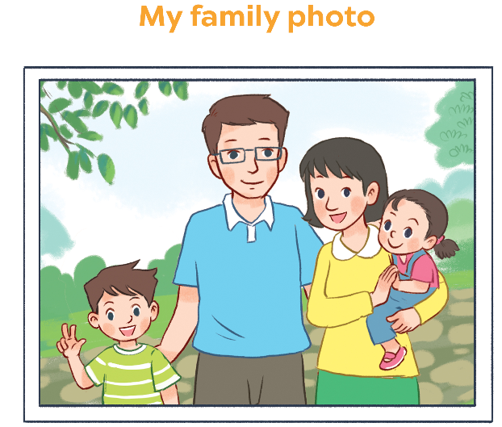
Facebook : Bùi Liễu
Mobile phone: 0968142780
6. Project

Slide 23
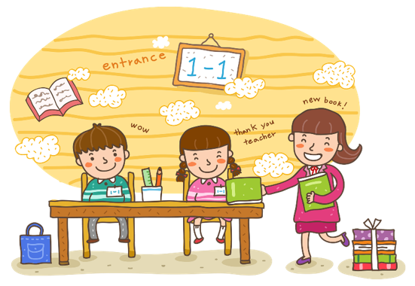
Wrap up

Slide 24
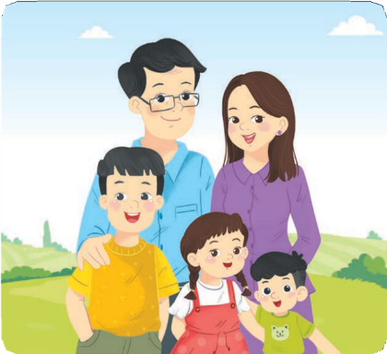






Vocabulary
f_mily
mo_her
fat_er
b_other
sist_r

Slide 25


Structures
Hỏi và trả lời “đây/kia là ai”
- Who’s this/that?
It’s my _______.
(Đây/kia là ai?)
(Đó là …. tớ)
who = who is
Example
Mary: Who’s this?
Linh: It’s my mother.

Slide 26










Numbers
eleven
/ɪˈlevən/
twelve
/twelv/
thirteen
/ˌθɜːˈtiːn/
fourteen
/ˌfɔːˈtiːn/
fifteen
/ˌfɪfˈtiːn/
sixteen
/ˌsɪksˈtiːn/
seventeen
/ˌsevənˈtiːn/
eighteen
/ˌeɪˈtiːn/
nineteen
/ˌnaɪnˈtiːn/

Slide 27










twenty
/ˈtwenti/
thirty
/ˈθɜːti/
forty
/ˈfɔːti/
fifty
/ˈfɪfti/
sixty
/ˈsɪksti/
seventy
/ˈsevənti/
eighty
/ˈeɪti/
ninety
/ˈnaɪnti/
one hundred
/wʌn ˈhʌndrəd/

Slide 28
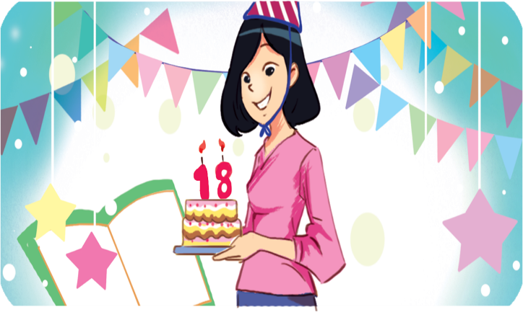
Structures
Hỏi và trả lời về tuổi của ai đó.
- How old is he / she?
He’s / She’s _______.
(Anh ấy / cô ấy bao nhiêu tuổi?)
(Anh ấy / cô ấy ........... tuổi)
he’s = he is
she’s = she is
Example
Mary: How old is she?
Linh:She’s eighteen.

Slide 29
Homework
......................................
......................................

Slide 30

Facebook : Bùi Liễu
0968142780
Thank you!

