Slide 1

................................................................................
Jobs
Unit
12
Lesson 1 (1+2+3)

Slide 2

Warm-up

Slide 3

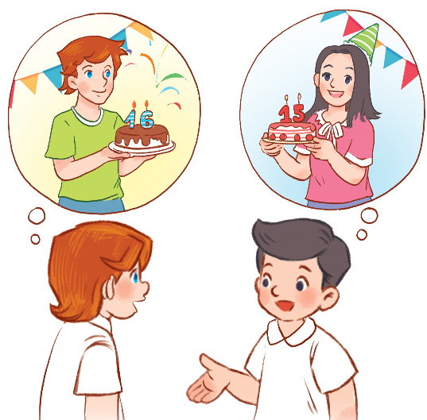
Let’s chant.
How old is your brother?
He’s sixteen.
He’s sixteen.
Are you sure?
Are you sure?
How old is your sister?
She’s fifteen.
She’s fifteen.
Are you sure?
Are you sure?
Ư

Slide 4



Contents
Facebook : Bùi Liễu
0968142780
Look, listen and repeat.
Listen, point and say.
Let’s talk.

Slide 5

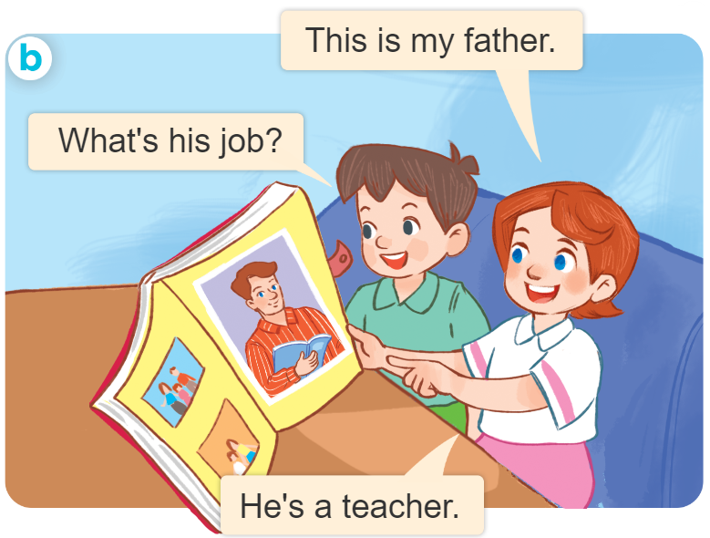
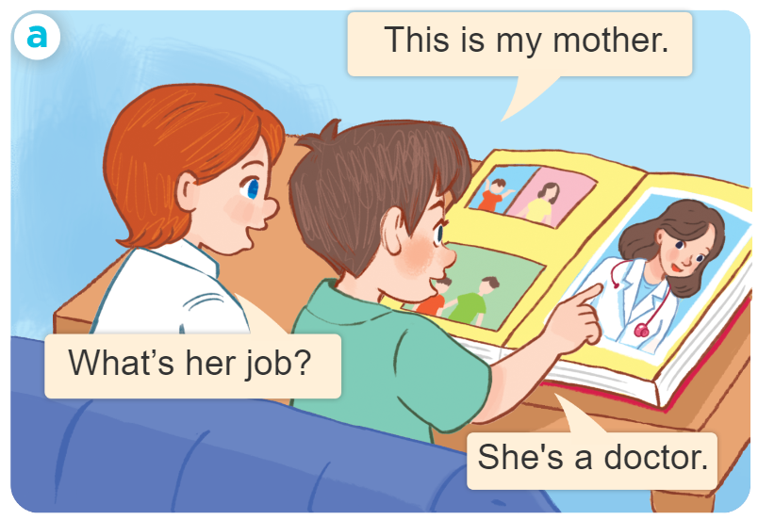
1. Look, listen and repeat.
Who are they?
Where are they?
What are they doing?

Slide 6
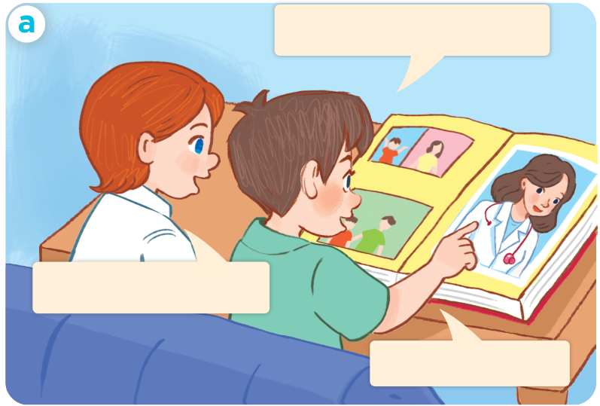
1. Look, listen and repeat.
This is my mother.
Click on the speaker of the sentence to hear the sound.
What’s her job?
She’s a doctor.

Slide 7
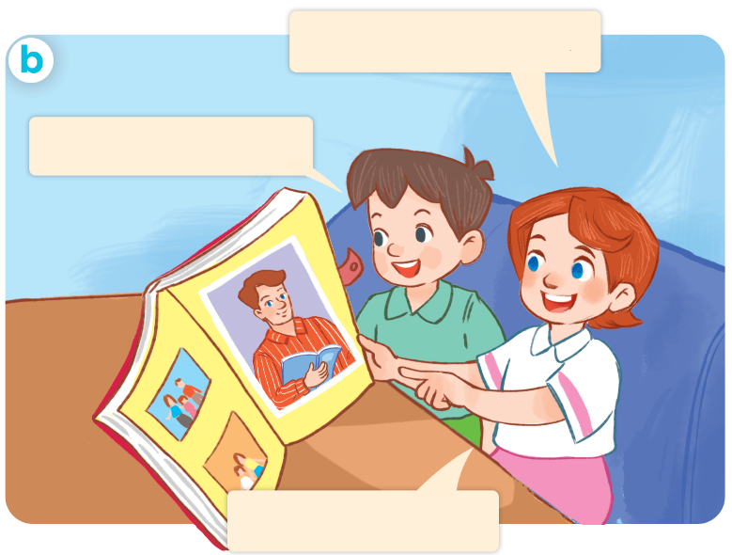
1. Look, listen and repeat.
Click on the speaker of the sentence to hear the sound.
This is my father.
What’s his job?
He’s a teacher.

Slide 8
Vocabulary

Slide 9

Vocabulary
job
/ʤɒb/
công việc

Slide 10

Vocabulary
doctor
/ˈdɒktə/
bác sĩ

Slide 11

Vocabulary
driver
/ˈdraɪvə/
tài xế (lái xe)

Slide 12

Vocabulary
teacher
/ˈtiːʧə/
giáo viên

Slide 13

Vocabulary
worker
/ˈwɜːkə/
công nhân

Slide 14





Review
job
doctor
driver
teacher
worker

Slide 15
Vocabulary
job /ʤɒb/ công việc
doctor /ˈdɒktə/ bác sĩ
driver /ˈdraɪvə/ tài xế (lái xe)
teacher /ˈtiːʧə/ giáo viên
worker /ˈwɜːkə/ công nhân

Slide 16




Match
1
3
a. doctor
b. teacher
2
c. worker
4
d. driver

Slide 17
Structures

Slide 18
Structures
Hỏi và trả lời về công việc của ai đó.
What’s her job?( cô ấy làm nghề gì?)
She’s a _______.
What’s his job?( anh ấy làm nghề gì?)
He’s a _______.
he’s = he is
she’s = she is

Slide 19

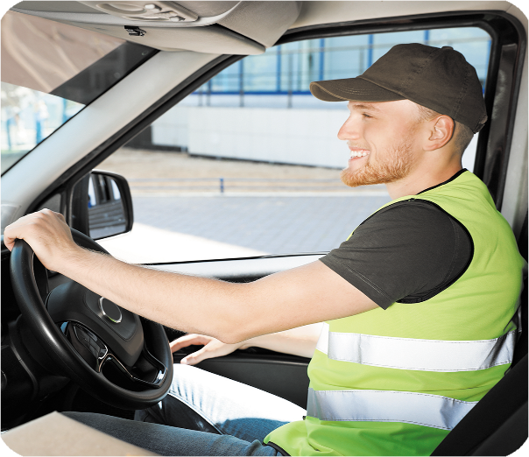


2. Listen, point and say.
a
b
- What’s his / her job?
He’s / She’s _____.
a doctor
a driver
c
d
a teacher
a worker

Slide 20
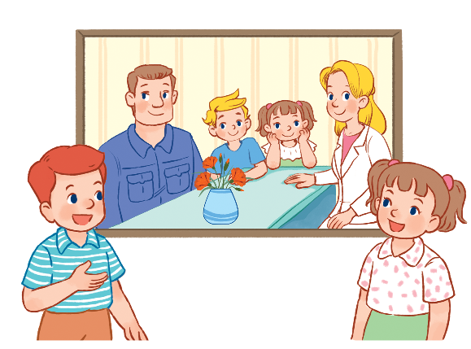
3. Let’s talk.
He’s / She’s _____.
- What’s his / her job?

Slide 21








Slide 22


A. teacher
B. worker

Slide 23

A. worker
B. doctor
Ms Huyền Phạm
0936.082.789

Slide 24
A. teacher
B. driver
Ms Huyền Phạm
0936.082.789

Slide 25
A. worker
B. doctor
Ms Huyền Phạm
0936.082.789

Slide 26

What’s his ______?
He’s a worker.
A. name
B. job
Ms Huyền Phạm
0936.082.789

Slide 27
What’s ______ job?
He’s a doctor.
A. her
B. his
Ms Huyền Phạm
0936.082.789

Slide 28
What is _____ job?
She is doctor
A. her
B. his
Ms Huyền Phạm
0936.082.789

Slide 29
What’s his job?
______ a driver.
A. She’s
B. He’s
Ms Huyền Phạm
0936.082.789

Slide 30
What’s her job?
______ a teacher.
A. She’s
B. She
Ms Huyền Phạm
0936.082.789

Slide 31
______ her job?
A. What is
B. What
Ms Huyền Phạm
0936.082.789

Slide 32

Good job!
Ms Huyền Phạm
0936.082.789

Slide 33

Wrap up

Slide 34
Review
job
doctor
driver
teacher
worker

Slide 35

Structures
Hỏi và trả lời về công việc của ai đó.
- What’s his / her job?
He’s / She’s a _______.
(Công việc của anh ấy/ cô ấy là gì?)
he’s = he is
she’s = she is
(Anh ấy/ cô ấy là ______)
Example
Mary: What’s her job?
Linh: She’s a doctor.

Slide 36
Homework
Learn by heart all the new words.
Read again the dialogue in part 1.

Slide 37

Facebook : Bùi Liễu
0968142780
Thank you!

