Slide 1

................................................................................
Jobs
Unit
12
Lesson 1 (4+5+6)
Facebook : Bùi Liễu
0968142780

Slide 2

Warm-up

Slide 3

Facebook : Bùi Liễu
0968142780
Let’s play!

Slide 4





Facebook : Bùi Liễu
0968142780
START

Slide 5






Facebook : Bùi Liễu
0968142780
A. doctor
B. driver
C. teacher
Next

Slide 6

teacher
B. driver
C. doctor
Notes:
Facebook : Bùi Liễu 0968142780

Slide 7

Facebook : Bùi Liễu
0968142780
A. teacher
B. driver
C. worker
Next
Notes:
Facebook : Bùi Liễu 0968142780

Slide 8

Facebook : Bùi Liễu
0968142780
A. worker
B. driver
C. teacher
Next
Notes:
Facebook : Bùi Liễu 0968142780

Slide 9

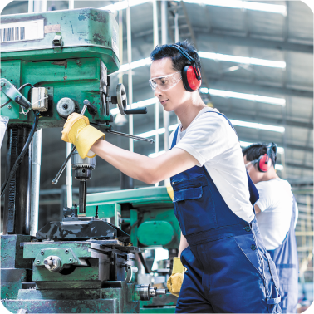

teacher
A.
B.
C.
Notes:
Facebook : Bùi Liễu 0968142780

Slide 10



doctor
Facebook : Bùi Liễu
0968142780
A.
B.
C.
Notes:
Facebook : Bùi Liễu 0968142780

Slide 11
Facebook : Bùi Liễu
0968142780
A. driver
B. teacher
C. doctor
Notes:
Facebook : Bùi Liễu 0968142780

Slide 12



Facebook : Bùi Liễu
0968142780
A.
B.
C.
Notes:
Facebook : Bùi Liễu 0968142780

Slide 13



A.
B.
C.
Notes:
Facebook : Bùi Liễu 0968142780

Slide 14



A.
B.
C.
Notes:
Facebook : Bùi Liễu 0968142780

Slide 15

te_cher
A. o
B. s
C. a
Notes:
Facebook : Bùi Liễu 0968142780

Slide 16

d_ctor
Facebook : Bùi Liễu
0968142780
A. o
B. p
C . k
Notes:
Facebook : Bùi Liễu 0968142780

Slide 17

What’s __ job?
Facebook : Bùi Liễu
0968142780
A. her
B. his
Next
Notes:
Facebook : Bùi Liễu 0968142780

Slide 18

What’s his job?
Facebook : Bùi Liễu
0968142780
A. She’s a worker.
B. He’s a worker.
Next
Notes:
Facebook : Bùi Liễu 0968142780

Slide 19
____is his job?
He’s a driver.
Facebook : Bùi Liễu
0968142780
A. Where
B. What
Notes:
Facebook : Bùi Liễu 0968142780

Slide 20


Well done!
Notes:
Facebook : Bùi Liễu 0968142780

Slide 21



Contents
Facebook : Bùi Liễu
0968142780
Listen and tick.
Look, complete and read.
Let’s sing.

Slide 22


Vocabulary
worker
/ˈwɜːkə/
công nhân

Slide 23




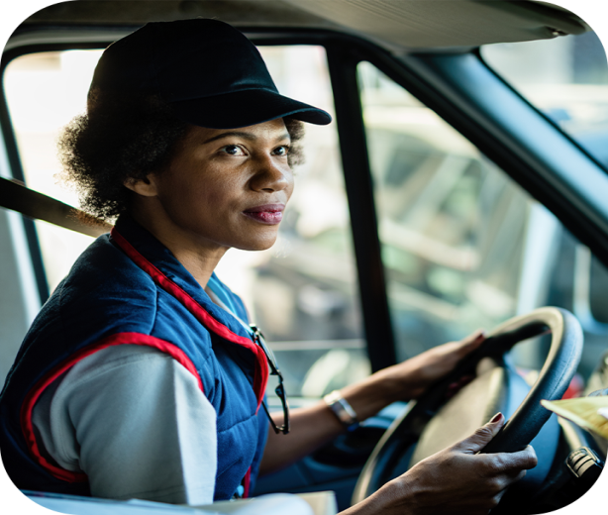
4. Listen and tick.
1
a
b
2
a
b

Slide 24



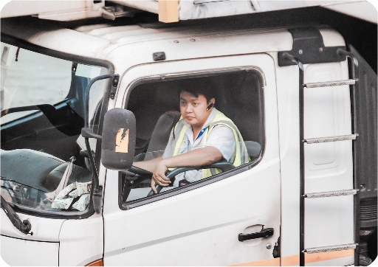
5. Look, complete and read.
1. She’s _______.
2. He’s ________.
a doctor
a teacher
2. She’s ________.
2. he’s ________.
a worker
a driver

Slide 25
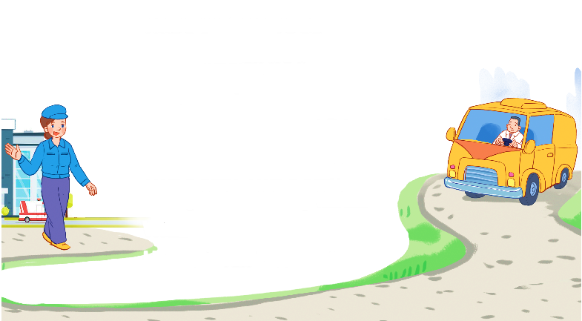
6. Let’s sing.
My father and my mother
Who’s this?
Who’s this?
It’s my mother.
It’s my mother.
What’s her job?
She’s a worker.
She’s a worker.
Who’s that?
Who’s that?
It’s my father.
It’s my father.
What’s his job?
He’s a driver.
He’s a driver.

Slide 26

6. Let’s sing.
My father and my mother
Who’s this?
Who’s this?
It’s my mother.
It’s my mother.
What’s her job?
She’s a worker.
She’s a worker.
Who’s that?
Who’s that?
It’s my father.
It’s my father.
What’s his job?
He’s a driver.
He’s a driver.

Slide 27

Wrap up

Slide 28


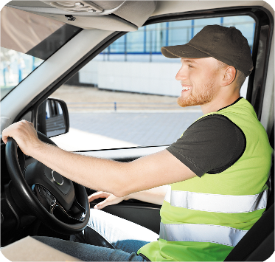


Review
job
doctor
driver
teacher
worker

Slide 29

Structures
Hỏi và trả lời về công việc của ai đó.
- What’s his / her job?
He’s / She’s a _______.
(Công việc của anh ấy/ cô ấy là gì?)
he’s = he is
she’s = she is
(Anh ấy/ cô ấy là ______)
Example
Mary: What’s her job?
Linh: She’s a doctor.

Slide 30
Homework
............................................................
............................................................

Slide 31

Facebook : Bùi Liễu
0968142780
Thank you!

