Slide 1


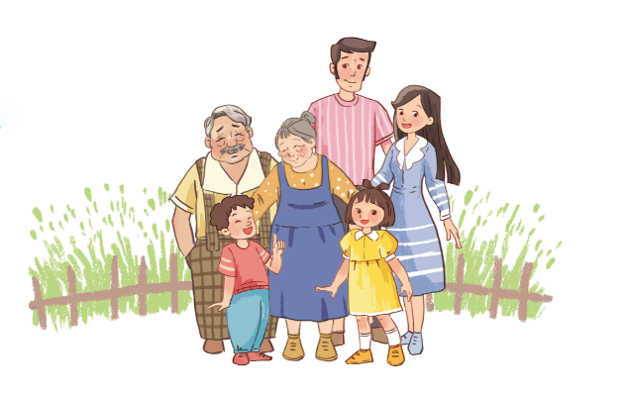
Unit
13
APPEARANCE
Lesson 1 (1+2+3)

Slide 2
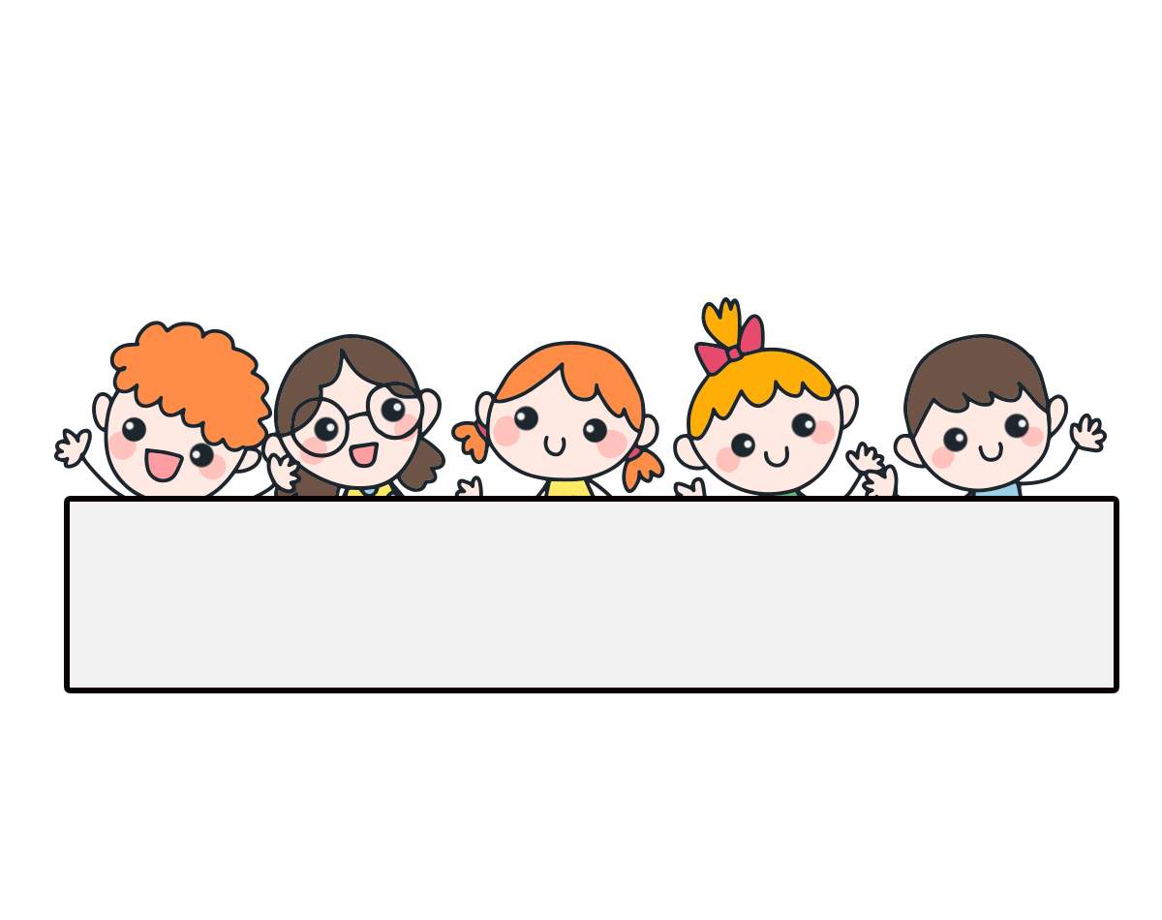
Warm-up

Slide 3

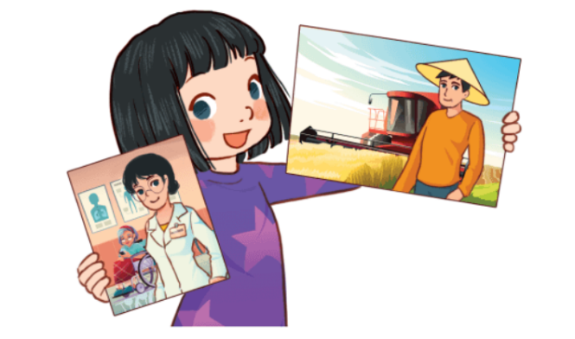
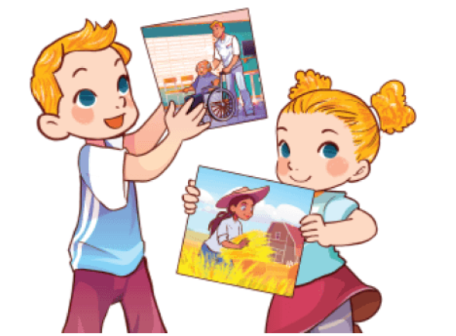
Let’s chant.
My father is a farmer.
He works on a farm.
My mother is a nurse.
She works at a nursing home.
Our father is a nurse.
He works at a nursing home.
Our mother is a farmer.
She works on a farm.

Slide 4
Contents
1. Look, listen and repeat.
2. Listen, point and say.
3. Let’s talk.

Slide 5

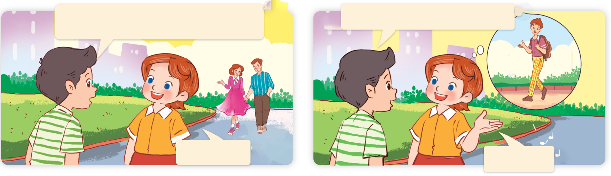
1. Look, listen and repeat.
Do you have a brother, Lucy?
What does he look like?
a
b
Yes, I do.
He’s tall.
Where are they?
What are they talking about?
Who are they?

Slide 6
Vocabulary

Slide 7
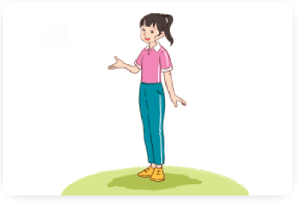
Vocabulary
tall
/tɔːl/
cao

Slide 8
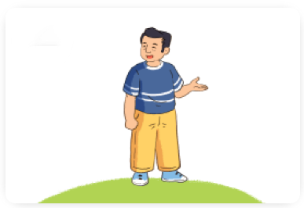
Vocabulary
short
/ʃɔːt/
thấp, ngắn

Slide 9
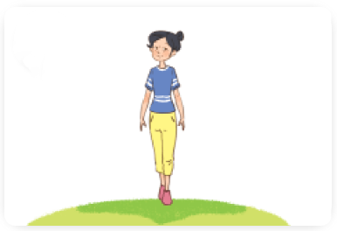
Vocabulary
slim
/slɪm/
mảnh mai

Slide 10
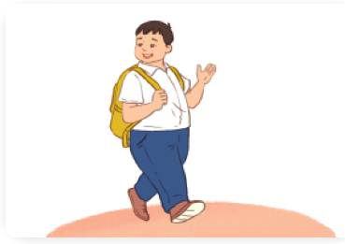
Vocabulary
big
/bɪɡ/
to, lớn

Slide 11
Review
tall
short
slim
big

Slide 12

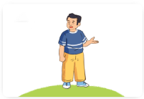
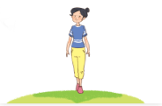

Vocabulary
1. tall
: cao
2. short
: thấp, ngắn
3. slim
: mảnh mai
4. big
: to, lớn

Slide 13
Match
1
2
3
4
a
b
c
d
big
short
tall
slim

Slide 14
2. Listen, point and say.
a
b
What does he / she look like?
tall
short
He’s / She’s ______.
c
d
he’s = he is
she’s = she is
slim
big

Slide 15


2. Listen, point and say.
a
What does he / she look like?
He’s / She’s ______.
tall
What does she look like?
She’s tall.
Click on the sentences to listen.

Slide 16

2. Listen, point and say.
b
What does he / she look like?
He’s / She’s ______.
short
What does he look like?
He’s short.

Slide 17
2. Listen, point and say.
c
What does he / she look like?
He’s / She’s ______.
slim
What does she look like?
She’s slim.

Slide 18
2. Listen, point and say.
d
What does he / she look like?
He’s / She’s ______.
big
What does he look like?
He’s big.

Slide 19
Structures

Slide 20
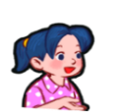


Cách hỏi anh ấy, cô ấy trông như thế nào:
What does he / she look like?
( Anh ấy, cô ấy trông như thế nào?)
He’s / She’s _______.
(Anh ấy / Cô ấy _________.)
he’s = he is
she’s = she is
Ex:
What does she look like?
She’s tall.

Slide 21
Unit 13 lesson 1
What does he / she look like?
He’s / She’s ________.
he’s = he is
she’s = she is
tall
big
short
slim

Slide 22
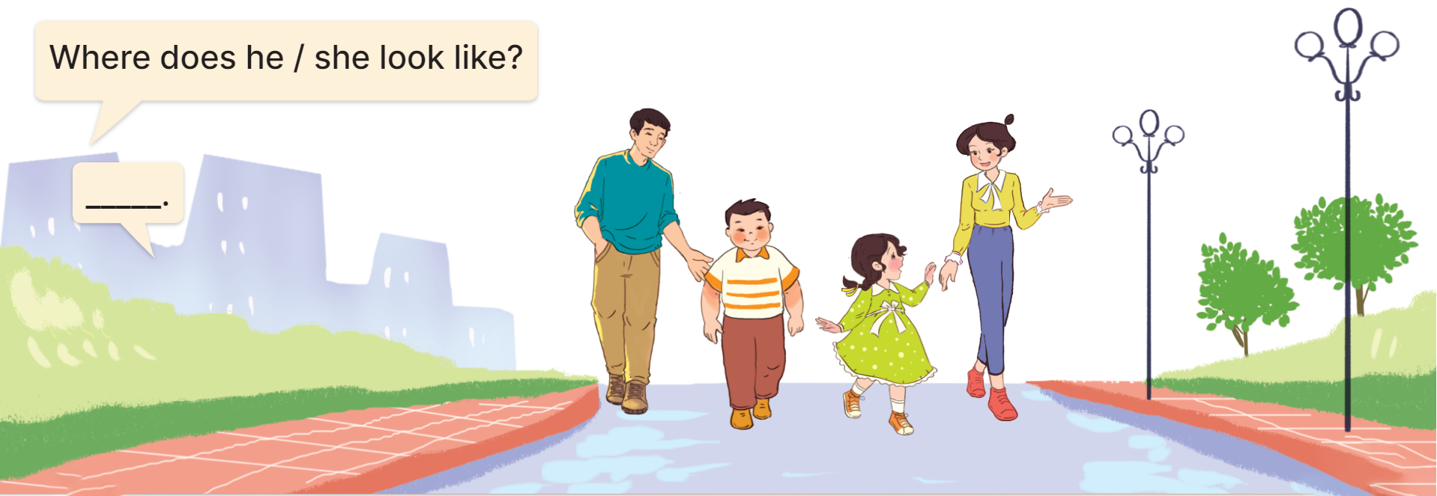
3. Let’s talk.

Slide 23

Facebook: Bùi Liễu
0968142780
Let’s play!

Slide 24






PLAY

Slide 25

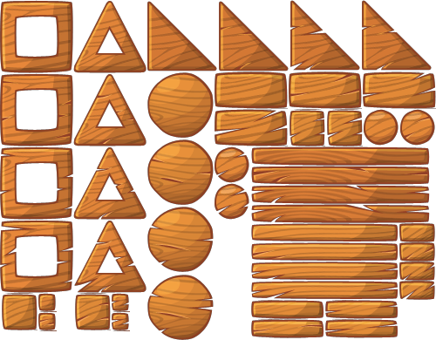





a.
b.
a
b

Slide 26
a.
b.
a
b

Slide 27


a
a.
b.
b

Slide 28
a
a.
b.
b

Slide 29
The meaning of “tall” in Vietnamese is:
a
a.
cao
b.
thấp, ngắn
b

Slide 30
The meaning of “slim” in Vietnamese is:
a
a.
to, lớn
b.
mảnh mai
b

Slide 31

sh__t
A. or
B. ir

Slide 32
b_g
A. i
B. u

Slide 33
What does she look like?
a. She’s tall.
b. She’s a farmer.

Slide 34

A:___________
B: He’s slim.
a
a.
What does he look like?
b.
What does he do?
b

Slide 35
Thank you!

Slide 36
Wrap up

Slide 37
Unit 13 lesson 1
What does he / she look like?
He’s / She’s ________.
he’s = he is
she’s = she is
tall
big
short
slim

Slide 38
Homework
Learn by heart all the new words.
Read again the dialogue in part 1.

Slide 39

Thank you!

