Slide 1

..................................
My house
Unit
13
Lesson 1 (4+5+6)

Slide 2

Warm-up

Slide 3
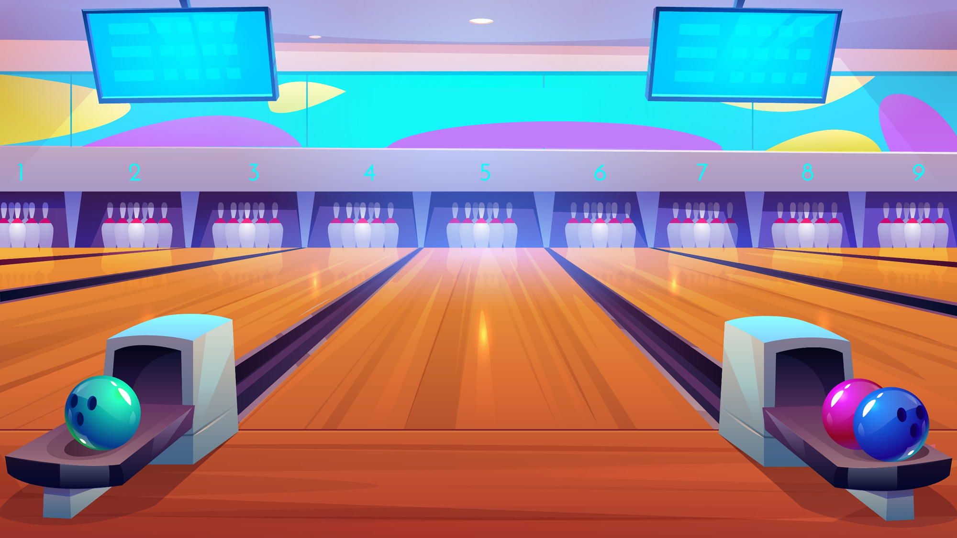




BOWLING
GAME
Notes:
Bùi Liễu

Slide 4
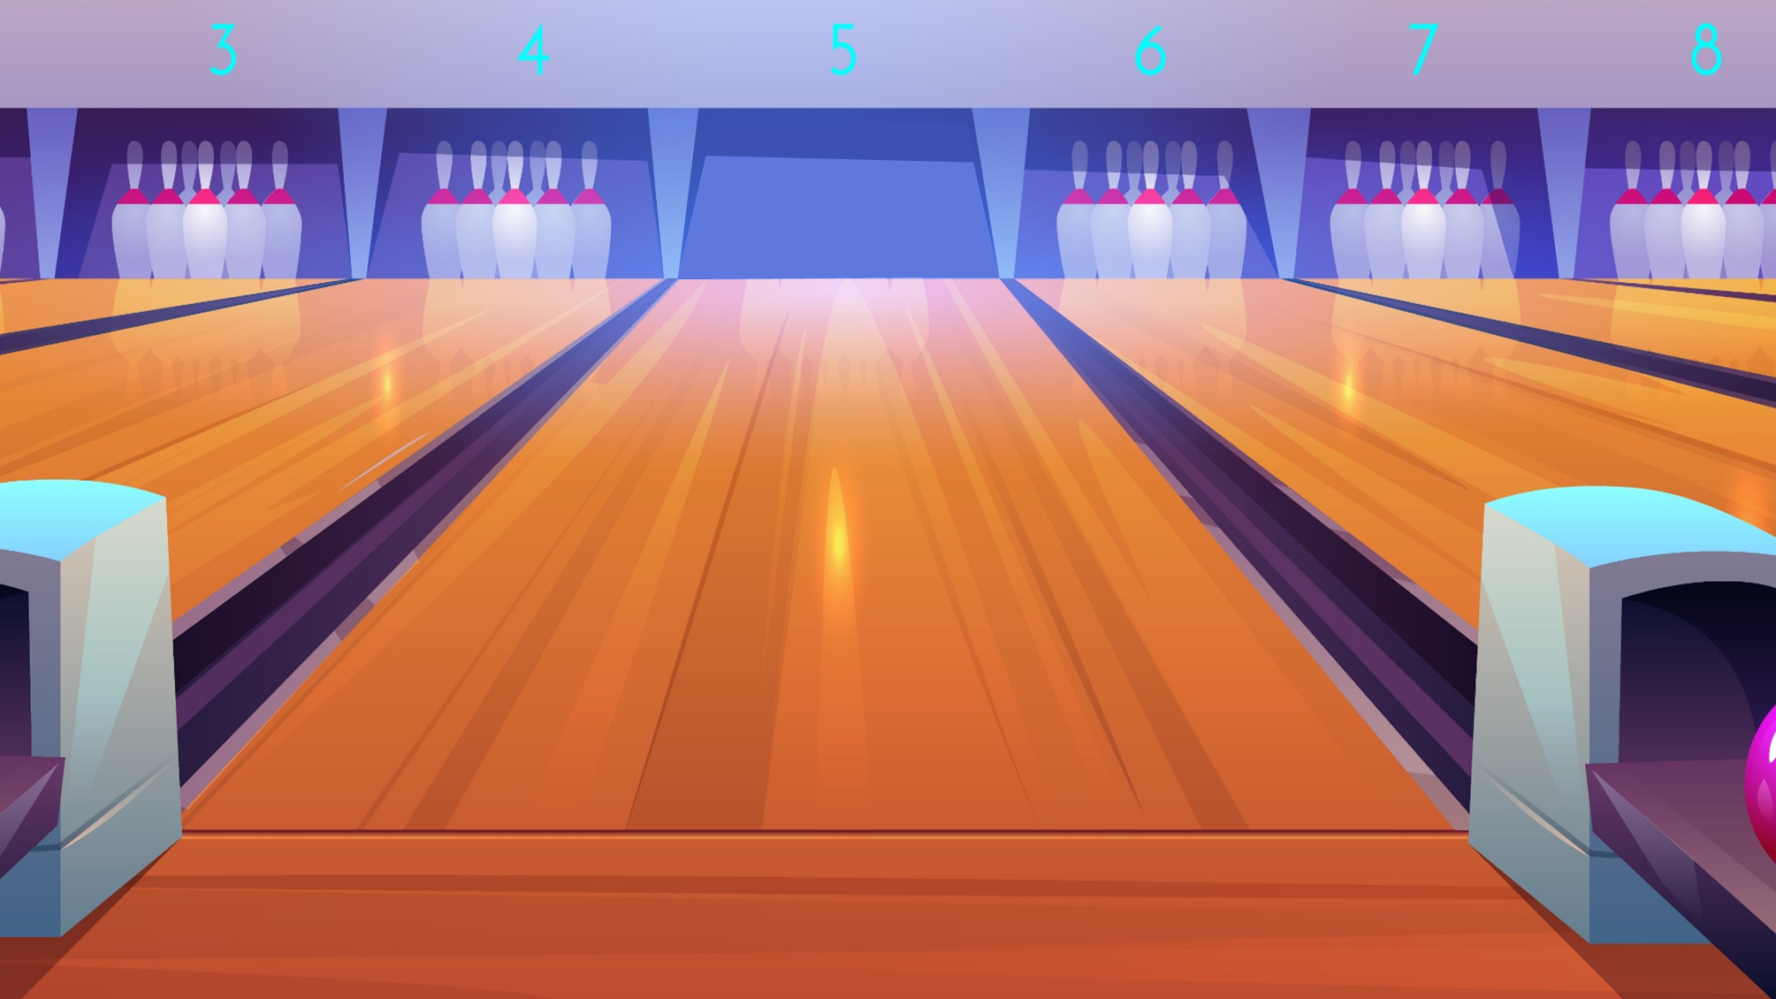
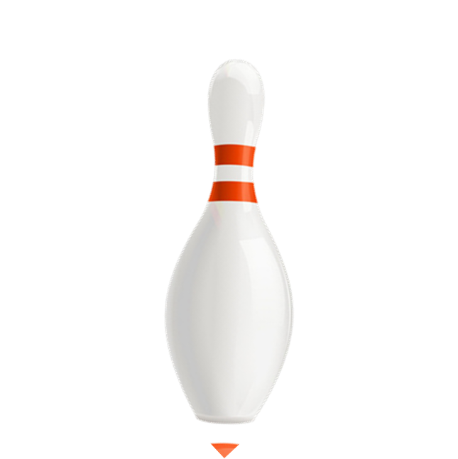
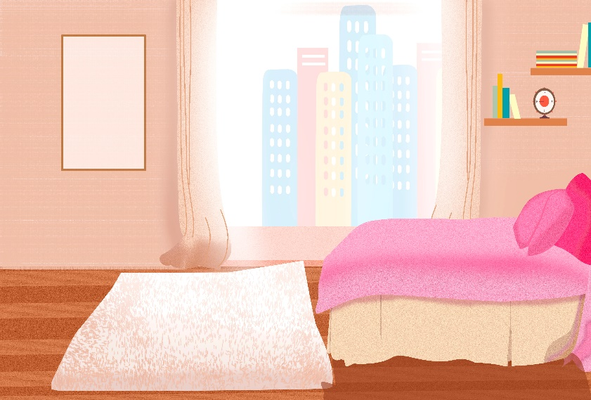


A. bedroom
B. kitchen
C. living room
D. bathroom

Slide 5
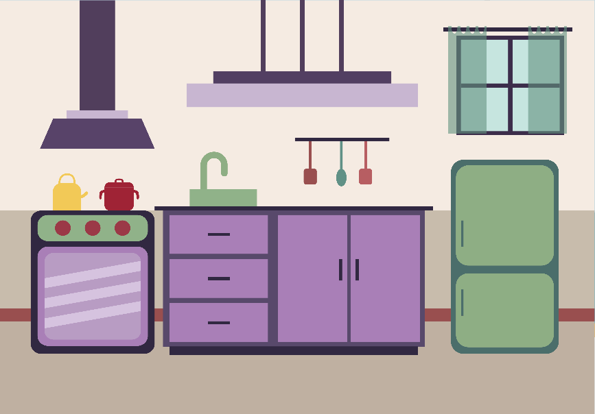
A. living room
B. kitchen
C. bathroom
D. bedroom

Slide 6
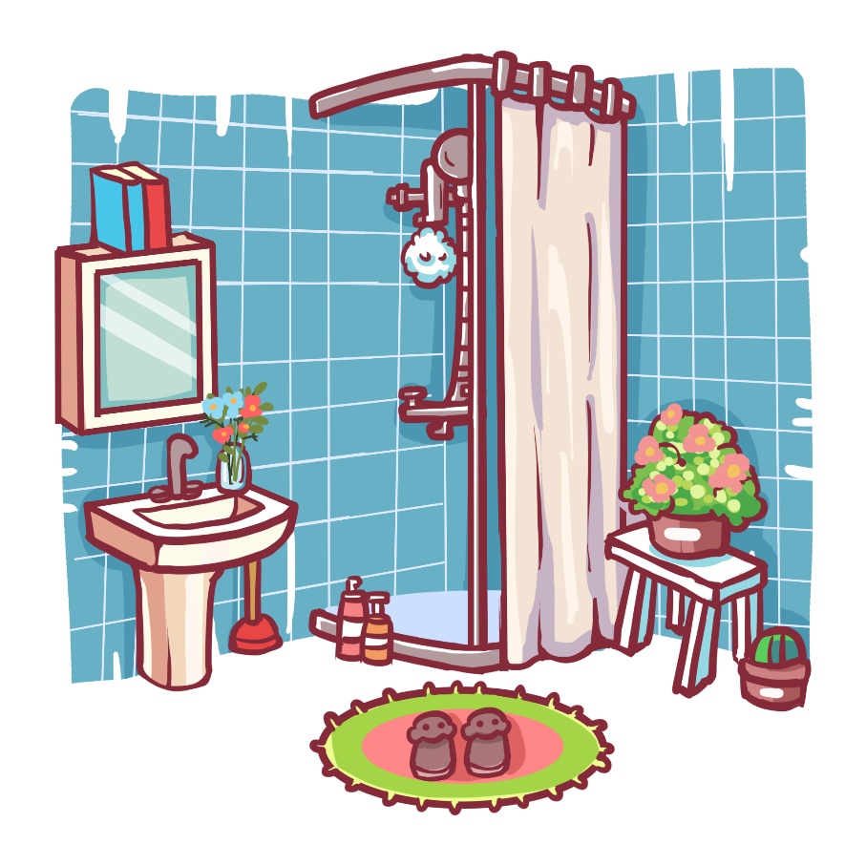
A. bedroom
B. kitchen
C. bathroom
D. living room

Slide 7
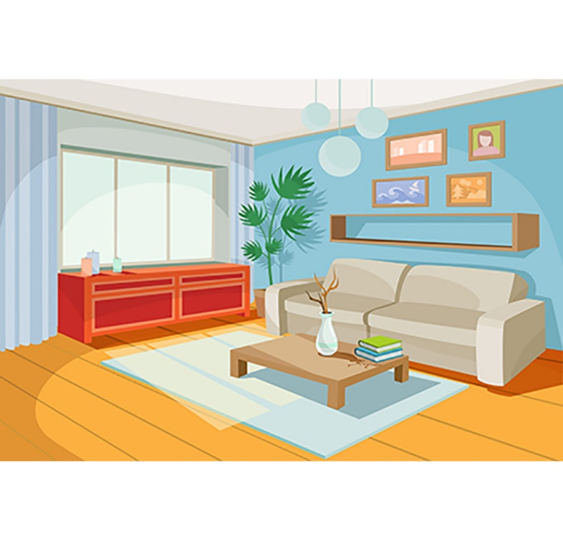
A. kitchen
B. bathroom
C. bedroom
D. living room
Next

Slide 8
_____ room
A. living
B. bed
C. bath
Next
Notes:
Bùi Liễu

Slide 9
A. kitchen
B. bedroom
C. living room
D. bathroom
Next

Slide 10
A. living room
B. bedroom
C. bathroom
D. kitchen
Next

Slide 11
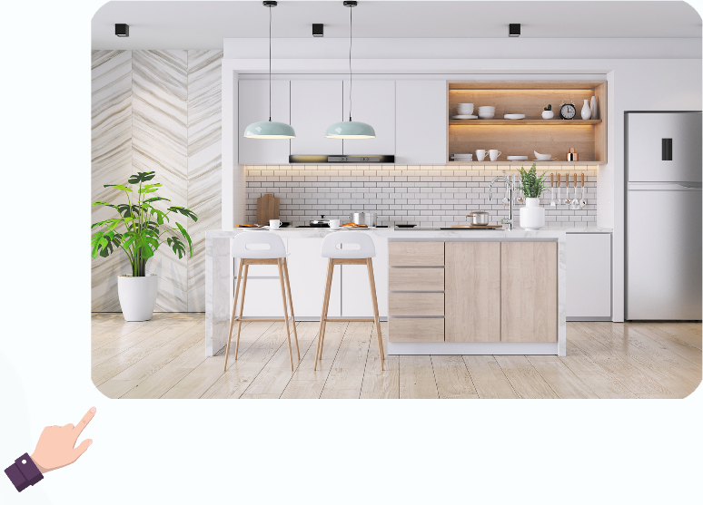
Where’s the kitchen?
A. It’s here.
B. It’s there.
Next

Slide 12
____ the living?
It’s there.
A. Where’s
B. What’s
C. Who’s
D. How’s

Slide 13
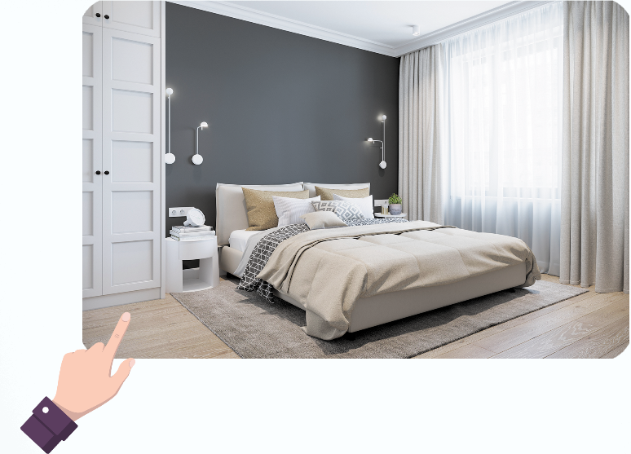
Where’s the _____?
A. living room
B. bedroom
Next

Slide 14
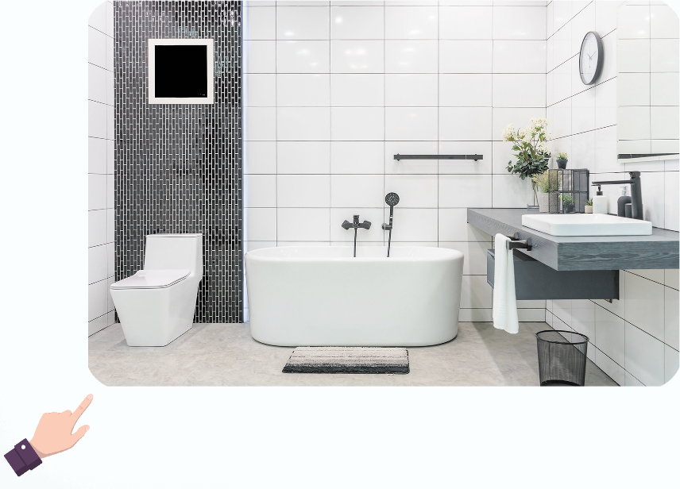
Where’s the bathroom?
It’s ____.
A. here
B. there
Next
Notes:
Bùi Liễu

Slide 15
Where’s the ______?
A. bathroom
B. living room
C. kitchen
Notes:
Bùi Liễu

Slide 16
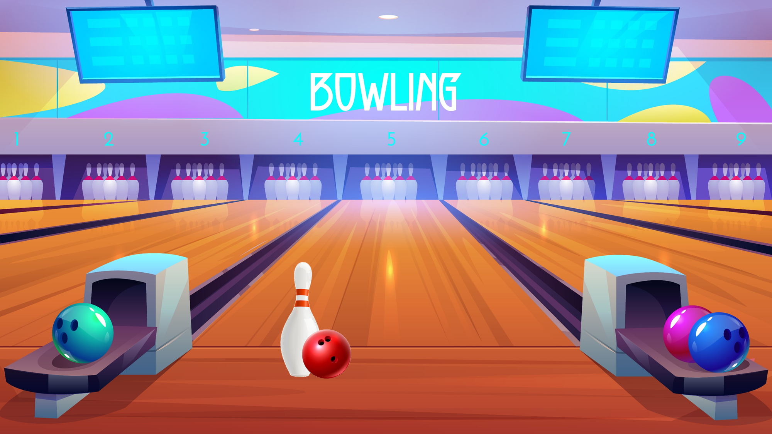



Slide 17



Facebook : Bùi Liễu
0968142780
Contents
Listen and circle.
Look, complete and read.
Let’s sing.

Slide 18


Slide 19
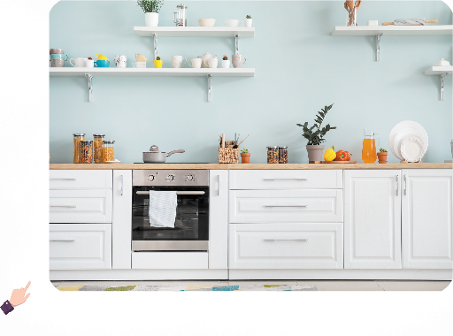
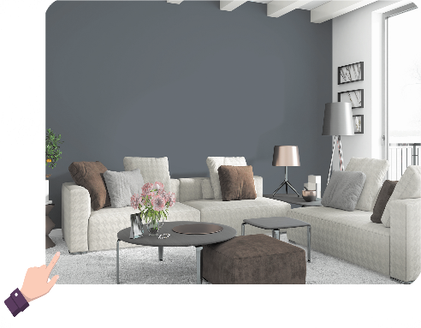
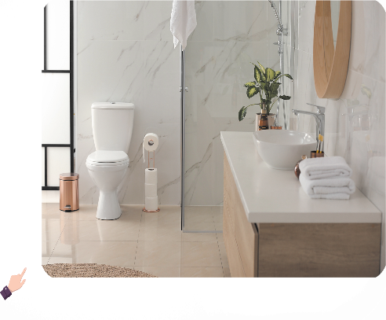
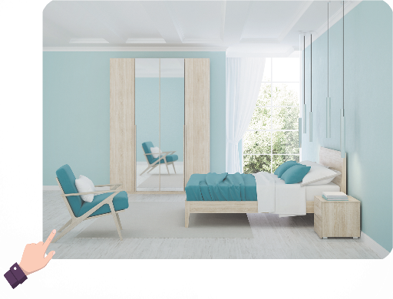
5. Look, complete and read.
1. A: Where’s the ____?
B: It’s here.
2. A: Where’s the ____?
B: It’s there.
3. A: Where’s the ____?
B: It’s ____.
2. A: Where’s the ____?
B: It’s ____.

Slide 20
5. Look, complete and read.
1. A: Where’s the __________?
B: It’s here.
living room

Slide 21
5. Look, complete and read.
2. A: Where’s the __________?
B: It’s there.
dining room

Slide 22
5. Look, complete and read.
3. A: Where’s the __________?
B: It’s _______.
bathroom
there

Slide 23
5. Look, complete and read.
4. A: Where’s the __________?
B: It’s _____.
bedroom
here

Slide 24
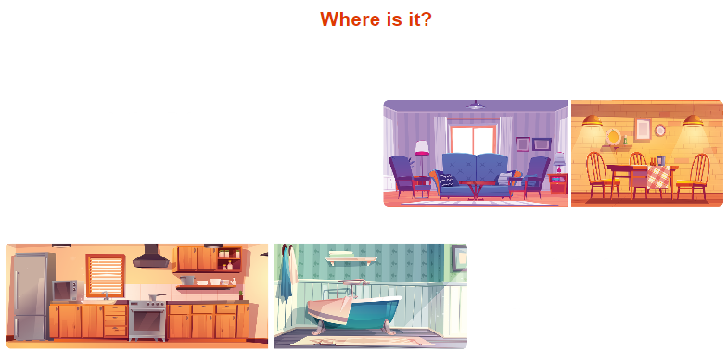
6. Let’s sing.
Where is it?
This is the living room.
Where’s the dining room?
Where is it?
It’s here. It’s here.
That is the kitchen.
Where’s the bathroom?
Where is it?
It’s there. It’s there.

Slide 25

6. Let’s sing.
Where is it?
This is the living room.
Where’s the dining room?
Where is it?
It’s here. It’s here.
That is the kitchen.
Where’s the bathroom?
Where is it?
It’s there. It’s there.

Slide 26

Wrap up

Slide 27

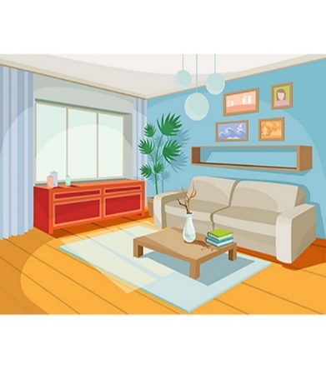
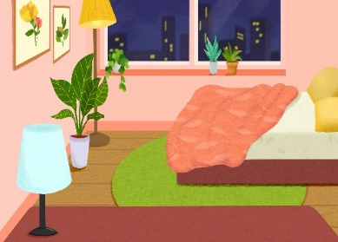

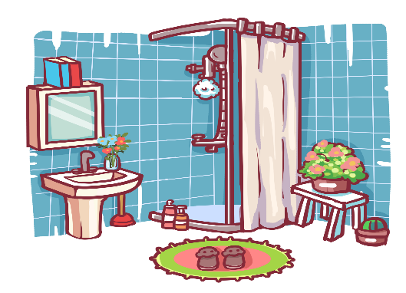
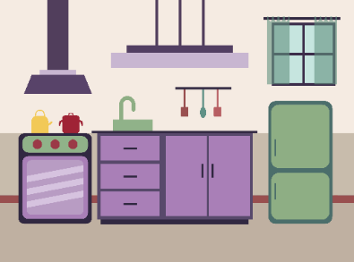


Review
house
living room
bedroom
kitchen
bathroom
here
there

Slide 28
Structures
Hỏi và trả lời về vị trí của căn phòng trong ngôi nhà
- Where’s the _________? It’s here / there.
( _________ ở đâu?)
where’s = where is
it’s = it is
(Nó ở đây/kia.)
Example
Mary: Where’s the living room?
Linh: It’s there.

Slide 29
Homework
...........................................................
...........................................................

Slide 30

Thank you!

