Slide 1


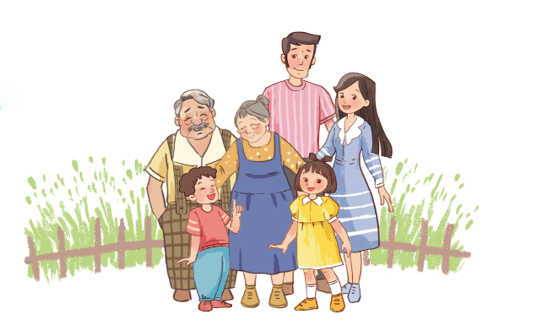
Unit
13
APPEARANCE
Lesson 1 (4+5+6)

Slide 2
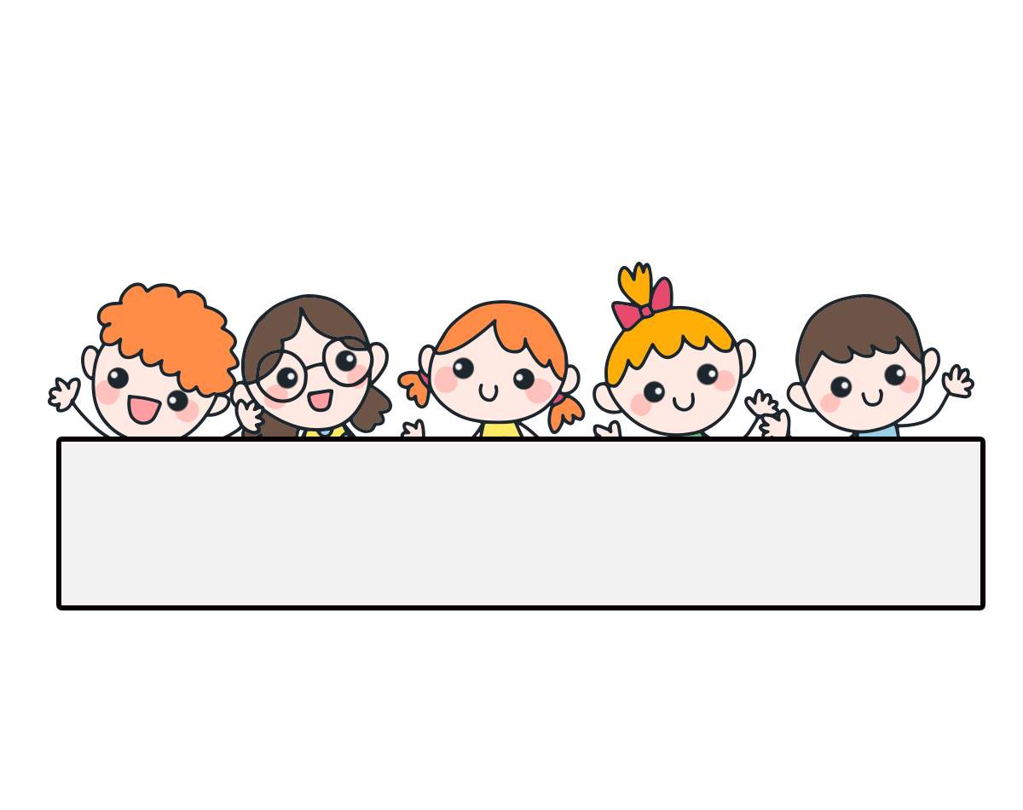
Warm-up

Slide 3


Facebook : Bùi Liễu
0968142780
Let’s play!

Slide 4
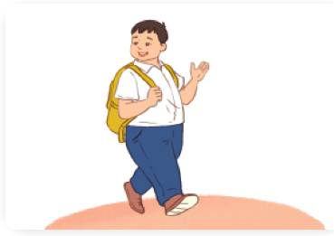


Choose the right answer.
Click the clock to start the timer.
1/10
A
big
B
slim
C
tall
Next
Click on the words/sentences to choose.

Slide 5
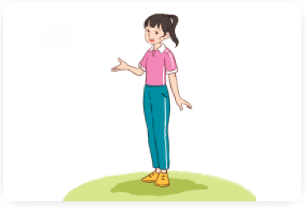
Click the clock to start the timer.
2/10
A
short
B
tall
C
slim
Next

Slide 6
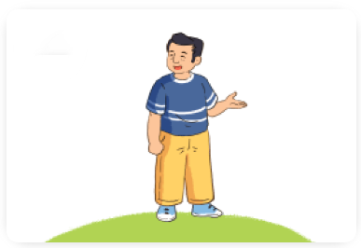
Click the clock to start the timer.
3/10
A
short
B
big
C
tall
Next
Click on the words/sentences to choose.

Slide 7
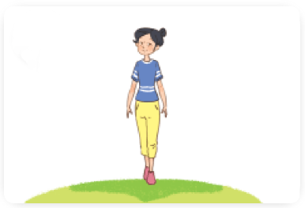
Click the clock to start the timer.
4/10
A
tall
B
slim
C
short
Next

Slide 8
5/10
Click the clock to start the timer.
Choose the odd one out.
A
farmer
B
actor
C
short
Next

Slide 9

6/10
Click the clock to start the timer.
A
She’s an actor.
B
He’s big.
C
She’s tall.
Next

Slide 10
7/10
Click the clock to start the timer.
A
What does she do?
B
What’s the street like?
C
What does he look like?
Next

Slide 11
8/10
Mai: What does she look like?
Nam: She’s tall.
Click the clock to start the timer.
A
False
B
True
Next

Slide 12

9/10
A: What does he look like?
B: She’s slim.
Click the clock to start the timer.
→ He’s big.
A
False
B
True

Slide 13
10/10
A: ______ does he look like?
B: He’s short.
Click the clock to start the timer.
A
Who
B
Where
C
What
Next

Slide 14
Facebook : Bùi Liễu
0968142780
Good job!

Slide 15
Contents
4. Listen and tick.
5. Look, complete and read.
6. Let’s sing.

Slide 16


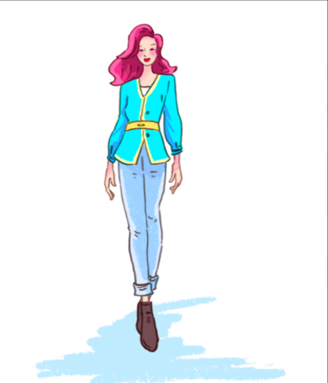
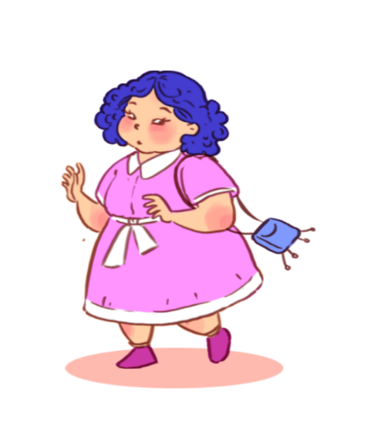
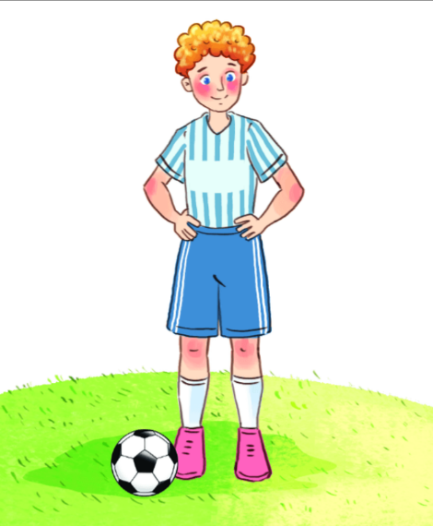
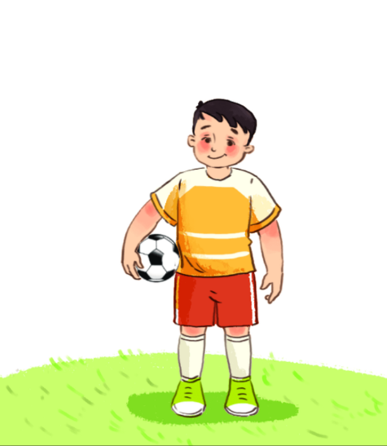


4. Listen and tick.
1.
2.
a
b
a
b

Slide 17
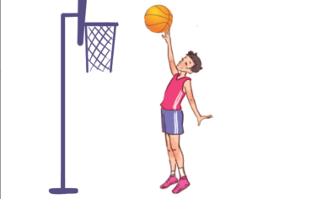
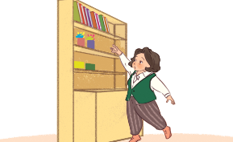
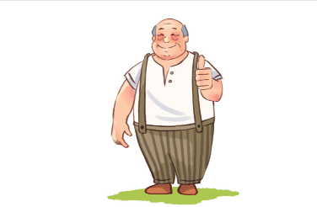
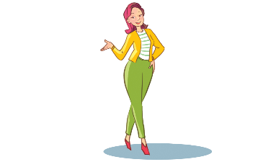
5. Look, complete and read.
1.
A: What does your brother look like?
B: He’s ________.
tall
2.
A: What does your grandmother look like?
B: She’s ________.
short
A: What does your grandfather ____ like?
B: He’s tall and ________.
3.
look
big
What
4.
A: _______ does your mother look like?
B: __________________ and tall.
She’s / She is slim

Slide 18




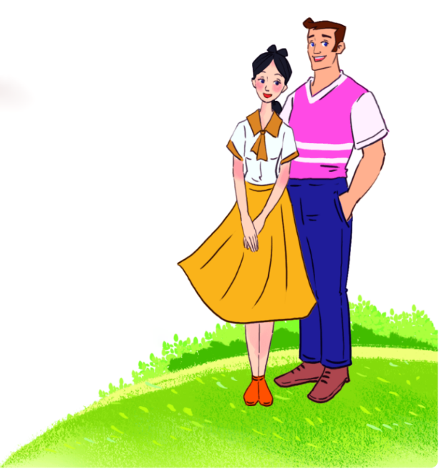






6. Let’s sing.
What do your parents look like?
Your mum,
your mum.
Your dad,
your dad.
What does she look like?
What does he look like?
She’s slim.
She’s tall.
He’s big.
He’s tall.
She’s slim and tall.
He’s big and tall.

Slide 19
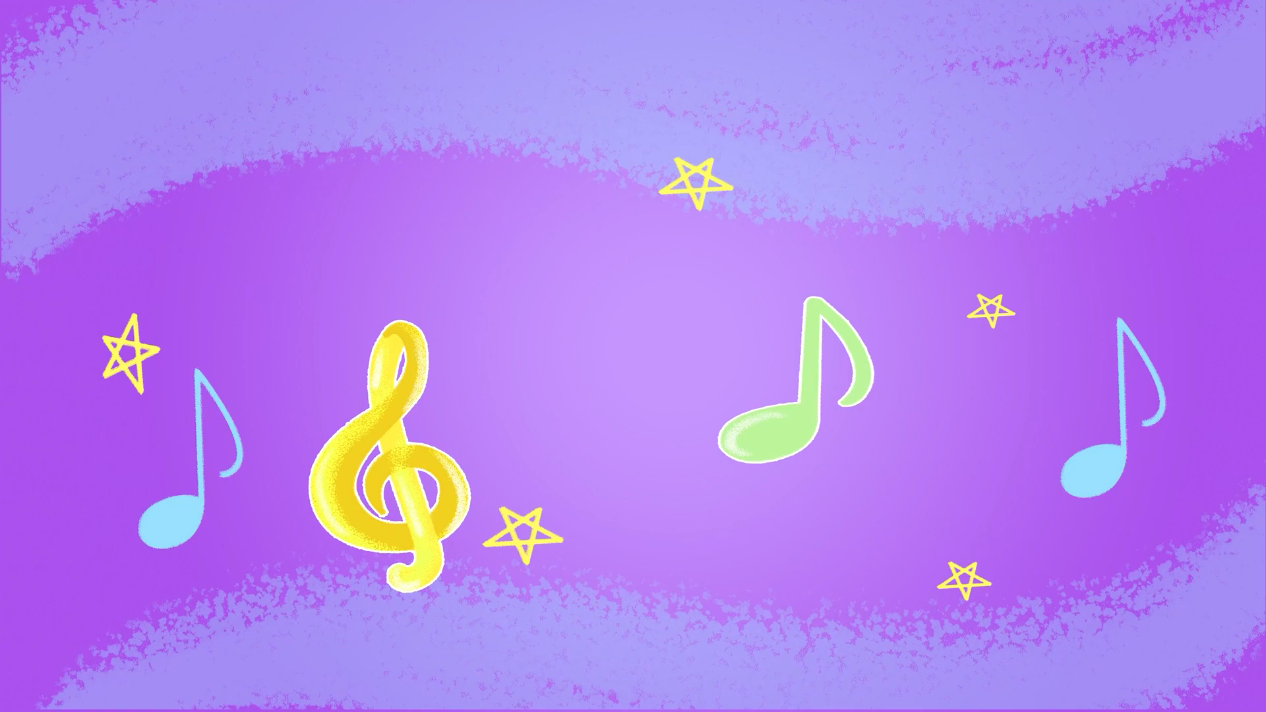
6. Let’s sing.

Slide 20


6. Let’s sing.
What do your parents look like?
Your mum,
your mum.
Your dad,
your dad.
What does she look like?
What does he look like?
She’s slim.
She’s tall.
He’s big.
He’s tall.
She’s slim and tall.
He’s big and tall.

Slide 21
Wrap up

Slide 22


Unit 13 lesson 1
What does he / she look like?
He’s / She’s ________.
he’s = he is
she’s = she is
tall
big
short
slim

Slide 23
Homework
……………………………………...
……………………………………...

Slide 24

Thank you!

