Slide 1

..................................
My house
Unit
13
Lesson 2 (1+2+3)

Slide 2

Warm-up

Slide 3

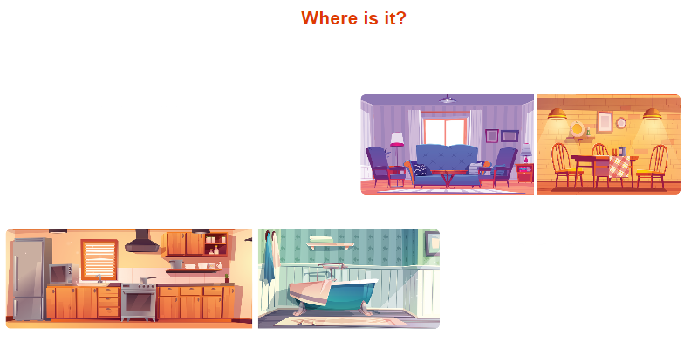
Let’s sing.
Where is it?
This is the living room.
Where’s the dining room?
Where is it?
It’s here. It’s here.
That is the kitchen.
Where’s the bathroom?
Where is it?
It’s there. It’s there.

Slide 4



Contents
Look, listen and repeat.
Listen, point and say.
Let’s talk.

Slide 5

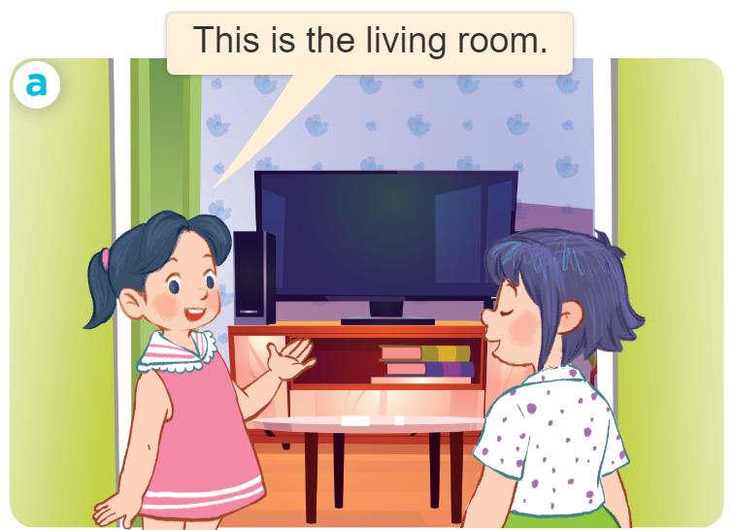
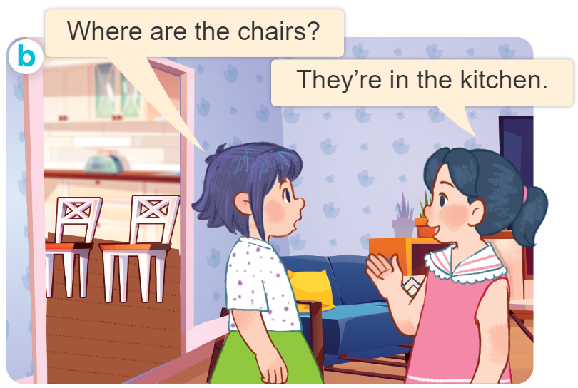
1. Look, listen and repeat.
Who are they?
Where are they?
What are they doing?

Slide 6

1. Look, listen and repeat.
This is the living room.

Slide 7
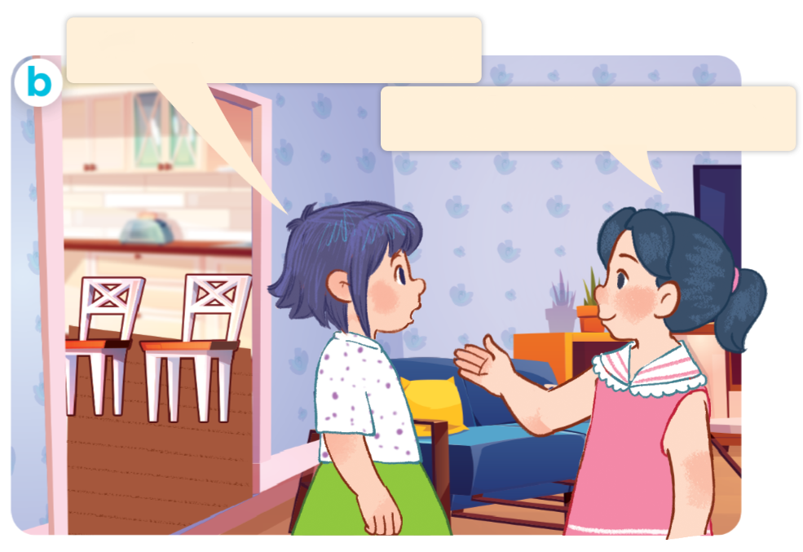
1. Look, listen and repeat.
Where are the chairs?
They’re in the kitchen.

Slide 8
Vocabulary

Slide 9
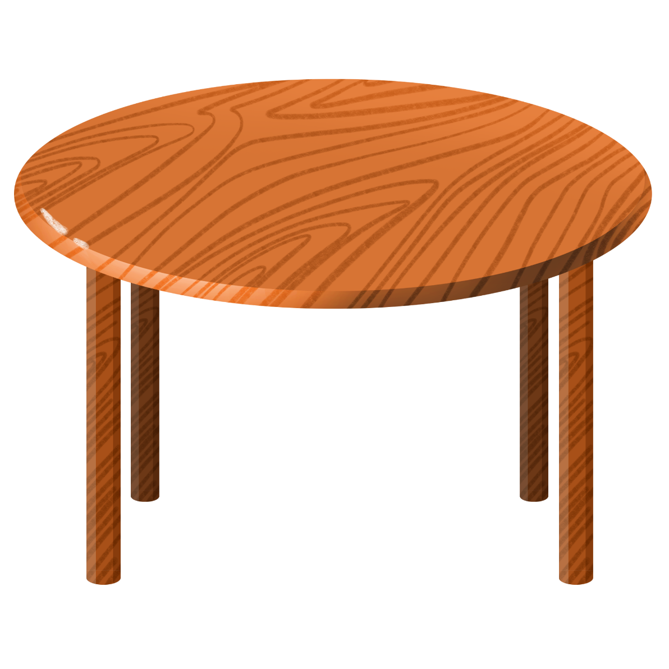
table
/ˈteɪ.bəl/
cái bàn

Slide 10
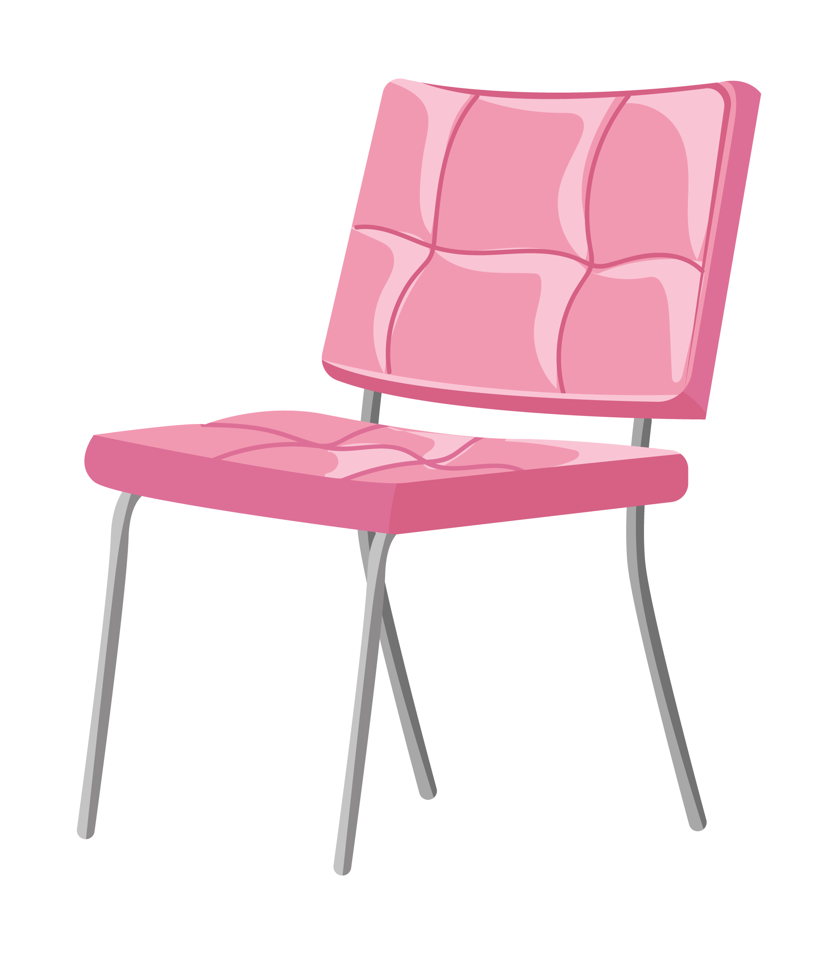
chair
/tʃeər/
cái ghế

Slide 11

lamp
/læmp/
cái đèn

Slide 12
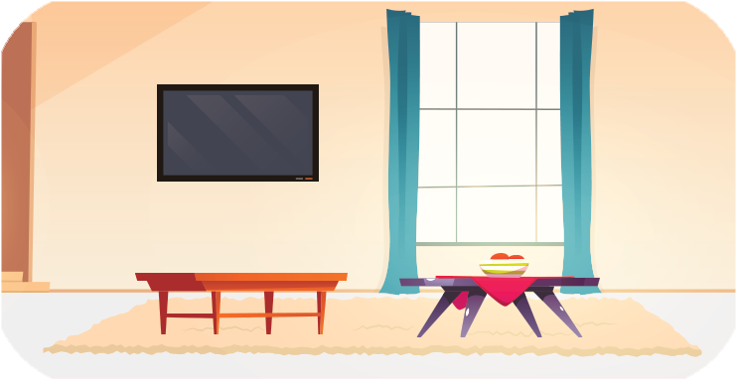
in
/ɪn/
ở trong

Slide 13

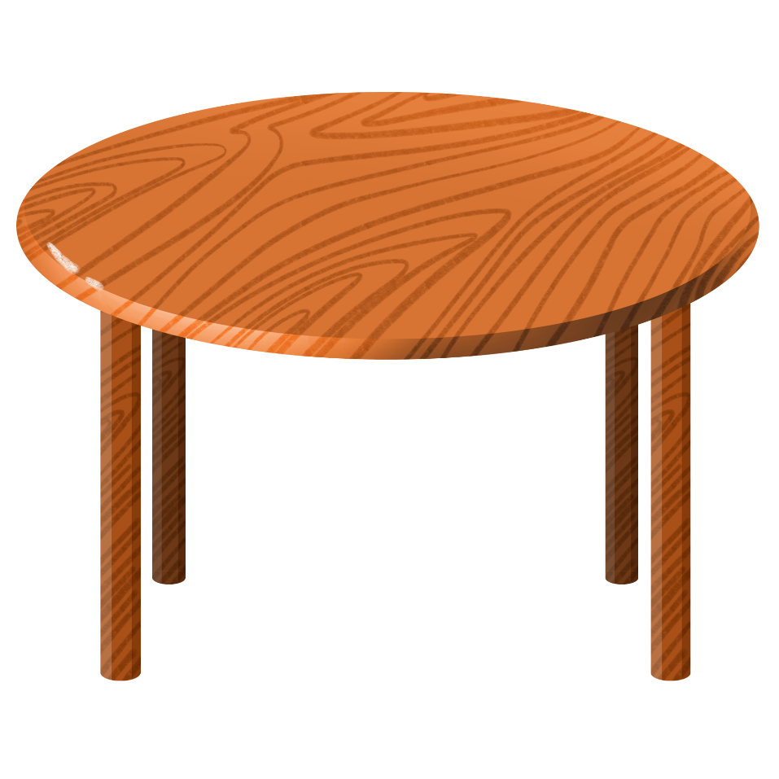
on
/ɒn/
ở trên

Slide 14
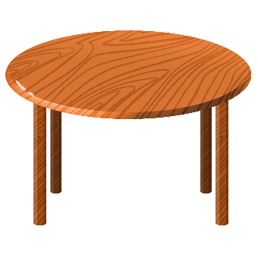
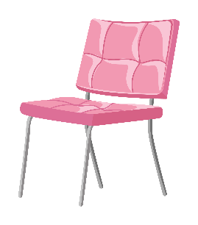

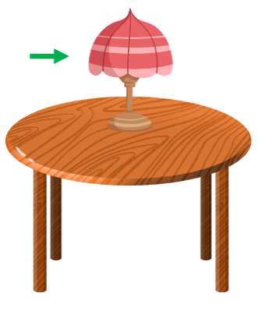
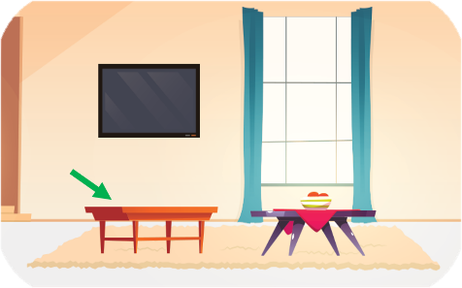
Review
table
chair
lamp
in
on

Slide 15
1/ New words:
table: cái bàn
chair: cái ghế
lamp: cái đèn
in: ở trong
on: ở trên

Slide 16
Structures

Slide 17
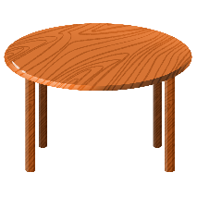




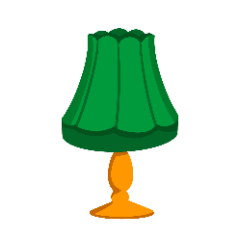




Danh từ số nhiều( 2 vật trở lên)
Danh từ số ít ( 1 vật)
table
tables
chair
chairs
lamp
lamps
book
books

Slide 18
2/ Model sentences:
Hỏi và trả lời đồ vật ở đâu.
A: Where are the _______?
B: They’re __________.
books
on the table.
they’re = they are

Slide 20
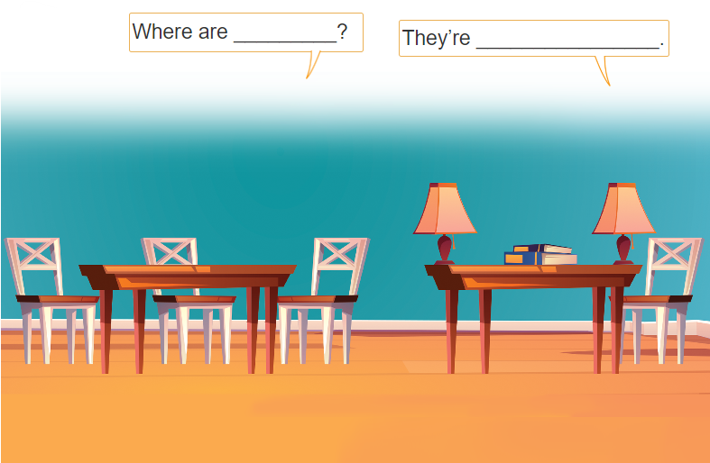
3. Let’s talk.

Slide 21
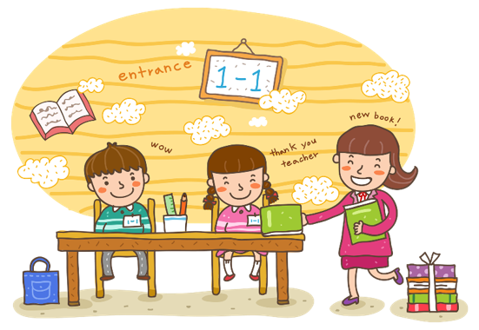
Wrap up

Slide 22
Review
table
chair
lamp
in
on

Slide 23
Singular nouns and plural nouns
table
tables
chair
chairs
lamp
lamps
book
books

Slide 24
Structures
Hỏi và trả lời về vị trí của đồ vật.
- Where are the _______?
They’re _____.
( _________ ở đâu?)
(Chúng ở ______.)
they’re = they are

Slide 25
Homework
Learn by heart all the new words.
Read again the dialogue in part 1.

Slide 26

Thank you!

