Slide 1

..................................
My house
Unit
13
Lesson 2 (4+5+6)

Slide 2

Warm-up

Slide 3
Let’play!

Slide 4



Contents
Listen and number.
Look, circle and read.
Let’s play.

Slide 5


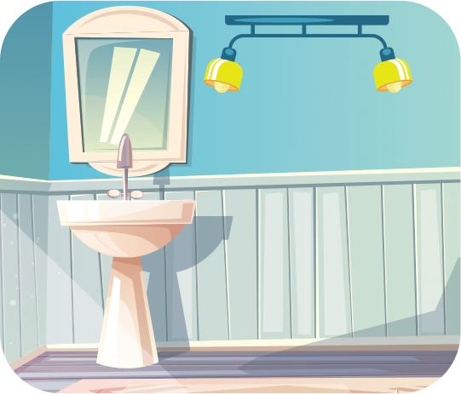
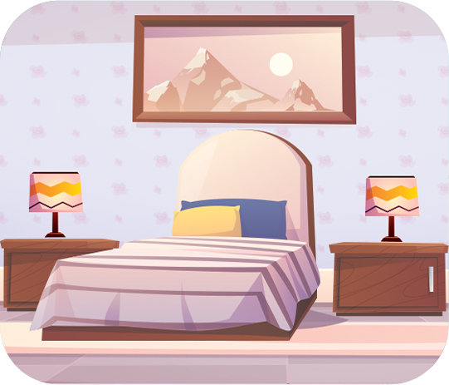
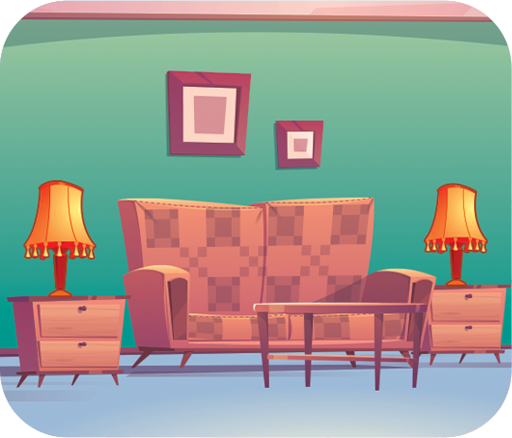
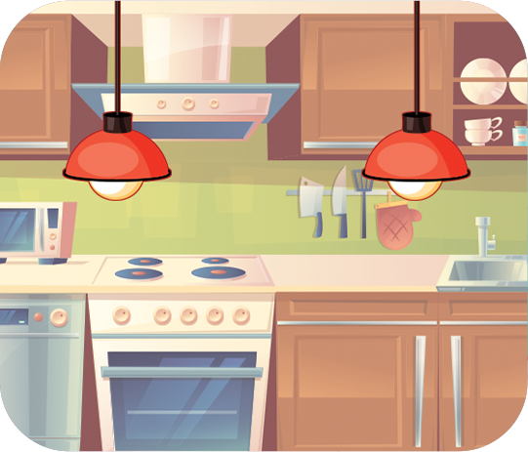




4. Listen and number.
a
b
c
d
3
1
2
4
Notes:
Facebook : Bùi Liễu
Mobile phone: 0968142780

Slide 6
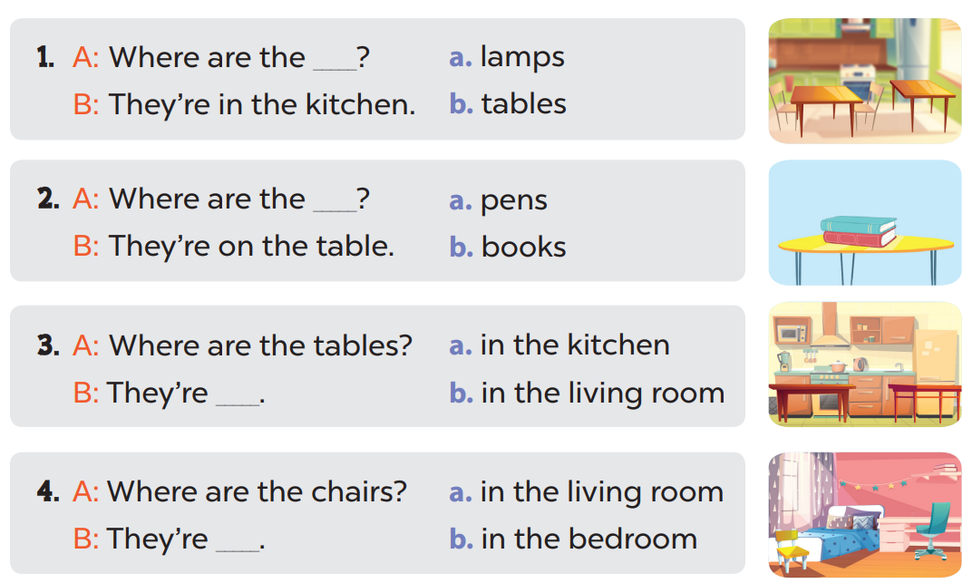
5. Look, circle and read.

Slide 7
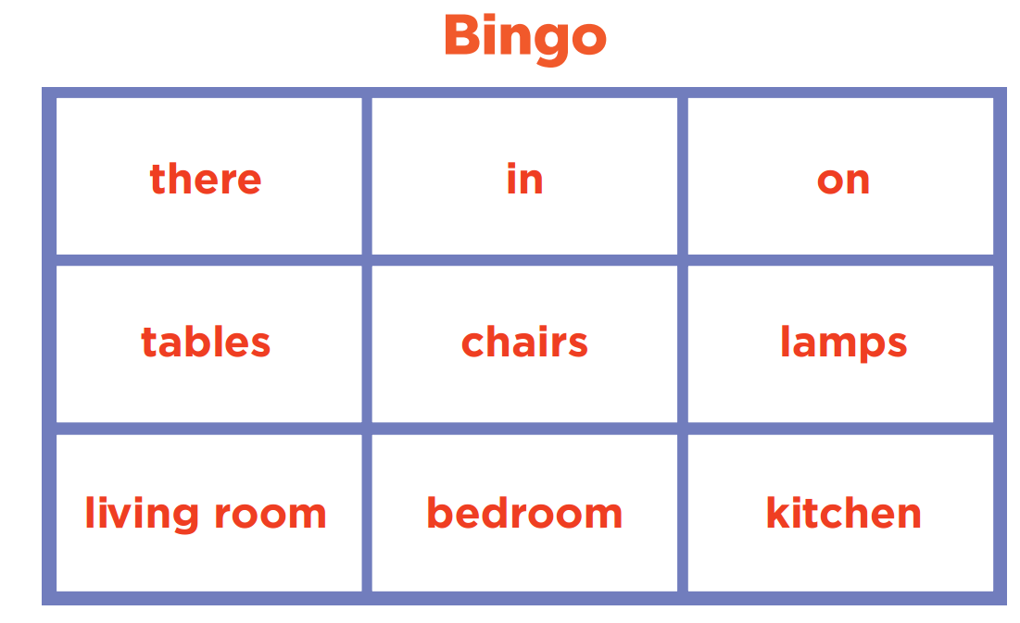
6. Let’s play.

Slide 8
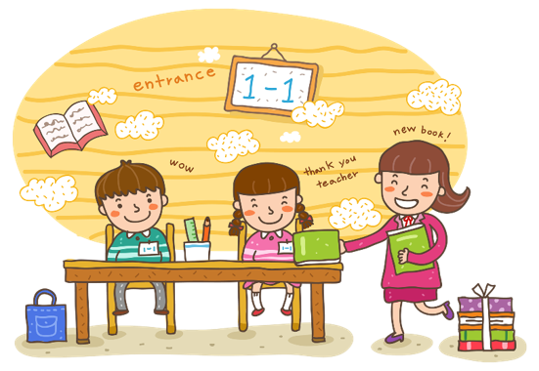
Wrap up

Slide 9
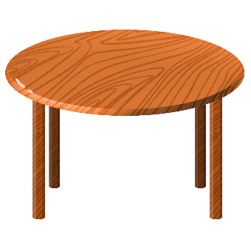
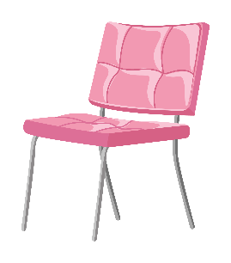

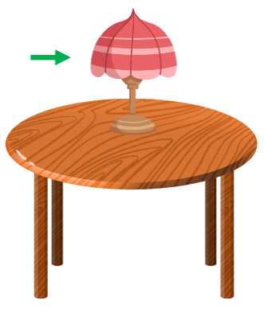
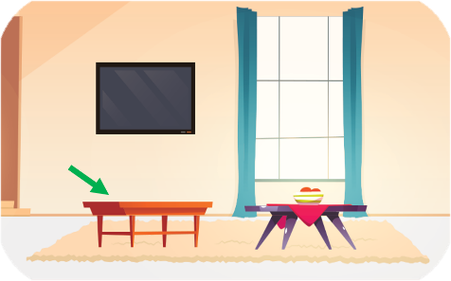
Review
table
chair
lamp
in
on

Slide 10
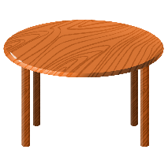




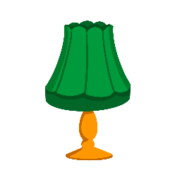




Singular nouns and plural nouns
table
tables
chair
chairs
lamp
lamps
book
books

Slide 11
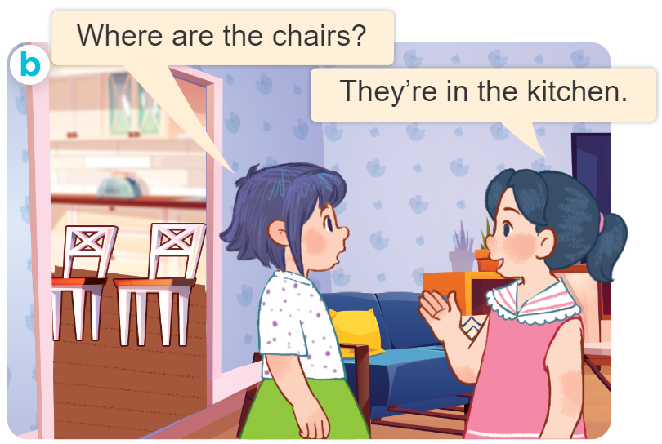
Structures
Hỏi và trả lời về vị trí của đồ vật.
- Where are the _______?
They’re _____.
( _________ ở đâu?)
(Chúng ở ______.)
they’re = they are

Slide 12
Homework
...............................................................
...............................................................

Slide 13

Thank you!

