Slide 1


Slide 2


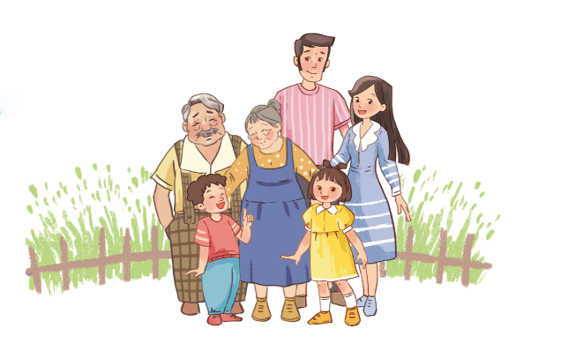
Facebook : Bùi Liễu
0968142780
Unit
13
APPEARANCE
Lesson 2 (4+5+6)

Slide 3
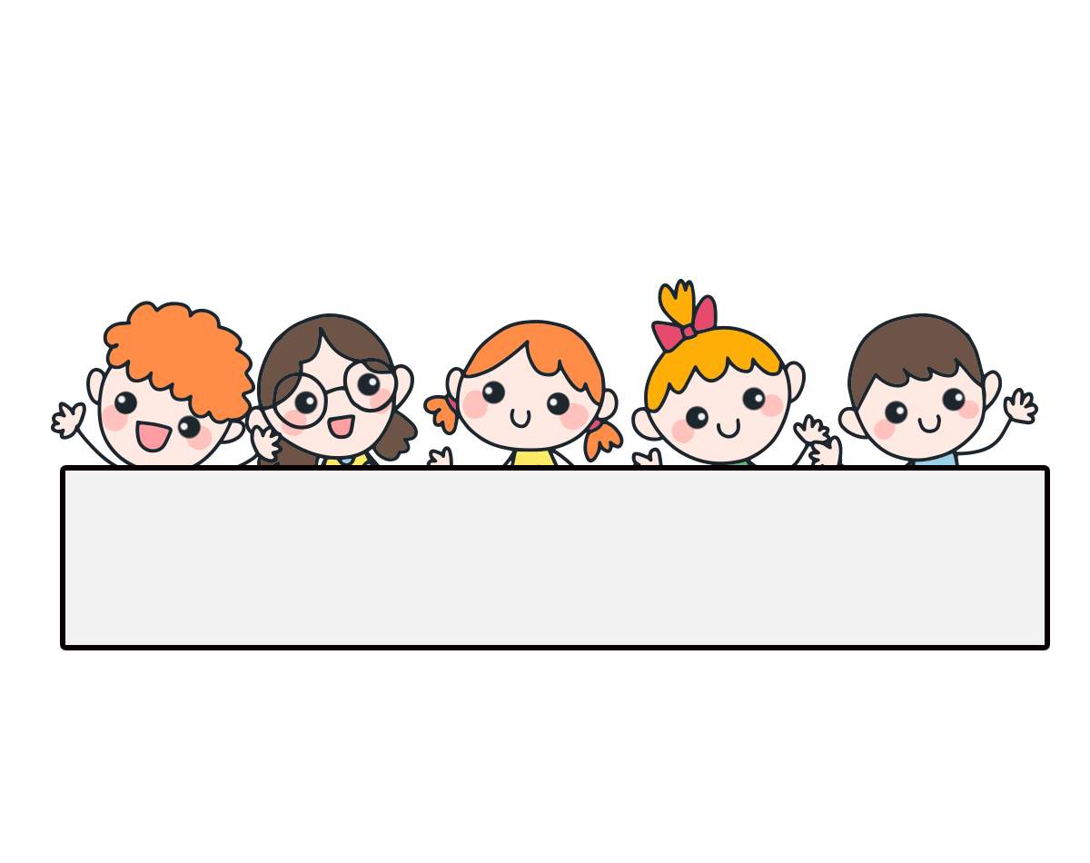
Warm-up

Slide 4
Play game!

Slide 5



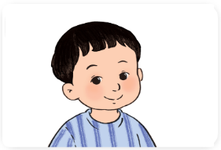

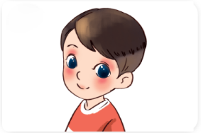
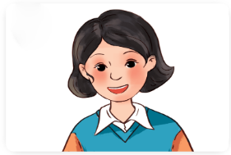



Question 1
10
9
8
7
6
5
4
3
2
1
0
A.
B.
C.
Nhấn vào “play” để xuất hiện 3 đáp án và xuất hiện đồng hồ đếm ngược 10 giây. Hết 10 giây suy nghĩ, sẽ xuất hiện dấu “???”. GV nhấn vào “???” để hiển thị đán án đúng. Nhấn “next” để chuyển tới câu khác.

Slide 6
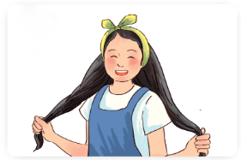

Question 2
10
9
8
7
6
5
4
3
2
1
0
A.
B.
C.

Slide 7

Question 3
10
9
8
7
6
5
4
3
2
1
0
A.
B.
C.

Slide 8

Question 4
10
9
8
7
6
5
4
3
2
1
0
What does he look like?
A. She has big eyes.
B. He has a round face.
C. He has short hair.

Slide 9

Question 5
10
9
8
7
6
5
4
3
2
1
0
___ eyes
A. round
B. small
C. big

Slide 10

Question 6
10
9
8
7
6
5
4
3
2
1
0
____ hair
A. long
B. big
C. short

Slide 11
Question 7
10
9
8
7
6
5
4
3
2
1
0
A. short hair
Choose the odd one out:
B. father
C. round face

Slide 12
Question 8
10
9
8
7
6
5
4
3
2
1
0
A. street
Choose the odd one out:
B. long hair
C. road

Slide 13
Question 9
10
9
8
7
6
5
4
3
2
1
0
A. What does she look like?
A: ____________
B: He has big eyes.
B. What does he look like?
C. Where do you live?

Slide 14
Question 10
10
9
8
7
6
5
4
3
2
1
0
She has long hair.
A. False
B. True

Slide 15


Click on the bell.

Slide 16



Contents
Listen and number.
Look, complete and read.
Let’s play.

Slide 17
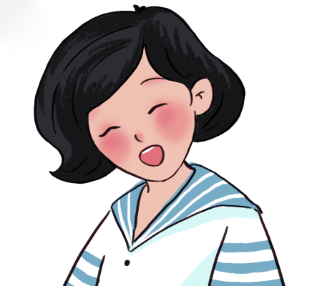
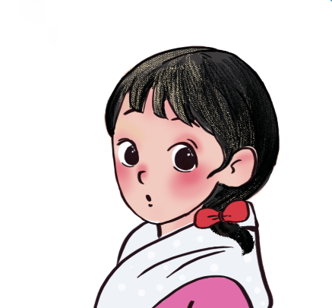
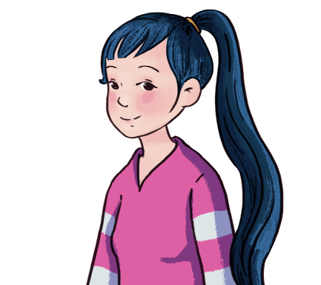
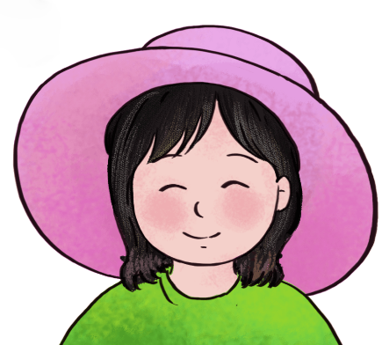




4. Listen and number.
a
b
c
d
2
4
3
1

Slide 18
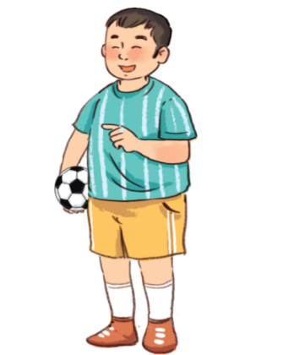
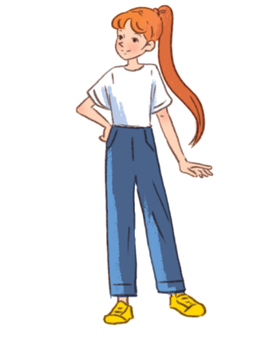
5. Look, complete and read.
1.
A: Do you have a brother, Mai?
B: Yes, I do.
A: What does he look like?
B: He’s _________. He has a round _____.
big / short
face
2.
A: Do you have a sister, Bill?
B: Yes, I do.
A: What does she _____________?
B: She’s slim. She has ____________.
look like
long hair

Slide 19
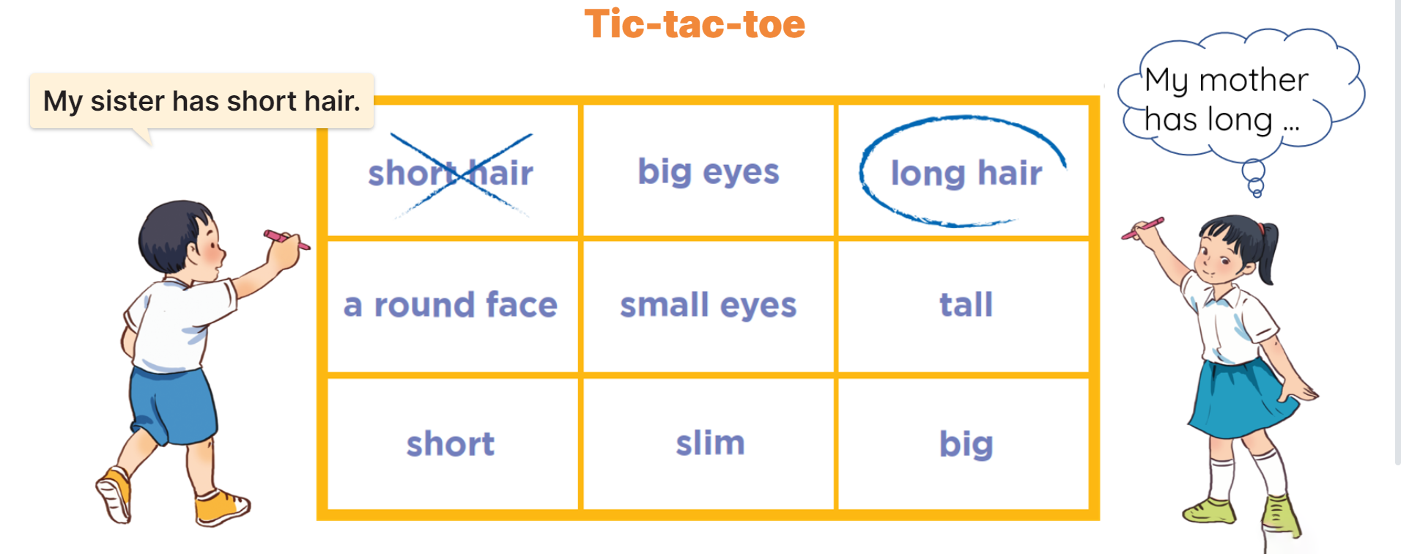
6. Let’s play.

Slide 20
Wrap up

Slide 21


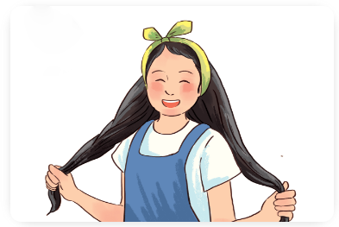
Unit 13 lesson 2
What does he / she look like?
He / She has ________.
short hair
big eyes
long hair
round face

Slide 22
Homework
……………………………………..
……………………………………..

Slide 23

Thank you!

