Slide 1

..................................
My house
Unit
13
Lesson 3 (1+2+3)

Slide 2

Warm-up

Slide 3

Let’s play!
Notes:
Facebook : Bùi Liễu
Mobile phone: 0968142780

Slide 4


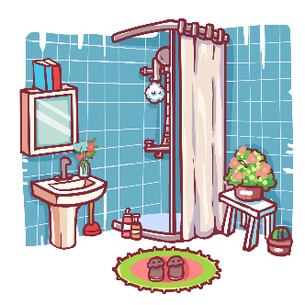
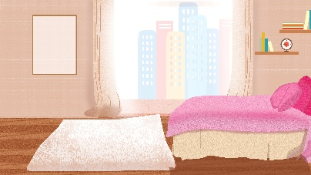

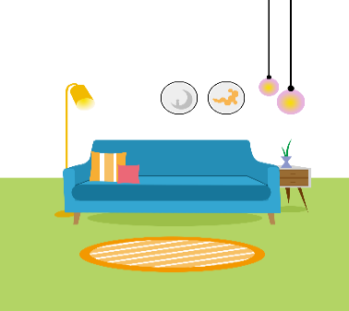
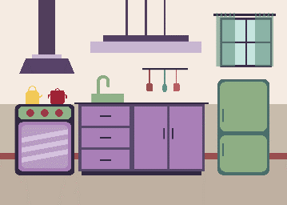
Choose the right answer.
a
b
c
d
kitchen
Next
Notes:
Facebook : Bùi Liễu Mobile phone: 0968142780

Slide 5
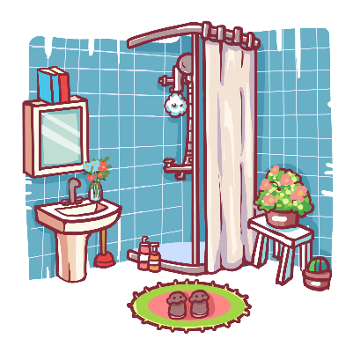


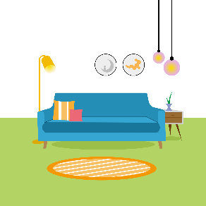
Choose the right answer.
a
b
c
d
living room
Next
Notes:
Facebook : Bùi Liễu
Mobile phone: 0968142780

Slide 6
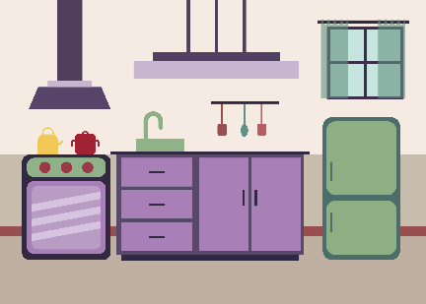

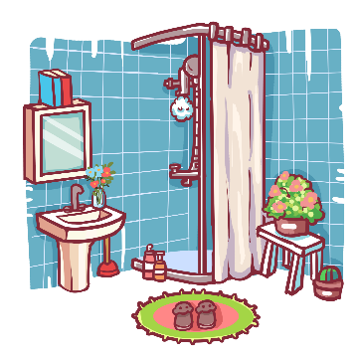

Choose the right answer.
a
b
c
d
bedroom
Next
Notes:
Facebook : Bùi Liễu
Mobile phone: 0968142780

Slide 7
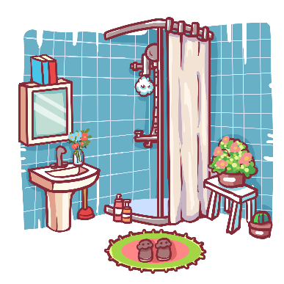

Choose the right answer.
a
b
c
d
bathroom
Next
Notes:
Facebook : Bùi Liễu
Mobile phone: 0968142780

Slide 8


Choose the right answer.
a
b
c
d
Next
Notes:
Facebook : Bùi Liễu
Mobile phone: 0968142780

Slide 9
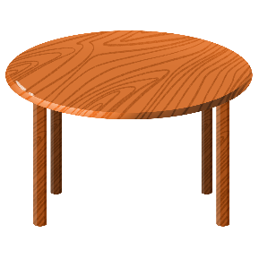
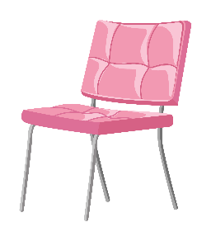
Choose the right answer.
a
b
c
d
Next
Notes:
Facebook : Bùi Liễu
Mobile phone: 0968142780

Slide 10
Facebook : Bùi Liễu
0968142780
Choose the right answer.
a
b
Where’s the kitchen?
It’s here.
Next
Notes:
Facebook : Bùi Liễu Mobile phone: 0968142780

Slide 11
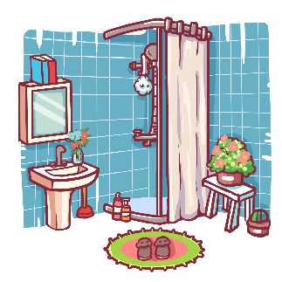
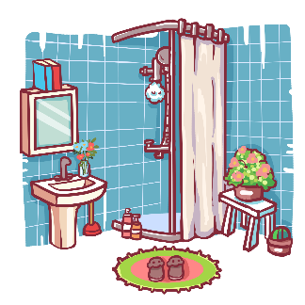
Choose the right answer.
a
b
Where’s the bathroom
It’s there.
Next
Notes:
Facebook : Bùi Liễu
Mobile phone: 0968142780

Slide 12
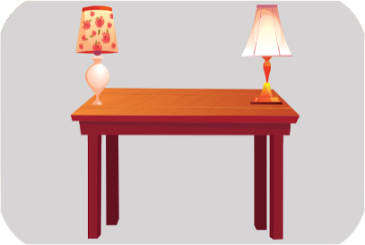
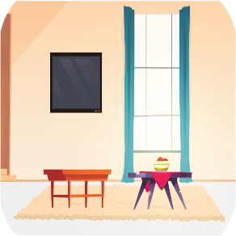
Choose the right answer.
a
b
Where are the table?
They’re in the livingroom
Next
Notes:
Facebook : Bùi Liễu
Mobile phone: 0968142780

Slide 13
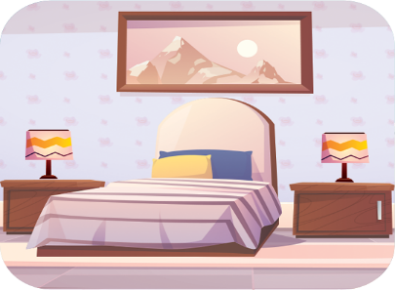
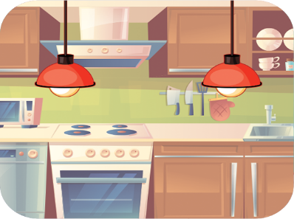
Choose the right answer.
a
b
Where are the lamps?
They are in the bedroom.
Next
Notes:
Facebook : Bùi Liễu
Mobile phone: 0968142780

Slide 14

Good job!
Notes:
Facebook : Bùi Liễu Mobile phone: 0968142780

Slide 15



Contents
Facebook : Bùi Liễu
0968142780
Look, listen and repeat.
Listen and circle.
Let’s chant.

Slide 16

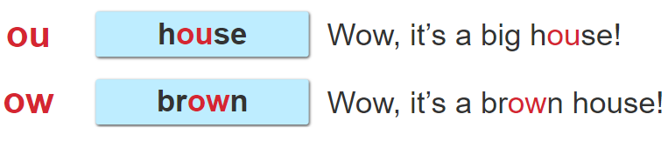
1. Look, listen and repeat.

Slide 17
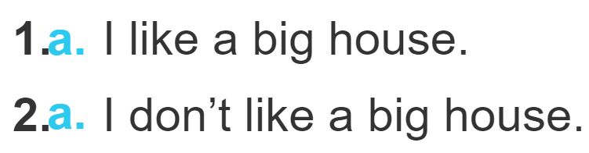
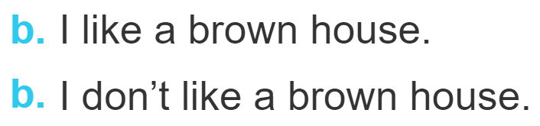
2. Listen and circle.

Slide 18
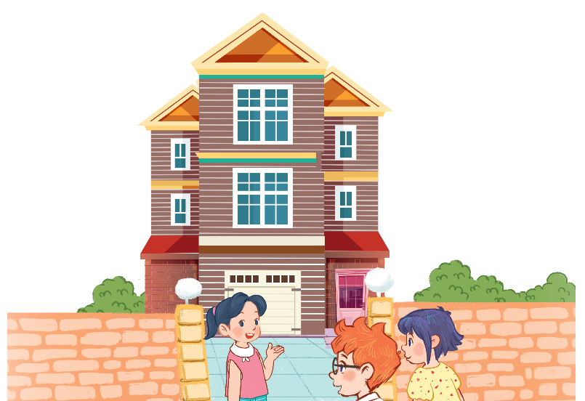
3. Let’s chant.
Big house, big house.
It’s a big house.
It’s my big house.
Come in, please!
Brown house, brown house.
It’s a brown house.
It’s my brown house.
Come in, please!

Slide 19
3. Let’s chant.
Big house, big house.
It’s a big house.
It’s my big house.
Come in, please!
Brown house, brown house.
It’s a brown house.
It’s my brown house.
Come in, please!

Slide 20

Wrap up

Slide 21

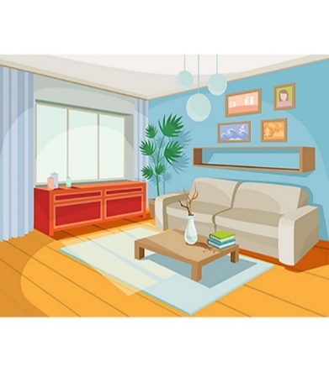
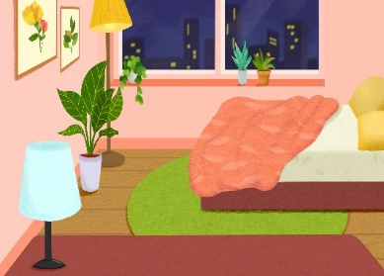

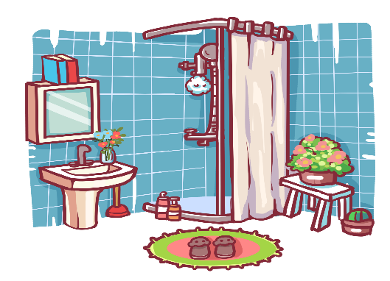



Review
house
living room
bedroom
kitchen
bathroom
here
there

Slide 22
Structures
Hỏi và trả lời về vị trí của căn phòng trong ngôi nhà
- Where’s the _________? It’s here / there.
( _________ ở đâu?)
where’s = where is
it’s = it is
(Nó ở đây/kia.)
Example
Mary: Where’s the living room?
Linh: It’s there.

Slide 23
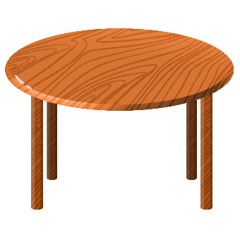


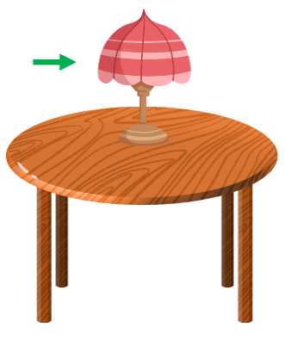
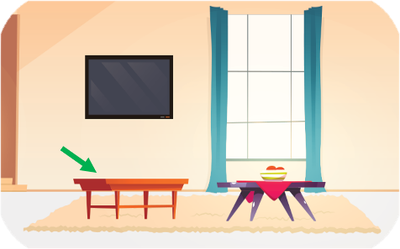
Review
table
chair
lamp
in
on

Slide 24
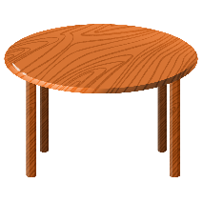









Singular nouns and plural nouns
table
tables
chair
chairs
lamp
lamps
book
books

Slide 25
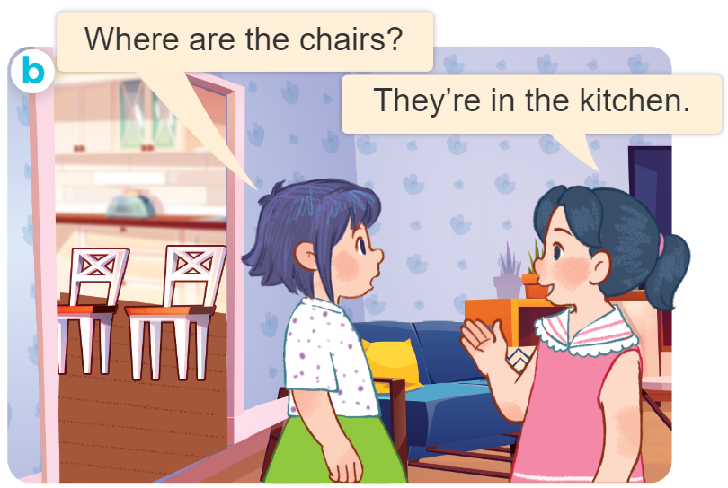
Structures
Hỏi và trả lời về vị trí của đồ vật.
- Where are the _______?
They’re _____.
( _________ ở đâu?)
(Chúng ở ______.)
they’re = they are

Slide 26
Homework
........................................
........................................

Slide 27

Thank you!

