Slide 1


Slide 2


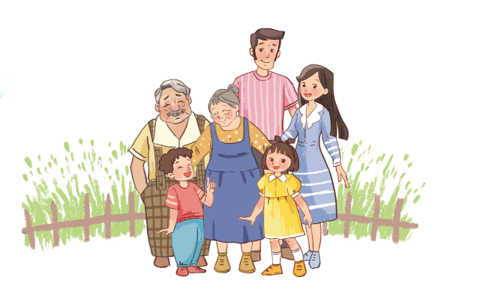
Unit
13
APPEARANCE
Lesson 3 (4+5+6)

Slide 3
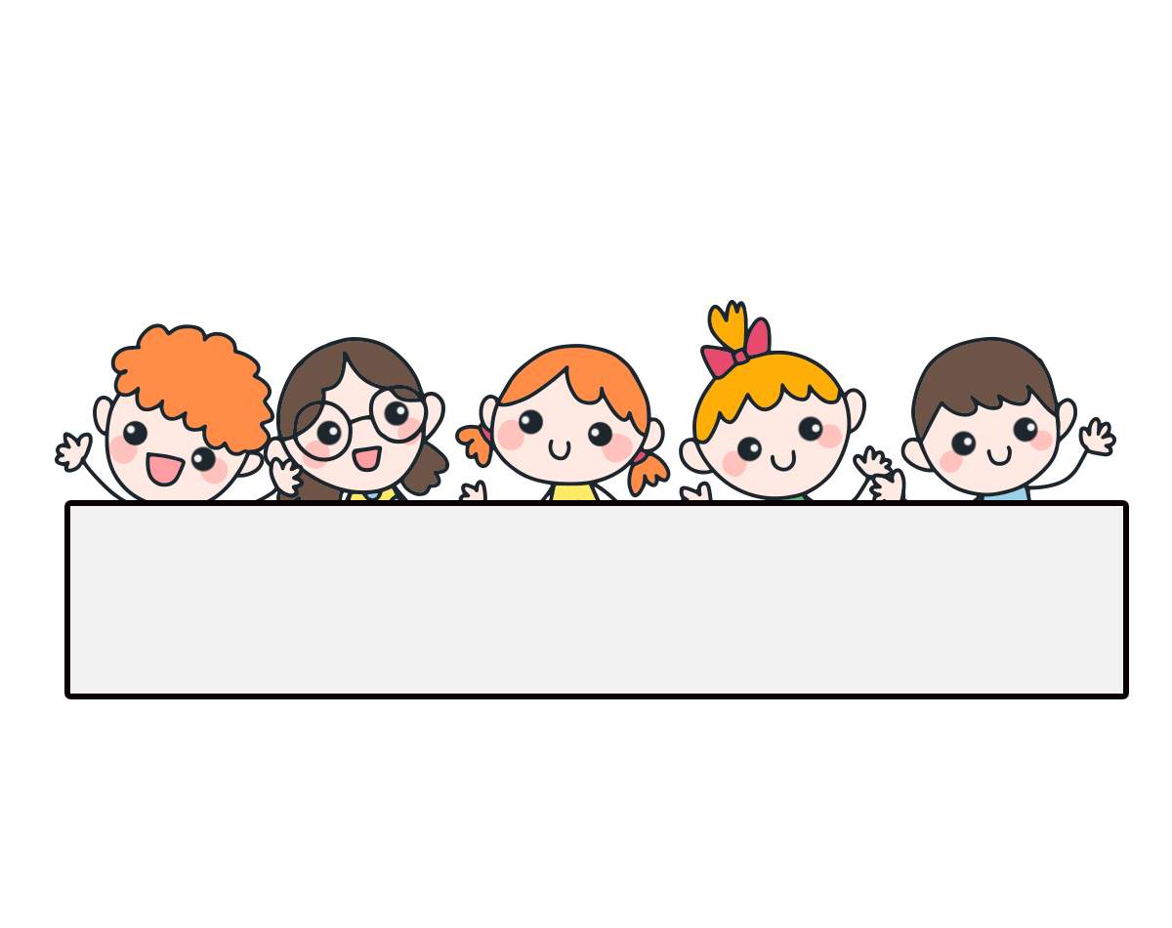
Warm-up

Slide 4
Let’s play!

Slide 5


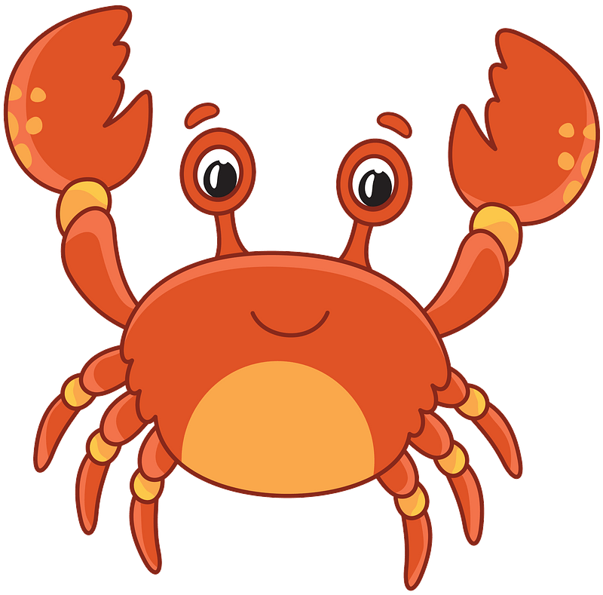

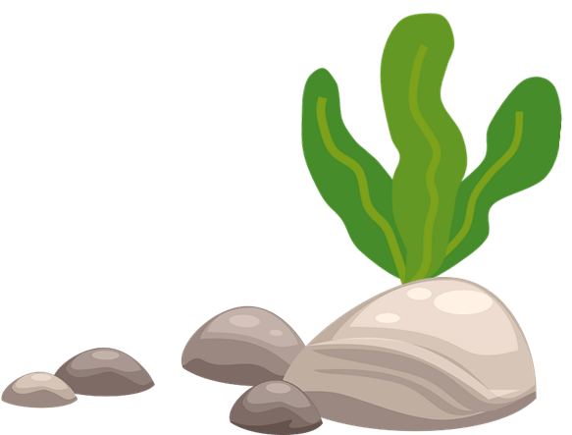

THE FUNNY CRAB
START

Slide 6
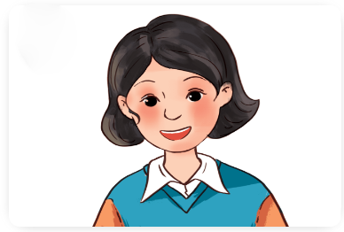

Facebook: Bùi Liễu
0968142780
short
____ hair
Next
Check

Slide 7
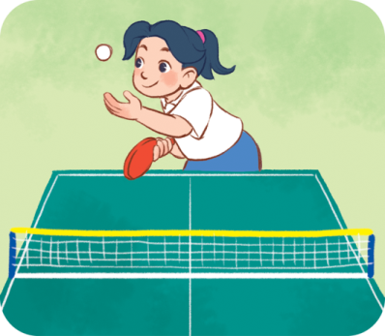
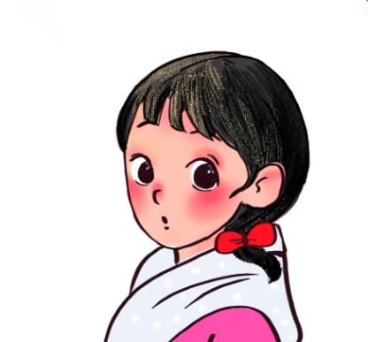

big
____ eyes
Next
Check

Slide 8
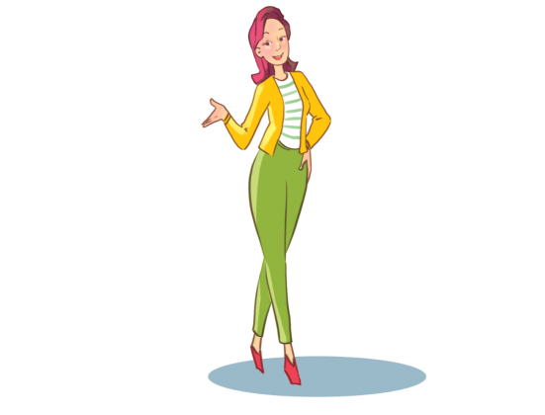

tall
She is slim and ______.
Next
Check

Slide 9
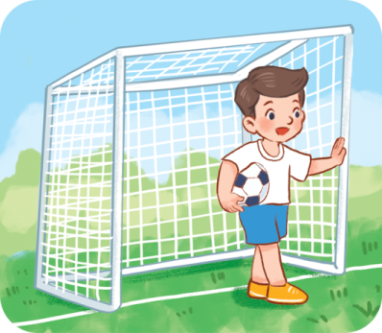
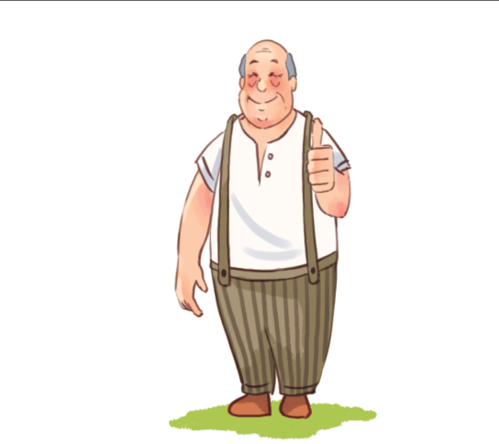

big
What does he look like?
He’s tall and _____.
Next
Check

Slide 10
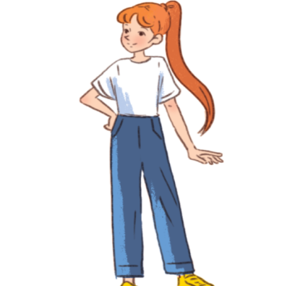

She is / She’s tall.
What does she look like?
Next
Check

Slide 11
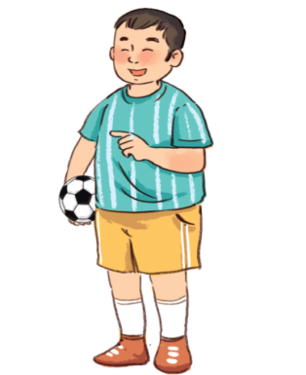
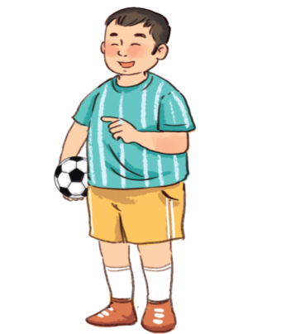

round
He has a ____ face.
Next
Check

Slide 12
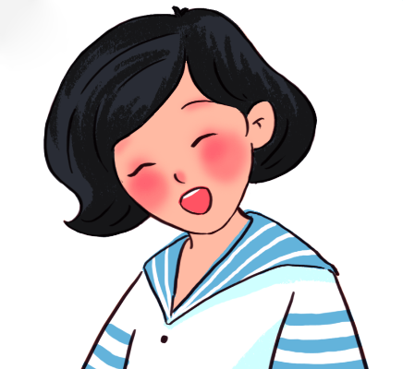
True
She has short hair.
True or False?
Next
Check

Slide 13

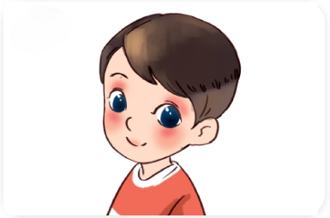
False
→ He has big eyes.
He has long hair.
True or False?
Next
Check

Slide 14
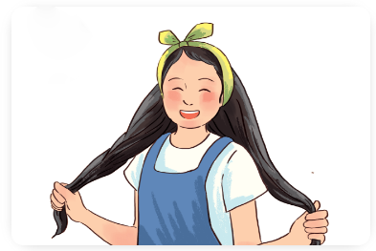
She has long hair.
What does your sister look like?
Next
Check

Slide 15
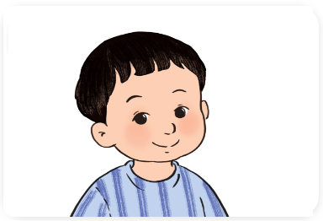
He has a round face.
What does your brother look like?
Next
Check

Slide 16
Goodjob!
Exit

Slide 17
Contents
04
05
06
Read and complete.
Let’s write.
Project.

Slide 18
4. Read and complete.
I have a big family: my grandfather, my grandmother, my father, my mother, my sister and me. My grandfather is big. My grandmother is big, too. My father is very tall. My mother is slim. She has long hair. My sister has a round face and big eyes.
1
2
3
4
1. My grandfather and grandmother are ____.
big
2. My father is ______________.
very tall
long hair
3. My mother has ______________.
4. My sister has ______________________.
a round face and big eyes

Slide 19
5. Let’s write.
There are _________ people in my family. My father is __________. He has __________. My mother is __________. She has ______________________. My ________________. We love our family.
four
tall
short hair
short
long hair and big eyes
brother is big

Slide 20
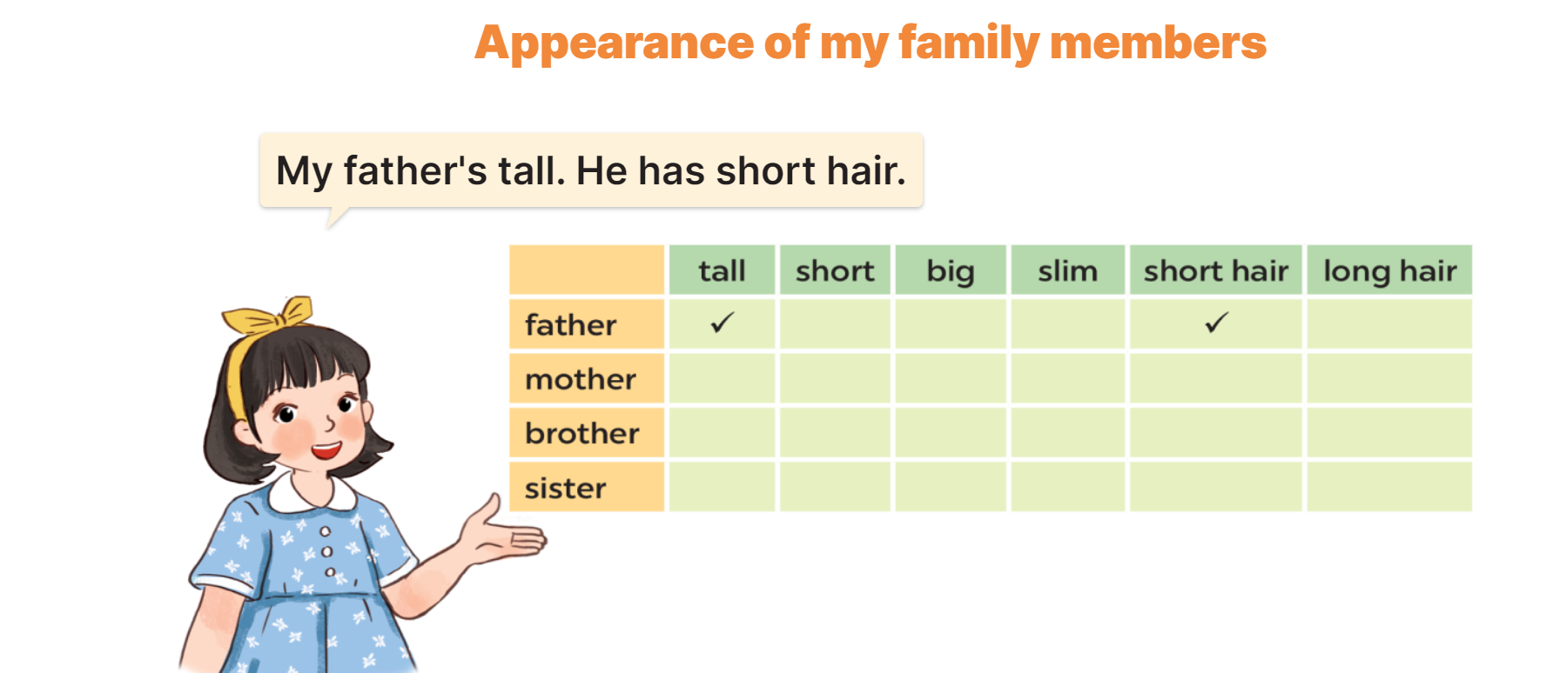
6. Project

Slide 21
Wrap up

Slide 22


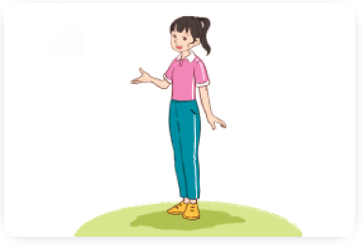
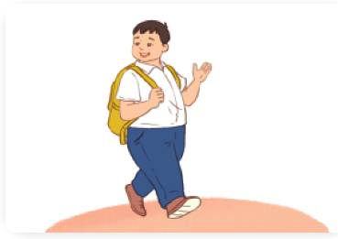
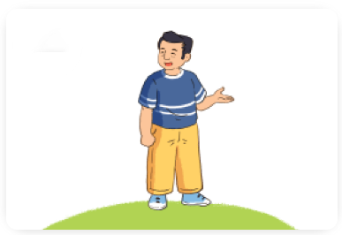
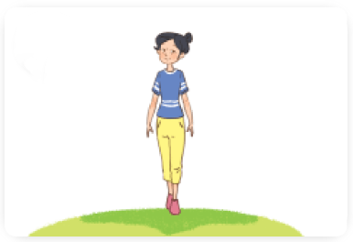
Unit 13 lesson 1
What does he / she look like?
He’s / She’s ________.
he’s = he is
she’s = she is
tall
big
short
slim

Slide 23
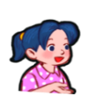
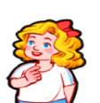
Unit 13 lesson 2
What does he / she look like?
He / She has ________.
short hair
big eyes
long hair
round face

Slide 24
Homework
……………………………………..
………………………………………

Slide 25

Thank you!

