Slide 1
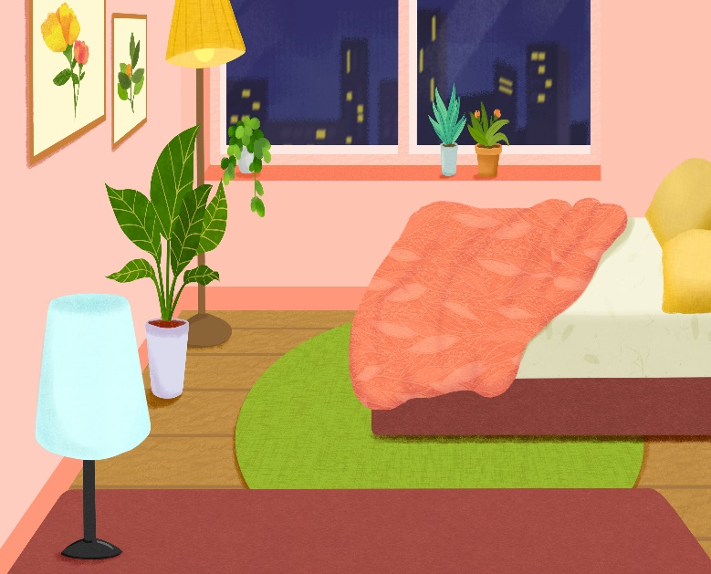
..................................
My bedroom
Unit
14
Lesson 1 (4+5+6

Slide 2

Warm-up

Slide 3
Well done!

Slide 4



Contents
Facebook : Bùi Liễu
0968142780
Listen and tick.
Look, complete and read.
Let’s play.

Slide 5

Warm up

Slide 6
Let’s play!

Slide 7




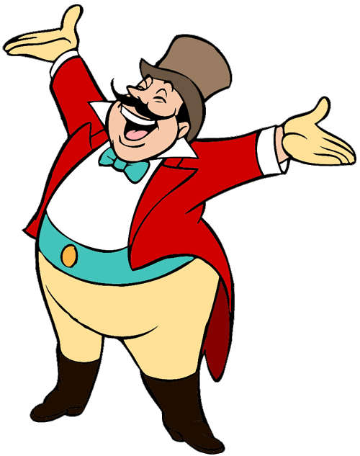
START

Slide 8




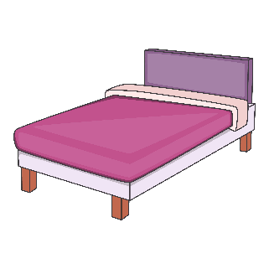



desk
A.
B.
C.
Notes:
Facebook : Bùi Liễu 0968142780

Slide 9



window
A.
B.
C.
Notes:
Facebook : Bùi Liễu 0968142780

Slide 10

b_d
A. a
B. e
C. o
Notes:
Facebook : Bùi Liễu 0968142780

Slide 11

doo_
A. d
B. s
C. r
Notes:
Facebook : Bùi Liễu 0968142780

Slide 12

w_ndow
A. a
B. e
C. i
Notes:
Facebook : Bùi Liễu 0968142780

Slide 13

A. bed
B. desk
C. door
Next

Slide 14

A. window
B. door
C. bed
Notes:
Facebook : Bùi Liễu 0968142780

Slide 15

A. window
B. desk
C. door
Next
Notes:
Facebook : Bùi Liễu 0968142780

Slide 16

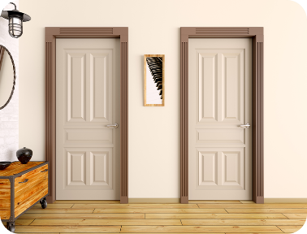
doors
A.
B.
C.
Notes:
Facebook : Bùi Liễu 0968142780

Slide 17


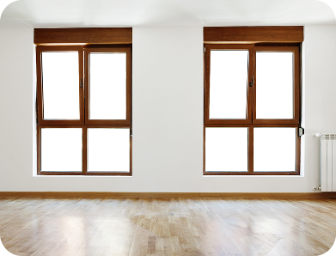

beds
A.
B.
C.
Notes:
Facebook : Bùi Liễu 0968142780

Slide 18



A.
B.
C.
Notes:
Facebook : Bùi Liễu 0968142780

Slide 19

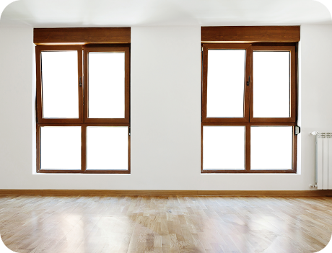
A.
B.
C.
Notes:
Facebook : Bùi Liễu 0968142780

Slide 20

_____ a desk.
A. There’s
B. There are
Notes:
Facebook : Bùi Liễu 0968142780

Slide 21

_____ a desk.
A. There is
B. There are
Notes:
Facebook : Bùi Liễu 0968142780

Slide 22
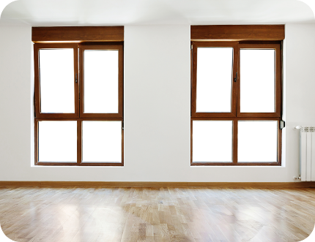
___ two windows.
A. There is
B. There are
Notes:
Facebook : Bùi Liễu 0968142780

Slide 23


Well done!
Notes:
Facebook : Bùi Liễu 0968142780

Slide 24
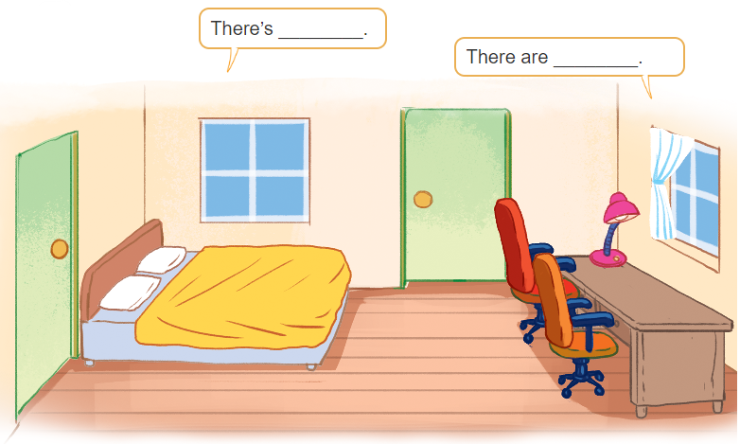
3. Let’s talk

Slide 25
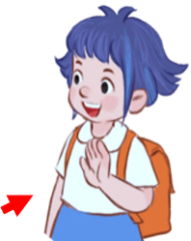
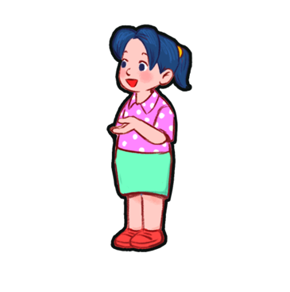
3. Let’s talk
There are two windows
in the room.
There’s a bed
in the room

Slide 26
3. Let’s talk
There’s a lamp
in the room.
There are two chairs in the room.

Slide 27
3. Let’s talk
Bùi Liễu
There is a desk
in the room.
There are two doors
in the room.

Slide 28


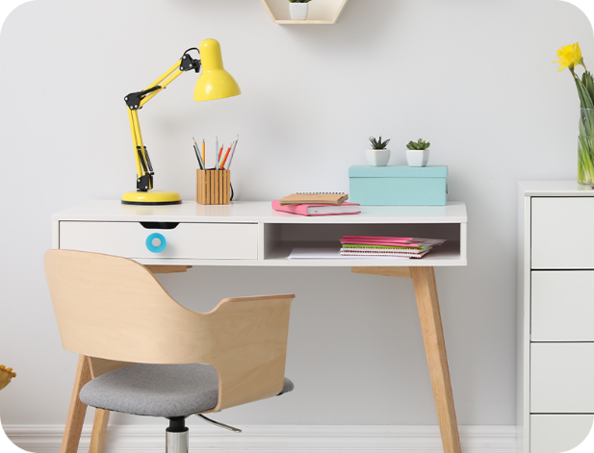

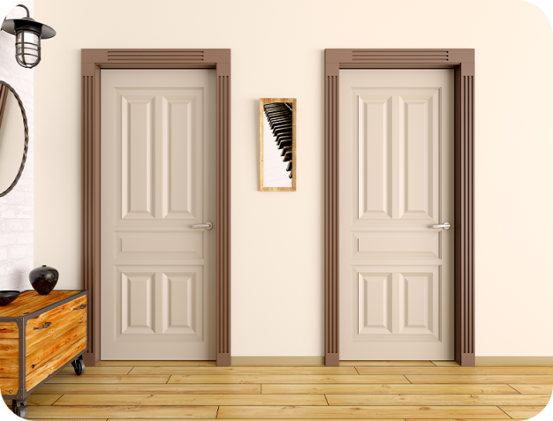

4. Listen and tick.
1
a
b
2
a
b

Slide 29
bed
a desk
lamps
two windows

Slide 30
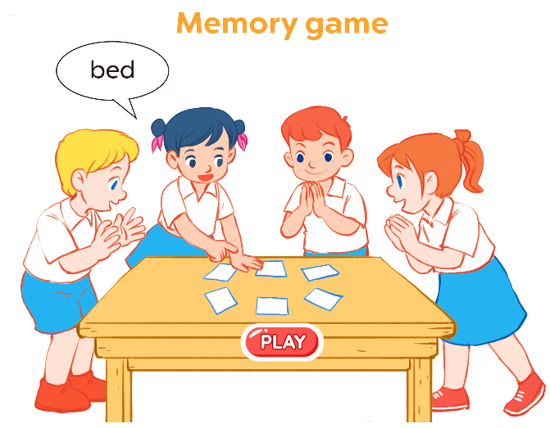
6. Let’s play.

Slide 31
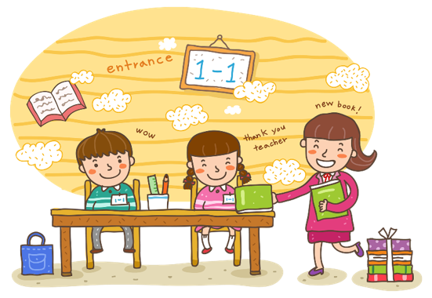
Wrap up

Slide 32

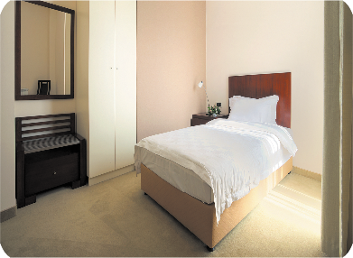

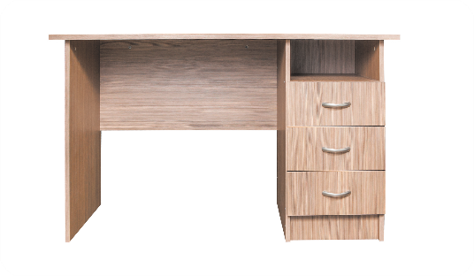

Vocabulary
door
bed
desk
window

Slide 33
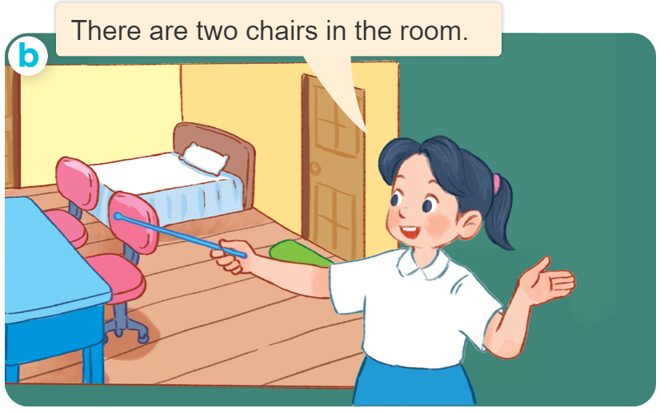
Structures
Cách nói về số lượng đồ vật ở trong phòng.
- There’s ____ in the room.
- There are ____ in the room.
( Có 1 ____ ở trong phòng)
(Có _______ ở trong phòng
there’s = there is

Slide 34
Homework
....................................................
....................................................

Slide 35

Thank you!

