Slide 1
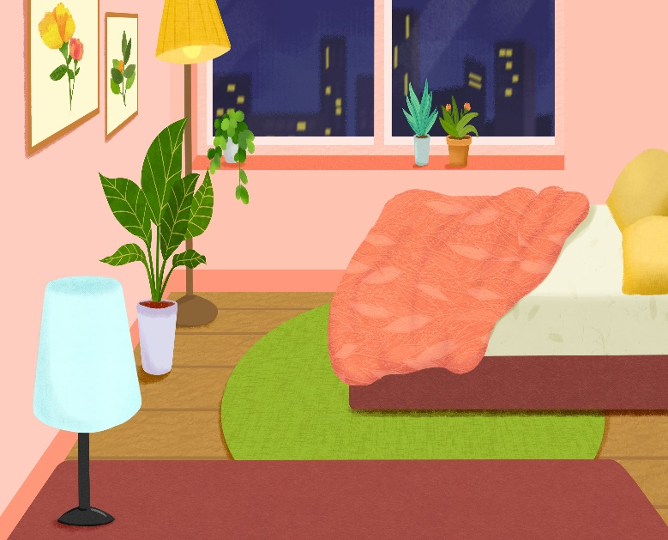
..................................
My bedroom
Unit
14
Lesson 1 (1+2+3)

Slide 2


Warm-up

Slide 3

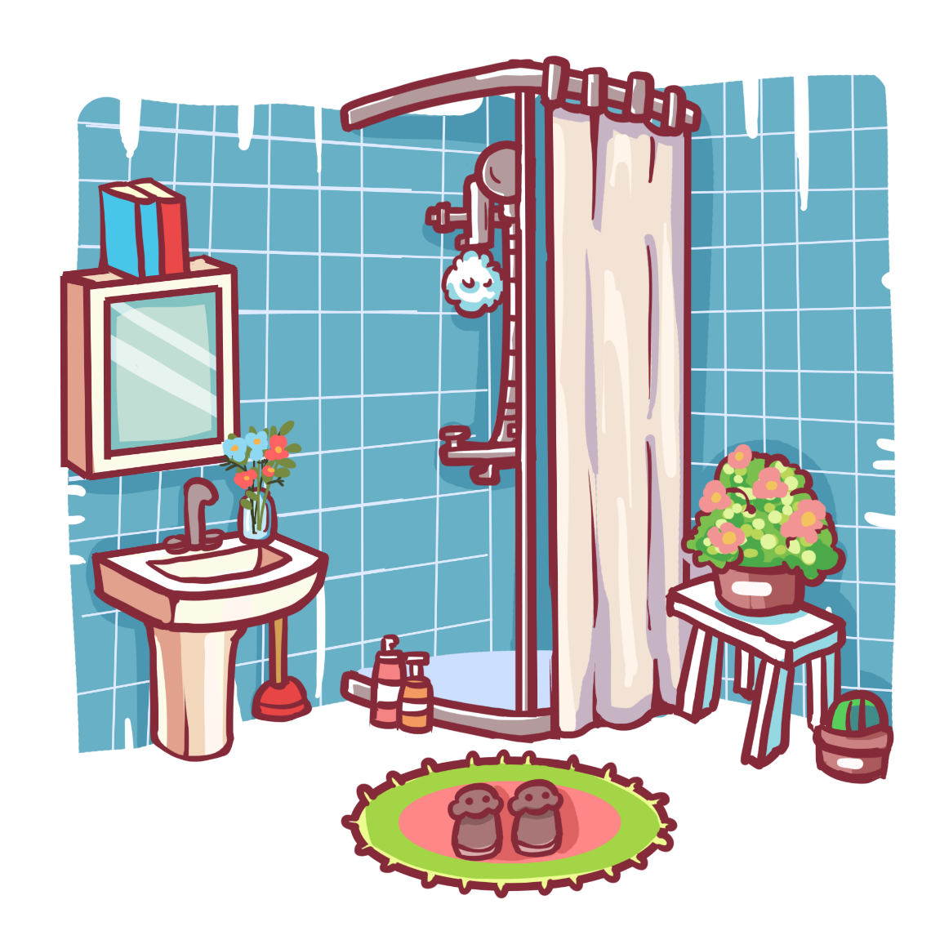
Click chuột lần thứ 1 để di chuyển ống nhòm.
Click chuột lần thứ 2 để hiển thị đáp án.
Can you guess?
Facebook : Bùi Liễu
0968142780
bathroom

Slide 4

Can you guess?
Facebook : Bùi Liễu
0968142780
bedroom

Slide 5
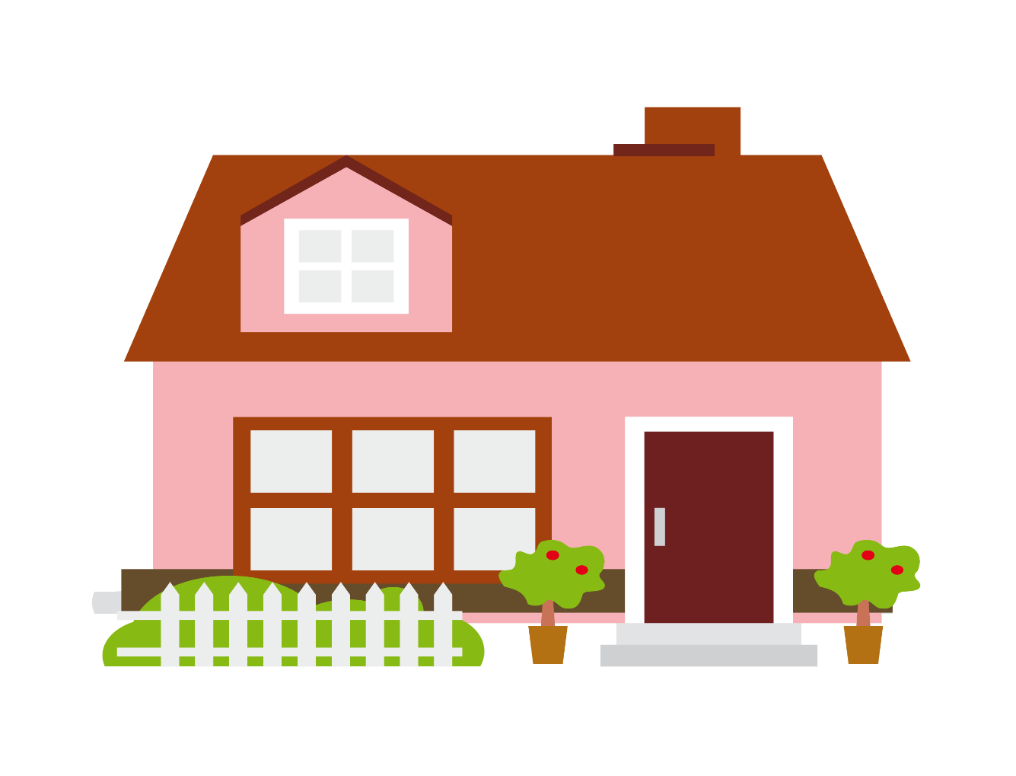
Can you guess?
Facebook : Bùi Liễu
0968142780
house

Slide 6
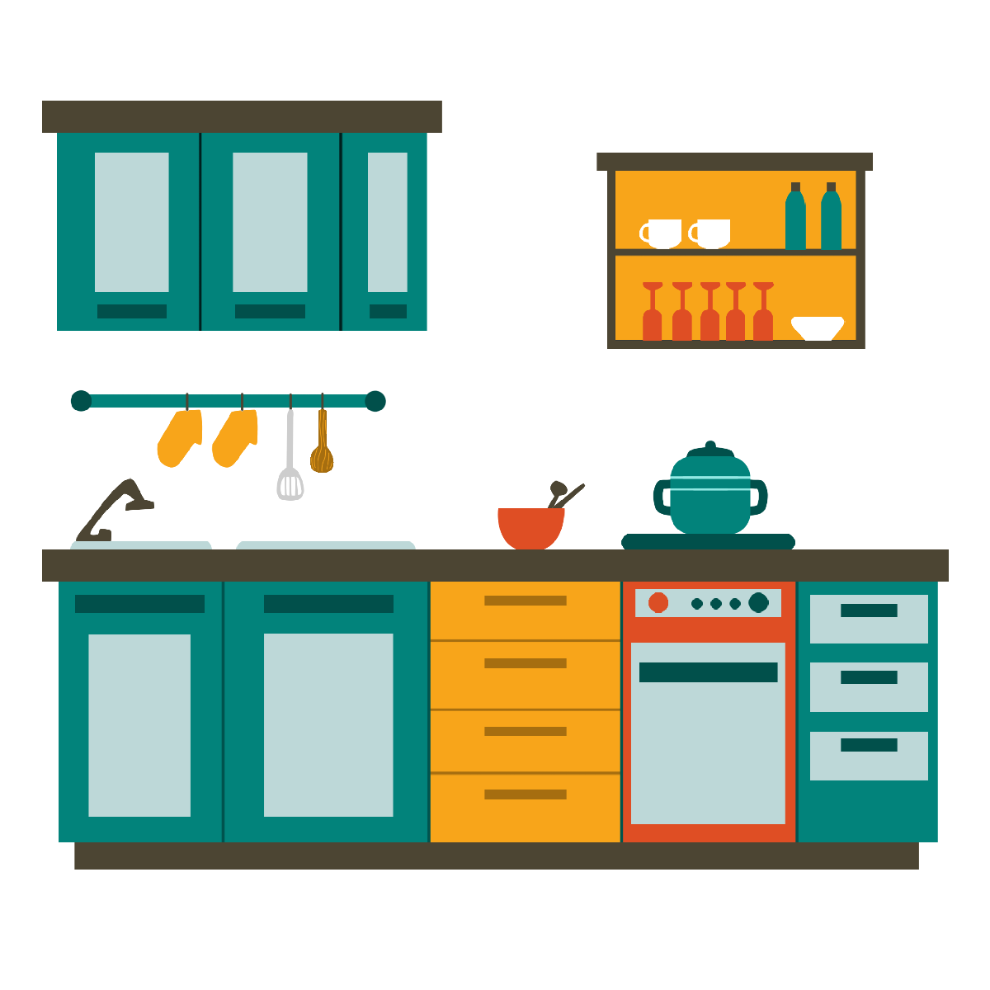
Can you guess?
Facebook : Bùi Liễu
0968142780
kitchen

Slide 7
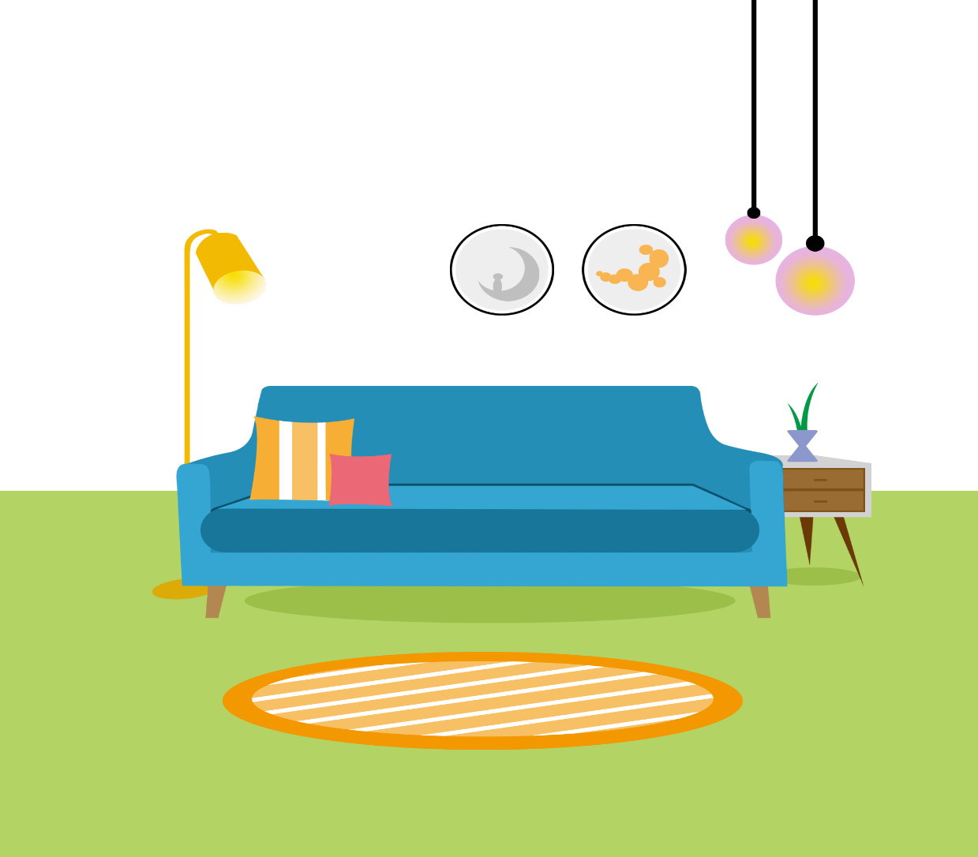
Can you guess?
Facebook : Bùi Liễu
0968142780
living room

Slide 8
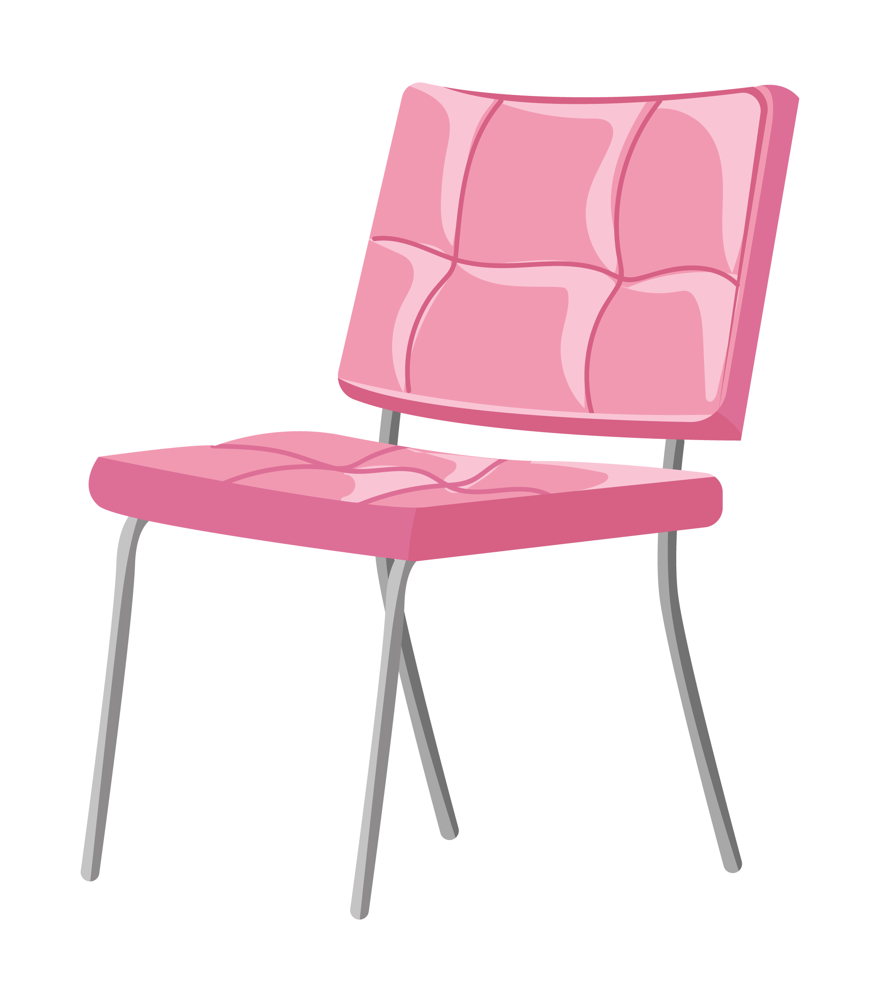
Can you guess?
Facebook : Bùi Liễu
0968142780
chair

Slide 9
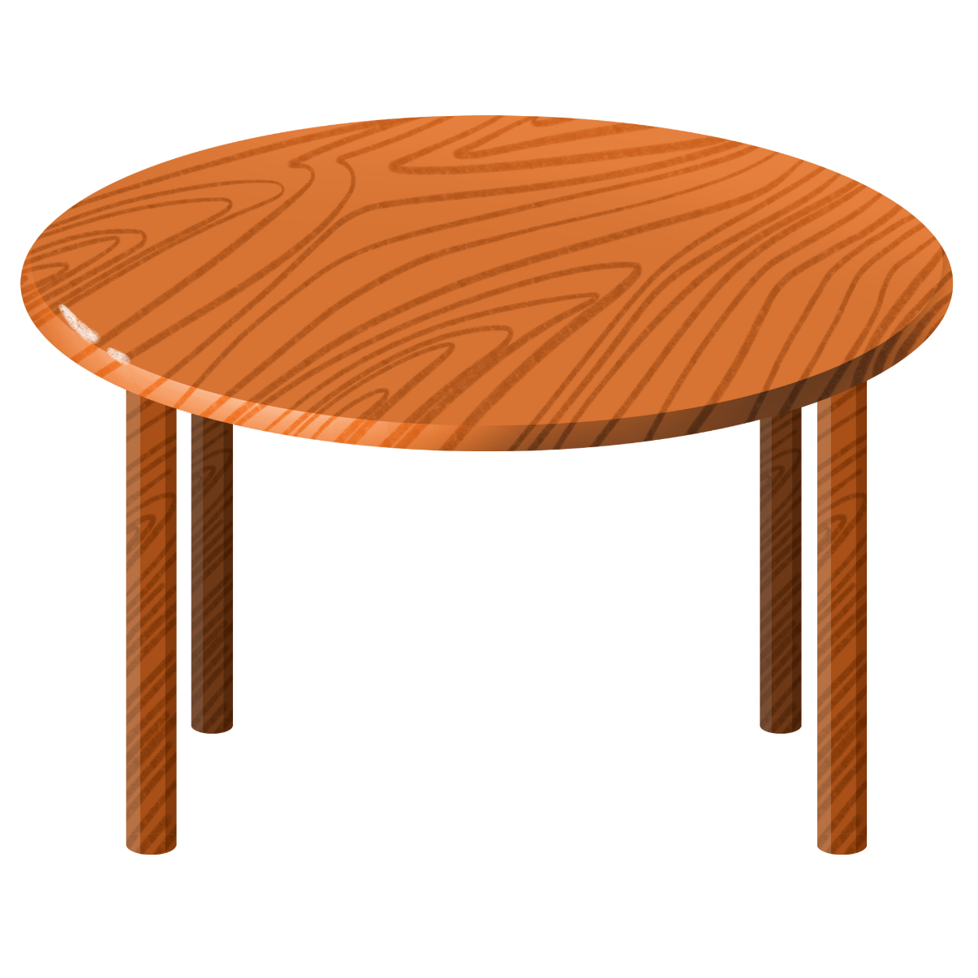
Can you guess?
Facebook : Bùi Liễu
0968142780
table

Slide 10

Can you guess?
Facebook : Bùi Liễu
0968142780
lamp

Slide 11
Well done!

Slide 12



Contents
Look, listen and repeat.
Listen, point and say.
Let’s talk.

Slide 13

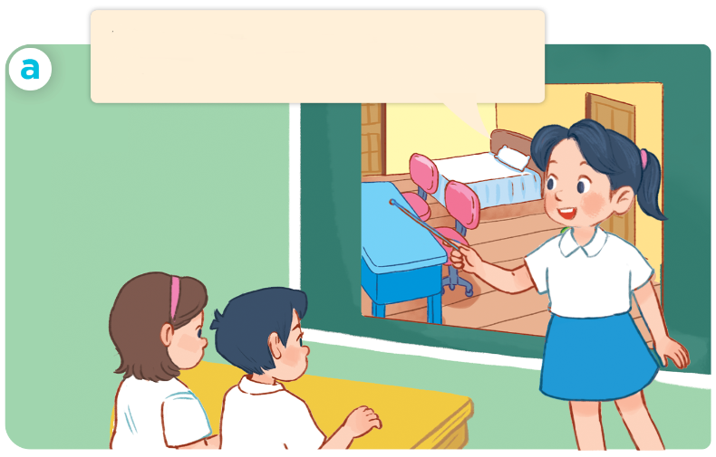
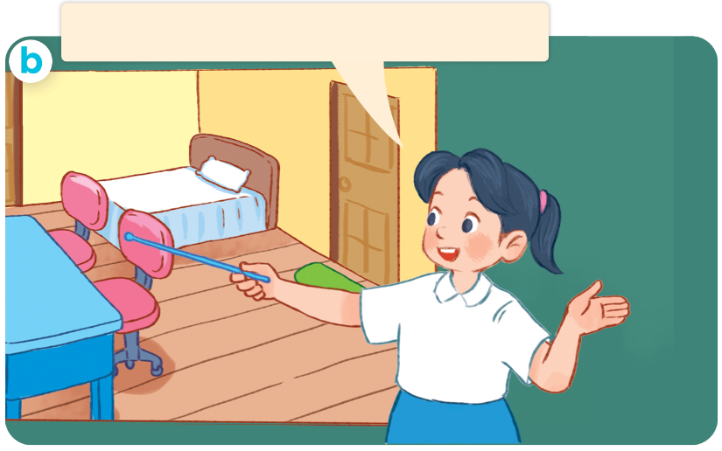
1. Look, listen and repeat.
This is my bedroom.
There’s a desk in the room.
There are two chairs in the room.
Who are they?
Where are they?
What are they doing?

Slide 14
Vocabulary

Slide 15


door
/dɔːr/
cái cửa

Slide 16
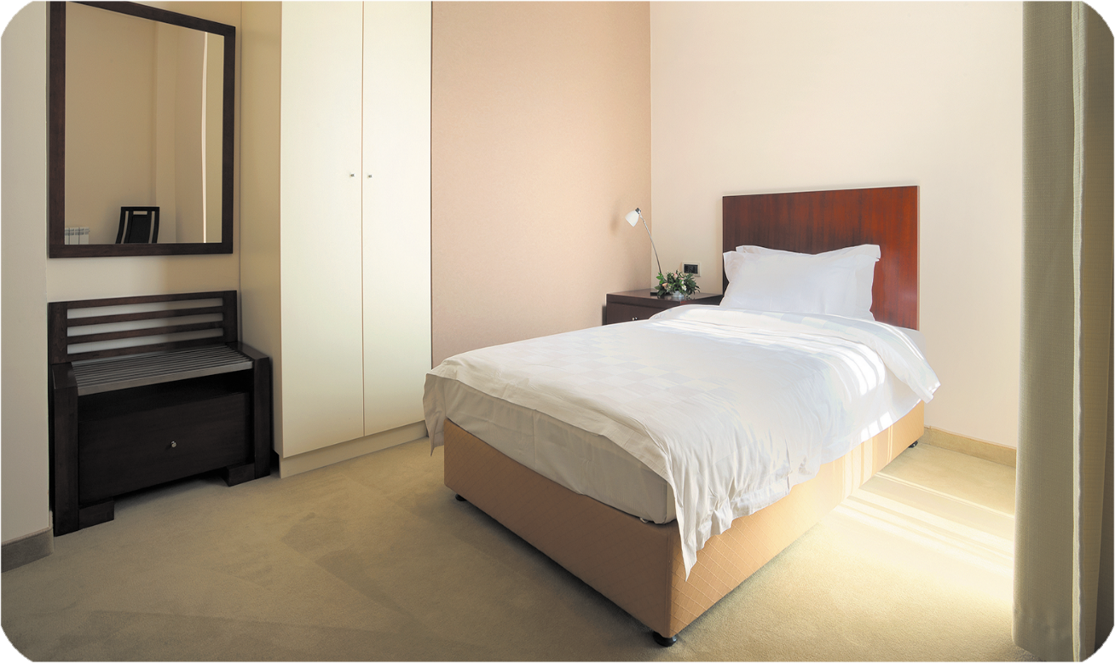
bed
/bed/
cái giường

Slide 17
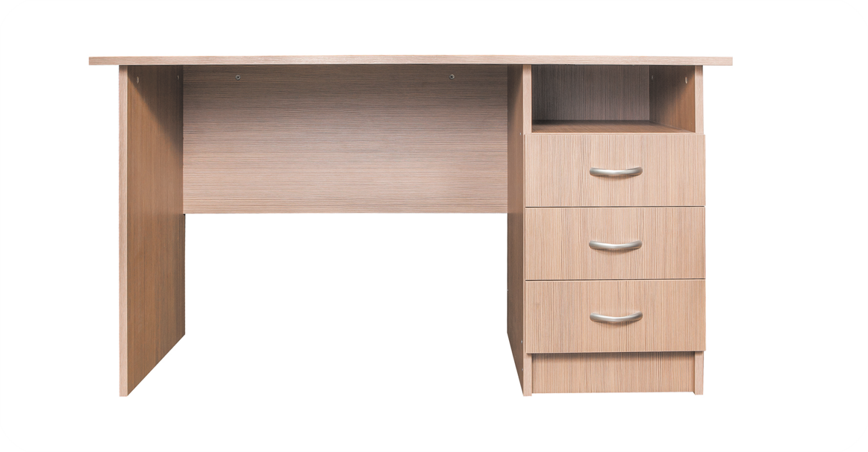
desk
/desk/
cái bàn (học sinh)

Slide 18
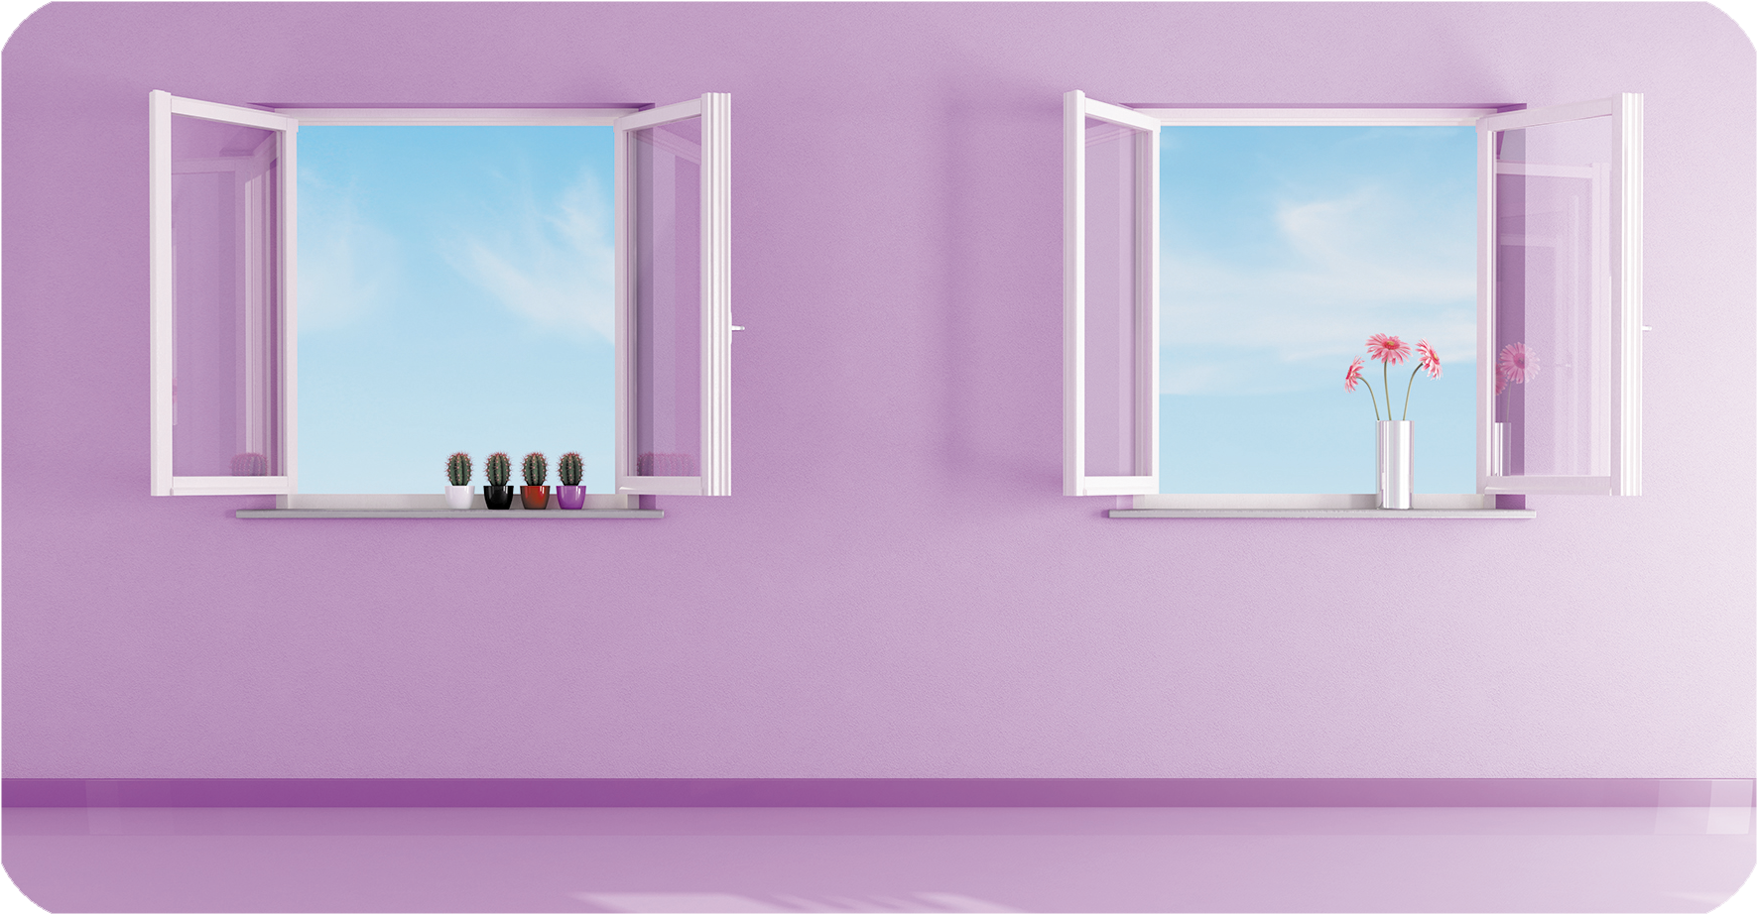
window
/ˈwɪn.dəʊ/
cửa sổ

Slide 19
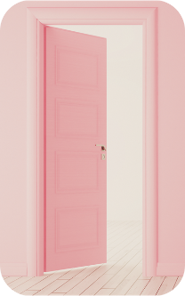



Review
door
bed
desk
window

Slide 20
Structures

Slide 21
1/Vocabulary
door cửa ra vào
bed cái giường
desk cái bàn (học sinh)
window cửa sổ

Slide 22
2/ Model sentences
Cách nói về số lượng đồ vật ở trong phòng.
There’s a bed in the room.
There are two chairs in the room.
( Có 1 cái giường ở trong phòng)
(Có 2 cái ghế ở trong phòng
Chú ý: there’s = there is

Slide 23




2. Listen, point and say.
a
b
There’s ____ in the room.
There are ____ in the room.
a desk
a bed
c
d
two doors
two windows

Slide 24
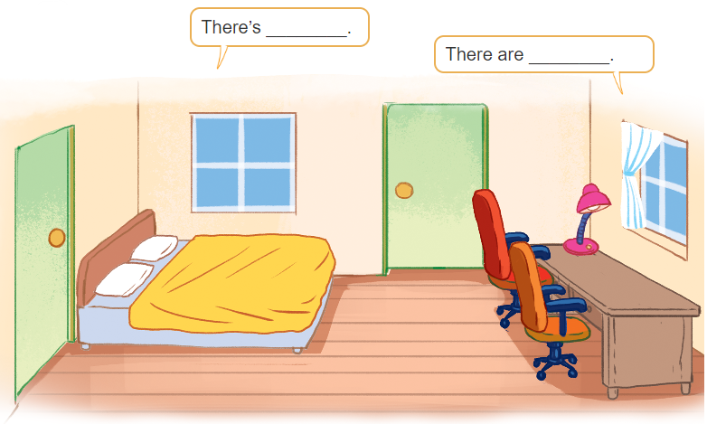
3. Let’s talk

Slide 25

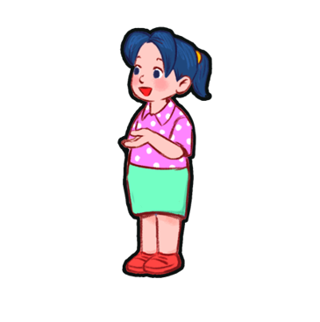
3. Let’s talk
There are two windows
in the room.
There’s a bed
in the room

Slide 26
3. Let’s talk
There’s a lamp
in the room.
There are two chairs in the room.

Slide 27
3. Let’s talk
Bùi Liễu
There is a desk
in the room.
There are two doors
in the room.

Slide 28
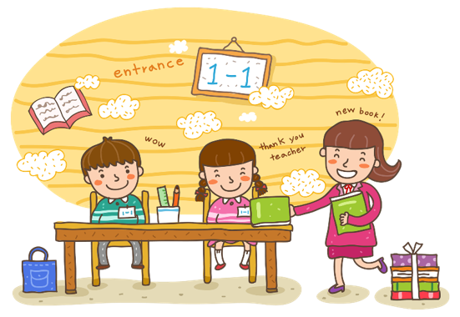
Wrap up

Slide 29
Vocabulary
door
bed
desk
window

Slide 30
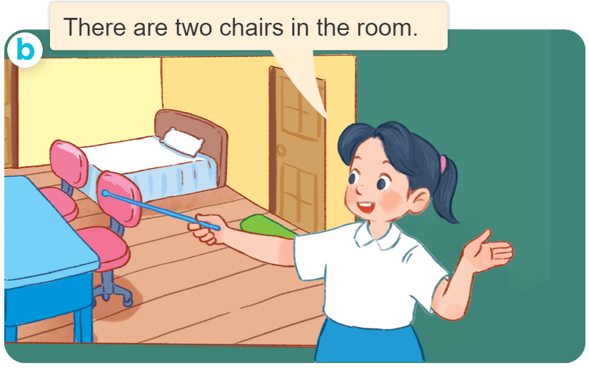
Structures
Cách nói về số lượng đồ vật ở trong phòng.
- There’s ____ in the room.
- There are ____ in the room.
( Có 1 ____ ở trong phòng)
(Có _______ ở trong phòng
there’s = there is

Slide 31
Homework
Learn by heart all the new words.
Read again the dialogue in part 1.

Slide 32

Facebook : Bùi Liễu
0968142780
Thank you!

