Slide 1



DAI LOC DEPARTMENT OF EDUCATION AND TRAINING
DAI QUANG PRIMARY SCHOOL
WELCOME TO OUR CLASS !
Subject: English 3
Class: 3E
Teacher: Pham Thi My Chau

Slide 2

Warm-up

Slide 3
Let’s play!
The lucky number

Slide 4

3
4
2
6
5
1
end

Slide 5


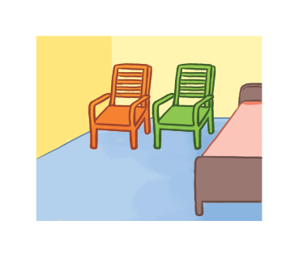
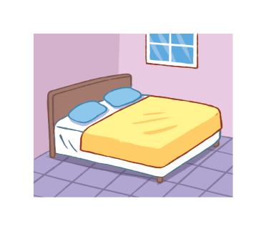
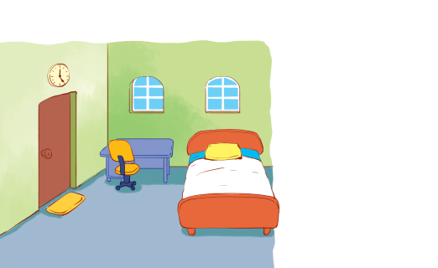
There are two chairs in my bedroom. They’re new.
+ 5
A
B
C
back

Slide 6

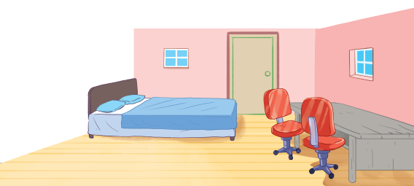
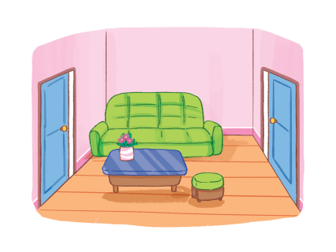
There is a window in the living room. It’s big.
+ 4
A
B
C
back

Slide 7
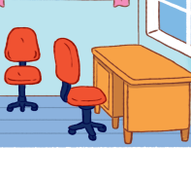
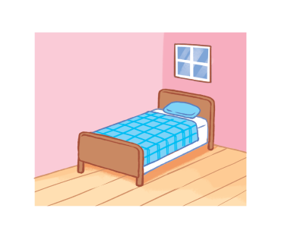
There is a bed in my bedroom. It’s old.
+ 2
A
B
C
back

Slide 8

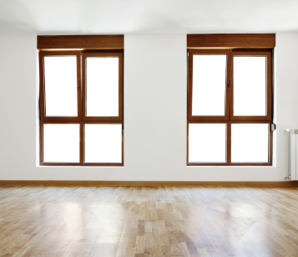
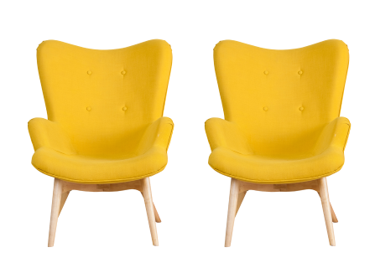
There are two chairs. They’re big.
+ 3
A
B
C
back

Slide 9
There are two doors in the living room. They’re small.
+ 5
A
B
C
back

Slide 10
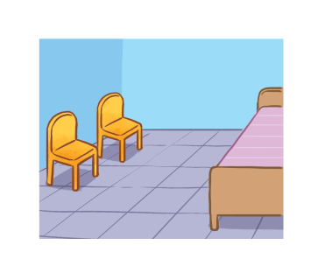
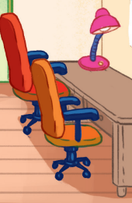
There is a lamp. It’s old.
+ 4
A
B
C
back

Slide 11
Well done!

Slide 12


UNIT 14: MY BEDROOM
Monday, February 26th, 2024
*Lesson 2:
Part: 4, 5, 6

Slide 13

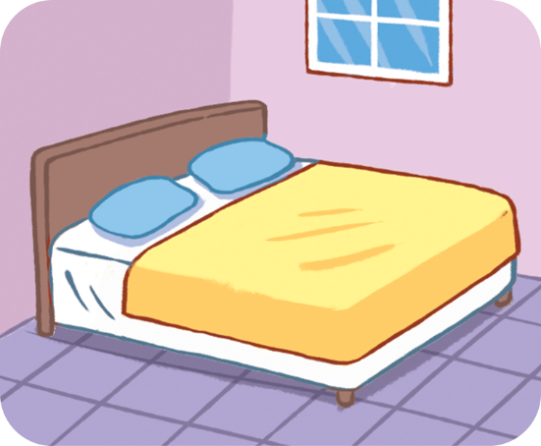
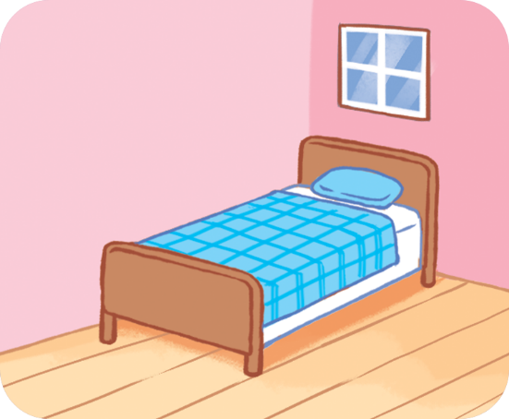
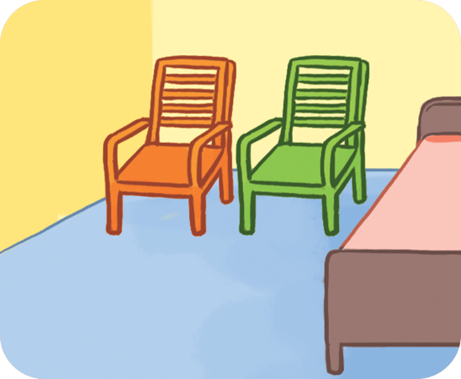
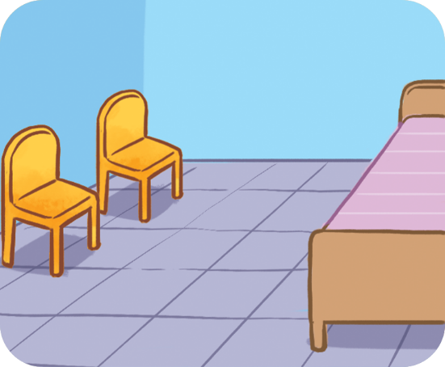
4. Listen and number.
a
b
c
d
2
3
4
1

Slide 14
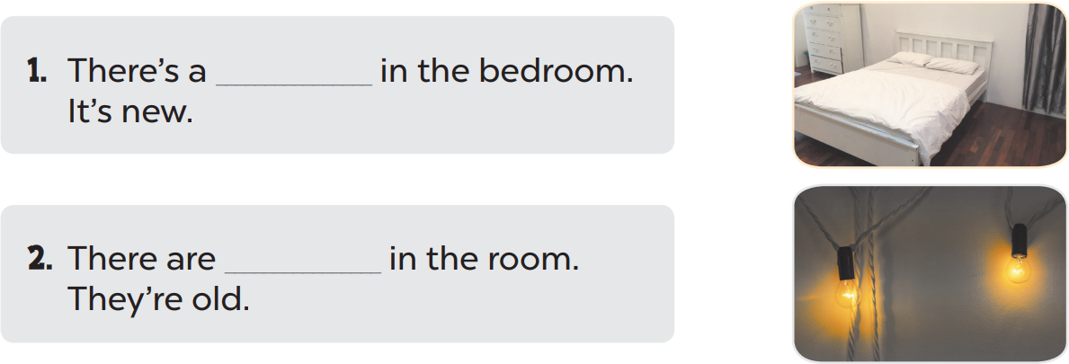
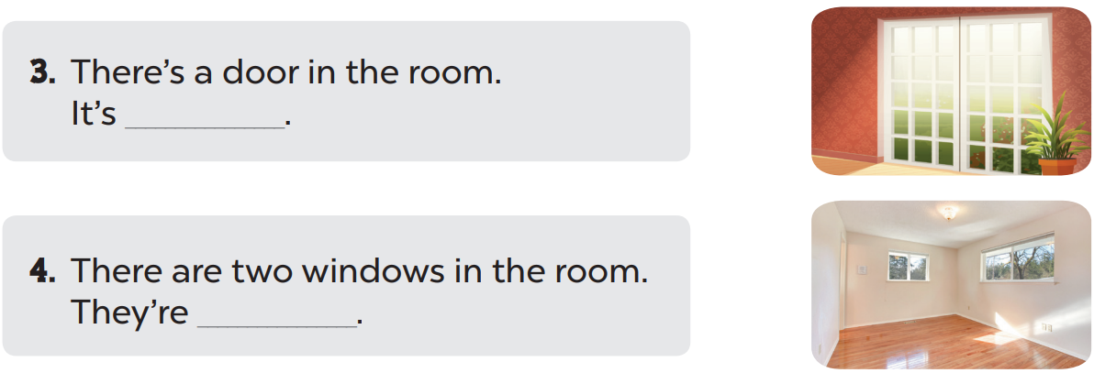
5. Look, complete and read.
bed
two lamps
big
small

Slide 15
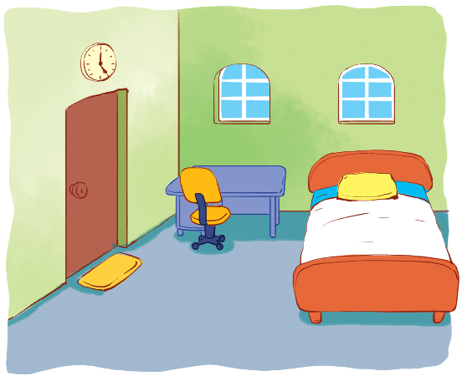
6. Let’s sing.
My bedroom
There’s a bed in my bedroom.
It’s new.
It’s new.
The bed is new.
There are two windows in my bedroom.
They’re small.
They’re small.
The windows are small.

Slide 16

6. Let’s sing.
My bedroom
There’s a bed in my bedroom.
It’s new.
It’s new.
The bed is new.
There are two windows in my bedroom.
They’re small.
They’re small.
The windows are small.

Slide 17
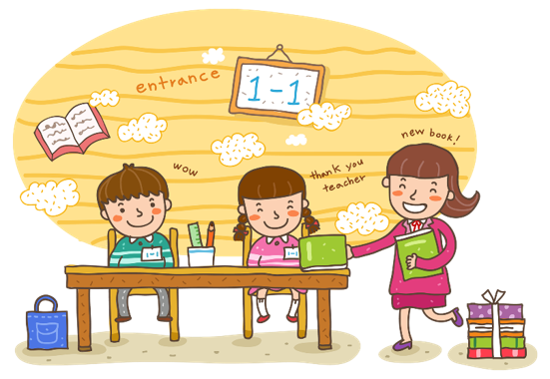
Wrap up

Slide 18

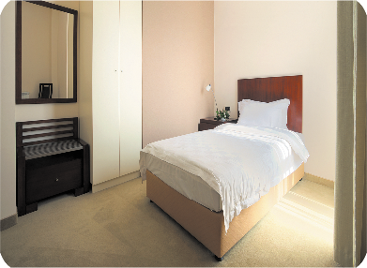

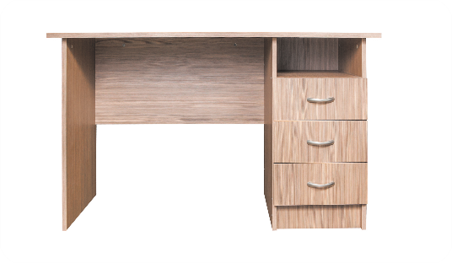

Vocabulary
door
bed
desk
window

Slide 19
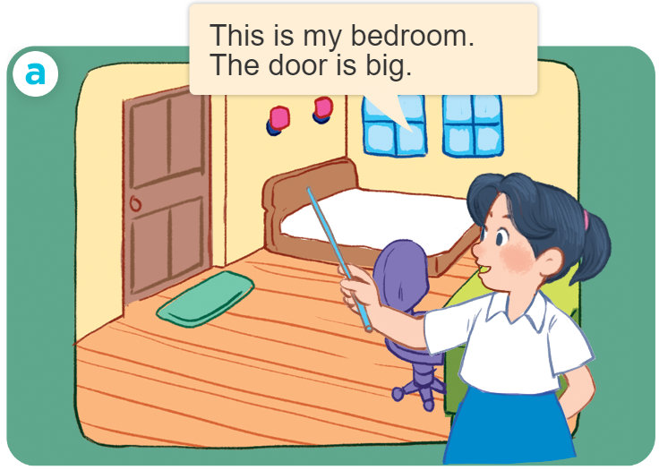
Structures
Cách miêu tả đồ vật ở trong phòng.
- The _____ is _______.
- The _____ are ______.
Example:

Slide 20
Homework
Learn by heart all the new words.
Prepare new lesson Unit 15- Lesson 1- P 1, 2, 3

Slide 21

Thank you!

