Slide 1


DAI LOC DEPARTMENT OF EDUCATION AND TRAINING
DAI QUANG PRIMARY SCHOOL
WELCOME TO OUR CLASS !
Subject: English 3
Class: 3D
Teacher: Pham Thi My Chau

Slide 2

Play game
Who’s the lucky student?

Slide 3

Vũ
Hoàng
Uyên
Quyền
Vũ
Thế Bảo
Khải
Đoan
Bảo Bảo
Hân
Trâm Anh
Anh Thư
Sang
Khang
Diểm My
Hoàng Bảo
Quý
H. Giang
Lộc
Hưng
Vũ Huy
Kỳ Thư
Lợi
Khoa
Duy
H. Trâm
Trang
Trí
Trinh
Vi
Diệu
Khương
Hoàng Anh
Dương
Thái Bảo
Hà Giang
Thương

Slide 4
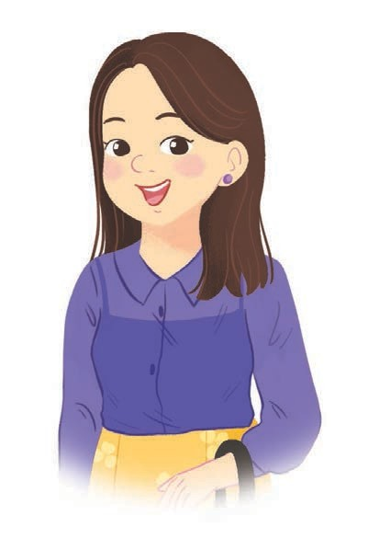

Question 1
Who’s this?
It’s my mother.

Slide 5
Vũ
Thế Bảo
Hoàng
Uyên
Quyền
Khải
Đoan
Bảo Bảo
Hân
Trâm Anh
Anh Thư
Sang
Khang
Diểm My
Hoàng Bảo
Quý
H. Giang
Lộc
Hưng
Vũ Huy
Kỳ Thư
Kỳ Thư
Lợi
Khoa
Duy
H. Trâm
Trang
Trí
Trinh
Vi
Diệu
Khương
Hoàng Anh
Dương
Thái Bảo
Hà Giang
Thương

Slide 6
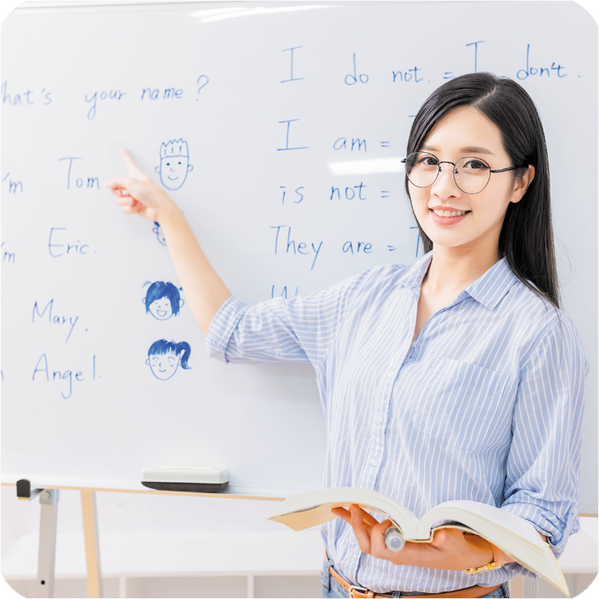
Question 1
What’s her job ?
She’s a teacher.

Slide 7
Vũ
Thế Bảo
Hoàng
Uyên
Quyền
Khải
Đoan
Bảo Bảo
Hân
Trâm Anh
Anh Thư
Sang
Khang
Diểm My
Hoàng Bảo
Quý
H. Giang
Lộc
Hưng
Vũ Huy
Kỳ Thư
Lợi
Khoa
Duy
H. Trâm
Trang
Trí
Trinh
Vi
Diệu
Diệu
Khương
Hoàng Anh
Dương
Thái Bảo
Hà Giang
Thương

Slide 8


Question 2
What’s his job?
He’s a worker.

Slide 9
Vũ
Thế Bảo
Hoàng
Uyên
Quyền
Khải
Đoan
Bảo Bảo
Hân
Trâm Anh
Anh Thư
Sang
Khang
Diểm My
Hoàng Bảo
Quý
H. Giang
Lộc
Hưng
Vũ Huy
Kỳ Thư
Lợi
Khoa
Duy
Duy
H. Trâm
Trang
Trí
Trinh
Vi
Diệu
Khương
Hoàng Anh
Dương
Thái Bảo
Hà Giang
Thương

Slide 10

Question 3
Read and complete
two windows
There are ____________in the room.

Slide 11
Wednesday, November 29th, 2023.
FUN TIME

Slide 12
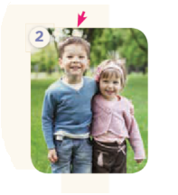
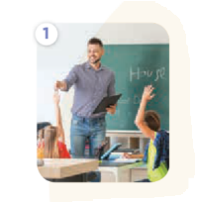
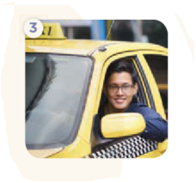


1. Do the puzzle.
2
b
1
3
t
e
a
c
h
e
r
o
d
4
m
o
t
h
e
r
h
i
5
Bùi Liễu
k
e
w
o
r
r
v
r
e
r

Slide 13
2. Quiz time.
 | Your friend’s name | His / Her answer
What would you like to eat / drink?

Slide 14
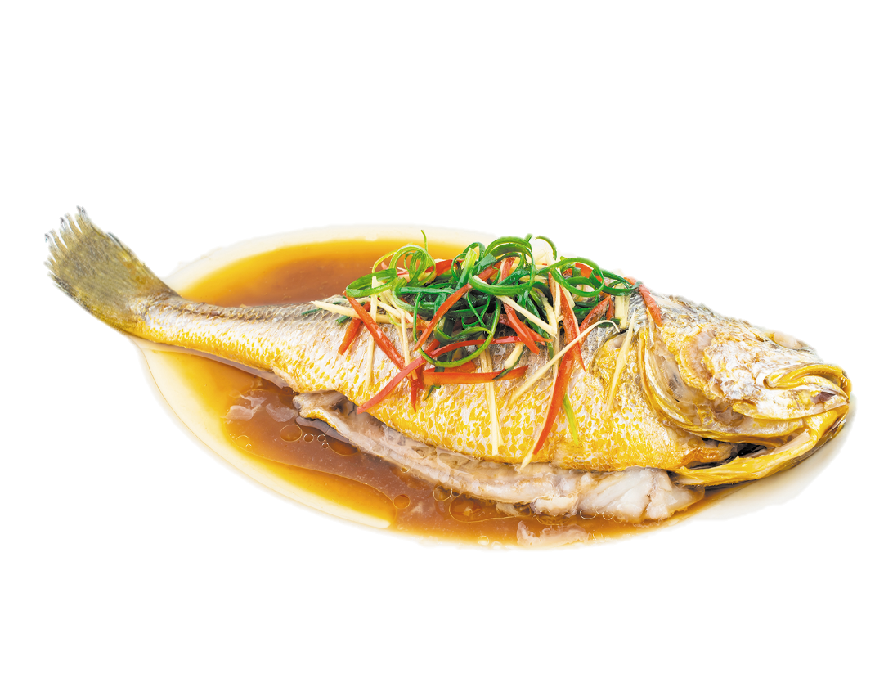

Answer the questions
1/ What’s your name ?
My name is Tram
2/ What would you like to eat ?
I’d like some fish, please.
I’d like some bread, please.

Slide 15


3/ What would you like to drink ?
I’d like some water, please.
I’d like some milk, please.

Slide 16
2. Quiz time.
1/ What’s your name ?
2/ What would you like to eat ?
3/ What would you like to drink ?
 | Your friend’s name | His / Her answer
What would you like to eat / drink? | dung | Chicken, milk
 | Yến | Fish, water
 | Tân | Beans, juice

Slide 17
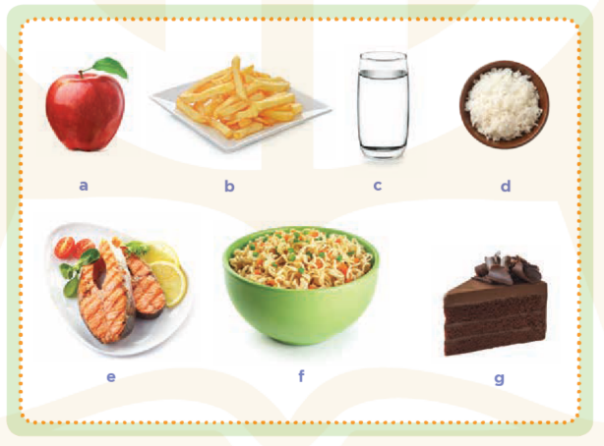
3. Circle the healthy foods.
apple
chips
water
rice
X
X
fish
noodles
cake
X
X

Slide 18
Play game

Slide 19










Where is Pikachu?

Slide 20


Choose the best answer
1. A: Where’s the___________?
B: It’s here.
A. bedroom
B. living room
C. kitchen

Slide 21
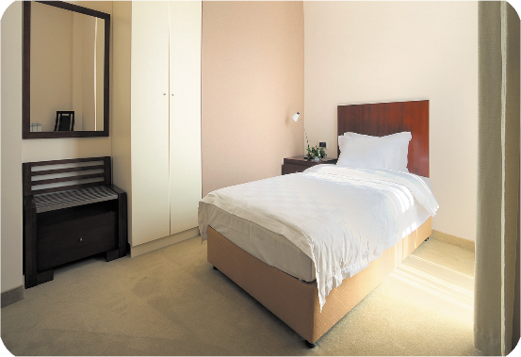
Choose the best answer
2. There’s _______in the room.
A. a desk
B. a door
C. a bed

Slide 22
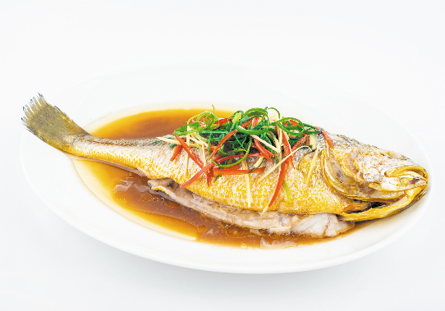
Choose the best answer
3. A: Would you like some_______?
B: Yes, please.
A. beans
B. meat
C. fish

Slide 23
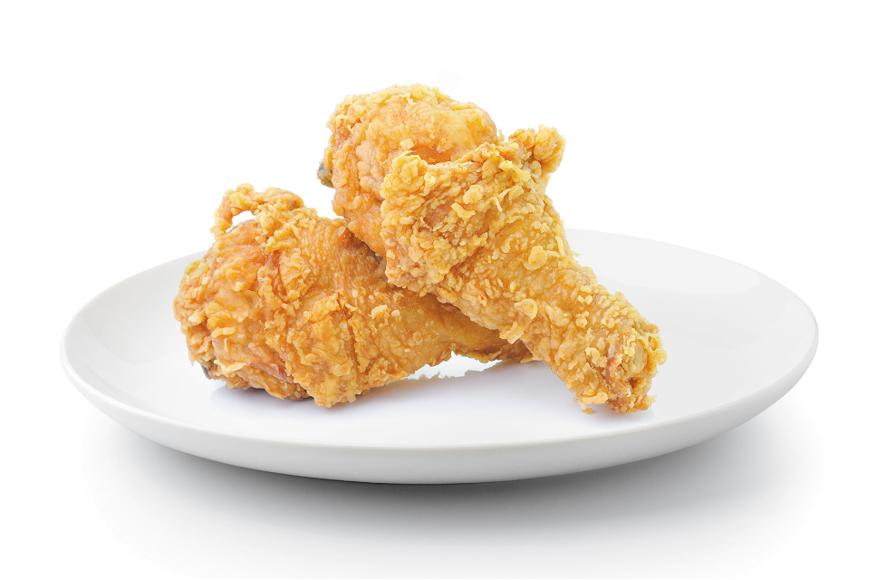
Choose the best answer
.
4. A: What would you like to eat ?
B: I’d like some _________.
A. chicken
B. eggs
C. water

Slide 24
Friday, Match 15th, 2024
FUN TIME
1. Do the puzzle
2. Quiz time
3. Circle the healthy foods
*Homelink.
- Do exercise in notebook
- Prepare: Unit 16: Lesson 1- P 1, 2, 3

Slide 25

Thank you very much!
Thank you very much!

