Slide 1


DAI LOC DEPARTMENT OF EDUCATION AND TRAINING
DAI QUANG PRIMARY SCHOOL
WELCOME TO OUR CLASS !
Subject: English 3
Class: 3G
Teacher: Pham Thi My Chau

Slide 2

Secret box

Slide 3


2
1
3
4

Slide 4


Question 1
Look and say
I’d like some_________.
milk

Slide 5
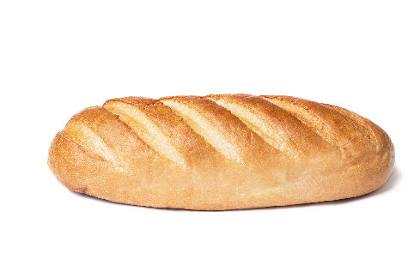
Question 2
Look and say
I’d like some_________.
bread

Slide 6

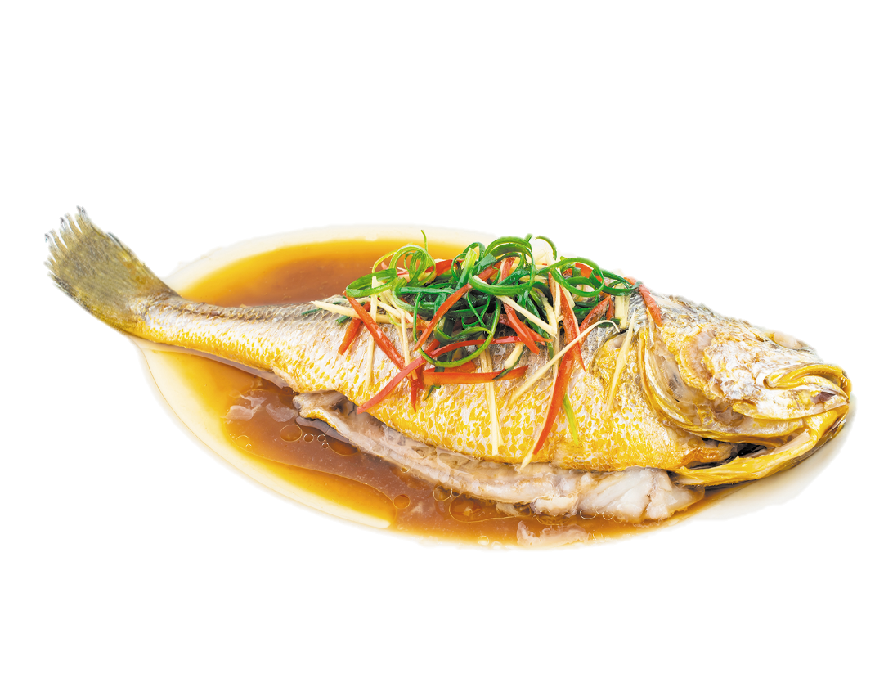
Question 3
Answer the question
Would you like some fish ?
Yes, please.

Slide 7

Question 4
What’s his job?
He’s a worker.

Slide 8
Friday, March 15th, 2024.
REVIEW 3

Slide 9

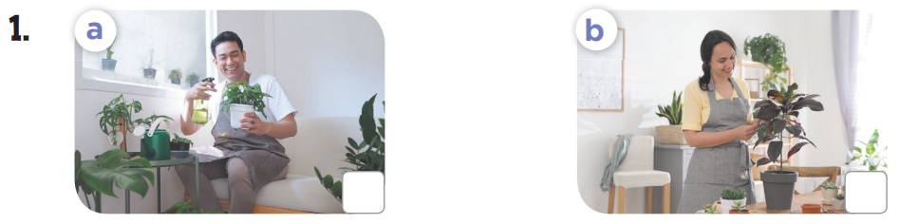
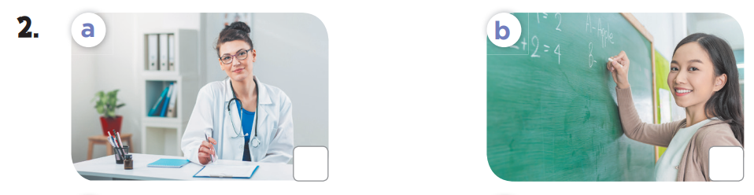
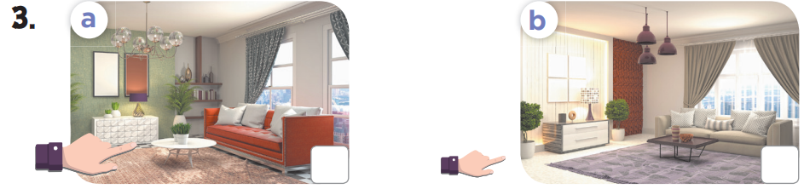
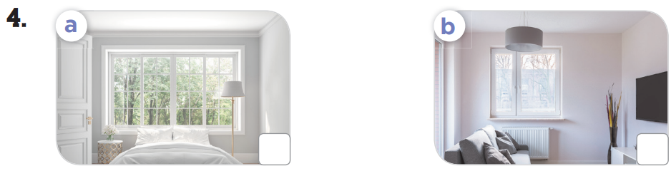
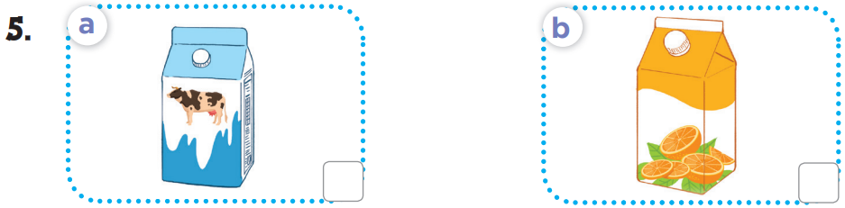


1/ Listen and tick

Slide 10
Friday, March 15th, 2024.
REVIEW 3
1/ Listen and tick

Slide 11
Friday, March 15th, 2024.
REVIEW 3
1/ Listen and tick

Slide 12

Friday, March 15th, 2024.
REVIEW 3
1/ Listen and tick

Slide 13
Friday, March 15th, 2024.
REVIEW 3
1/ Listen and tick

Slide 14
Friday, March 15th, 2024.
REVIEW 3
1/ Listen and tick

Slide 15
Friday, March 15th, 2024.
REVIEW 3
1/ Listen and tick

Slide 16
Friday, March 15th, 2024.
REVIEW 3
1/ Listen and tick

Slide 17
Wednesday, November 29th, 2023.
REVIEW 3
1/ Listen and tick
1/ A: Who’s that ?
B: It’s my father.
5/ A: What would you like to drink ?
B: I’d like some milk, please.
2/ A: What’s her job ?
B: She’s a doctor.
3/ A: Where’s the living room ?
B: It’s there.
4/ The window is small

Slide 18
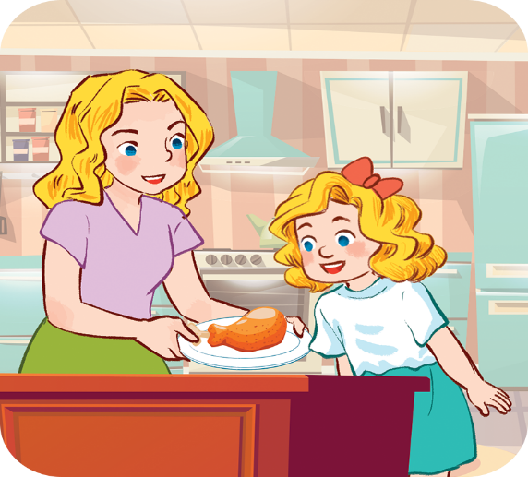
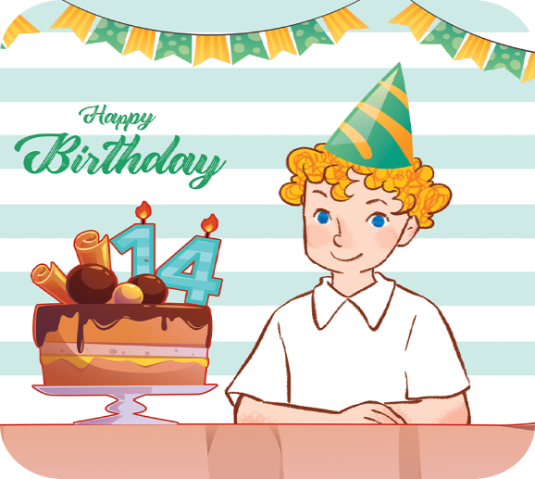
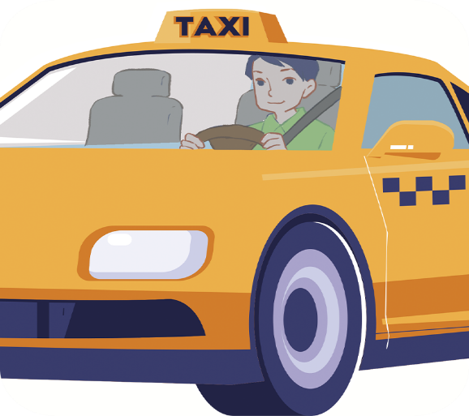
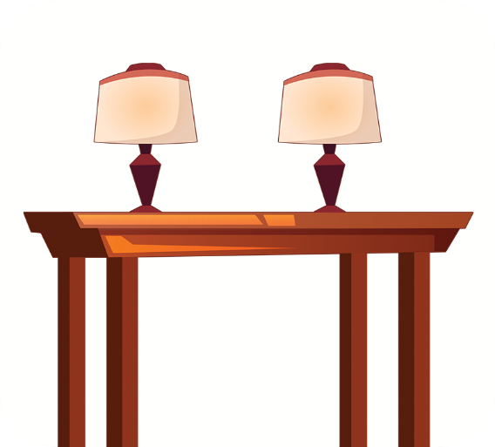
Wednesday, November 29th, 2023.
REVIEW 3
2/ Listen and number
a
b
c
d

Slide 19




Wednesday, November 29th, 2023.
REVIEW 3
2/ Listen and number
a
b
4
1
d
c
2
3

Slide 20
Wednesday, November 29th, 2023.
REVIEW 3
2/ Listen and number
1/ A: How old is your brother?
B: He’s fourteen years old.
2/ A: What’s his job ?
B: He’s a driver.
3/ A: Where are the lamps?
B: They’re on the table.
4/ A: Would you like some chicken ?
B: Yes, please.

Slide 21
3/ Read and match
1. How old is your sister?
a. It’s my mother.
2. Is she a doctor?
b. I’d like some meat, please.
3. Where are the chairs?
c. She’s sixteen years old.
4. What would you like to eat?
d. They’re in the kitchen.
5. Who’s that?
e. Yes, she is.
1 - c
2 - e
3 - d
4 - b
5 - a

Slide 22
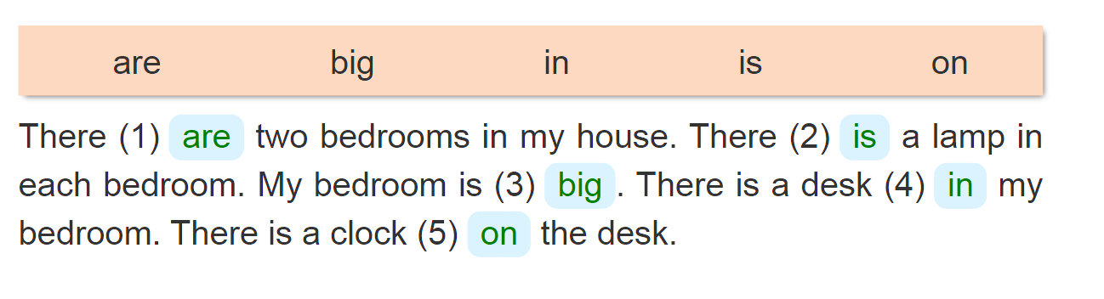
4/ Read and complete
___
__
___.
__
__

Slide 23
Friday, Match 15th, 2024
REVIEW
1. Listen and tick
2. Listen and number
3. Read and match
4. Read and match
*Homelink.
- Do exercise in notebook
- Prepare: Fun time

Slide 24

Thank you very much!
Thank you very much!

