Slide 1
Unit 15 – Lesson 2
What would you like to be in the future?

Slide 2
VOCABULARY

Slide 3


Vocabulary
write stories for children
/ raɪt ˈstɔːriz fə ˈʧɪldrən/

Slide 4
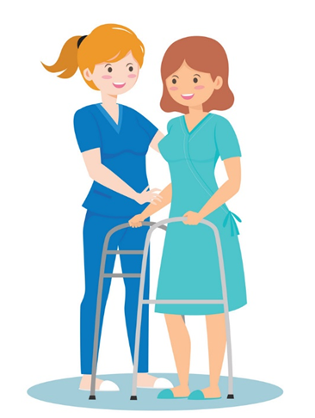
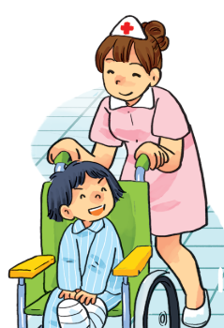
Vocabulary
look after patients
/lʊk ˈɑːftə ˈpeɪʃənts/

Slide 5

Vocabulary
fly a plane
/ flaɪ ə pleɪn/

Slide 6
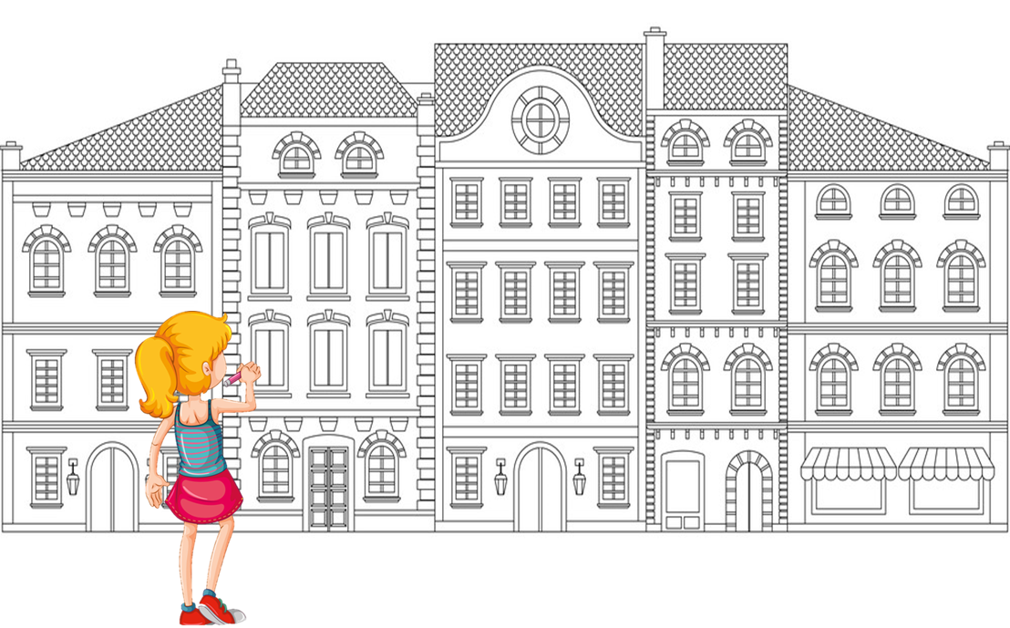
Vocabulary
design buildings
/dɪˈzaɪn ˈbɪldɪŋz/

Slide 7

Vocabulary
look after patients
write stories for children
fly a plane
design buildings
/lʊk ˈɑːftə ˈpeɪʃənts/
/raɪt ˈstɔːriz fə ˈʧɪldrən/
/flaɪ ə pleɪn/
/dɪˈzaɪn ˈbɪldɪŋz/

Slide 8










Đi tìm PIKACHU

Slide 9







fly a plane
write stories for children
design buildings

Slide 10
design buildings
fly a plane
look after patients

Slide 11
fly a plane
write stories for children
design buildings

Slide 12
look after patients
design buildings
writer

Slide 13
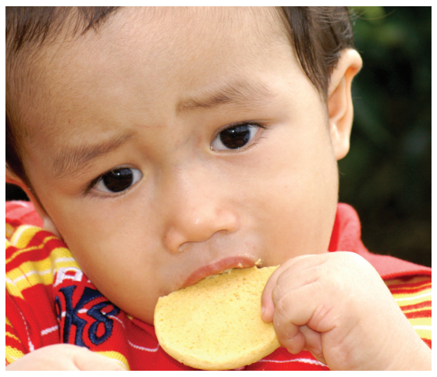
write stories for children

Slide 14
look after patients

Slide 15
design buildings

Slide 16
fly a plane

Slide 17
write stories
___________
patients
design
look after

Slide 18
design
write
______buildings
fly

Slide 19


Excellent!

Slide 20
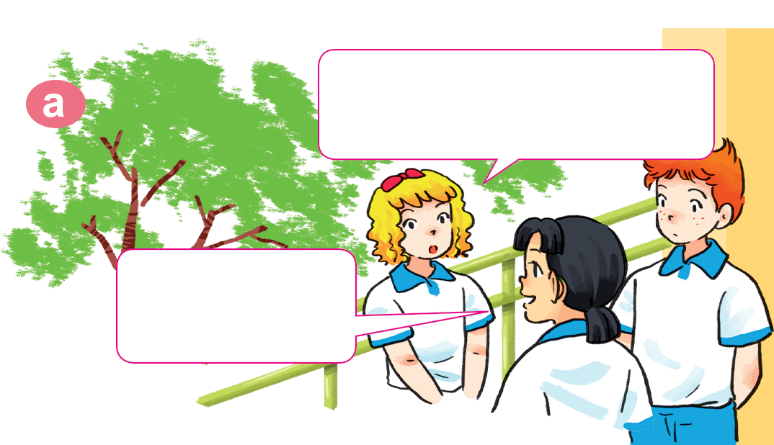
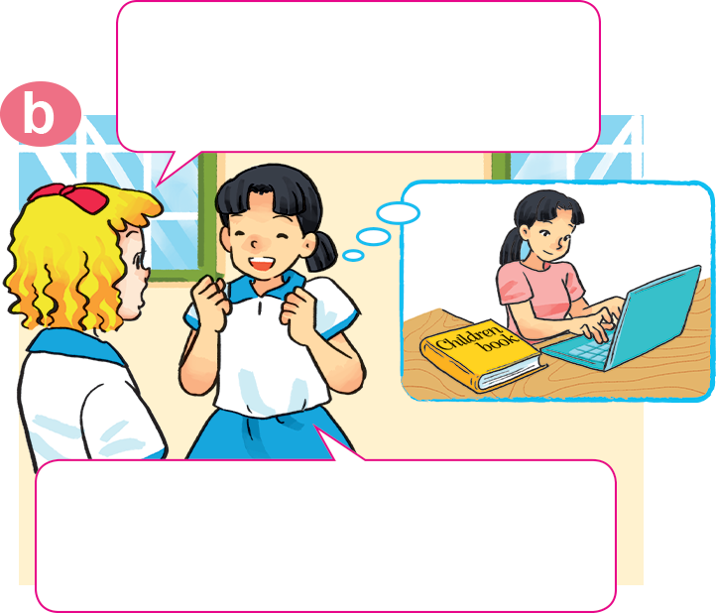

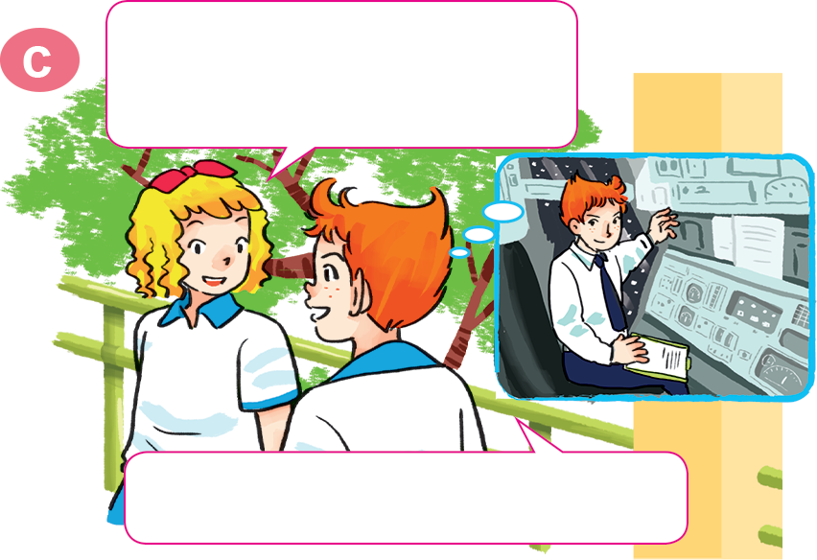
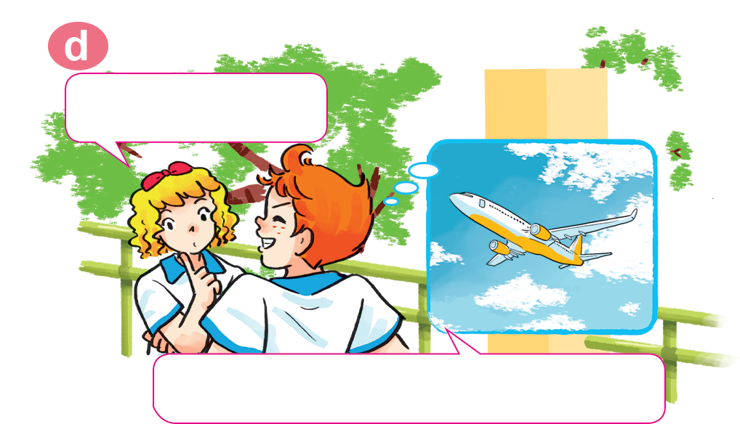
1. Look, listen and repeat
Why would you like to be a writer?
What would you like to be in the future, Mai?
I'd like to be a writer.
Because I'd like to write stories for children.
Would you like to be a writer too, Tony?
A pilot? Why?
No. I'd like to be a pilot.
Because I'd like to fly a plane.

Slide 21
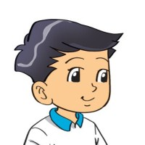

2. Point and say
a nurse
Why would you like to be _________?
Because I'd like to ________________.
look after patients

Slide 22
2. Point and say
a writer
Why would you like to be _________?
Because I'd like to _____________________.
write stories for children

Slide 23
2. Point and say
a pilot
Why would you like to be _________?
Because I'd like to ________________.
fly a plane

Slide 24
2. Point and say
Why would you like to be ___________?
an architect
Because I'd like to ________________.
design buildings

Slide 25
Why would you like to be _________?
Because I'd like to _____________.
look after patients
design buildings
write stories for children
fly a plane

Slide 26
3. Let’s talk

Slide 27
4. Listen and circle a, b or c
1. Trung would like to be ___________.
a. an engineer b. an artist c. an architect
2. Mai would like to be ___________.
a. a nurse b. a teacher c. a singer
3. Tony would like to ___________.
a. drive a car b. fly a plane c. work in a factory
4. Tom would like to ___________.
a. grow vegetables b. look after flowers
c. work on a farm

Slide 28
5. Read and complete.
A: What would you like to be in the future?
B: I'd like to be a (1) __________.
A: Why?
B: Because I'd like to (2) __________ patients.
A: Where would you like to work?
B: In a (3) __________ in the countryside.
A: What would you like to (4) _____ in your free time?
B: I'd like to (5) __________ comic stories.
nurse
look after
hospital
do
write

Slide 29
6. Let’s play.

Slide 30




Slide 31
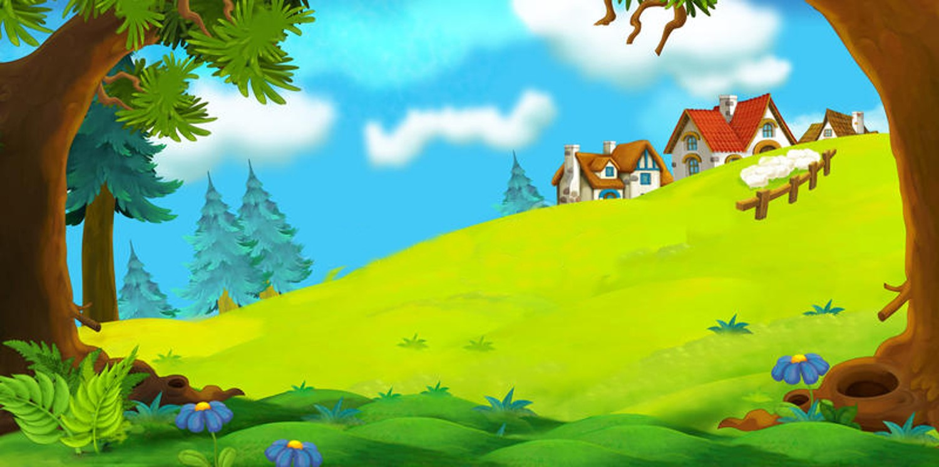

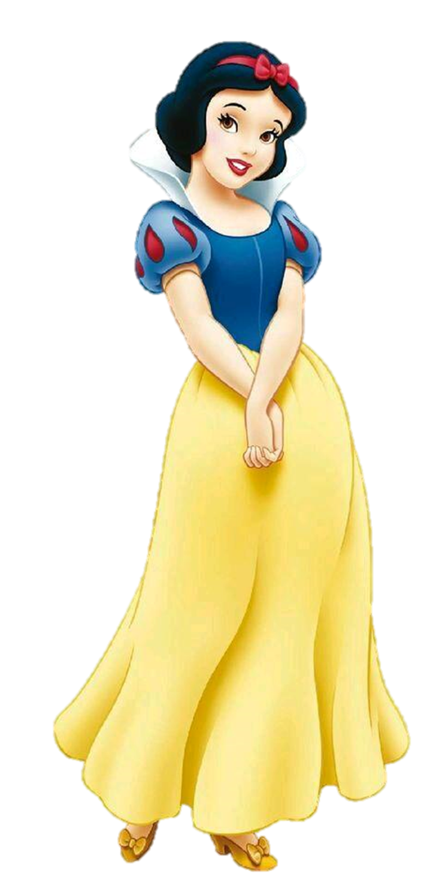
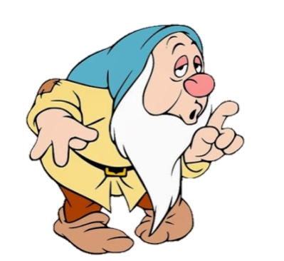
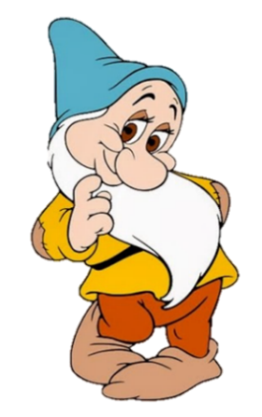
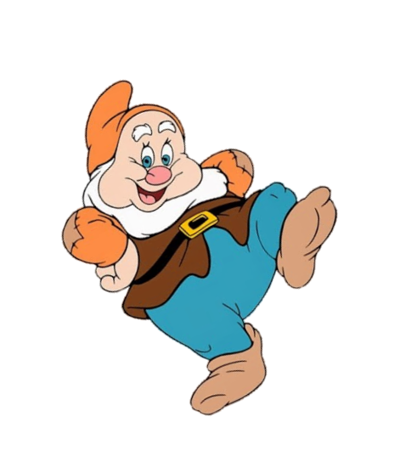
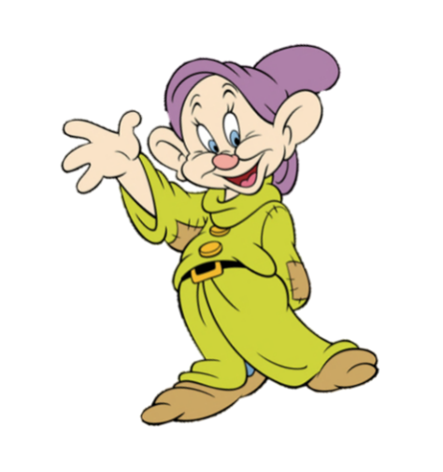
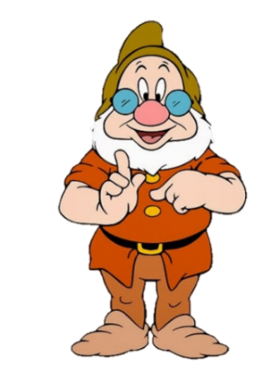
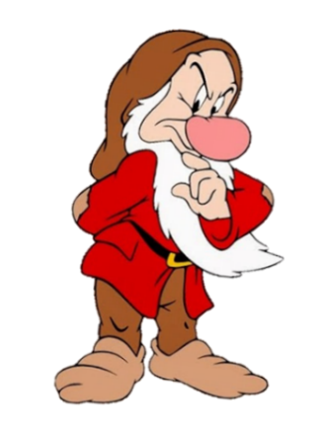
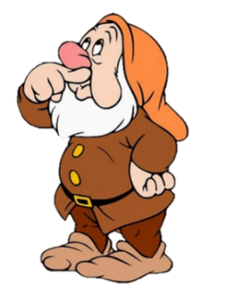

A: What would you like to be in the future?
B: I'd like to be a __________.
nurse
look after patients

Slide 32
A: Why would you like to be a nurse?
B: Because I'd like to __________ patients.
look
look after

Slide 33
A: Where would you like
to work?
B: In a __________.
farm
hospital
sheep
horses
next

Slide 34
A: What would you like to _____ in your free time?
B: I'd like to write comic stories.
go
do

Slide 35
Mai would like
to be a nurse.
True
False

Slide 36
Tom would like to work on a school.
True
False

Slide 37
Phong would like to fly a plane. .
True
False

Slide 38
Trung would like to be an architect.
True
False

Slide 39
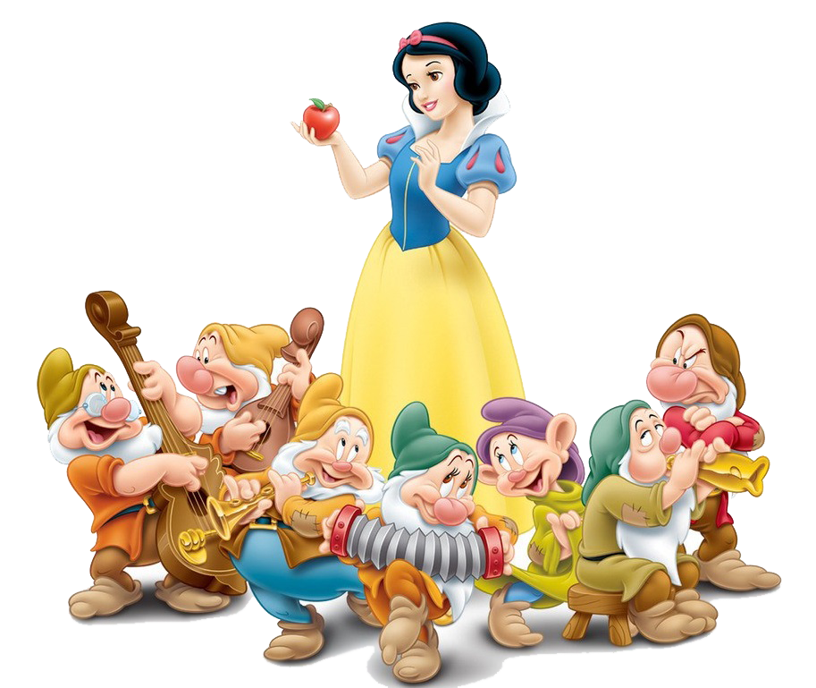
Good job!

Slide 40
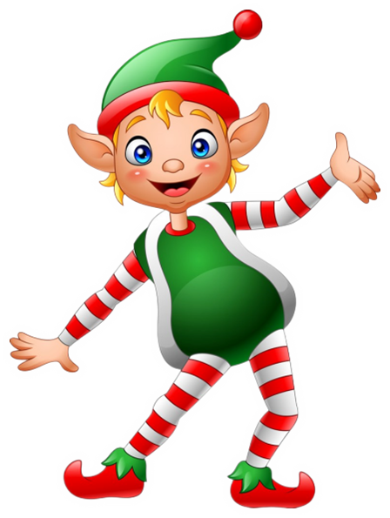


THANK YOU!
Welcome to join with me!
MsPham Powerpoint
Mspham

