Slide 1
Unit 16
WHERE’S THE POST OFFICE?
Lesson 1

Slide 2
VOCABULARY

Slide 3

Vocabulary
pharmacy
/ˈfɑːməsi/

Slide 4
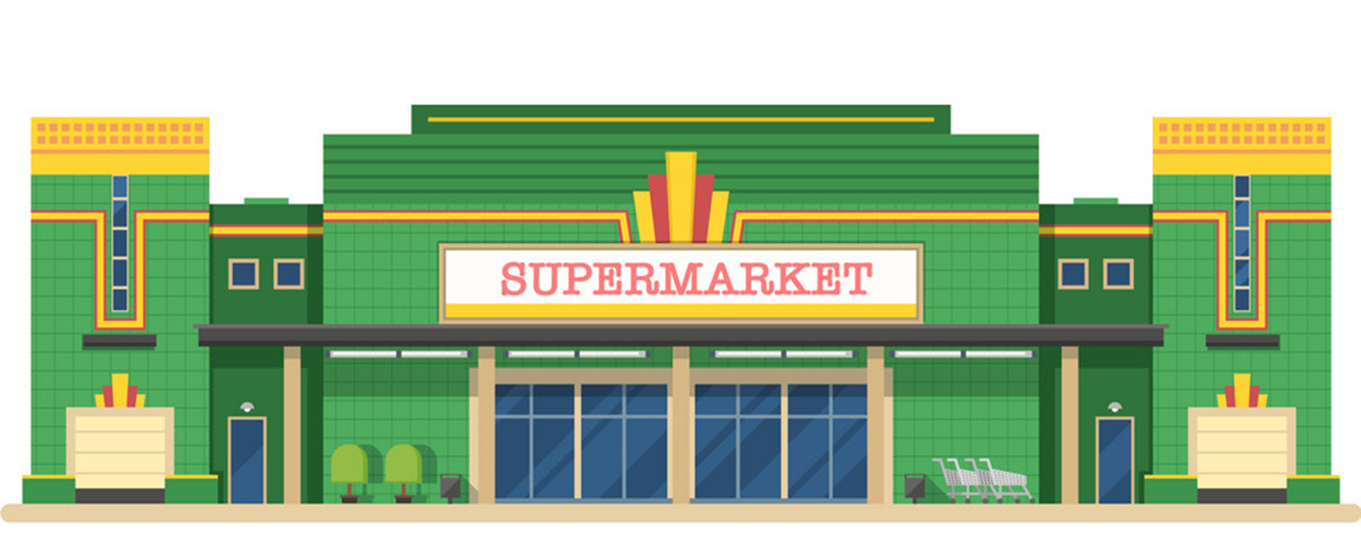



supermarket
/ˈsuːpəmɑːkɪt/

Slide 5
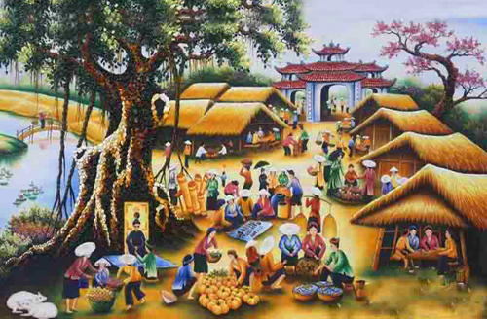
Vocabulary
market
/ˈmɑːrkɪt/

Slide 6

Vocabulary
Post office
/ˈpəʊst ɑːfɪs/

Slide 7
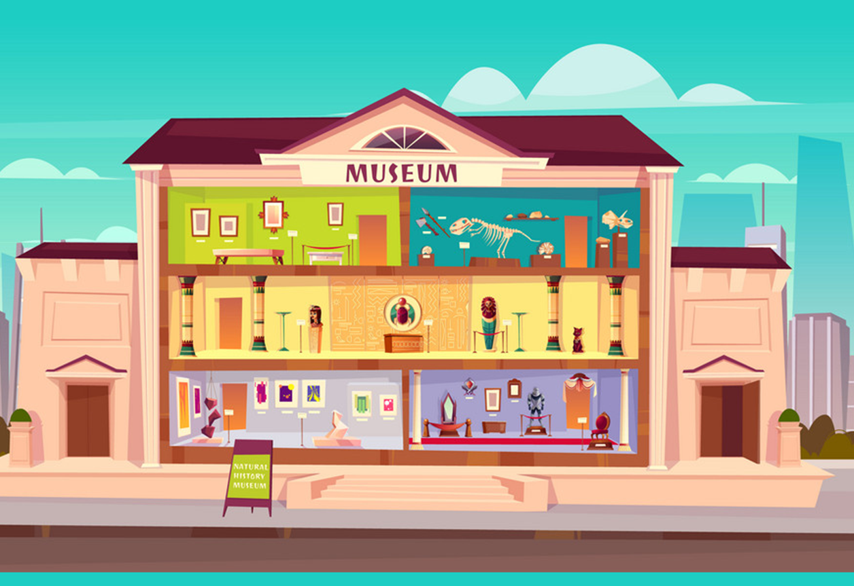
Vocabulary
Museum
/mjuˈziːəm/

Slide 8
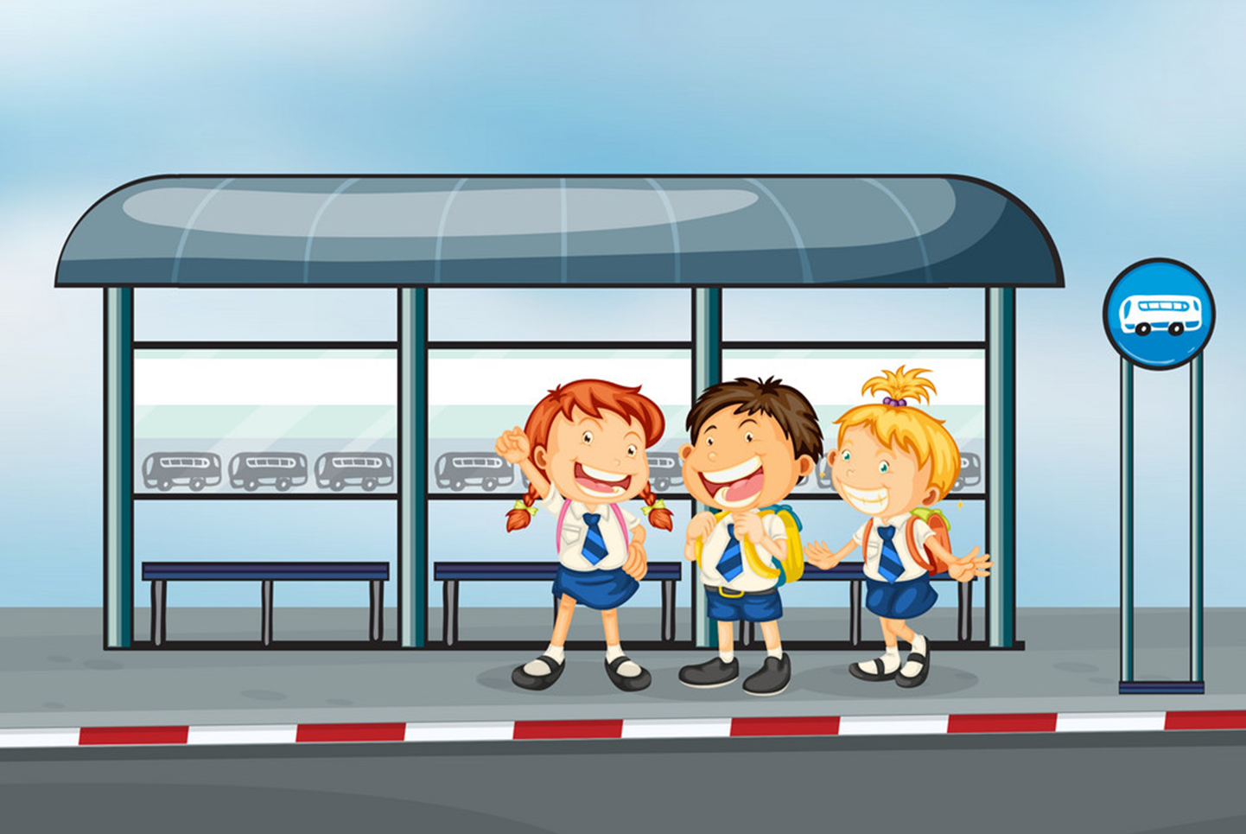
Vocabulary
Bus stop
/ˈbʌs stɑːp/

Slide 9

Vocabulary
Stadium
/ˈsteɪdiəm/

Slide 10

Vocabulary
Theatre
/ˈθiːətər/

Slide 11

Vocabulary
cinema
/ˈsɪnəmə/

Slide 12
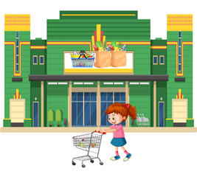
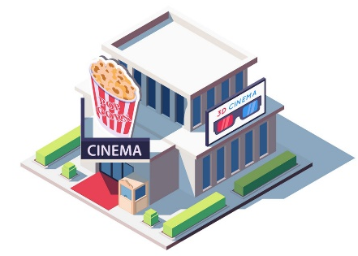
Vocabulary
museum
post office
bus stop
supermarket
market
pharmacy
theatre
cinema
stadium

Slide 13


right
left

Slide 14
Super
market
pharmacy

Slide 15
bakery
Pharmacy

Slide 16
Bus stop
Rainway station

Slide 17
museum
stadium

Slide 18
cinema
market

Slide 19
Post office
theatre

Slide 20
Post office
museum

Slide 21
cinema
museum

Slide 22
theatre
market

Slide 23


Vocabulary
Over there
/ˌəʊvər ˈðer/
: Ở đằng kia
Near
/nɪr/
: Ở gần
Opposite
/ˈɑːpəzɪt/
: Đối diện
Between
/bɪˈtwiːn/
: Ở giữa
Next to
/ˈnekst tu/
: Bên cạnh
At the end
/ ət ði end əv/
: Ở cuối
On the corner
/ɒn ðə kɔːrnər əv/
: Ở góc

Slide 24


Look and say
between

Slide 25
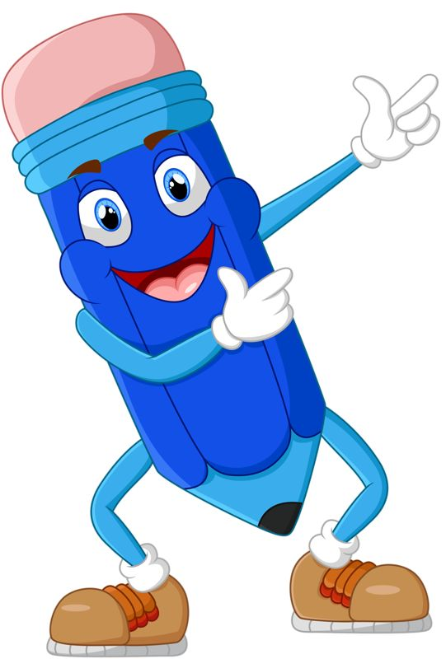
Look and say
over there

Slide 26
Look and say
start
At the end

Slide 27


Look and say
opposite

Slide 28
Look and say
next to

Slide 29
Look and say
On the corner

Slide 30
Look and say
near

Slide 31
Vocabulary
Turn left
/tɜːrn left/
: Rẽ trái
Turn right
/tɜːrn raɪt/
: Rẽ phải
Go straight
/ɡəʊ streɪt/
: Đi thẳng
Go ahead
/ɡəʊ əˈhed/
: Đi về phía trước
Go along
/ɡəʊ əˈlɔːŋ/
: Đi dọc theo

Slide 32
Read and match
Turn right
Đi về phía trước
Go ahead
Rẽ trái
Go along
Rẽ phải
Turn left
Đi thẳng
Go straight
Đi dọc theo

Slide 33
GRAMMAR

Slide 34

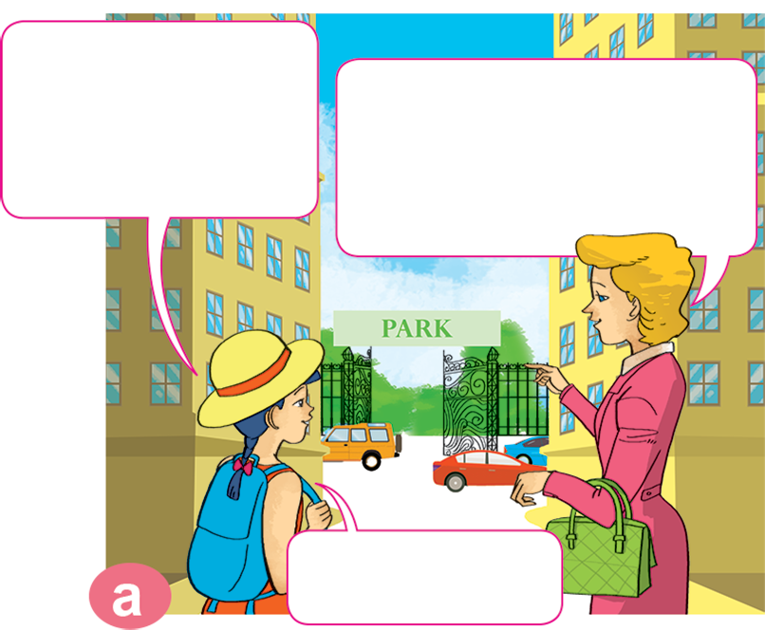
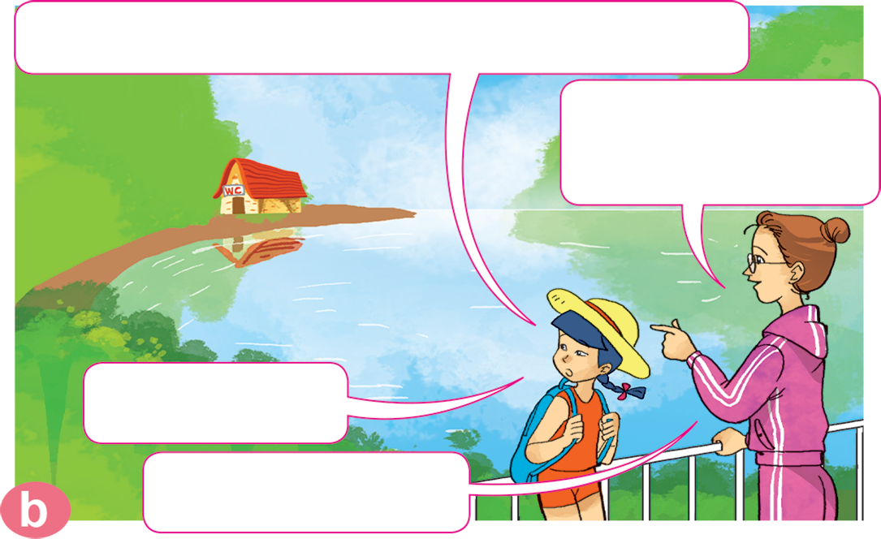
1. Look, listen and repeat.
Excuse me, where's the toilet, please?
Excuse me, where's the park, please?
Go straight ahead. It's at the end of the street.
It's over there, near the lake.
Thanks a lot.
Thank you.
You're welcome.

Slide 35
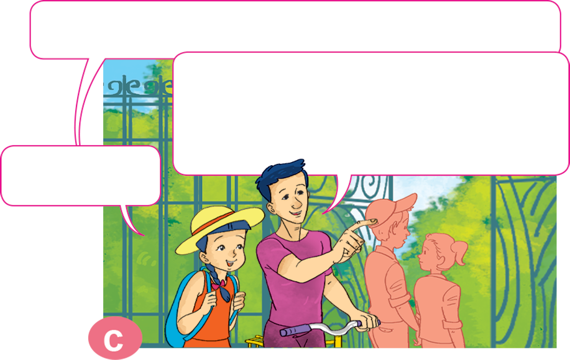
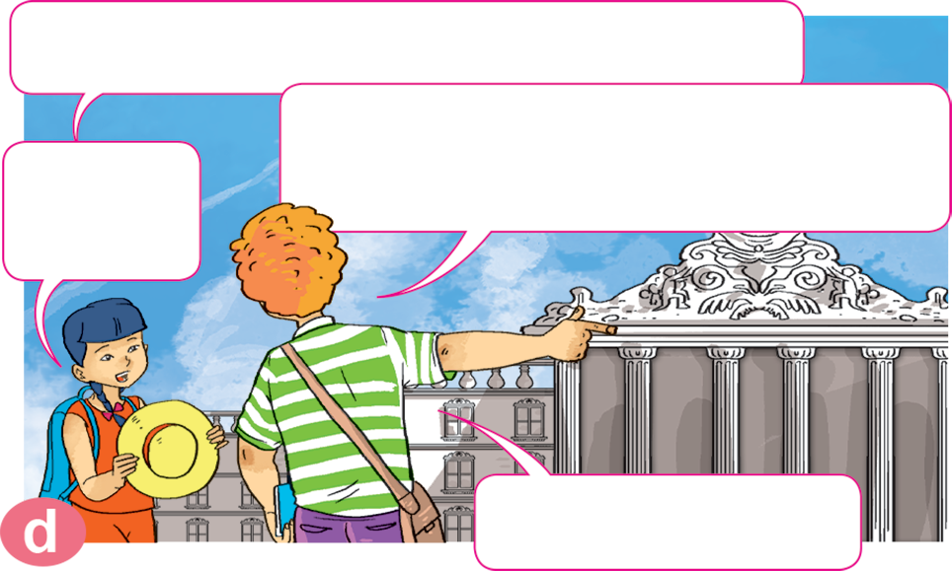
1. Look, listen and repeat.
Excuse me, is the museum near here?
Excuse me, where's the post office?
No, it isn't. Turn left. It's on the corner of the street, next to the theatre.
Turn right. It's between the supermarket and the cinema.
Thanks a lot.
Thank you.
Thank you.
You're welcome.

Slide 36

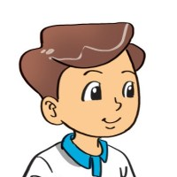
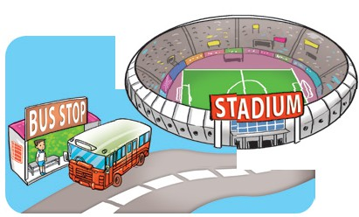
2. Point and say.
Excuse me, where's the ____________?
the bus stop
It's _______ ___________.
next to
the stadium
Excuse me, where's the bus stop?
It's next to the stadium.

Slide 37

2. Point and say.
Excuse me, where's the ____________?
theatre
It's ________ ______________________.
between
cinema and supermarket
Excuse me, where's the bus stop?
It's next to the stadium.

Slide 38

2. Point and say.
Excuse me, where's the ____________?
pharmacy
It's _________ ___________.
opposite
market
Excuse me, where's the bus stop?
It's next to the stadium.

Slide 39
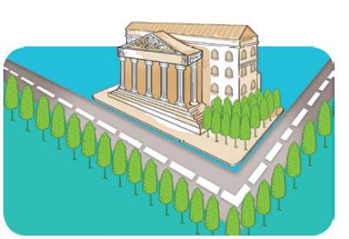
2. Point and say.
Excuse me, where's the ____________?
museum
It's _______________ _________.
on the corner of
the street
Excuse me, where's the bus stop?
It's next to the stadium.

Slide 40
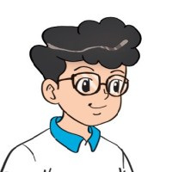
3. Let’s talk.
Where's the _____?
It's next to/opposite _____.
It's between _____and _____.
It's on the corner of _____.
Turn right/left _____.

Slide 41
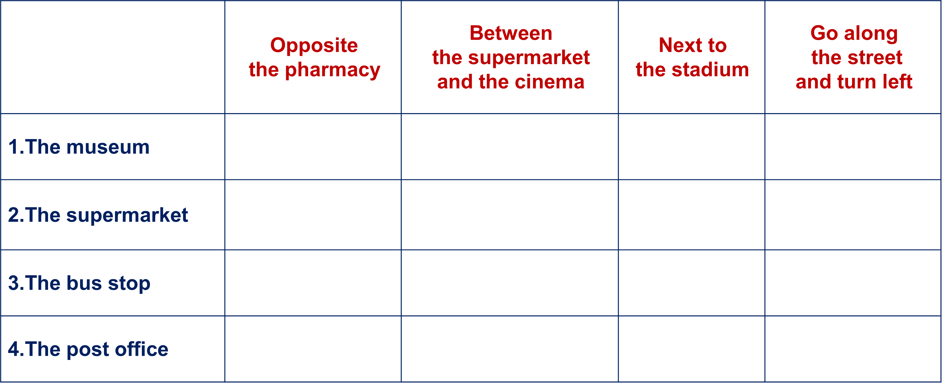

4. Listen and tick.

Slide 42
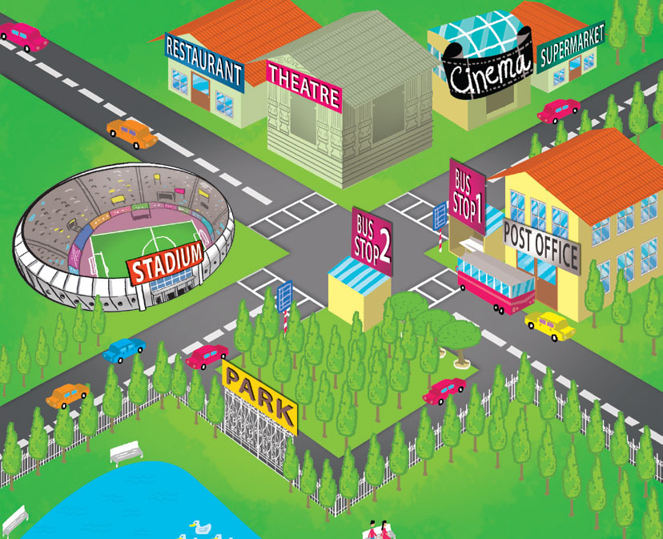
5. Look, read and complete.
1. The theatre is _____________ the stadium.
2. The cinema is __________ the theatre and the supermarket.
3. The stadium is ___________ of the street.
4. Bus stop 1 is _____________ Bus stop 2.
5. The post office is __________ Bus stop 1.
opposite
on the corner
opposite
opposite
next to
between
between
on the corner
opposite
next to

Slide 43



Next
ĐUA TÊN LỬA
Start
Notes:
Ms Huyền Phạm - 0936.082.789 – YOUTUBE: MsPham. Facebook: Dạy và học cùng công nghệ.

Slide 44










Next
Thử thách
QUYẾT ĐỊNH
Notes:
Ms Huyền Phạm - 0936.082.789 – YOUTUBE: MsPham. Facebook: Dạy và học cùng công nghệ.

Slide 45

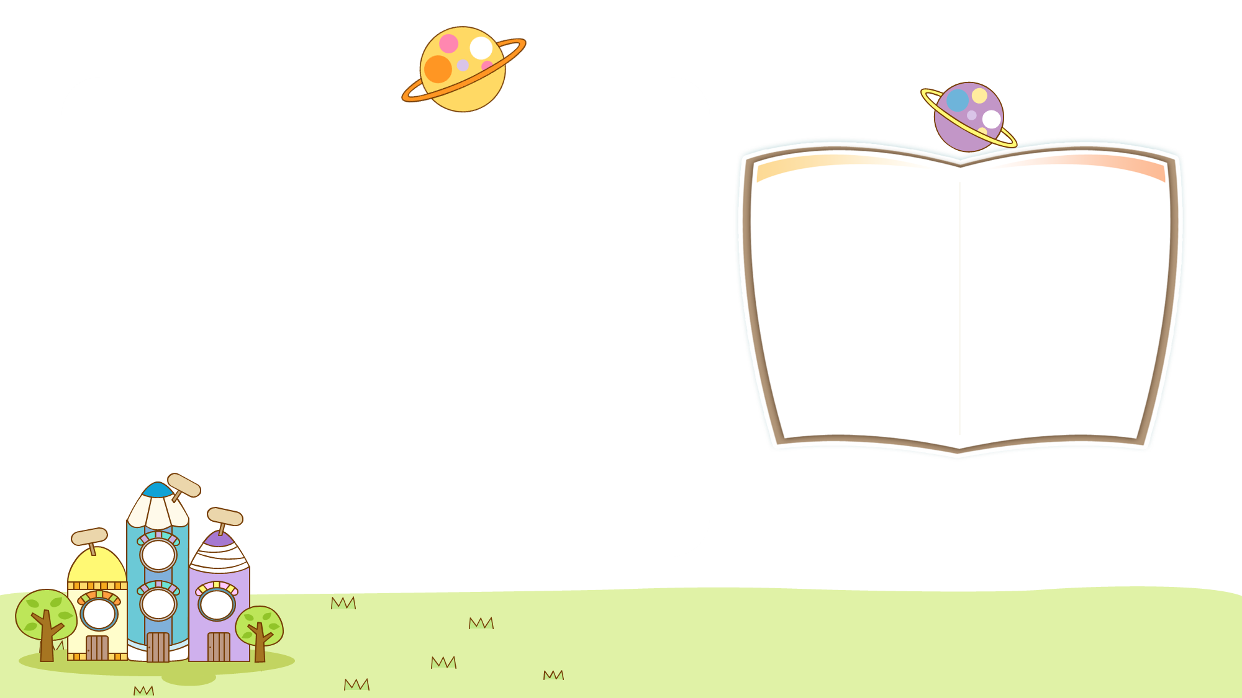
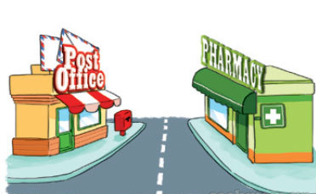

Back
Excuse me, where's the post office?
It's opposite the pharmacy.
Xem đáp án
Notes:
Ms Huyền Phạm - 0936.082.789 – YOUTUBE: MsPham. Facebook: Dạy và học cùng công nghệ.

Slide 46
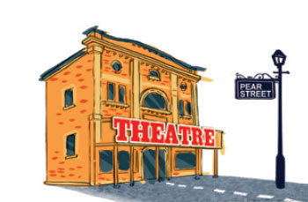
Back
Excuse me, _________________?
It's at the end of Pear Street
Where's the theatre?
Xem đáp án
Notes:
Ms Huyền Phạm - 0936.082.789 – YOUTUBE: MsPham. Facebook: Dạy và học cùng công nghệ.

Slide 47
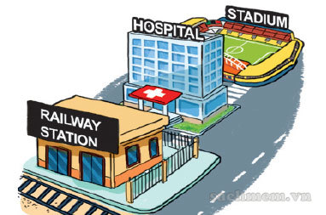
Back
Excuse me, where's the hospital?
It's between the railway station and the stadium.
Xem đáp án
Notes:
Ms Huyền Phạm - 0936.082.789 – YOUTUBE: MsPham. Facebook: Dạy và học cùng công nghệ.

Slide 48
Back
Excuse me, where's the cinema?
It’s next to the theatre.
Xem đáp án
Notes:
Ms Huyền Phạm - 0936.082.789 – YOUTUBE: MsPham. Facebook: Dạy và học cùng công nghệ.

Slide 49
Back
______, where's the supermarket?
It’s on the corner of the street.
Excuse me
Xem đáp án
Notes:
Ms Huyền Phạm - 0936.082.789 – YOUTUBE: MsPham. Facebook: Dạy và học cùng công nghệ.

Slide 50
Back
Excuse me, where's the ______?
The museum is near the bus stop.
the museum
Xem đáp án
Notes:
Ms Huyền Phạm - 0936.082.789 – YOUTUBE: MsPham. Facebook: Dạy và học cùng công nghệ.

Slide 51
Back
Excuse me, where's the market?
It’s _____ there.
over
Xem đáp án
Notes:
Ms Huyền Phạm - 0936.082.789 – YOUTUBE: MsPham. Facebook: Dạy và học cùng công nghệ.

Slide 52
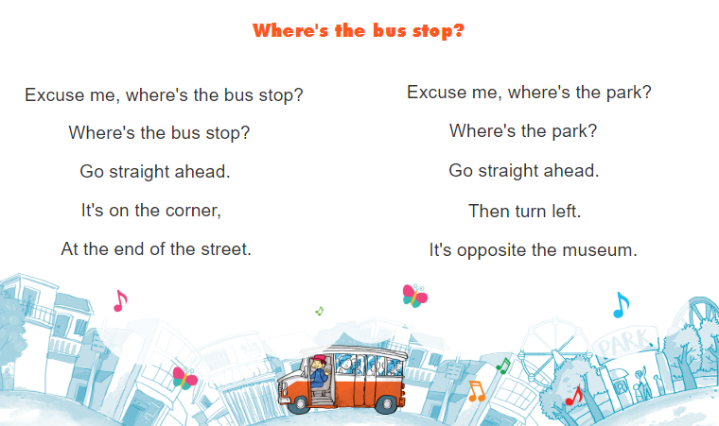


6. Let’s sing.

Slide 53
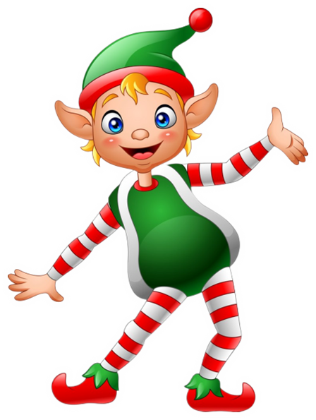


THANK YOU!
Welcome to join with me!
MsPham Powerpoint
Mspham

