Slide 1


DAI LOC DEPARTMENT OF EDUCATION AND TRAINING
DAI QUANG PRIMARY SCHOOL
WELCOME TO OUR CLASS !
Subject: English 3
Class: 3D
Teacher: Pham Thi My Chau

Slide 2

Warm-up

Slide 3
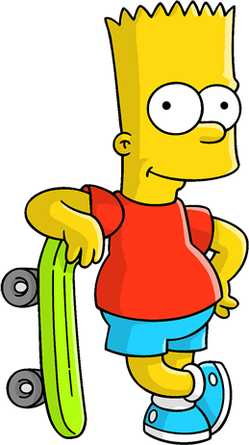

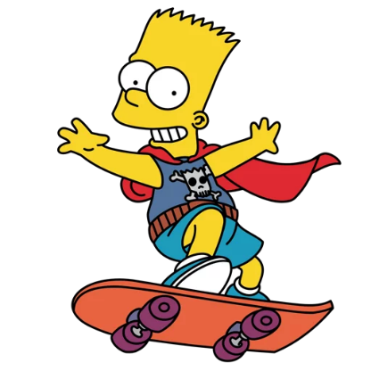

WHERE IS
BART
?

Slide 4

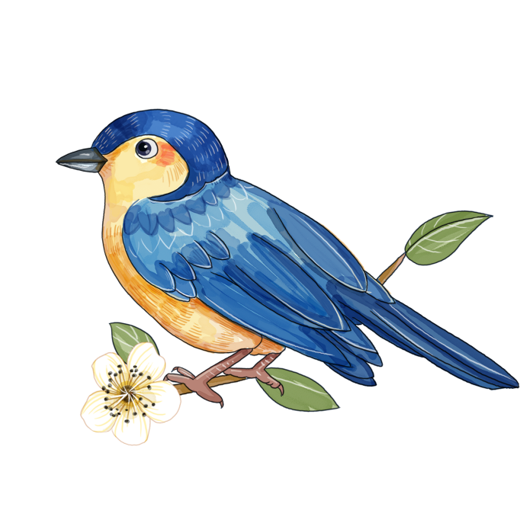



TIME’S UP
NEXT
A
cat
B
bird
C
rabbit

Slide 5

TIME’S UP
NEXT
A
bird
B
dog
C
cat

Slide 6

TIME’S UP
NEXT
A
dog
B
dogs
C
cat

Slide 7

TIME’S UP
NEXT
A
cat
B
goldfish
C
rabbit

Slide 8

TIME’S UP
p_ _rot
NEXT
A
or
B
er
C
ar

Slide 9
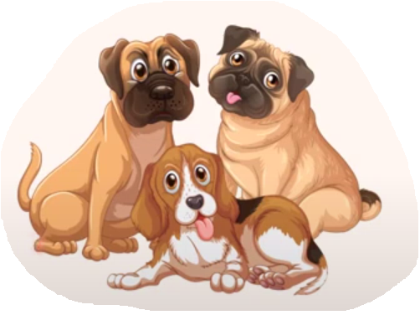
TIME’S UP
NEXT
A
some
B
many
C
cat

Slide 10

TIME’S UP
NEXT
A
dog
B
parrot
C
rabbit

Slide 11
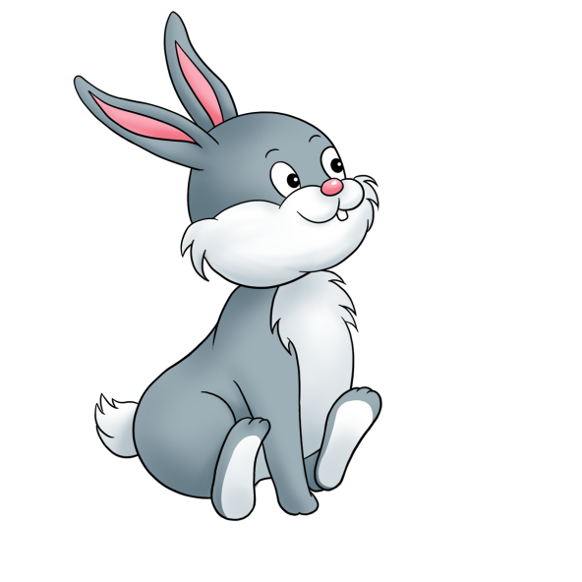
TIME’S UP
NEXT
A
rabbit
B
bird
C
cat

Slide 12
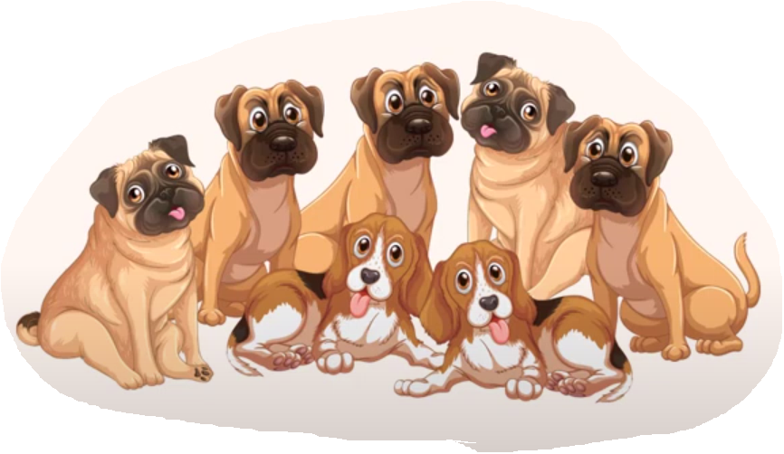
How many dogs do you have?
TIME’S UP
NEXT
A
I have some.
B
I have many.

Slide 13



How many parrots do you have?
TIME’S UP
NEXT
A
I have many.
B
I have some.

Slide 14
____ many dogs do you have?
I have many.
TIME’S UP
NEXT
A
Where
B
How
C
What

Slide 15
How many dogs do you have?
I ____some.
TIME’S UP
NEXT
A
had
B
have
C
has

Slide 16
Well done!
END

Slide 17


Thursday, March 22 nd , 2024
UNIT 16 : MY PETS
*Lesson 2:
Part: 4, 5 & 6

Slide 18

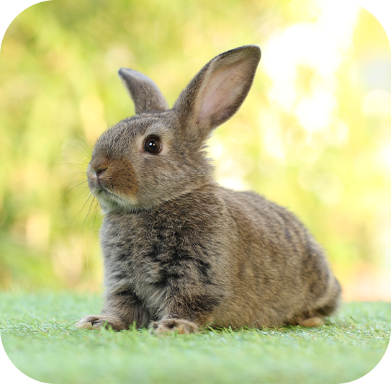
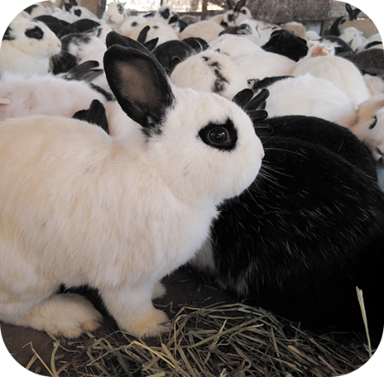
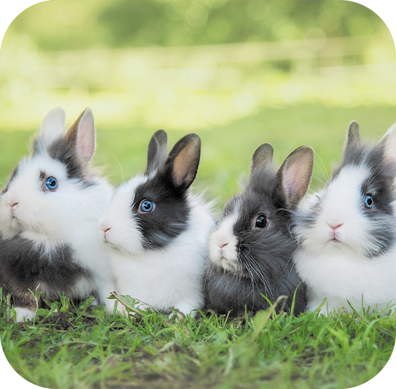
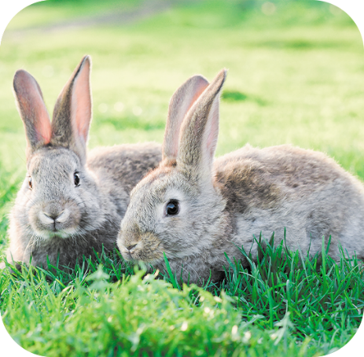




4. Listen and number.
a
b
c
d
4
1
2
3

Slide 19
1/ How many rabbits do you have ?
I have many.
2/ How many rabbits do you have ?
I have some.
3/ How many rabbits do you have ?
I have two.
4/ How many rabbits do you have ?
I have one.

Slide 20
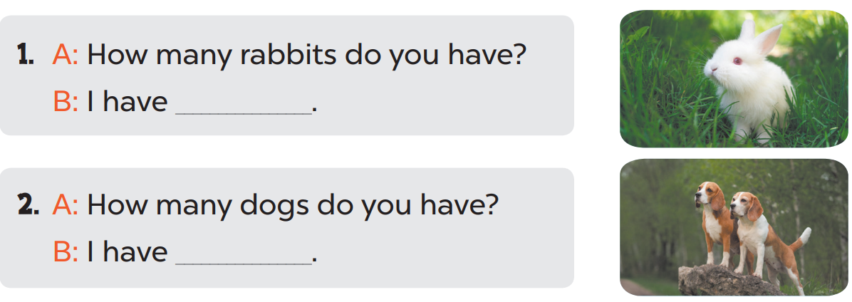
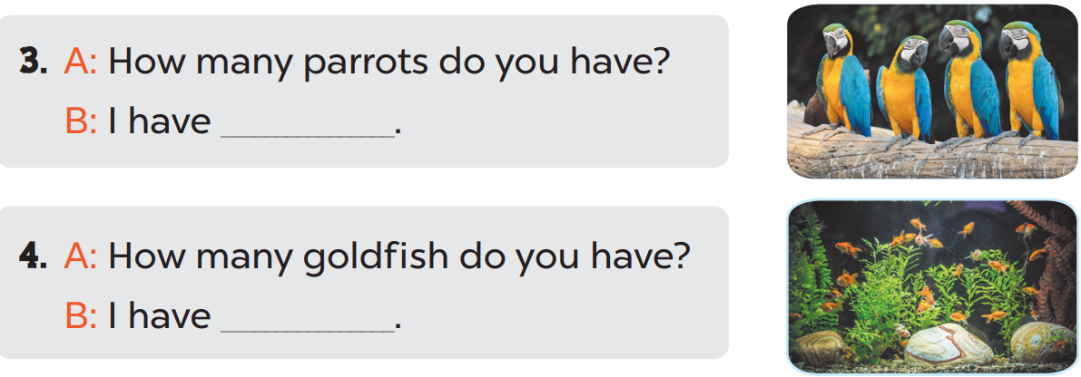
5. Look, complete and read.
one
two
some
many

Slide 21
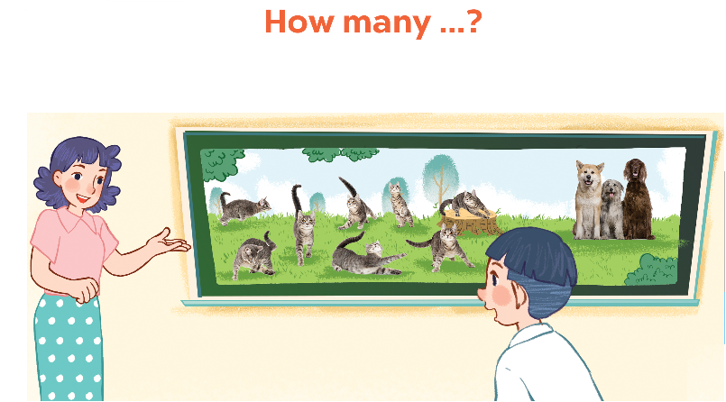
6. Let’s play.

Slide 22

Wrap up

Slide 23



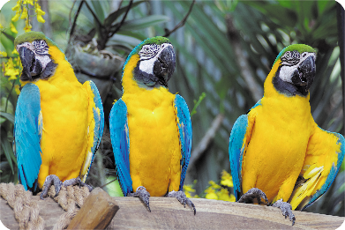
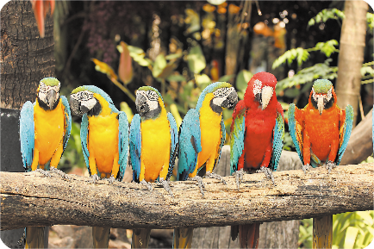
Review
dogs
goldfish
some
many

Slide 24
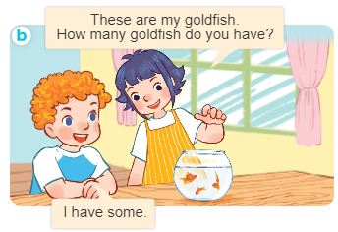
Structures
Cách hỏi và trả lời về số lượng vật nuôi.
- How many _____ do you have?
I have __________.

Slide 25

Facebook : Bùi Liễu
0968142780
Thank you!

