Slide 1

DAI LOC DEPARTMENT OF EDUCATION AND TRAINING
DAI QUANG PRIMARY SCHOOL
Welcome to our class !
Subject: English 2
Class: 2E
Teacher: Le Thi Hong Thanh

Slide 2
WARM-UP

Slide 3



Slide 4

UNIT 8
TRANSPORTATION
Lesson 2

Slide 5
1. Listen and repeat.
x
/ ks /

Slide 6


x
/ks/

Slide 7
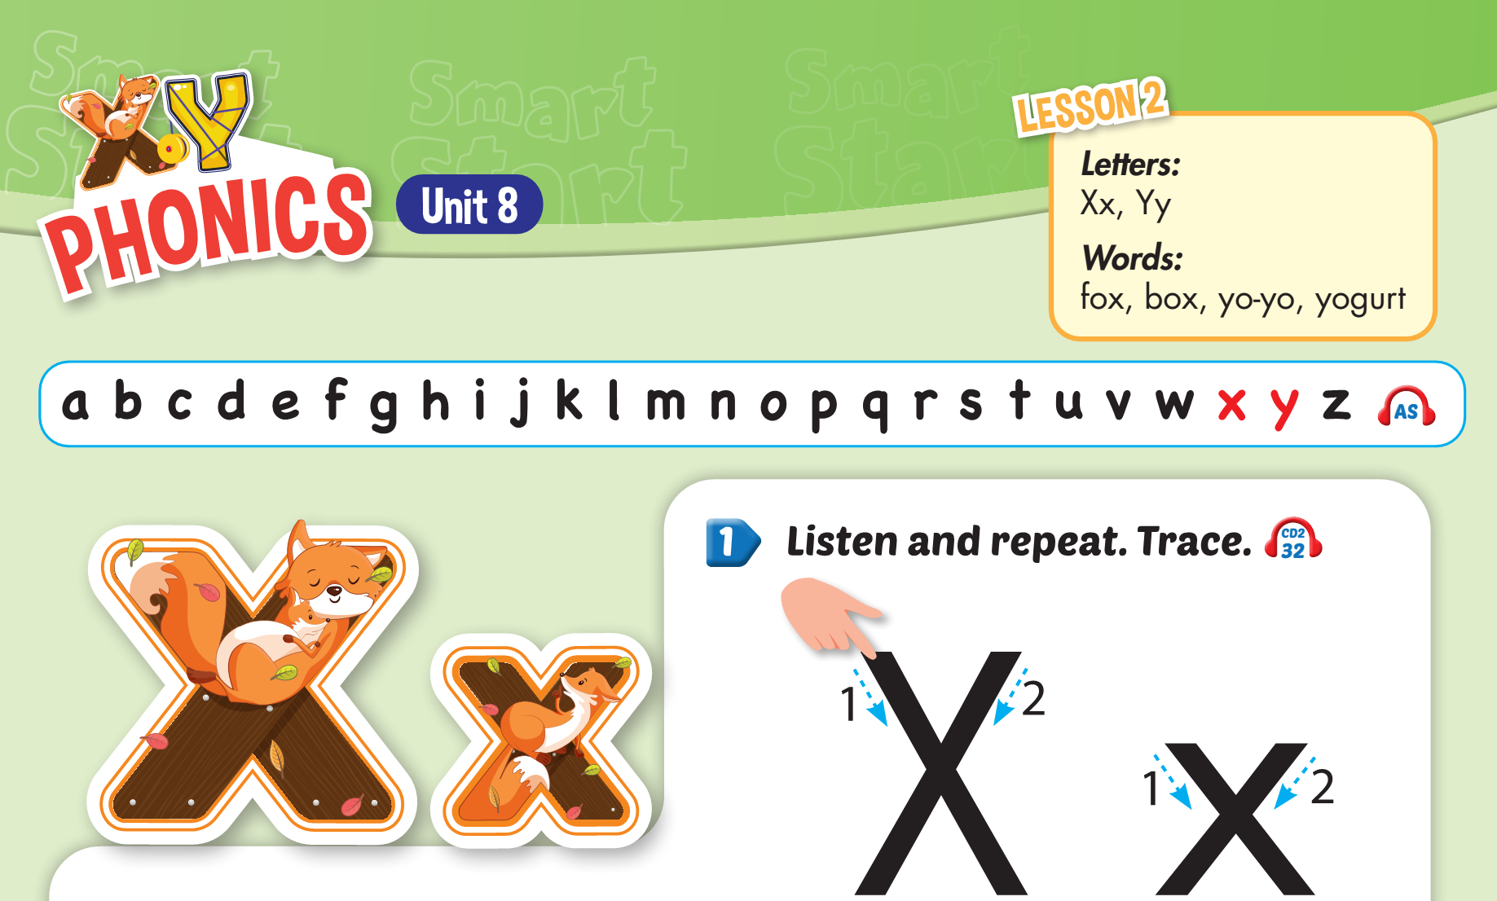


Slide 8

Trace the letter Xx
X
x

Slide 9


fox
con cáo

Slide 10

box
cái hộp

Slide 11
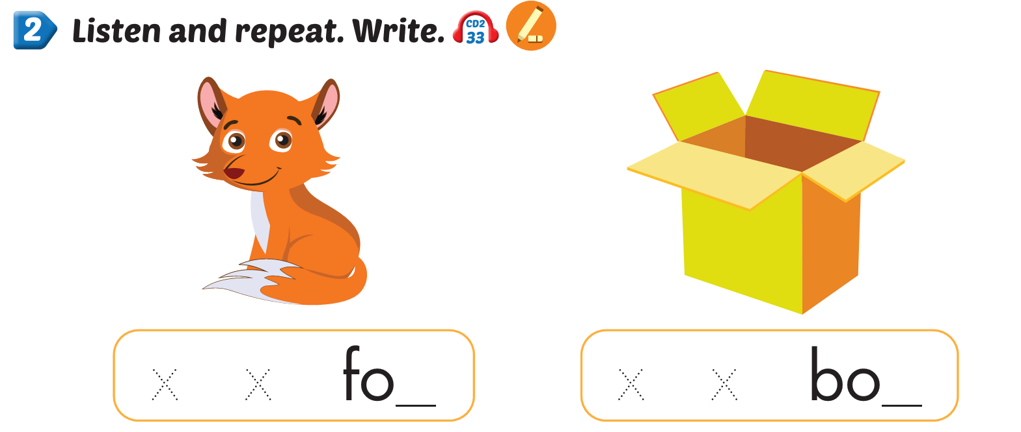
x
x

Slide 12


Part C:
Sing.

Slide 13

C. Sing
I can see a fox.

Slide 14


I can see a ,
x, x, .
I can see a ,
x, x, x.

Slide 15

D. Listen and hop.

Slide 16









Slide 17
1. fox
2. box
NEXT
Listen and choose

Slide 18
box
1.
fox
2.
NEXT
Listen and choose

Slide 19
1.
2.
NEXT
Choose the picture of “box”

Slide 20

1. “t”
2. ”x”
NEXT
This word has the sound…

Slide 21

Thank you

Slide 22
UNIT 8
TRANSPORTATION
Lesson 2
Letters:
Xx
2. Words:
fox: con cáo
box: cái hộp
3. Sentences:
- I can see a fox. ( Tôi có thể thấy một con cáo)

