Slide 1
WARM-UP

Slide 2



I can see a ,
x, x, .
I can see a ,
x, x, x.

Slide 3

UNIT 8
TRANSPORTATION
Lesson 2 ( 2)

Slide 4
1. Listen and repeat.
y
/ j /

Slide 5


y
/ j /

Slide 6
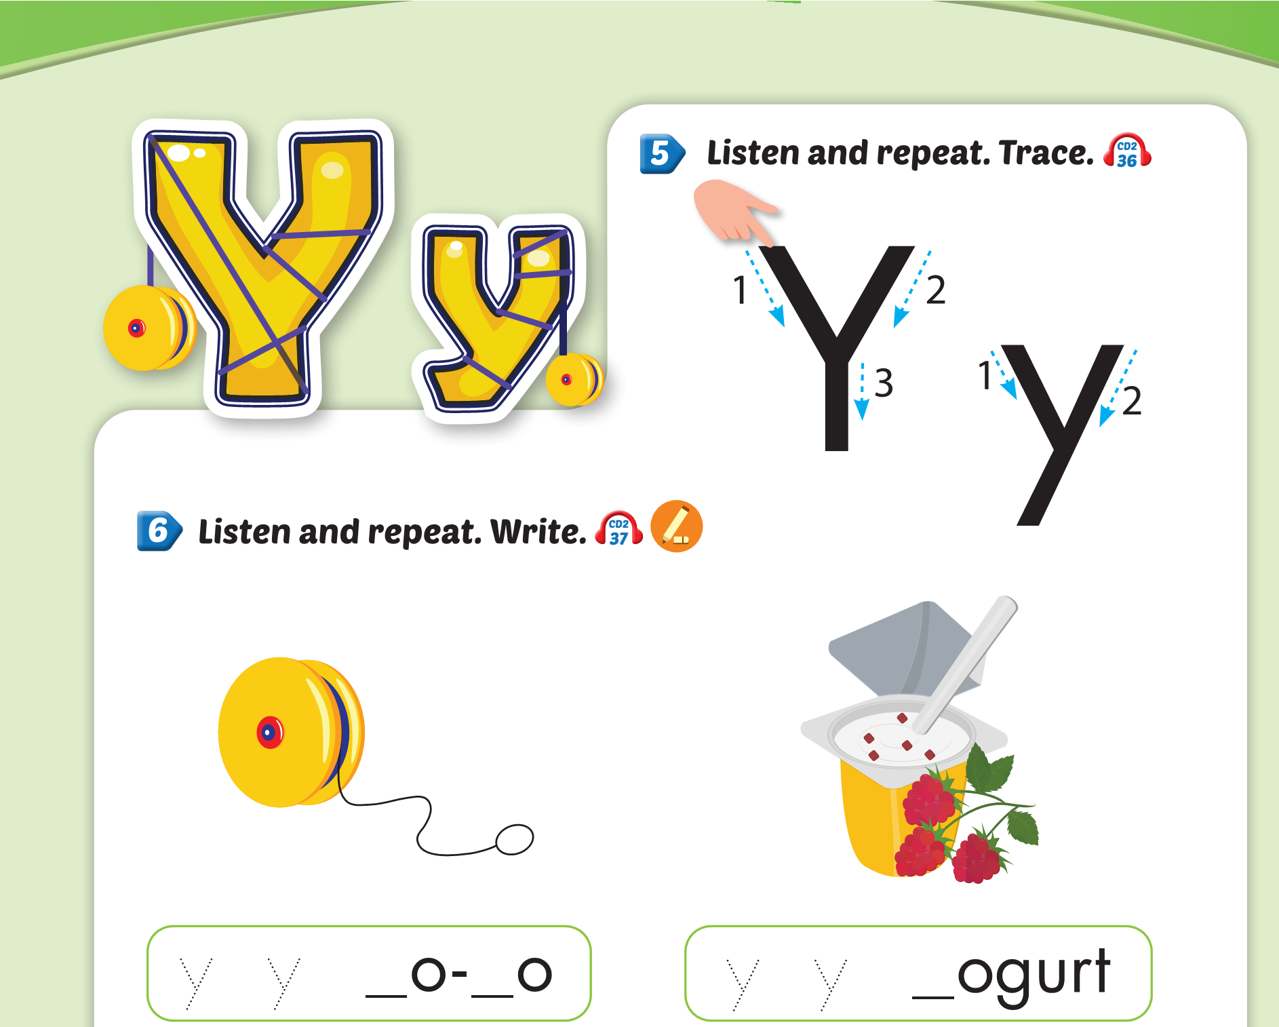


Slide 7

How to write letter Yy?
Y
y

Slide 8


Yy yo-yo

Slide 9

Yy yogurt

Slide 10
y
y
y
y

Slide 11


Part G:
Sing.

Slide 12

I have a ,
y, y, .
I have a ,
y, y, y.

Slide 13


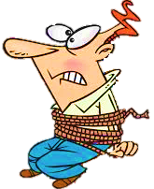






Slide 14
fox
box
NEXT
Listen and choose

Slide 15
fox
yo-yo
NEXT
Listen and choose

Slide 16
yogurt
yo-yo
NEXT
Listen and choose

Slide 17

NEXT
Choose the picture of “box”

Slide 18
NEXT
Choose the picture of “fox”

Slide 19

Thank you

