Slide 1


Slide 2
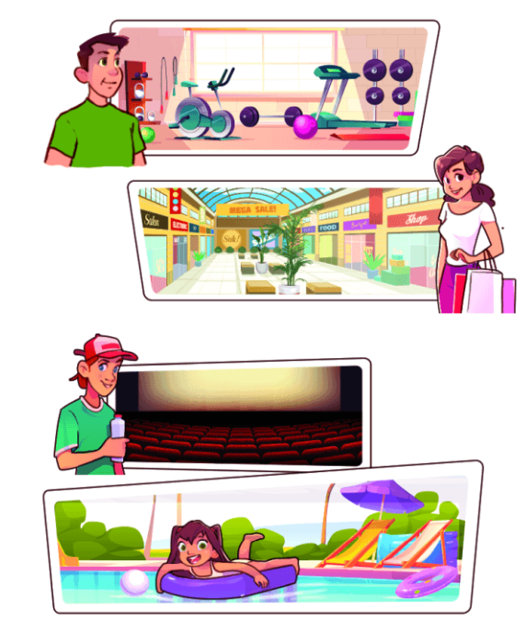
Monday, December 10th 2023
Unit
15
My family’s weekends
Lesson 1 (1+2+3)

Slide 3
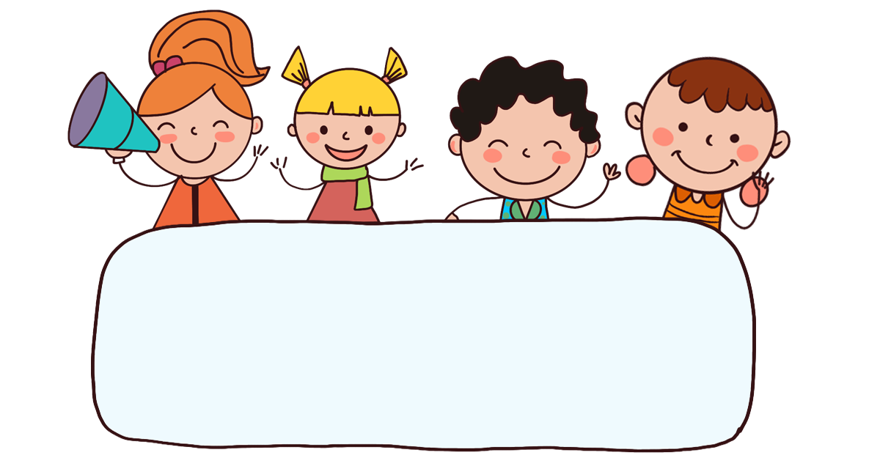
Warm-up

Slide 4

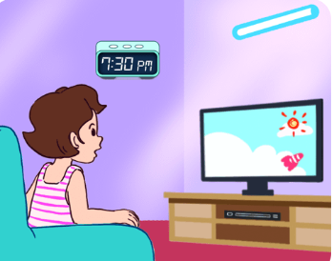
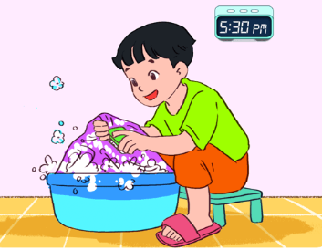
Let’s chant.
Watch TV,
watch TV
Wash clothes,
wash clothes.
Do you watch TV?
Do you wash your clothes?
Yes, I do.
Yes, I do.
Yes, I do.
Yes, I do.
When do you watch TV?
When do you wash your clothes?
In the evening. In the evening.
In the afternoon.
In the afternoon.

Slide 5



Contents
Look, listen and repeat.
Listen, point and say.
Let’s talk.

Slide 6

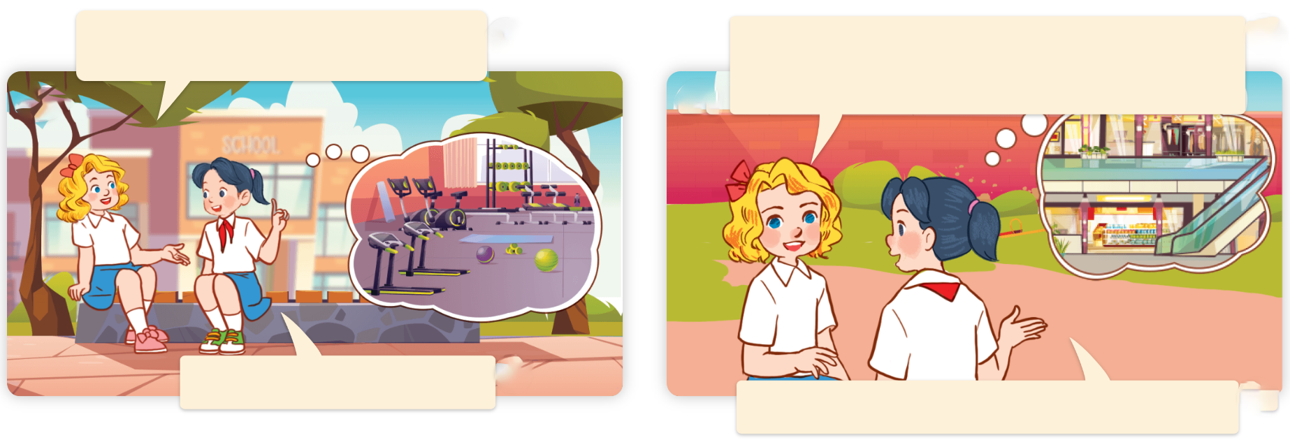
1. Look, listen and repeat.
Where does your father go
on Saturdays?
a
b
What about your mother?
Where does she go on Saturdays?
He goes to the gym.
She goes to the shopping centre.
What are they talking about?
Where are they?
Who are they?
Click on the speaker / sentences to listen.

Slide 7
Vocabulary

Slide 8
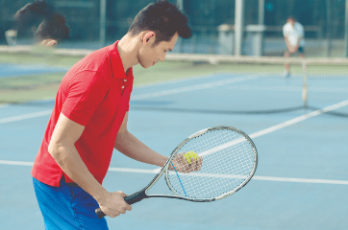
Vocabulary
sports centre
/ˈspɔːts sentə/
trung tâm thể thao
Click on the English words to listen.

Slide 9
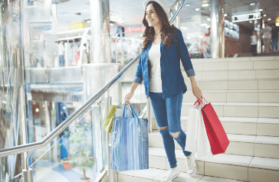
shopping centre
/ˈʃɒpɪŋ sentə/
trung tâm mua sắm

Slide 10
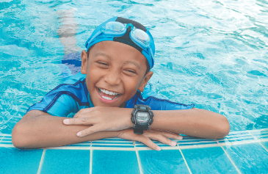
Vocabulary
swimming pool
/ˈswɪmɪŋ puːl/
bể bơi

Slide 11
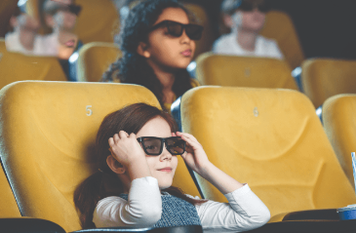
Vocabulary
cinema
/ˈsɪnəmə/
rạp chiếu phim
Click on the English words to listen again.

Slide 12
Review
sports centre
shopping centre
swimming pool
cinema

Slide 13

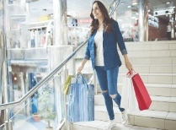

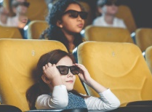
Vocabulary
1. sports centre
: trung tâm thể thao
2. shopping centre
: trung tâm mua sắm
3. swimming pool
: bể bơi
4. cinema
: rạp chiếu phim
Click on the English words to listen.

Slide 14
Match
1
2
3
4
a
b
c
d
swimming pool
cinema
sports centre
shopping centre

Slide 15
2. Listen, point and say.
a
b
Where does he / she go on Saturdays?
sports centre
shopping centre
c
d
He / She goes to the _____.
swimming pool
cinema

Slide 16


2. Listen, point and say.
Where does he / she go on Saturdays?
He / She goes to the _____.
sports centre
Where does he go on Saturdays?
He goes to the sports centre.
Click on the sentences to listen.

Slide 17
2. Listen, point and say.
Where does he / she go on Saturdays?
He / She goes to the _____.
shopping centre
Where does she go on Saturdays?
She goes to the shopping centre.

Slide 18
2. Listen, point and say.
Where does he / she go on Saturdays?
He / She goes to the _____.
swimming pool
Where does he go on Saturdays?
He goes to the swimming pool.

Slide 19
2. Listen, point and say.
Where does he / she go on Saturdays?
He / She goes to the _____.
cinema
Where does she go on Saturdays?
She goes to the cinema.

Slide 20
Structures

Slide 21



Cách hỏi anh ấy / cô ấy đi đâu vào ngày thứ 7.
Where does he / she go on Saturdays?
( Anh ấy / cô ấy đi đâu vào ngày thứ 7?)
He / She goes to the ______.
(Anh ấy / Cô ấy đi _______.)
Ex:
Where does he go on Saturdays?
He goes to the sports centre.

Slide 22
Unit 15.1
Where does he / she go on Saturdays?
He / She goes to the _______.
sports centre
cinema
shopping centre
swimming pool

Slide 23
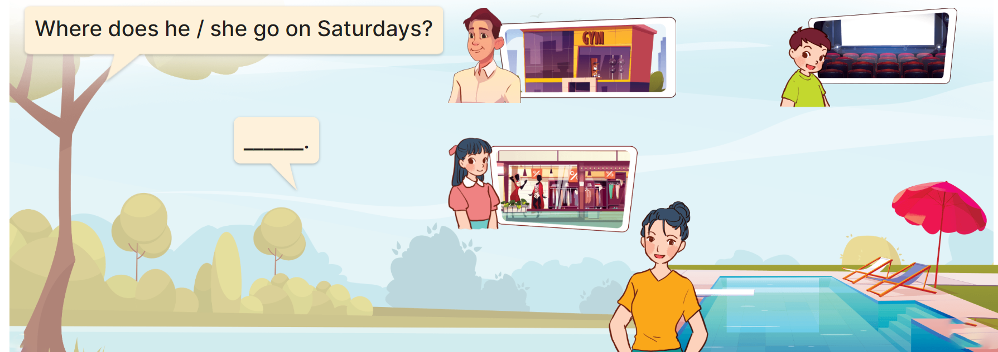
3. Let’s talk.

Slide 24
Let’s play!

Slide 25




Slide 26






- Where does he go on Saturdays?
- He goes to the _______.
A. sports centre
B. cinema
C. shopping centre

Slide 27
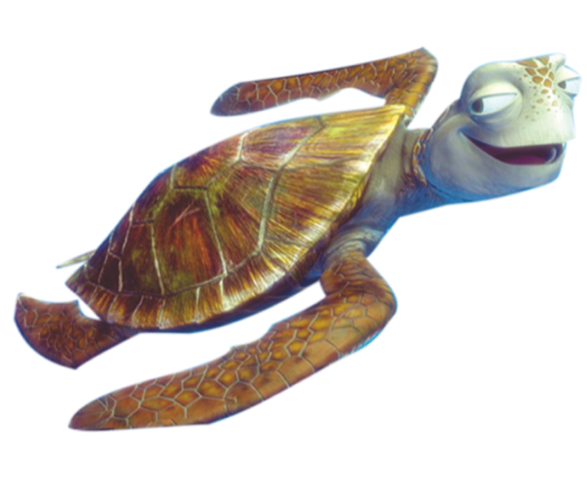
- Where does she go on Saturdays?
- She goes to the _______.
A. shopping centre
B. swimming pool
C. cinema

Slide 28
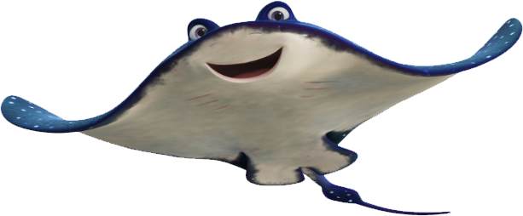
- Where does he go on Saturdays?
- He goes to the _______.
A. cinema
B. swimming pool
C. sports centre

Slide 29
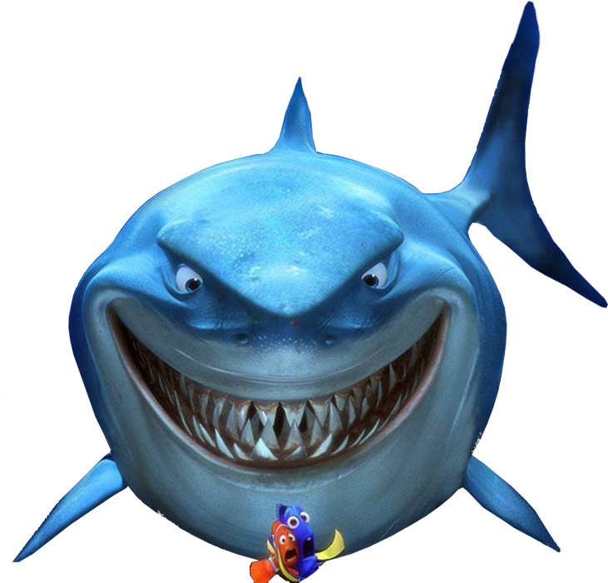
- Where does she go on Saturdays?
- She goes to the ______.
A. sports centre
B. shopping centre
C. cinema

Slide 30
______ does he go on Saturdays?
- He goes to the sports centre.
A. Where
B. What
C. When

Slide 31

- Where ____ he go on Saturdays?
- He goes to the swimming pool.
A. do
B. does
C. have

Slide 32

- Where does she ____ on Saturdays?
- She goes to the cinema.
A. have
B. goes
C. go

Slide 33

- Where does he go on Saturdays?
- He _____ to the swimming pool.
A. has
B. go
C. goes

Slide 34
Look and choose.
- She goes to the shopping centre.
A. True
B. False

Slide 35
Look and choose.
- He goes to the
swimming pool.
→ He goes to the sports centre.
A. True
B. False

Slide 36




Slide 37
Wrap up

Slide 38
Unit 15.1
Where does he / she go on Saturdays?
He / She goes to the _______.
sports centre
cinema
shopping centre
swimming pool

Slide 39
Homework
Learn by heart all the new words.
Read again the dialogue in part 1.

Slide 40

Thank you!

