Slide 1


Slide 2


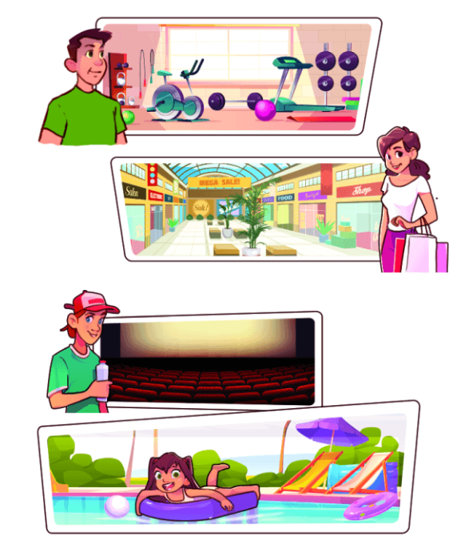
Unit
15
My family’s weekends
Lesson 2 (4+5+6)

Slide 3
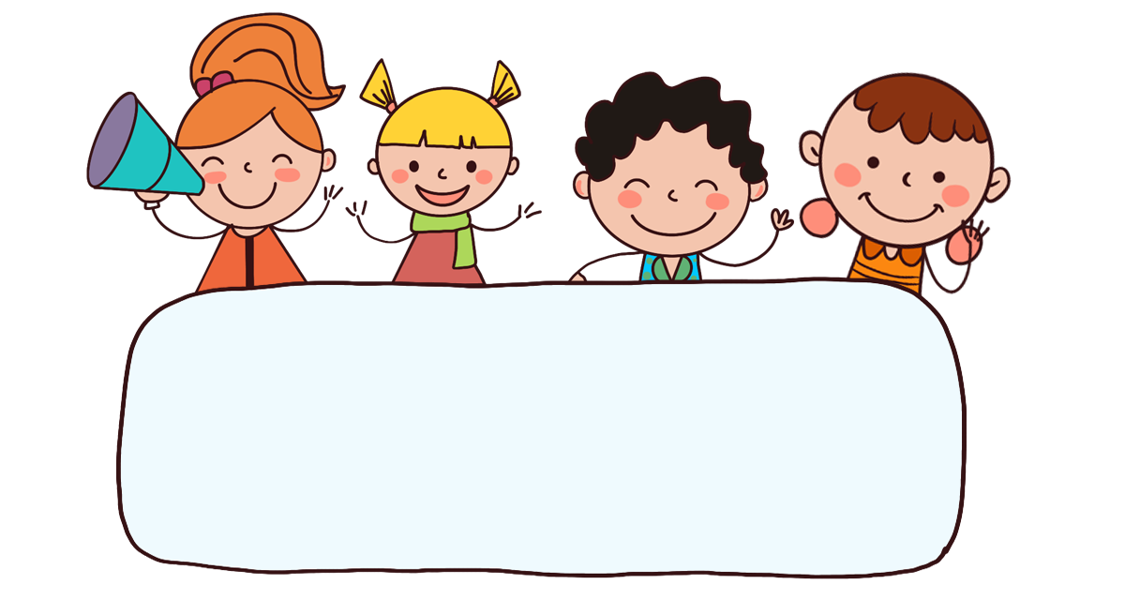
Warm-up

Slide 4
Let’s play!

Slide 5







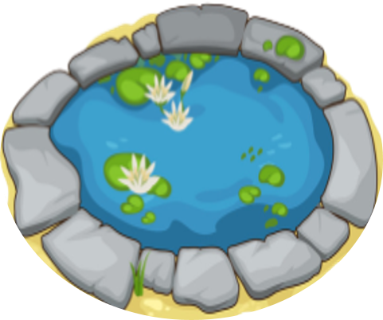
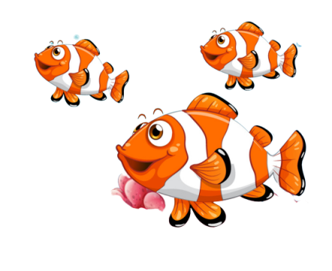
FEEDING GOLDFISH
Mỗi câu trả lời đúng là
CÂU THẦN CHÚ giúp cá Vàng
ngoi lên mặt nước nhận thức ăn.
Nào chúng mình cùng giúp
bạn nhỏ cho cá Vàng ăn nhé!
START

Slide 6



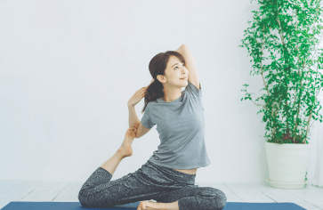


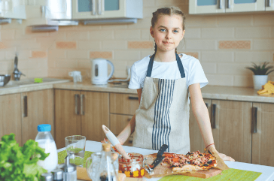
Next
A.
B.
C.

Slide 7
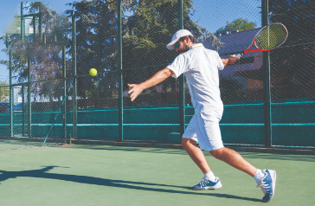
Next
A.
B.
C.

Slide 8
Nam: What does she do
on Sundays?
Linh: She does yoga.
Next
A.
B.
C.

Slide 9
Next
A.
B.
C.

Slide 10
Next
A.
B.
C.

Slide 11
Next
A. beans
She cooks _____.
B. meals
C. eggs

Slide 12
Next
He _____ tennis.
A. does
B. watches
C. plays

Slide 13
Next
A. does
She _____ yoga.
B. do
C. plays

Slide 14


Nam: What does she do
on Sundays?
Linh: She ______.
Next
A. watches films
B. watch films
C. has short hair

Slide 15
Nam: ____________?
Linh: He watches films.
Next
A. Where does he go on Saturdays?
B. What does he do on Sundays?

Slide 16
THANK YOU!
Next

Slide 17



Contents
Listen and match.
Look, complete and read.
Let’s play.

Slide 18








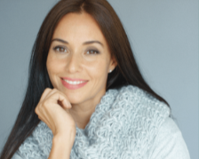




4. Listen and match.
1.
2.
3.
4.
a
b
c
d

Slide 19
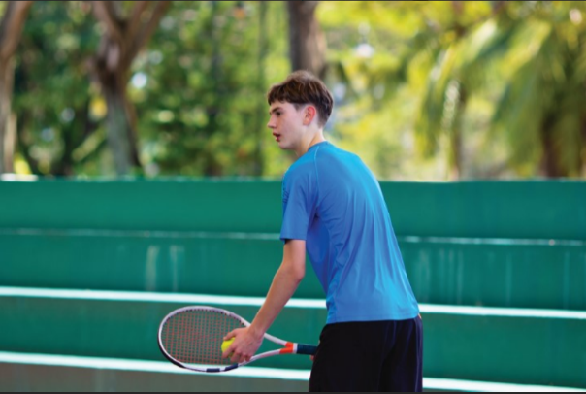
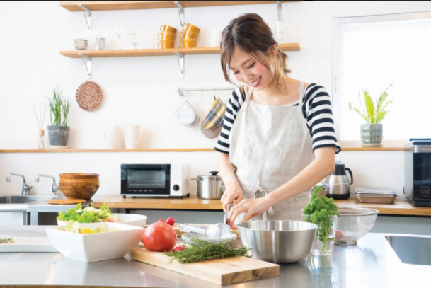
5. Look, complete and read.
3.
A: Where does your brother go on Sundays?
B: He goes to the ___________.
A: What does he _____ there?
B: He plays _________.
A: Where does your mother on Sundays?
B: She’s at __________.
A: ______ does she do?
B: She _______________.
4.
sports centre
home
do
What
tennis
cooks meals

Slide 20
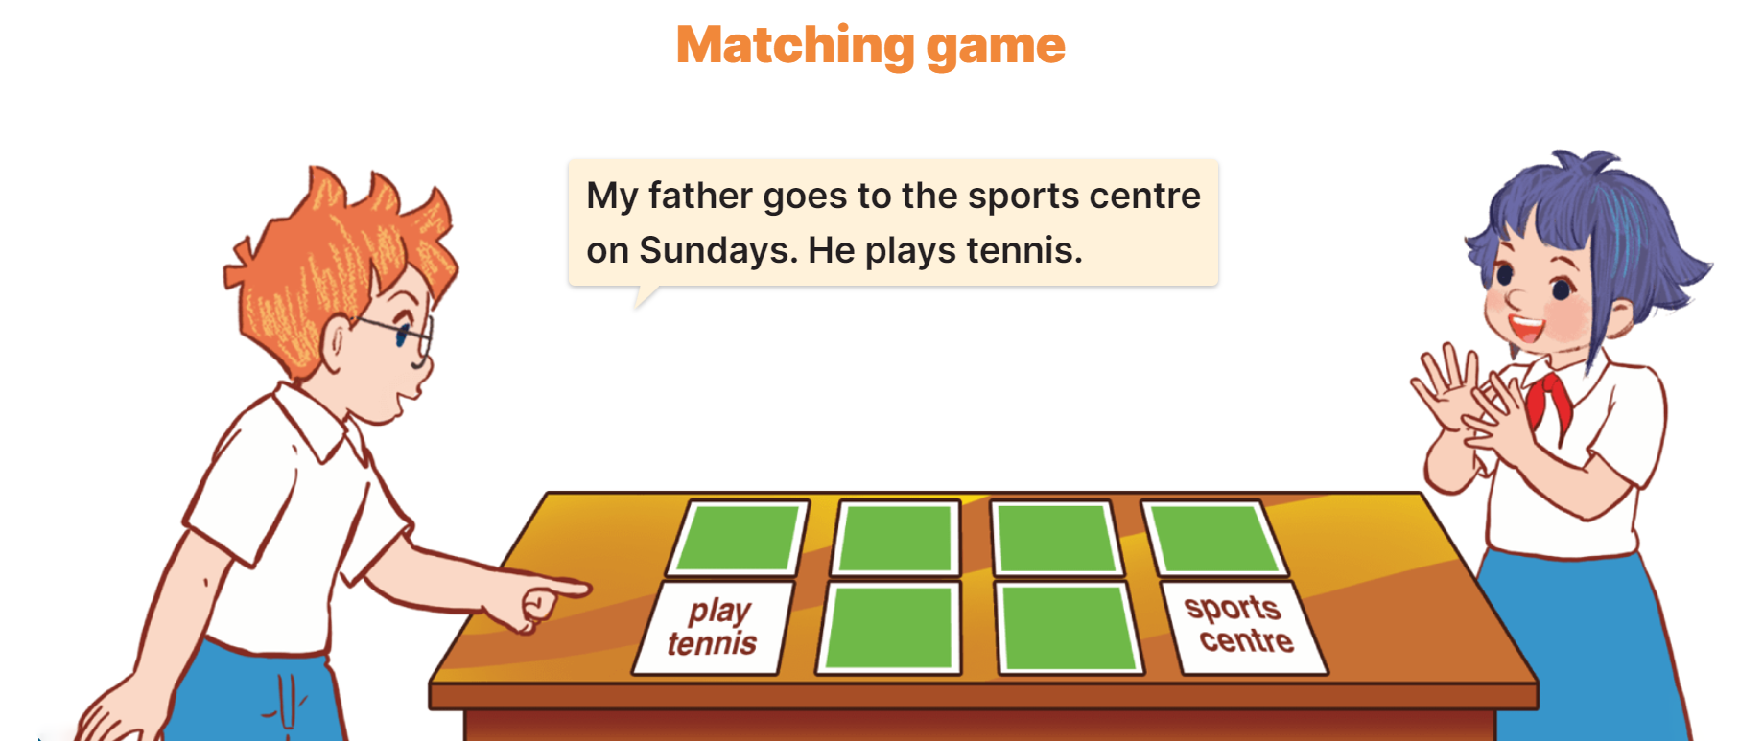
6. Let’s play.

Slide 21
Wrap up

Slide 22


Unit 15 lesson 2
What does he / she do on Sundays?
He / She _______.
cooks meals
does yoga
plays tennis
watches films

Slide 23
Homework
Learn by heart all the new words.
Read again the dialogue in part 1.

Slide 24

Thank you!

