Slide 1
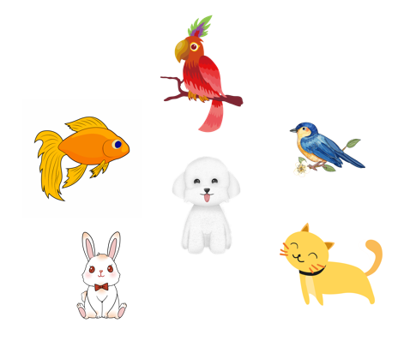
..................................
My pets
Unit
16
Lesson 1
Facebook : Bùi Liễu
0968142780

Slide 2
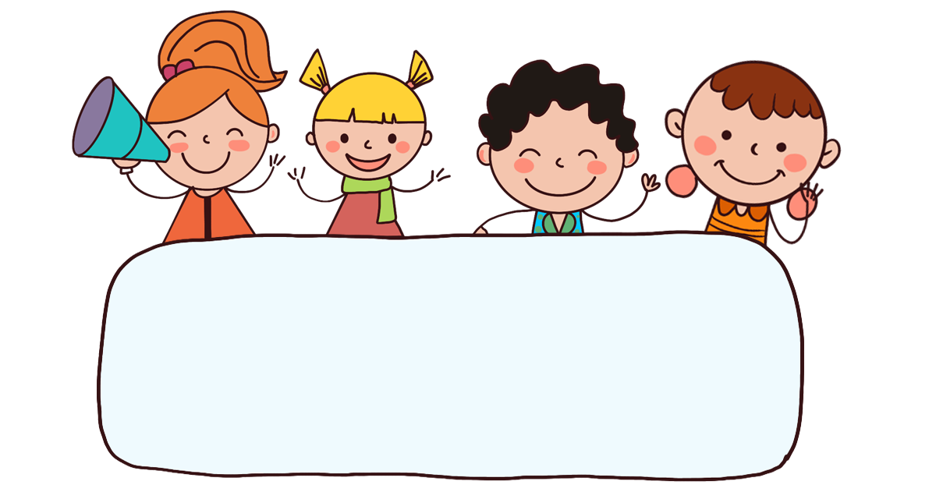
Warm-up

Slide 3




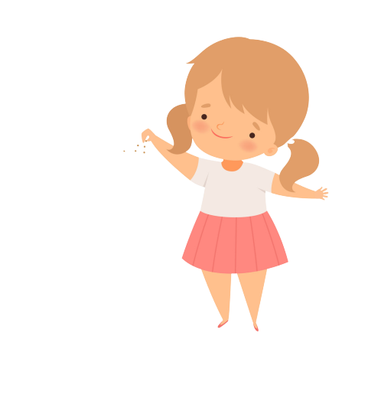


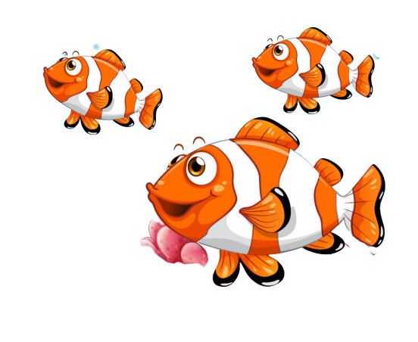
FEEDING GOLDFISH
Mỗi câu trả lời đúng là
CÂU THẦN CHÚ giúp cá Vàng
ngoi lên mặt nước nhận thức ăn.
Nào chúng mình cùng giúp
bạn nhỏ cho cá Vàng ăn nhé!
START

Slide 4

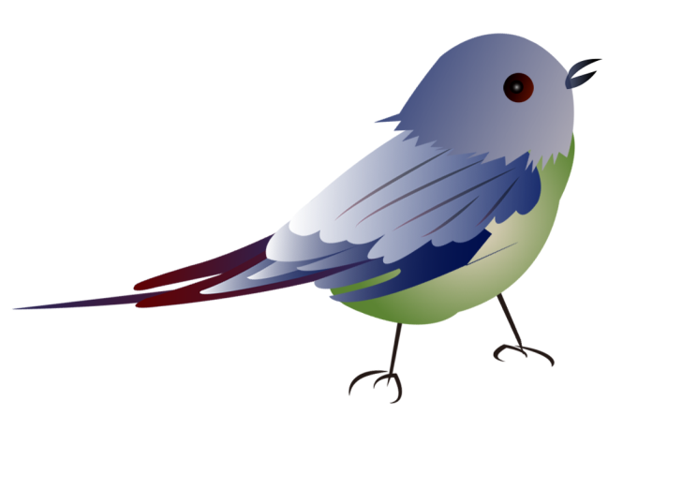
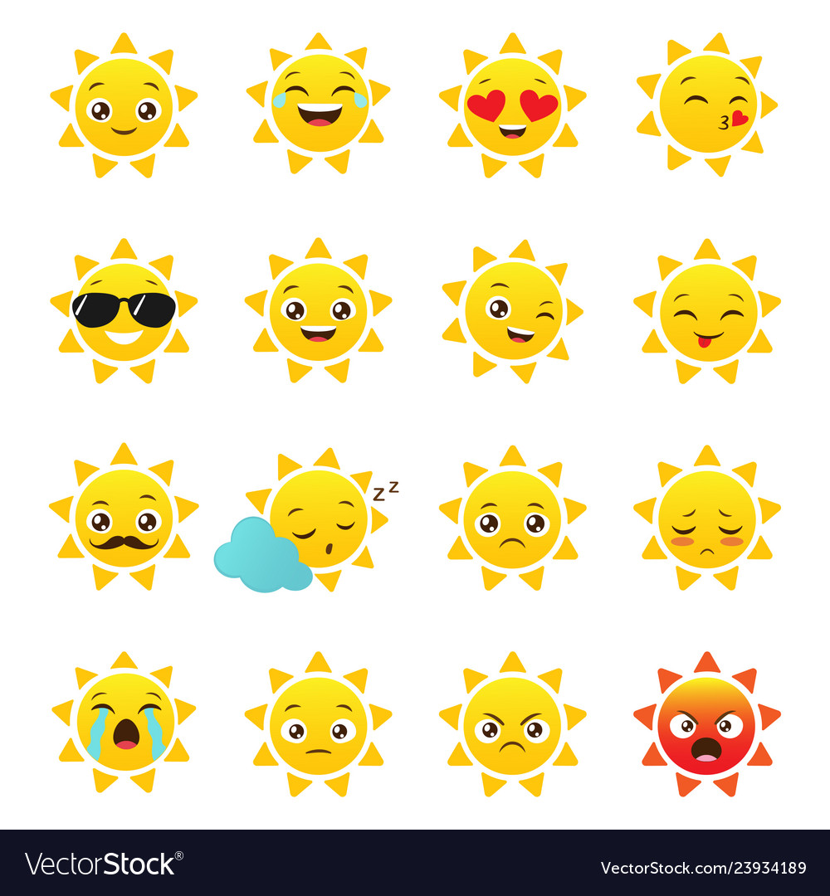
Next
A. bird
B. cat
C. rabbit
Notes:
Facebook : Bùi Liễu
Mobile phone: 0968142780

Slide 5
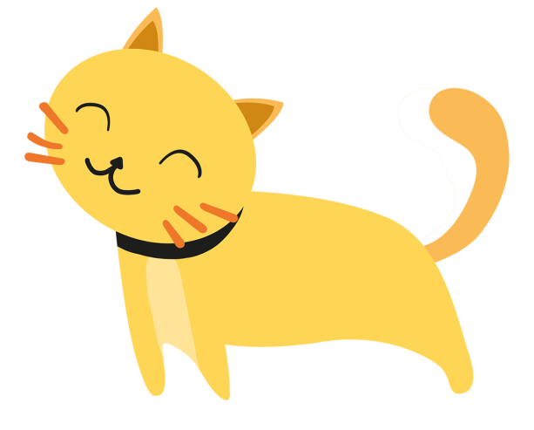
c_
Next
A. ot
B. et
C. at

Slide 6
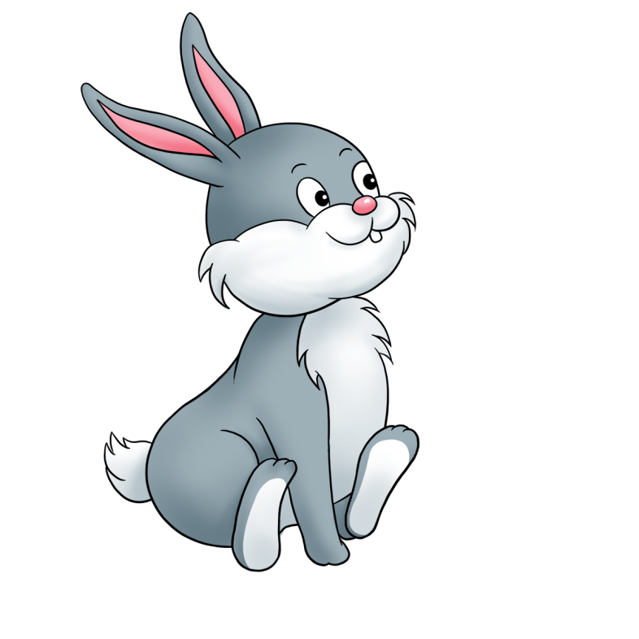
Next
A. cat
B. rabbit
C. bird
Notes:
Facebook : Bùi Liễu
Mobile phone: 0968142780

Slide 7
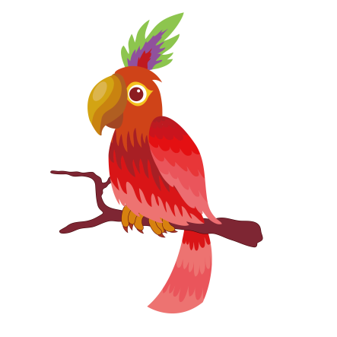
pa__ot
Next
A. ra
B. rr
C. ro
Notes:
Facebook : Bùi Liễu
Mobile phone: 0968142780

Slide 8

Next
A. bird
B. cat
C. rabbit
Notes:
Facebook : Bùi Liễu
Mobile phone: 0968142780

Slide 9
Next
A. cat
B. rabbit
C. bird
Notes:
Facebook : Bùi Liễu
Mobile phone: 0968142780

Slide 10
Next
Do you ___ any cats?
A. had
B. has
C. have

Slide 11
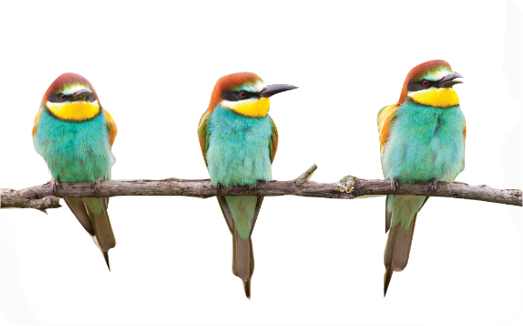
Do you have any ___?
Yes, I do.
Next
A. birds
B. cats
C. rabbits
Notes:
Facebook : Bùi Liễu
Mobile phone: 0968142780

Slide 12
Next
___ you have any rabbits?
No, I don’t.
A. Do
B. Does
C. Have
Notes:
Facebook : Bùi Liễu
Mobile phone: 0968142780

Slide 13


Do you have any birds?
Next
B. Yes, I do.
C. No, I don’t.

Slide 14
THANK YOU!
Next
Notes:
Facebook : Bùi Liễu
Mobile phone: 0968142780

Slide 15



Contents
Facebook : Bùi Liễu
0968142780
Listen and tick.
Look, complete and read.
Let’s sing.

Slide 16

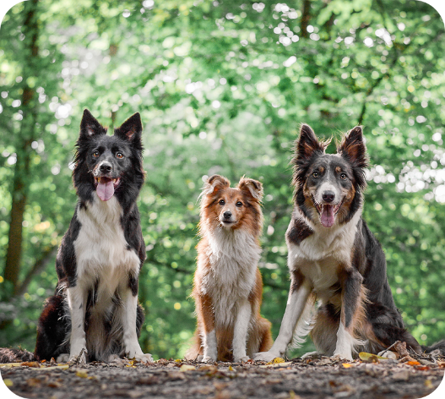
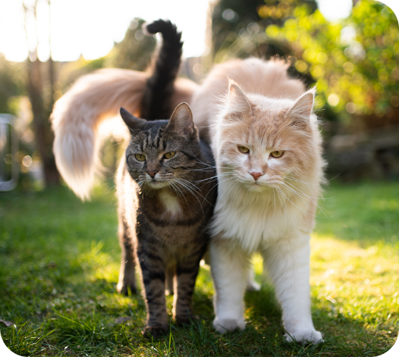

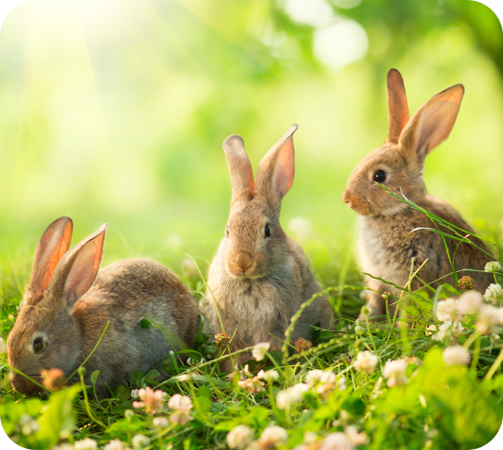
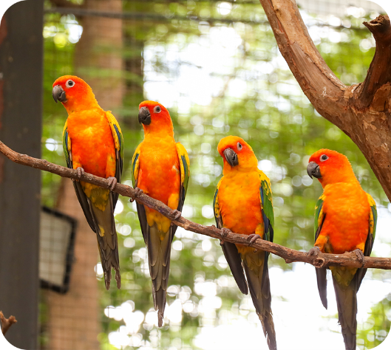
4. Listen and tick.
a
b
1
a
b
2

Slide 17
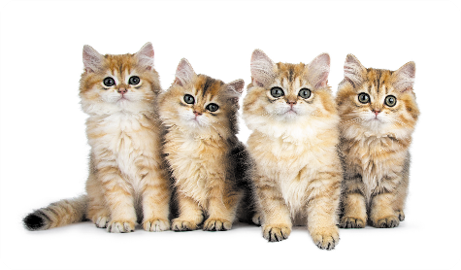
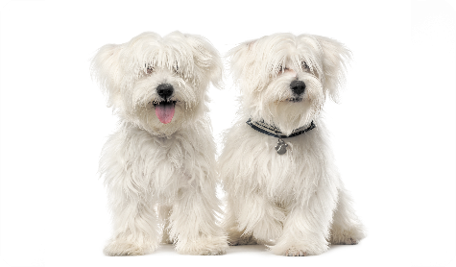
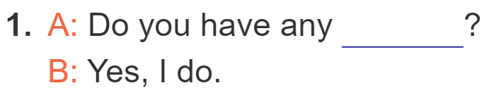
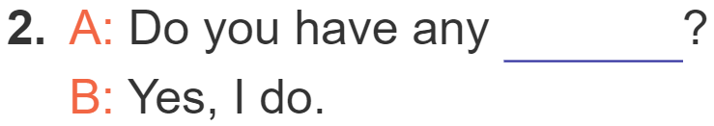
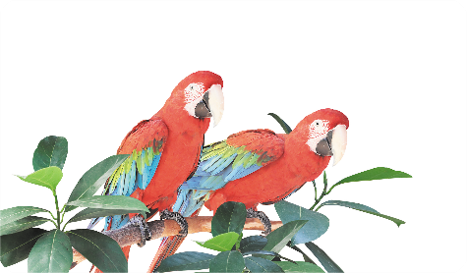
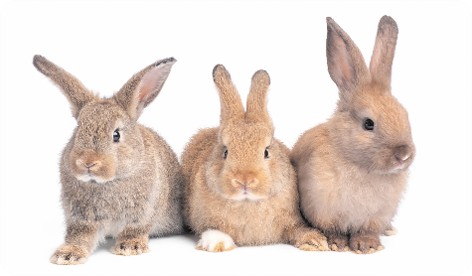
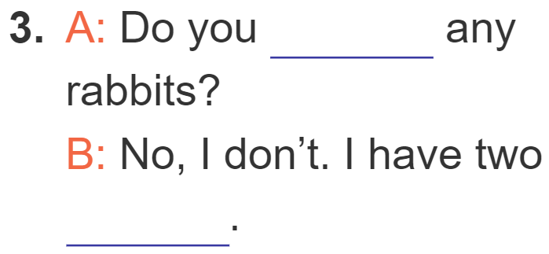
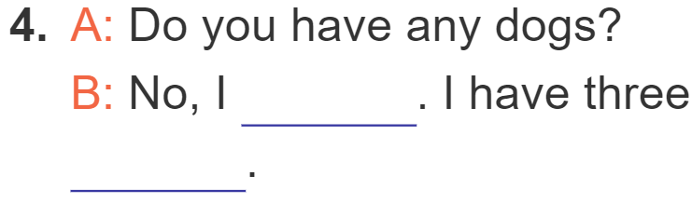
5. Look, complete and read.
cats
dogs
have
don’t
rabbits
parrots

Slide 18
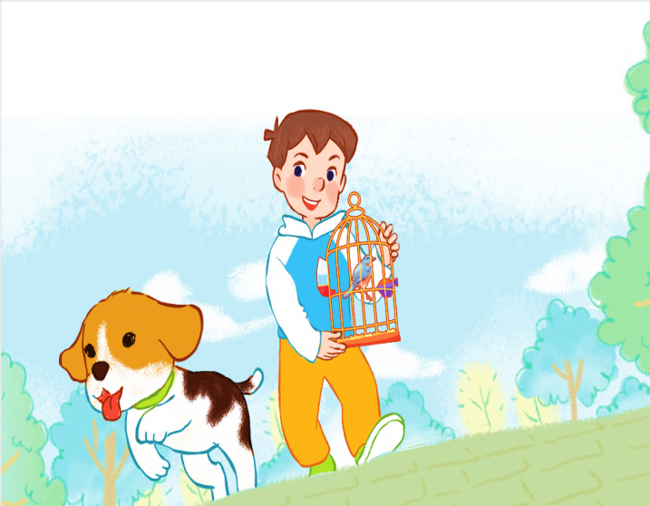
6. Let’s sing.
My pets
Do you have any dogs?
Do you have any cats?
Do you have any dogs?
Do you have any cats?
Yes, I do.
No, I don’t.
Yes, I do.
No, I don’t.
I have one dog.
I have one bird.

Slide 19

6. Let’s sing.
My pets
Do you have any dogs?
Do you have any cats?
Do you have any dogs?
Do you have any cats?
Yes, I do.
No, I don’t.
Yes, I do.
No, I don’t.
I have one dog.
I have one bird.

Slide 20
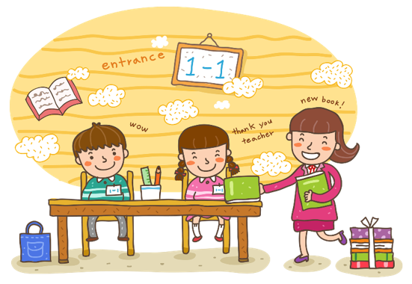
Wrap up

Slide 21


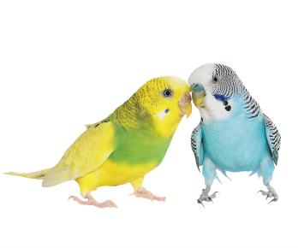
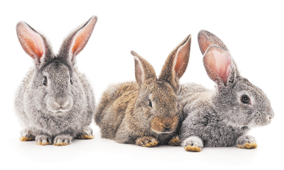
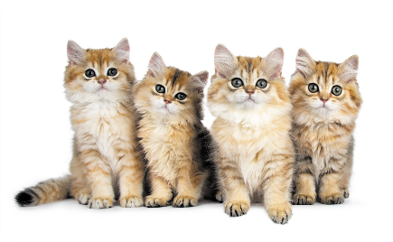
Review
pets
birds
parrots
rabbits
cats

Slide 22
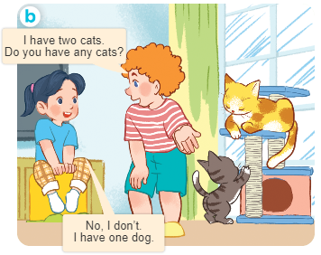
Structures
Cách hỏi bạn có loại thú cưng nào không.
- Do you have any ________?
+ Yes, I do.
+ No, I don’t.

Slide 23

Facebook : Bùi Liễu
0968142780
Thank you!

