Slide 1
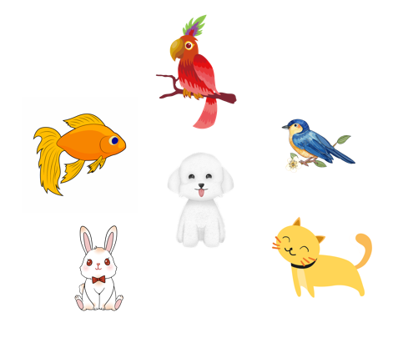
Thursday March 23rd, 2024
My pets
Unit
16
Lesson 2
Facebook : Bùi Liễu
0968142780

Slide 2

Warm-up

Slide 3

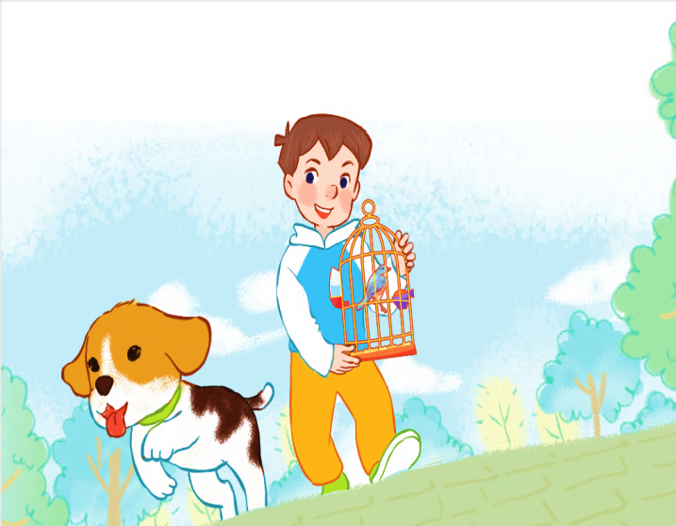
Let’s sing.
My pets
Do you have any dogs?
Do you have any cats?
Do you have any dogs?
Do you have any cats?
Yes, I do.
No, I don’t.
Yes, I do.
No, I don’t.
I have one dog.
I have one bird.

Slide 4



Contents
Facebook : Bùi Liễu
0968142780
Look, listen and repeat.
Listen, point and say.
Let’s talk.

Slide 5

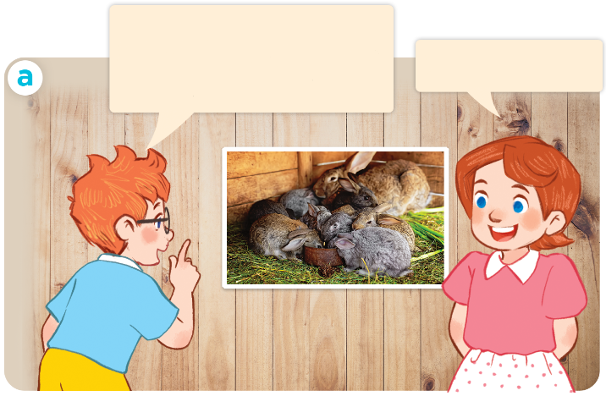
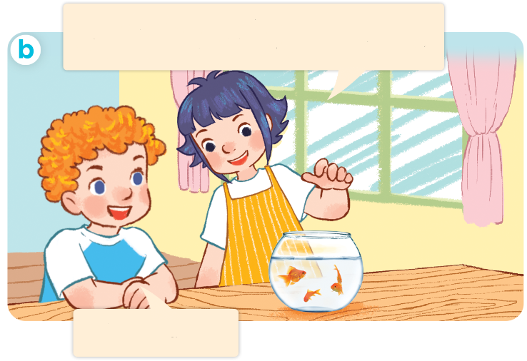
I have two rabbits. How many rabbits do you have?
1. Look, listen and repeat.
Click on the sentences to hear.
I have two rabbits.
How many rabbits do you have?
These are my goldfish. How many goldfish do you have?
I have many.
I have some.
Who are they?
Where are they?
What are they doing?

Slide 6
Vocabulary

Slide 7



dog
dogs
/dɒɡ/
/dɒɡz/
con chó
những con chó

Slide 8

goldfish
/ˈɡəʊld.fɪʃ/
con cá vàng

Slide 9
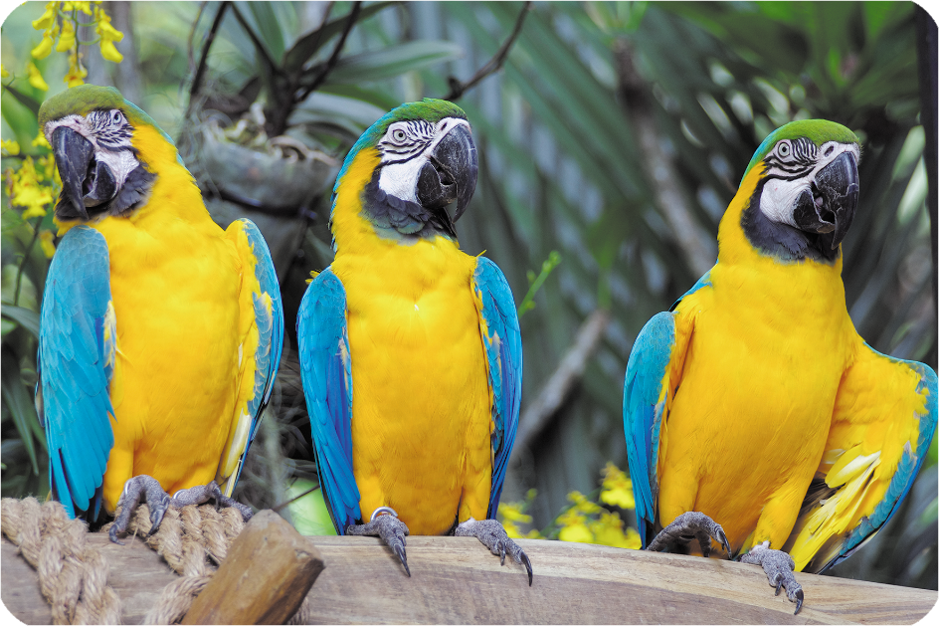
some
/sʌm/
một vài

Slide 10
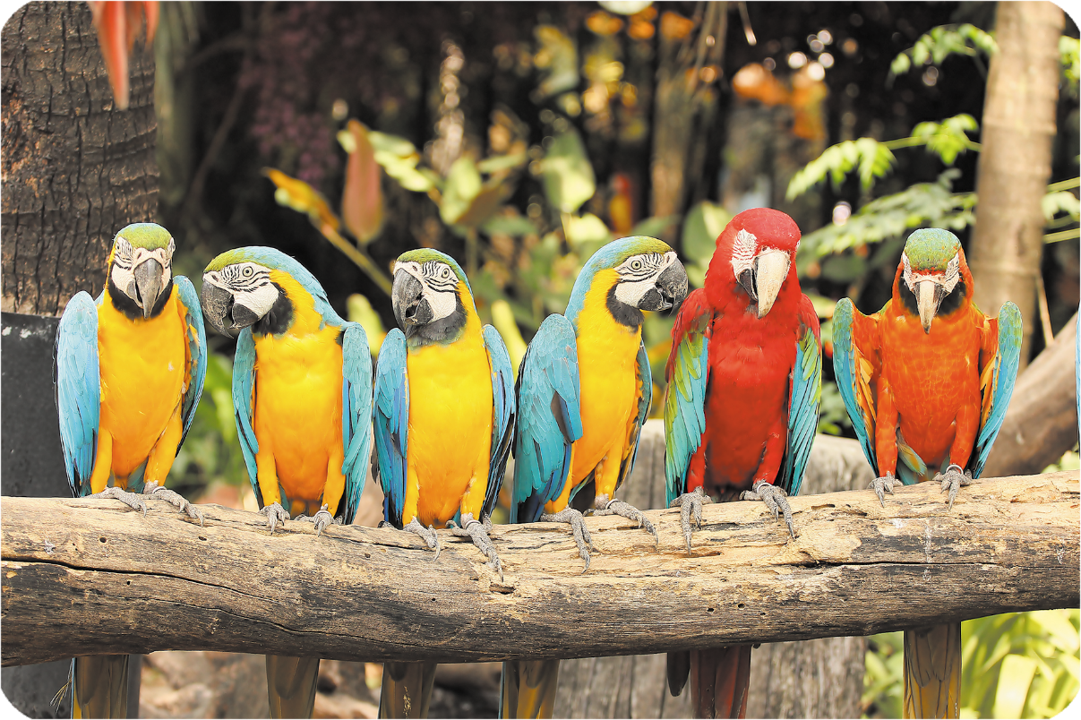
many
/ˈmen.i/
nhiều

Slide 11





Review
dogs
goldfish
some
many

Slide 12
1. New words:
dogs
các con chó
goldfish
cá vàng
some
một vài
many
nhiều
How many: bao nhiêu

Slide 13
Structures

Slide 14
2.Model sentences:
Cách hỏi và trả lời về số lượng vật nuôi.
- How many _parrots_do you have?
I have __two_/ many/ some_.

Slide 15


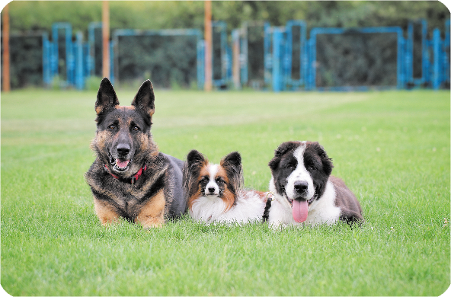
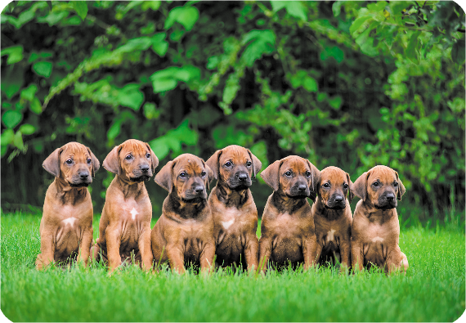
2. Listen, point and say.
How many _____ do you have?
a
b
parrots / some
parrots / many
I have ____.
c
d
dogs / some
dogs / many

Slide 16
Parrots
How many _____ do you have?
parrots / some
I have ____.
some

Slide 17
Parrots
How many _____ do you have?
parrots / many
I have ____.
many

Slide 18
dogs
How many _____ do you have?
dogs / some
some
I have ____.

Slide 19
dogs
How many _____ do you have?
many
dogs / many
I have ____.

Slide 20
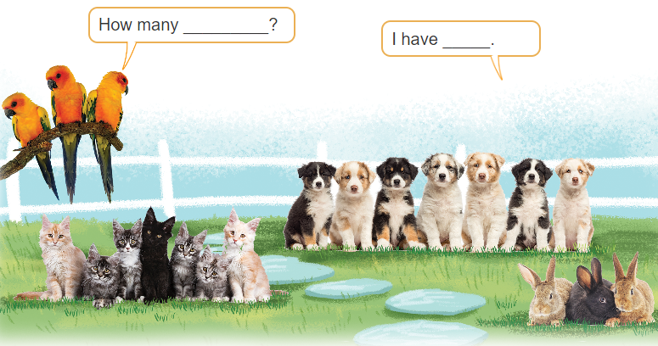
3. Let’s talk

Slide 21

Facebook : Bùi Liễu
0968142780
Let’s play!

Slide 22

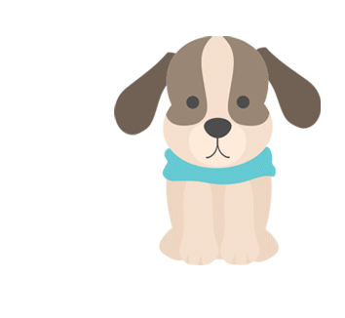

1
2
3
✔
dog

Slide 23

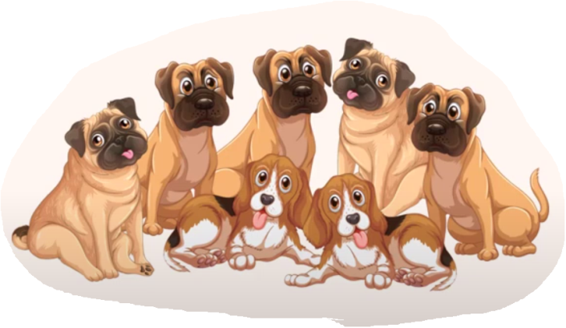
1
2
3
✔
goldfish

Slide 24
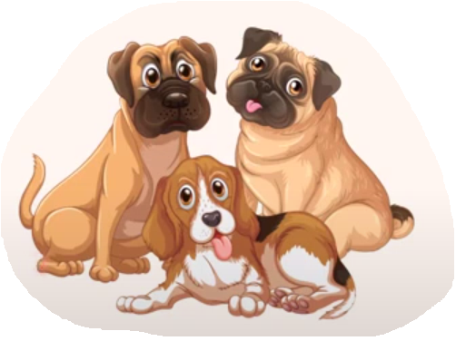

1
2
3
✔
many

Slide 25

1
2
3
✔
some

Slide 26

1
2
3
some
many
goldfish
✔

Slide 27
a. cat
b. goldfish
c. dog

Slide 28
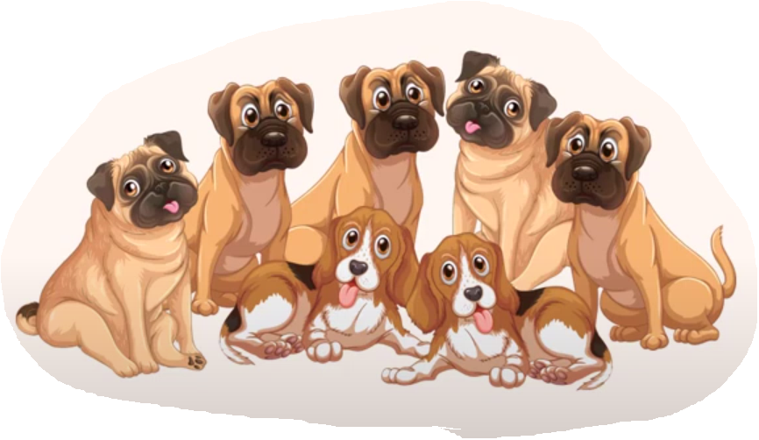
a. some
b. many
c. cat

Slide 29
a. goldfish
b. many
c. some

Slide 30
How many dogs do you have?
a. I have many.
b. I have dogs.
c. I have some.

Slide 31

How many dogs do you have?
a. I have many.
b. I have cat.
c. I have some.

Slide 32

Facebook : Bùi Liễu
0968142780
WELL DONE!

Slide 33

Wrap up

Slide 34
Review
dogs
goldfish
some
many

Slide 35
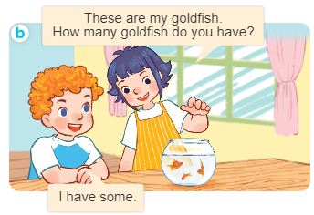
Structures
Cách hỏi và trả lời về số lượng vật nuôi.
- How many _____ do you have?
I have __________.

Slide 36

Facebook : Bùi Liễu
0968142780
Thank you!

