Slide 1
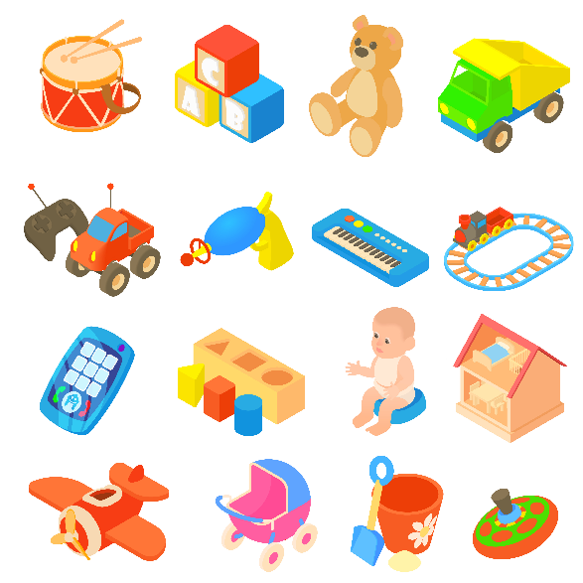
..................................
Our toys
Unit
17
Lesson 1 (1+2+3)
Facebook : Bùi Liễu
0968142780

Slide 2

Warm-up

Slide 3

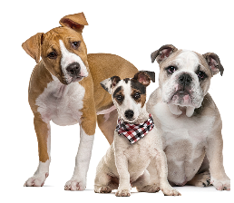
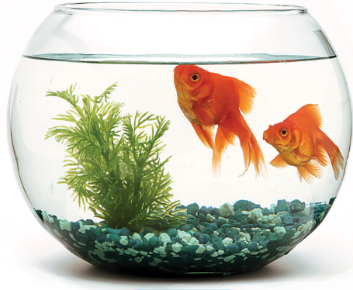
Let’s chant.
Dogs, dogs, dogs.
Do you have any dogs?
Do you have any dogs?
Goldfish, goldfish, goldfish.
Yes, I do.
How many goldfish do you have?
Yes, I do.
How many goldfish do you have?
I have some goldfish.
I have some goldfish.

Slide 4



Contents
Facebook : Bùi Liễu
0968142780
Look, listen and repeat.
Listen, point and say.
Let’s talk.

Slide 5
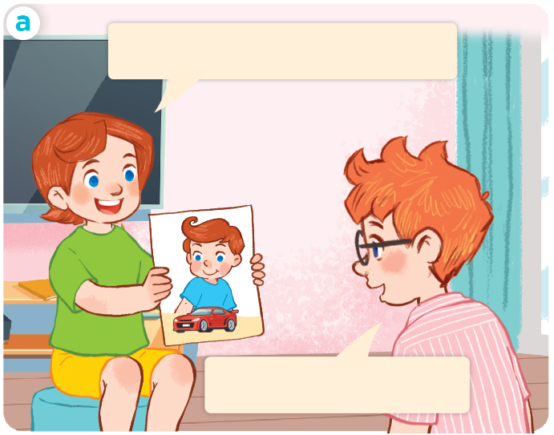
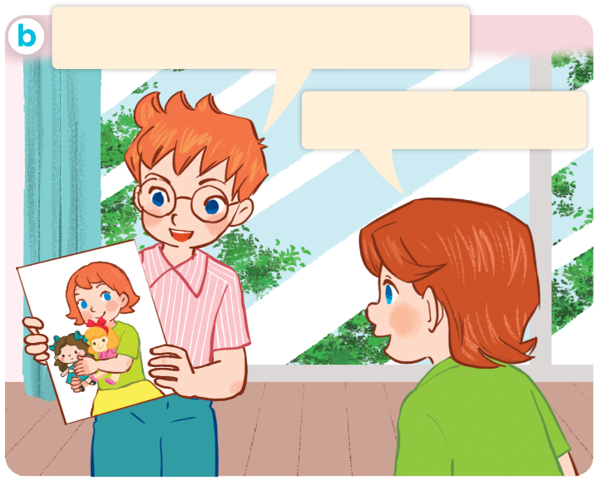
1. Look, listen and repeat.
My sister has two dolls.
My brother has a car.
Wow! I like dolls.
Wow, I like cars.
Who are they?
Where are they?
What are they doing?

Slide 6
Vocabulary

Slide 7
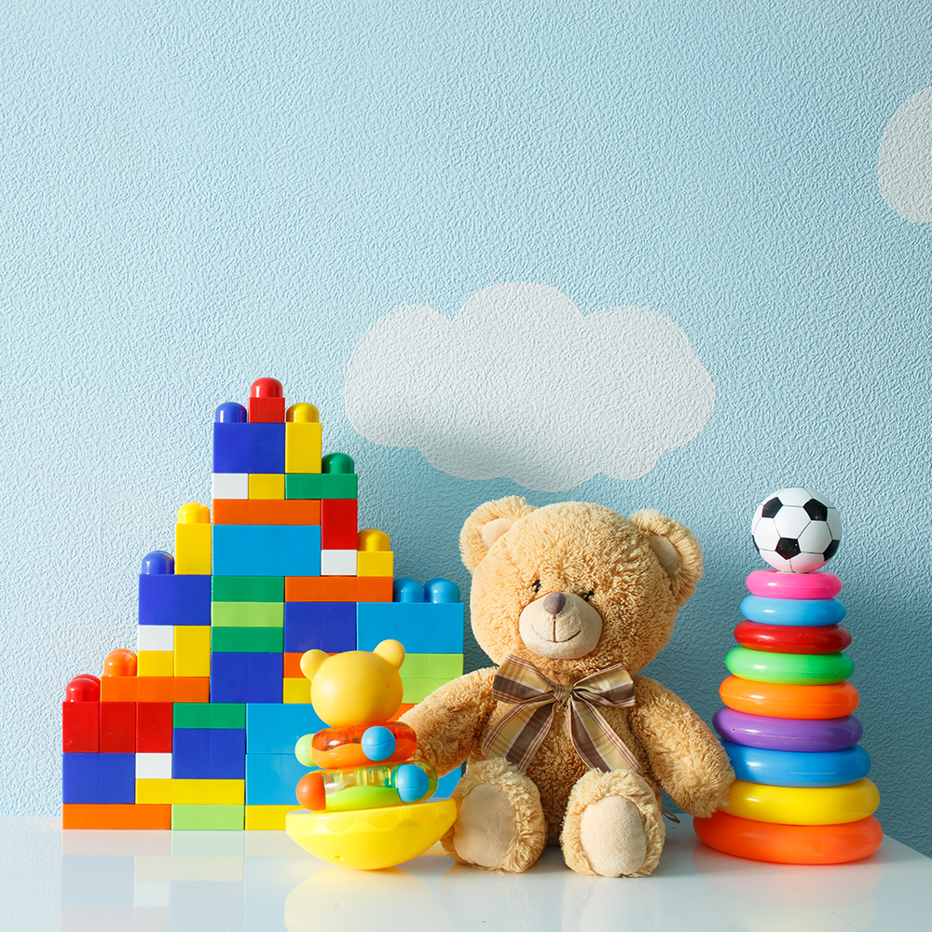
toys
/tɔɪz/
đồ chơi

Slide 8
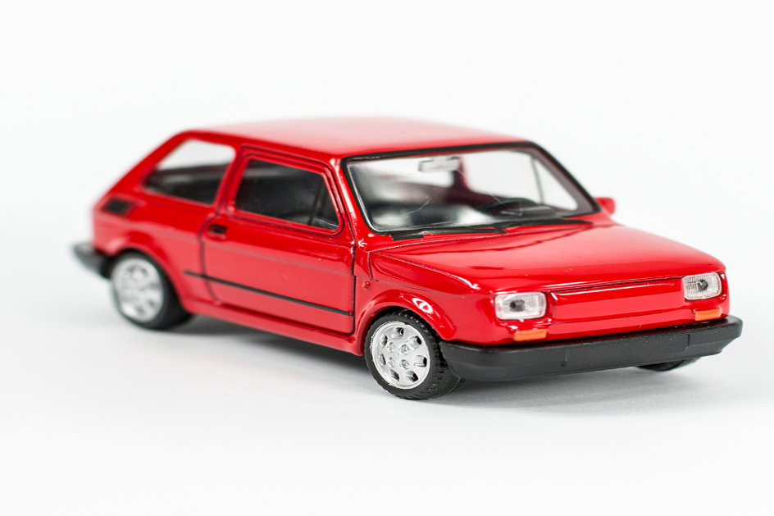
car
/kɑ:/
xe ô tô

Slide 9
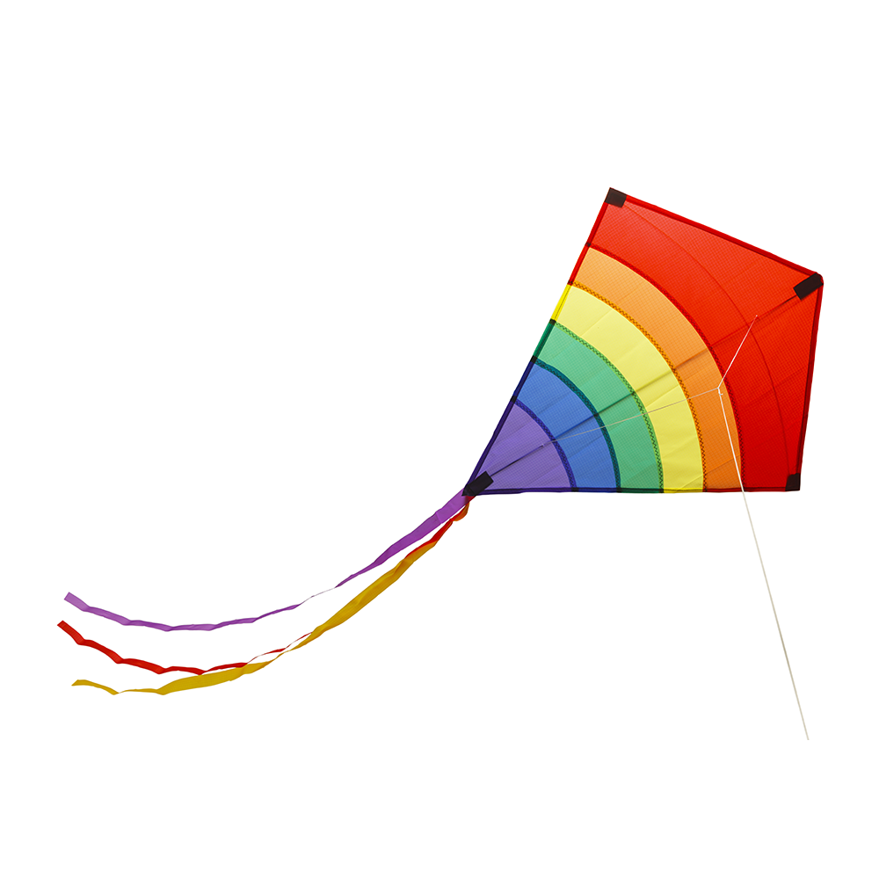
kite
/kaɪt/
cái diều

Slide 10
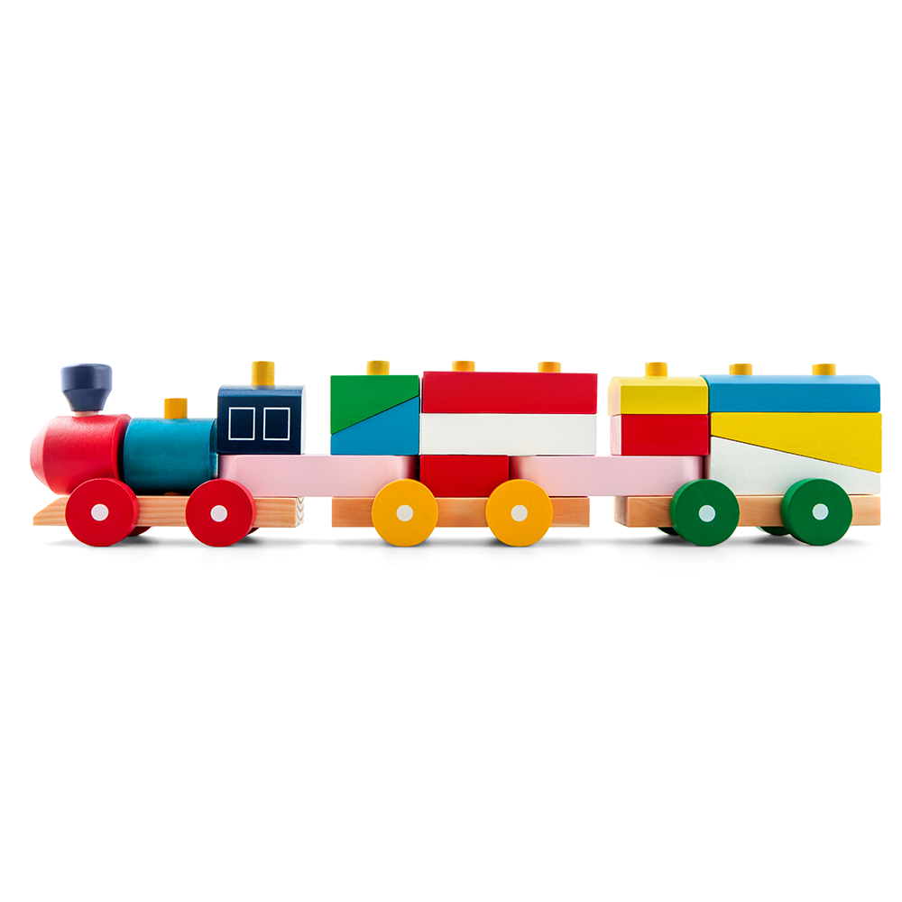
train
/treɪn/
tàu hỏa

Slide 11

plane
/pleɪn/
máy bay

Slide 12

doll
/dɒl/
búp bê

Slide 13






Review
toys
car
kite
train
plane
doll

Slide 14
1/ new words:
has:có
toys
đồ chơi
car
xe ô tô
kite
cái diều
train
tàu hỏa
plane
máy bay
doll
búp bê

Slide 15
Structures

Slide 16
2/Model sentences
Cách nói cậu ấy/cô ấy có cái gì đó.
He has two planes.
She has a car.

Slide 17
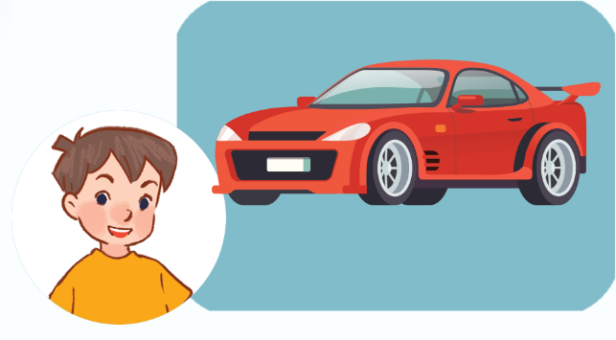

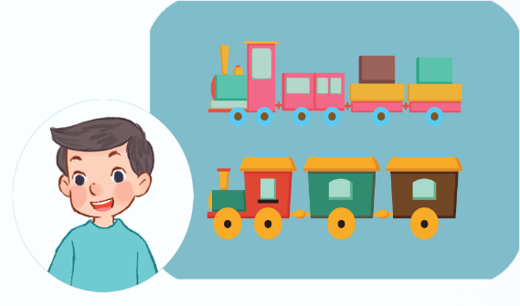
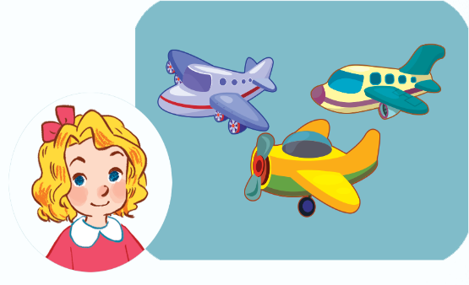
2. Listen, point and say.
a
b
He / She has ________.
a car
a kite
c
d
trains
planes

Slide 18
He has ________.
a car

Slide 19
She has ________.
a kite

Slide 20
He has ________.
trains

Slide 21
She has ________.
planes

Slide 22
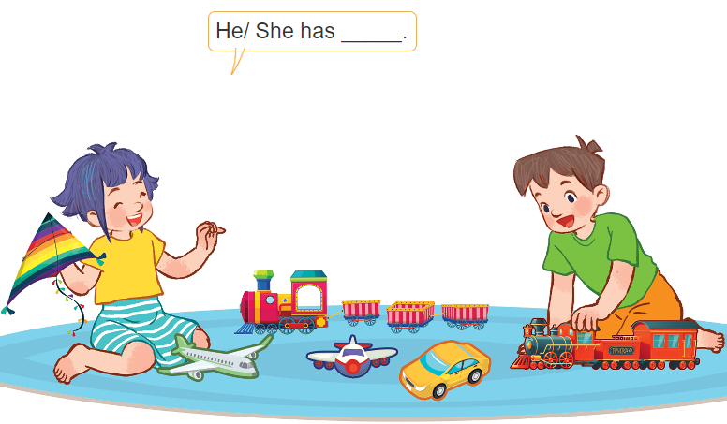
3. Let’s talk
2 planes
2 trains
He / She has ________.
a kite
a car
1
2
3
4

Slide 23


Facebook : Bùi Liễu
0968142780
Let’s play!

Slide 24

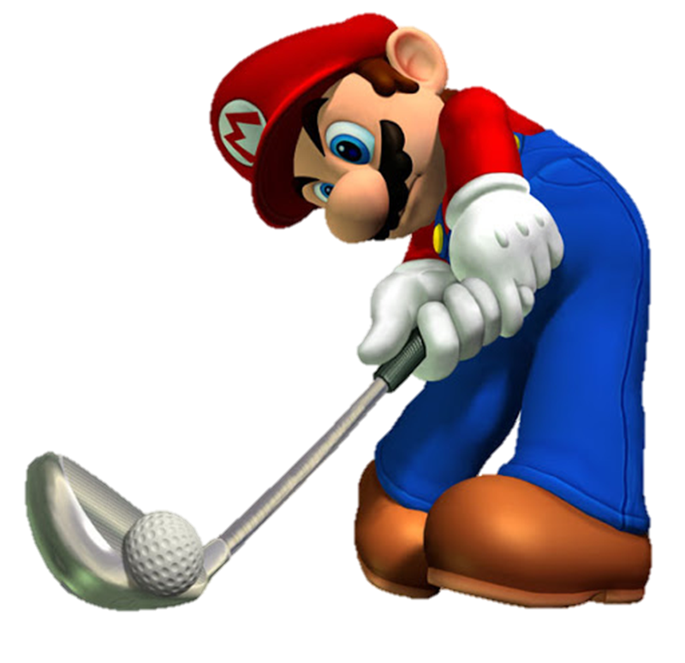
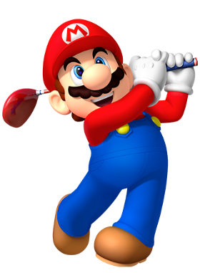




Slide 25







He has a ________.
A. toys
B. car
C. planes

Slide 26

He has ________.
A. a train
B. two kites
C. a kite

Slide 27
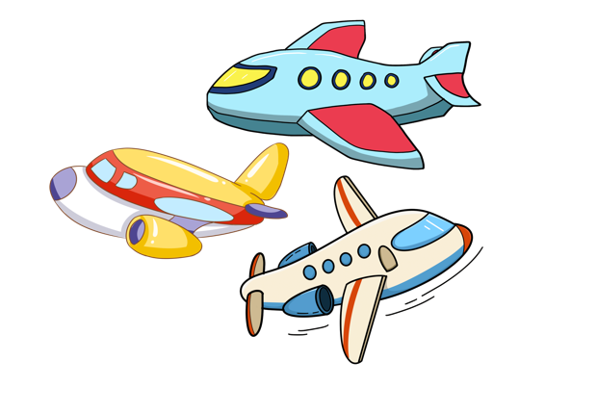
He has ________.
A. three planes
B. two planes
C. 5 planes

Slide 28

She has ________.
A. a toy
B. toys
C. three toys

Slide 29

She has ________.
A. toys
B. a kite
C. a car

Slide 30

He has ________.
A. two trains
B. a train
C. a car

Slide 31

_____ has three planes.
A. I
B. He
C. She

Slide 32
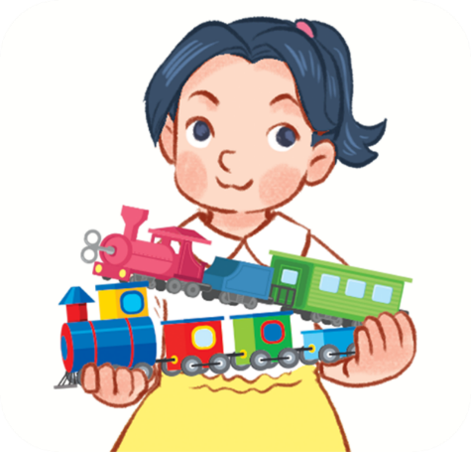
She ___ two trains.
A. have
B. has

Slide 33

____ has a car .
A. He
B. She

Slide 34


Slide 35

Wrap up

Slide 36
Review
toys
car
kite
train
plane
doll

Slide 37


Structures
Cách nói cậu ấy/cô ấy có cái gì đó.
He / She has _______.
Example:
He has a car.
She has three planes.

Slide 38

Facebook : Bùi Liễu
0968142780
Thank you!

