Slide 1
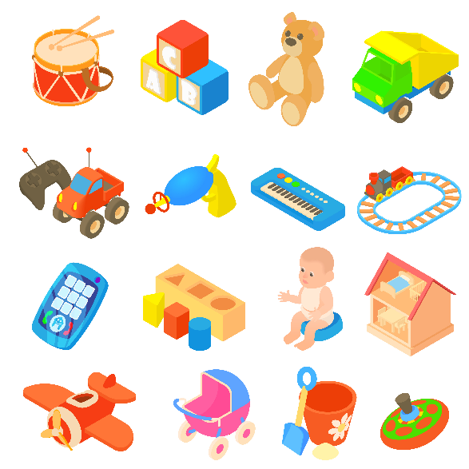
..................................
Our toys
Unit
17
Lesson 1 (4+5+6)
Facebook : Bùi Liễu
0968142780

Slide 2
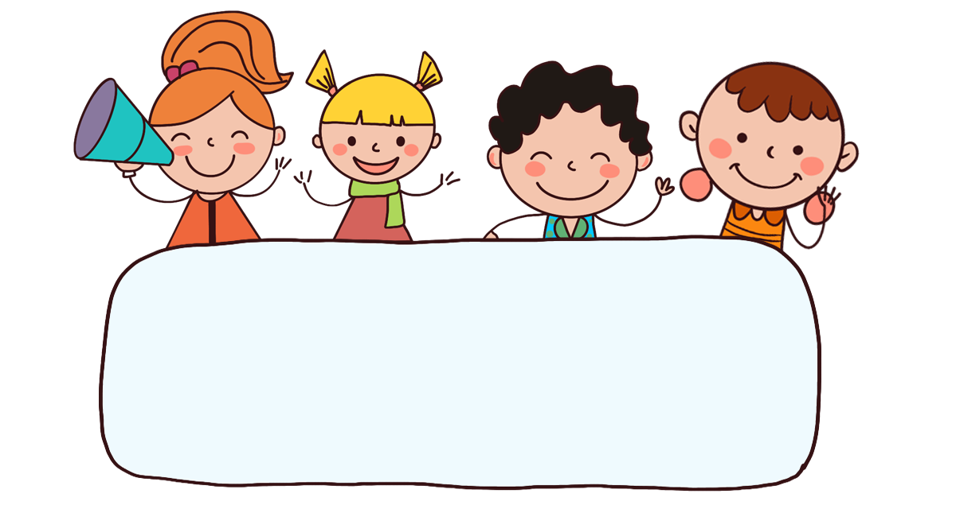
Warm-up

Slide 3


Facebook : Bùi Liễu
0968142780
Let’s play!

Slide 4



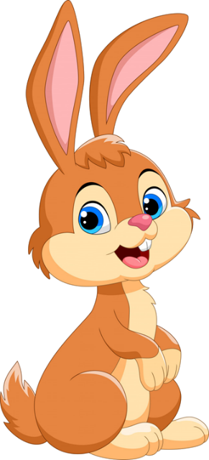

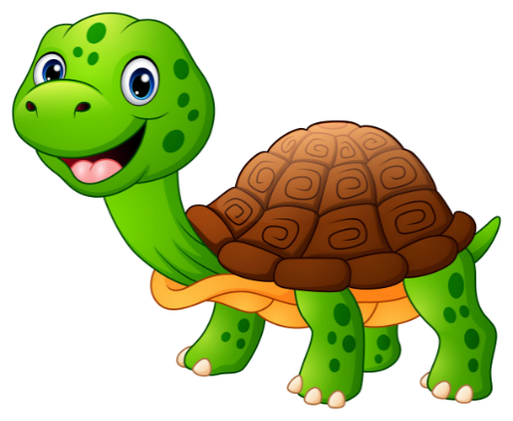

Slide 5
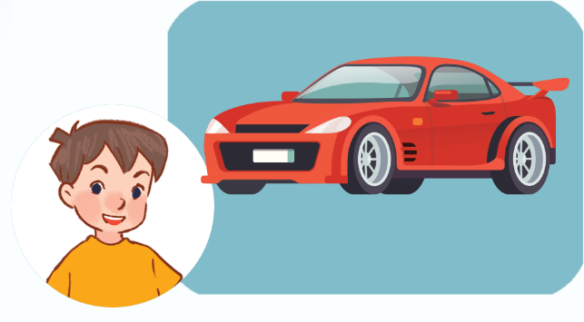

Click the clock to start the timer.
Click hình chú Thỏ hoặc chú Rùa để chọn đáp án.
A. He has a car.
B. She has
a car.

Slide 6
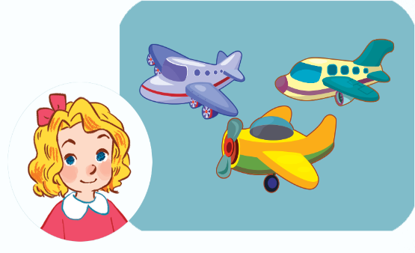
Click the clock to start the timer.
A. She has a plane.
B. She has three planes.

Slide 7



Click the clock to start the timer.
A.
B.

Slide 8

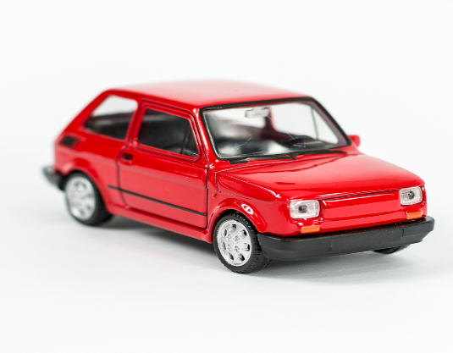
Click the clock to start the timer.
A.
B.

Slide 9
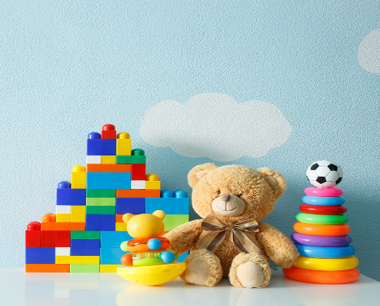
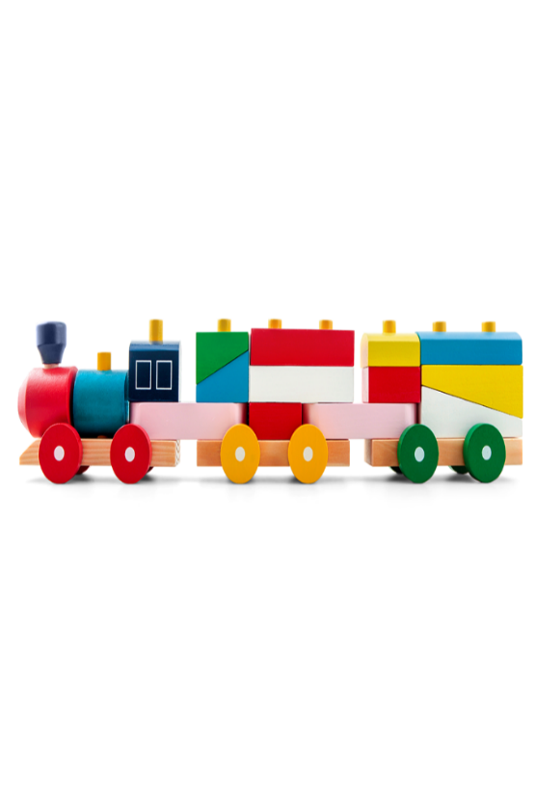
Click the clock to start the timer.
He has a _________.
A.
B.

Slide 10
d___
Click the clock to start the timer.
A. old
B. oll

Slide 11
Click the clock to start the timer.
t____
A. ois
B. oys

Slide 12
Click the clock to start the timer.
p____
A. lane
B. nane

Slide 13


Slide 14



Contents
Facebook : Bùi Liễu
0968142780
Listen and number.
Look, complete and read.
Let’s sing.

Slide 15
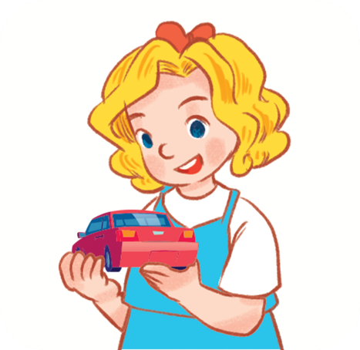

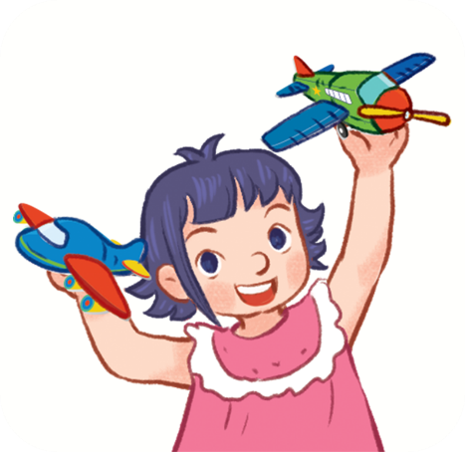
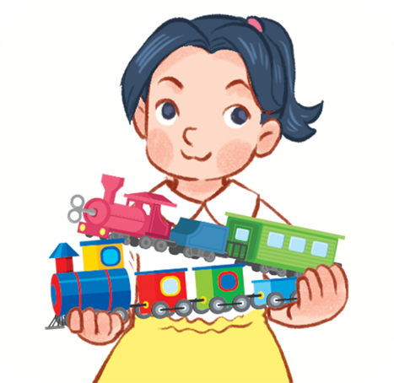




4. Listen and number.
a
b
c
d
4
1
3
2

Slide 16
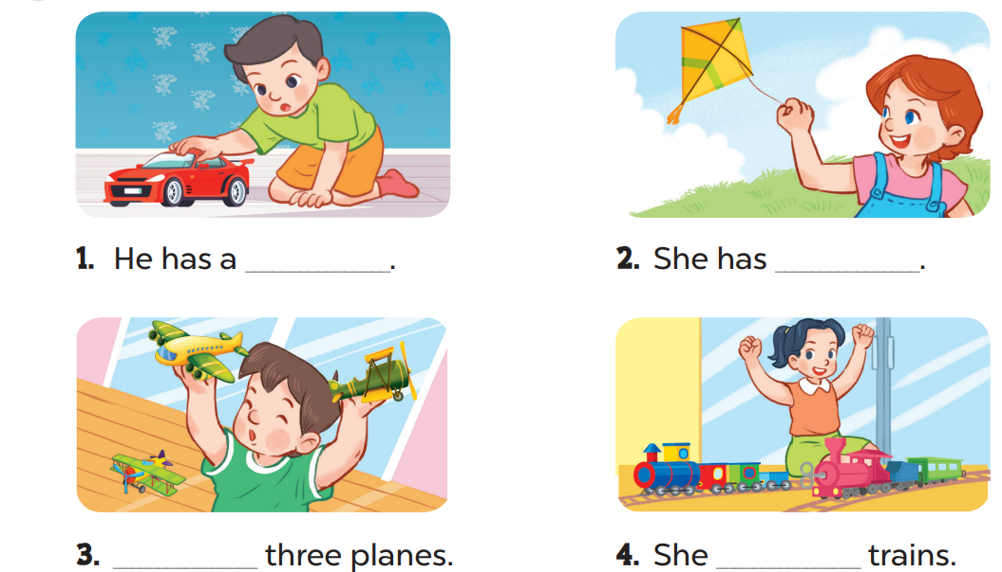
5. Look, complete and read.
car
a kite
He has
has two

Slide 17
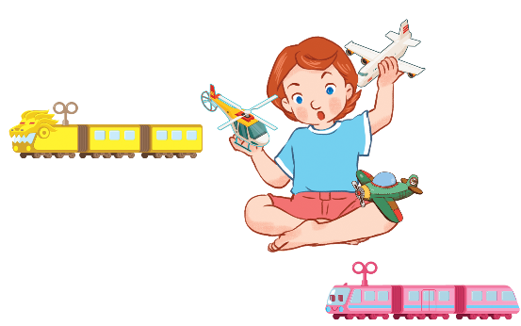
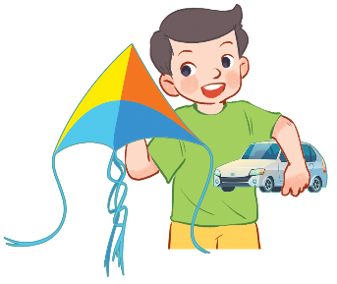
6. Let’s sing.
Their toys
A kite and a car.
A kite and a car.
He has a kite and a car.
He has a kite and a car.
Trains and planes.
Trains and planes.
She has trains and planes.
She has trains and planes.

Slide 18

6. Let’s sing.
Their toys
A kite and a car.
A kite and a car.
He has a kite and a car.
He has a kite and a car.
Trains and planes.
Trains and planes.
She has trains and planes.
She has trains and planes.

Slide 19
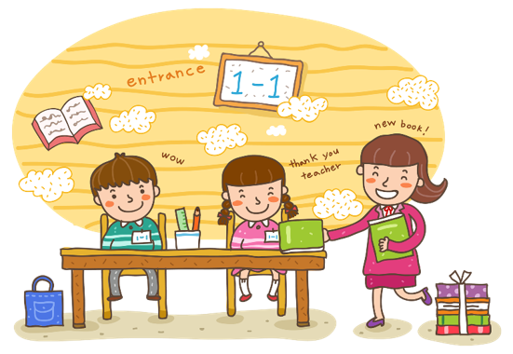
Wrap up

Slide 20


Review
toys
car
kite
train
plane
doll

Slide 21


Structures
Cách nói cậu ấy/cô ấy có cái gì đó.
He / She has _______.
Example:
He has a car.
She has three planes.

Slide 22

Facebook : Bùi Liễu
0968142780
Thank you!

