Slide 1
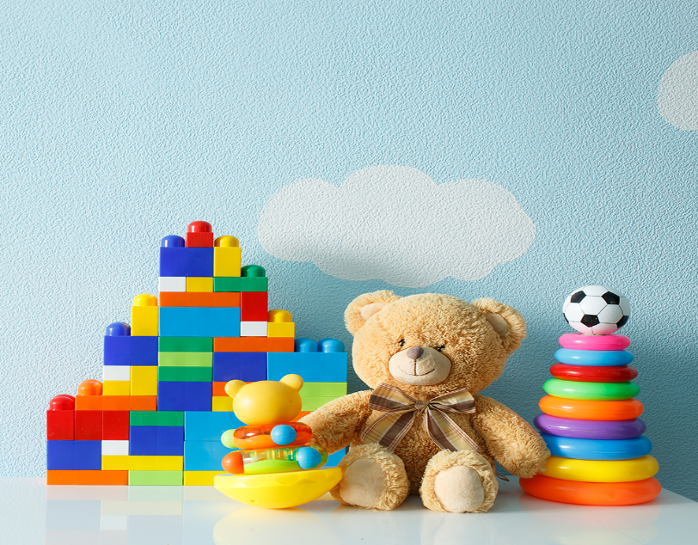
..................................
Our toys
Unit
17
Lesson 2 (1+2+3)
Facebook : Bùi Liễu
0968142780

Slide 2

Warm-up

Slide 3

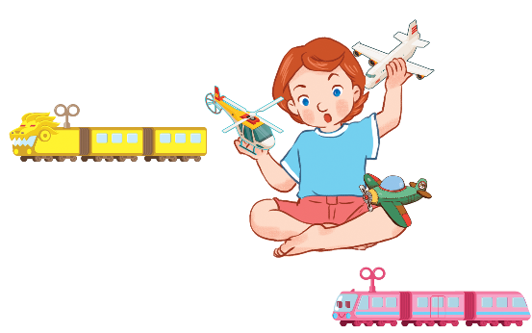
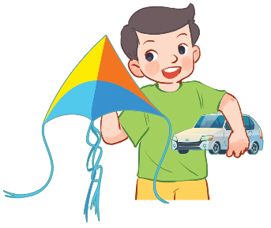
Let’s sing.
Their toys
A kite and a car.
A kite and a car.
He has a kite and a car.
He has a kite and a car.
Trains and planes.
Trains and planes.
She has trains and planes.
She has trains and planes.

Slide 4



Contents
Facebook : Bùi Liễu
0968142780
Look, listen and repeat.
Listen, point and say.
Let’s talk.

Slide 5

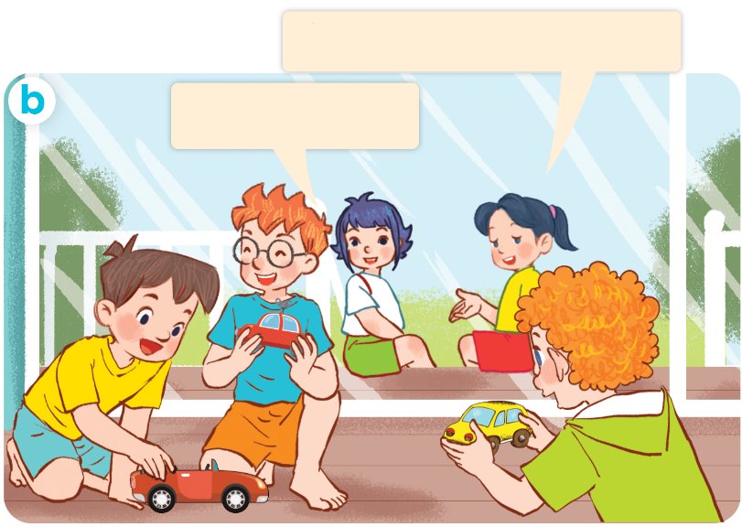
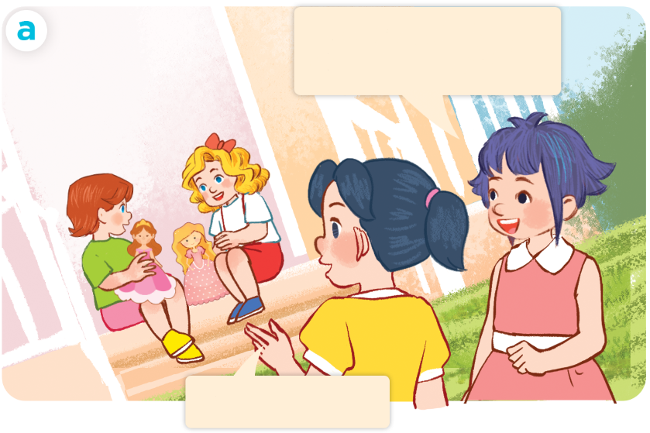
1. Look, listen and repeat.
They have three cars.
Lucy and Mary
have two dolls.
Yes, they do.
Yes, they do.
Who are they?
Where are they?
What are they doing?

Slide 6
Vocabulary

Slide 7
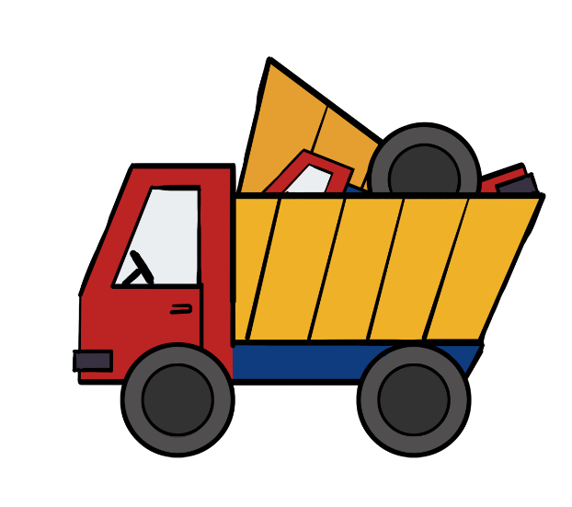
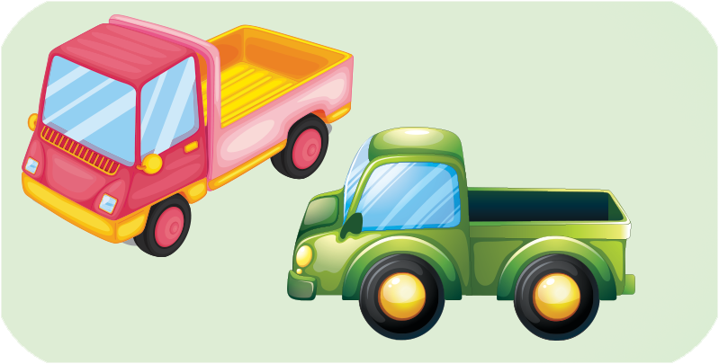
truck
trucks
/trʌk/
/trʌks/

Slide 8
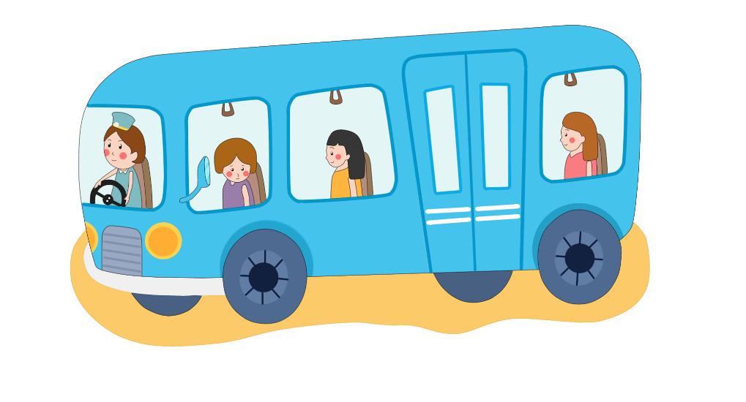
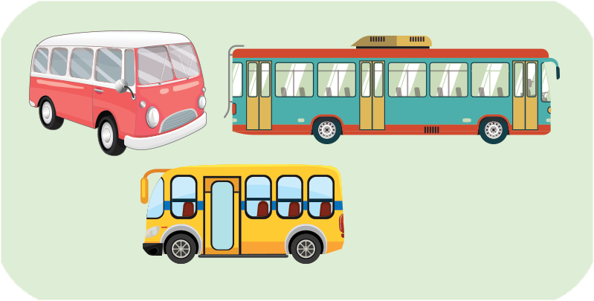
bus
buses
/bʌs/
/bʌsɪz/

Slide 9

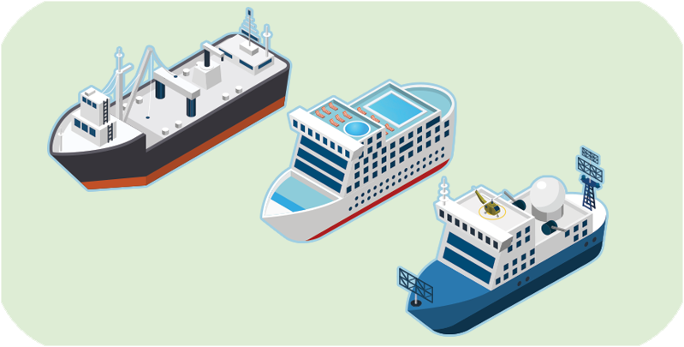
ship
ships
/ʃɪp/
/ʃɪps/

Slide 10
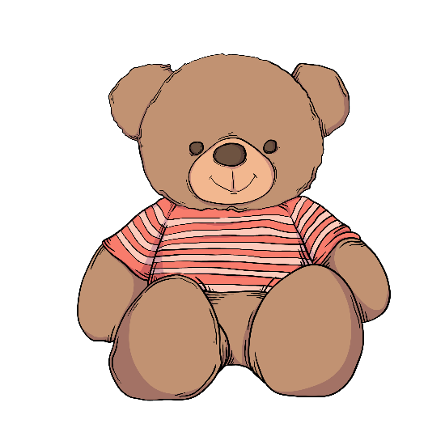

teddy bear
teddy bears
/ˈtedi beə/
/ˈtedi beəz/

Slide 11



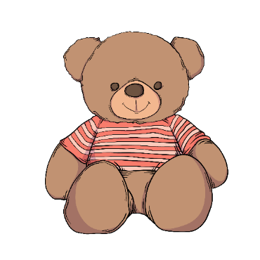
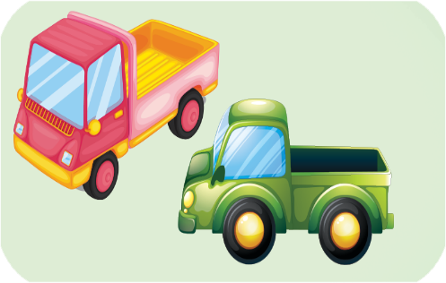
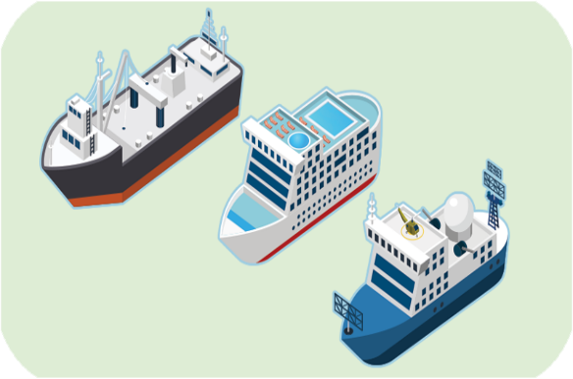
Review
truck
bus
ship
teddy bear
trucks
buses
ships
teddy bears

Slide 12
1/ New words
truck:
xe tải
bus:
xe buýt
ship:
tàu thủy
teddy bear:
con gấu bông
have:
có
they:
Họ

Slide 13
Structures

Slide 14
2/Model sentences
Cách nói họ có cái gì đó.
They have two trucks.

Slide 15

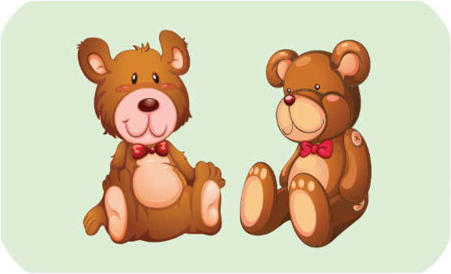
2. Listen, point and say.
a
b
They have ________.
trucks
buses
c
d
ships
teddy bears

Slide 16
They have ________.
two trucks
trucks

Slide 17
They have ________.
three buses
buses

Slide 18
They have ________.
three ships
ships

Slide 19
They have ________.
two teddy bears
teddy bears

Slide 20
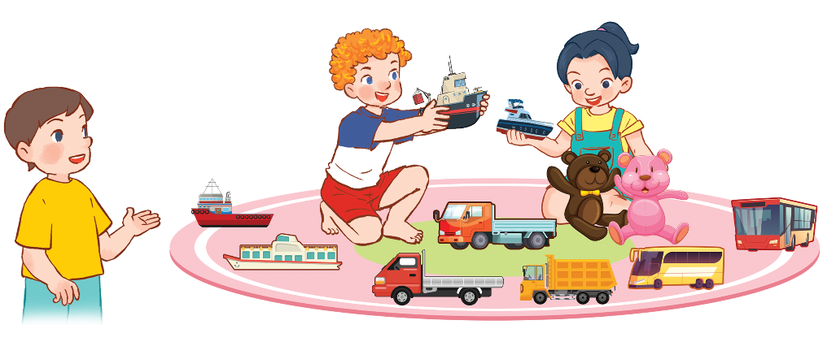
3. Let’s talk
They have _____________.
two teddy bears
three trucks
four ships
two buses
1
4
2
3

Slide 21
Let’s play!

Slide 22








Facebook : Bùi Liễu
0968142780
truck
bus
ship

Slide 23

Facebook : Bùi Liễu
0968142780
buses
bus
teddy bear

Slide 24
Facebook : Bùi Liễu
0968142780
teddy bear
trucks
teddy bears

Slide 25

Facebook : Bùi Liễu
0968142780
teddy ________
bear
bears
dolls

Slide 26
Facebook : Bùi Liễu
0968142780
trucks
teddy bear
bus

Slide 27

Facebook : Bùi Liễu
0968142780
tr_____
acks
uck
ucks

Slide 28
Facebook : Bùi Liễu
0968142780
bus
ship
buses

Slide 29

Facebook : Bùi Liễu
0968142780
They have ______.
three buses
two trucks
a bus

Slide 30
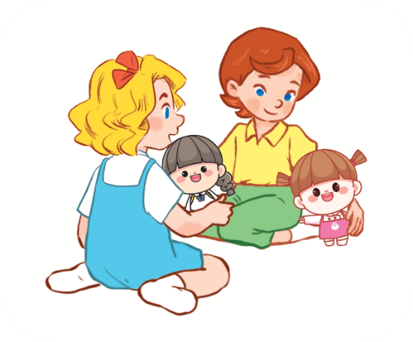
Facebook : Bùi Liễu
0968142780
_____ ______ two dolls.
She has
They have
He has

Slide 31
Facebook : Bùi Liễu
0968142780
They _____ _____ ships.
have two
has three
have three

Slide 32

Facebook : Bùi Liễu
0968142780
Good job!

Slide 33
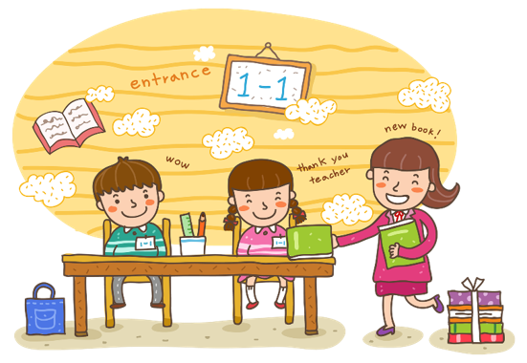
Wrap up

Slide 34
Review
truck
bus
ship
teddy bear
trucks
buses
ships
teddy bears

Slide 35
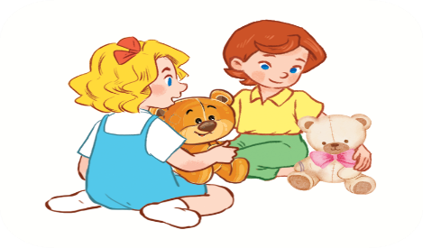
Structures
Cách nói họ có cái gì đó.
They have _______.
Example:
They have two teddy bears.

Slide 36

Facebook : Bùi Liễu
0968142780
Thank you!

