Slide 1


Slide 2


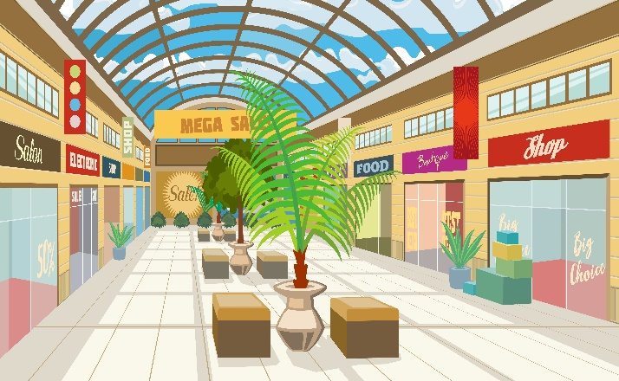
At the
shopping centre
Unit 18
Lesson 1 (1+2+3)

Slide 3

Warm-up

Slide 4

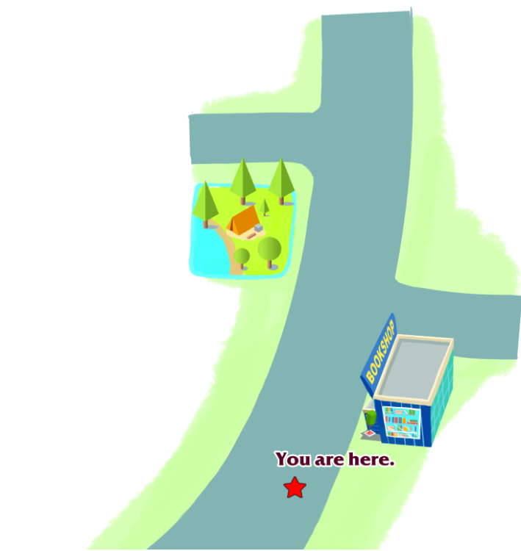
Let’s chant.
Bookshop,
bookshop,
bookshop.
How can I get to the bookshop?
Go straight, go straight.
The bookshop is on the right.
Campsite,
campsite,
campsite.
How can I get to the campsite?
Go straight, go straight.
The campsite is on the left.

Slide 5



Contents
Look, listen and repeat.
Listen, point and say.
Let’s talk.

Slide 6

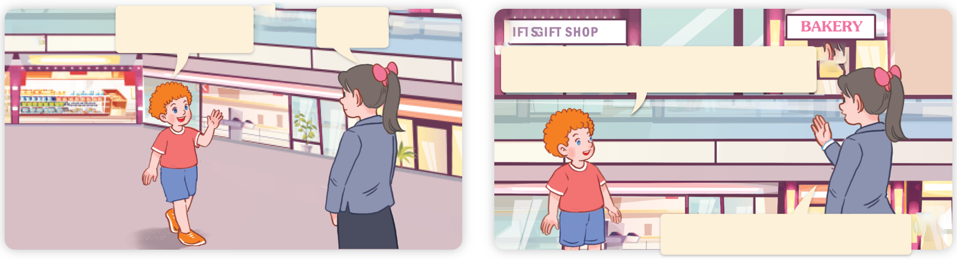
1. Look, listen and repeat.
a
Excuse me!
Yes?
b
Where’s the bakery, please?
It’s near the gift shop.
Where are they?
What are they talking about?
Who are they?
Click on the speaker / sentences to listen.

Slide 7
Vocabulary

Slide 8
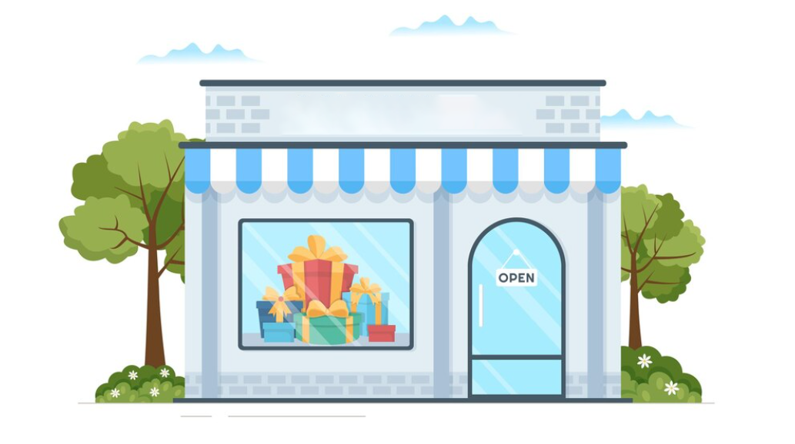
Vocabulary
gift shop
/ˈɡɪft ʃɒp/
cửa hàng quà tặng
Click on the English words to listen.

Slide 9
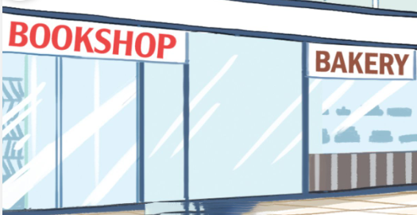
near
/nɪə/
ở gần

Slide 10
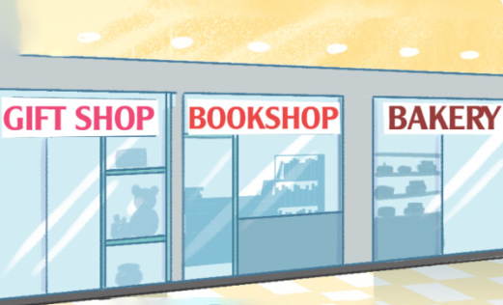
between
/bɪˈtwiːn/
ở giữa

Slide 11
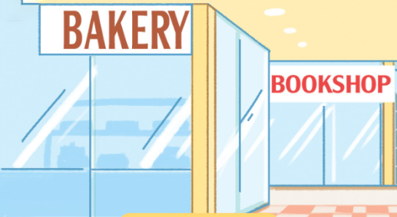
behind
/bɪˈhaɪnd/
đằng sau

Slide 12
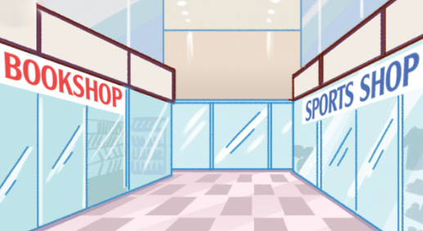
opposite
/ˈɒpəzɪt/
đối diện

Slide 13
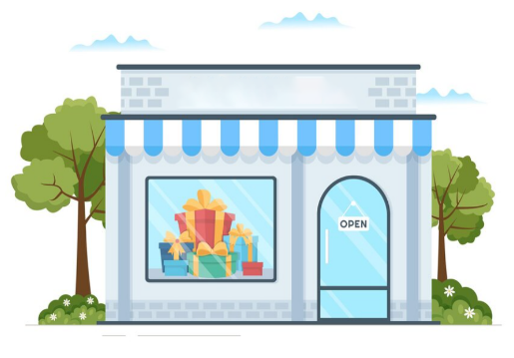
Review
gift shop
near
between
behind
opposite

Slide 14
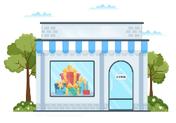
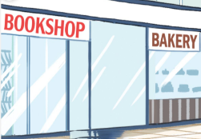
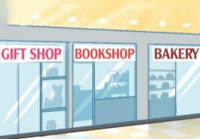

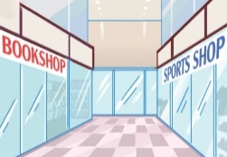
Vocabulary
1. gift shop
: cửa hàng quà tặng
2. near
: ở gần
3. between
: ở giữa
4. behind
: đằng sau
5. opposite
: đối diện

Slide 15


Checking vocabulary!

Slide 16
Can you guess?
behind

Slide 17
Can you guess?
opposite

Slide 18
Can you guess?
gift shop

Slide 19
Can you guess?
near

Slide 20
Can you guess?
between

Slide 21
Well done!

Slide 22
2. Listen, point and say.
a
b
Where’s the bookshop?
near
opposite
It’s ________.
c
d
behind
between

Slide 23


2. Listen, point and say.
a
Where’s the bookshop?
It’s ________.
near
Where’s the bookshop?
It’s near the bakery.
Click on the sentences to listen.

Slide 24

2. Listen, point and say.
b
Where’s the bookshop?
It’s ________.
opposite
Where’s the bookshop?
It’s opposite the sports shop.

Slide 25


2. Listen, point and say.
c
Where’s the bookshop?
It’s ________.
behind
Where’s the bookshop?
It’s behind the bakery.

Slide 26
2. Listen, point and say.
d
Where’s the bookshop?
It’s ________.
between
Where’s the bookshop?
It’s between the gift shop and the bakery.

Slide 27
Structures

Slide 28



Cách hỏi vị trí của một địa điểm:
Where’s the bookshop?
( Nhà sách ở đâu?)
It’s ________.
( Nó ở ________.)
Example:
Where’s the bookshop?
It’s near the bakery.

Slide 29

Unit 18 Lesson 1
Where’s the bookshop?
It’s ________.
near
between
opposite
behind

Slide 30
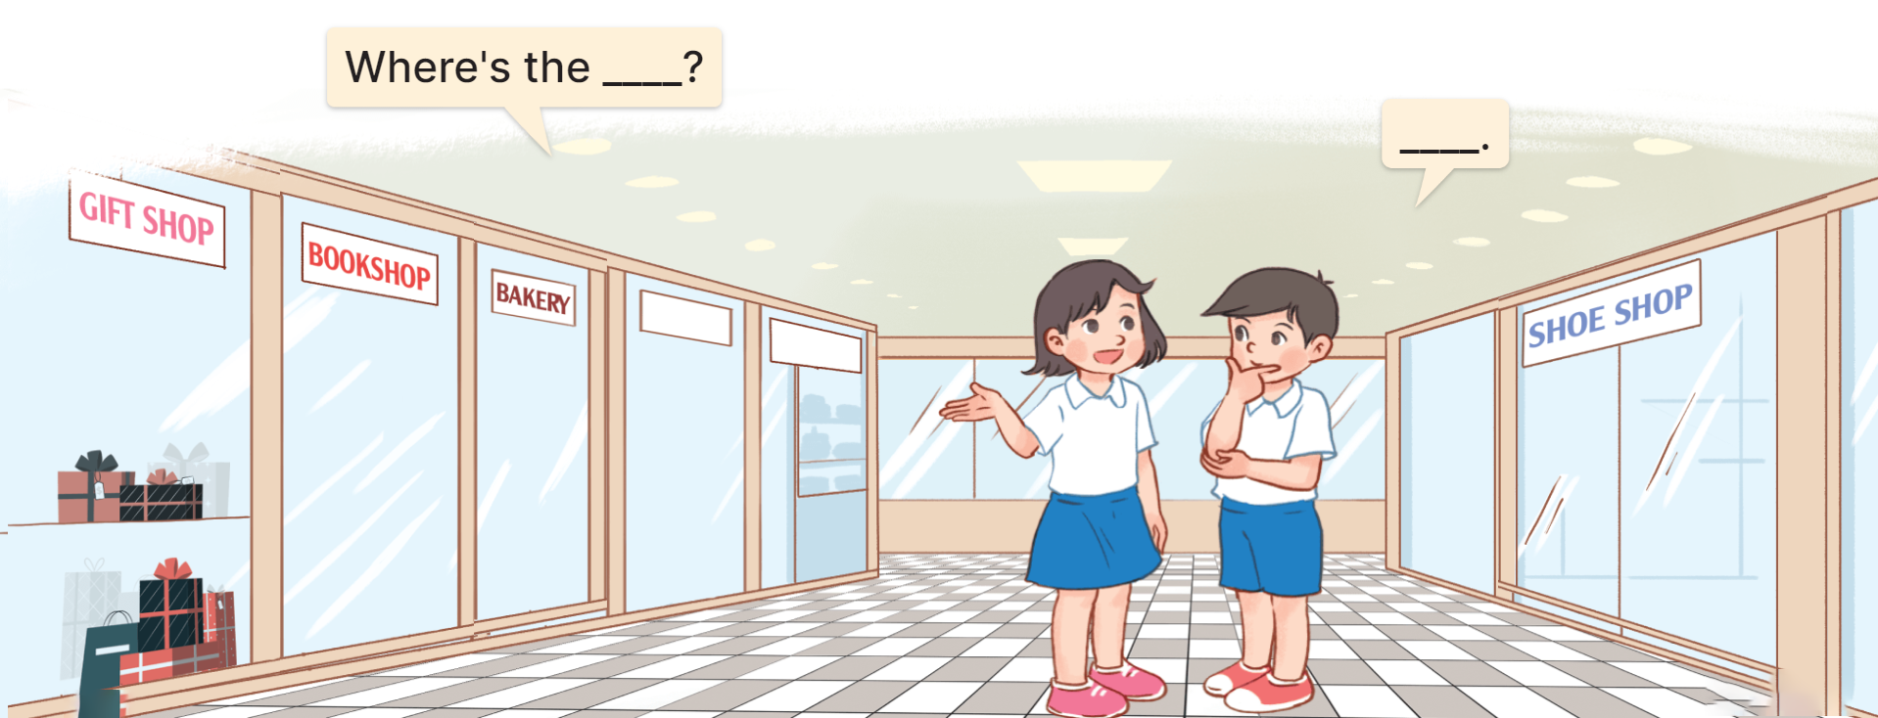
3. Let’s talk.

Slide 31
3. Let’s talk.
Where’s the ________?
gift shop
It’s near the bookshop
__________________.

Slide 32
3. Let’s talk.
Where’s the _________?
bookshop
____________________________________.
It’s between the gift shop and the bakery

Slide 33
3. Let’s talk.
Where’s the _______?
bakery
__________________.
It’s near the bookshop

Slide 34
3. Let’s talk.
Where’s the _________?
shoe shop
_____________________.
It’s opposite the bookshop

Slide 35



START

Slide 36




A. gift shop
B. bakery
C. bookshop
D. food stall

Slide 37
Linh: Where’s the bookshop?
Nam: It’s _____ the bakery.
A. between
B. opposite
C. behind
D. near

Slide 38
Lucy: Where’s the bakery?
Minh: It’s _____ the bookshop.
A. between
B. behind
C. opposite
D. near

Slide 39

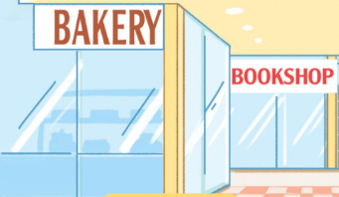


A.
B.
C.
D.

Slide 40
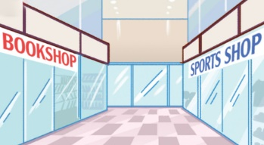



A.
B.
C.
D.

Slide 41


A.
B.
C.
D.

Slide 42




A.
B.
C.
D.

Slide 43
Choose the odd one out.
A. opposite
B. behind
C. between
D. gift shop

Slide 44

Bill: Where’s the sports shop?
Mary: It’s opposite the bookshop.
A. True
B. False

Slide 45

Ben: Where’s the bookshop?
Lucy: It’s behind the bakery.
It’s near the bakery.
A. True
B. False

Slide 46


Thank you!

Slide 47
Wrap up

Slide 48
Review
Where’s the bookshop?
It’s ________.
near
between
opposite
behind

Slide 49
Homework
Learn by heart all the new words.
Read again the dialogue in part 1.

Slide 50

Thank you!

