Slide 1


Slide 2


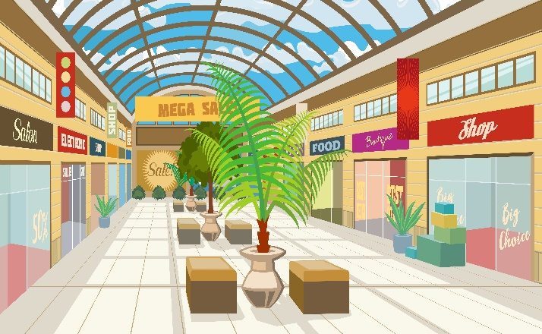
Monday, February 29th 2024
At the
shopping centre
Unit 18
Lesson 2 (1+2+3)

Slide 3

Warm-up

Slide 4

Let’s sing!

Slide 5



Contents
Look, listen and repeat.
Listen, point and say.
Let’s talk.

Slide 6

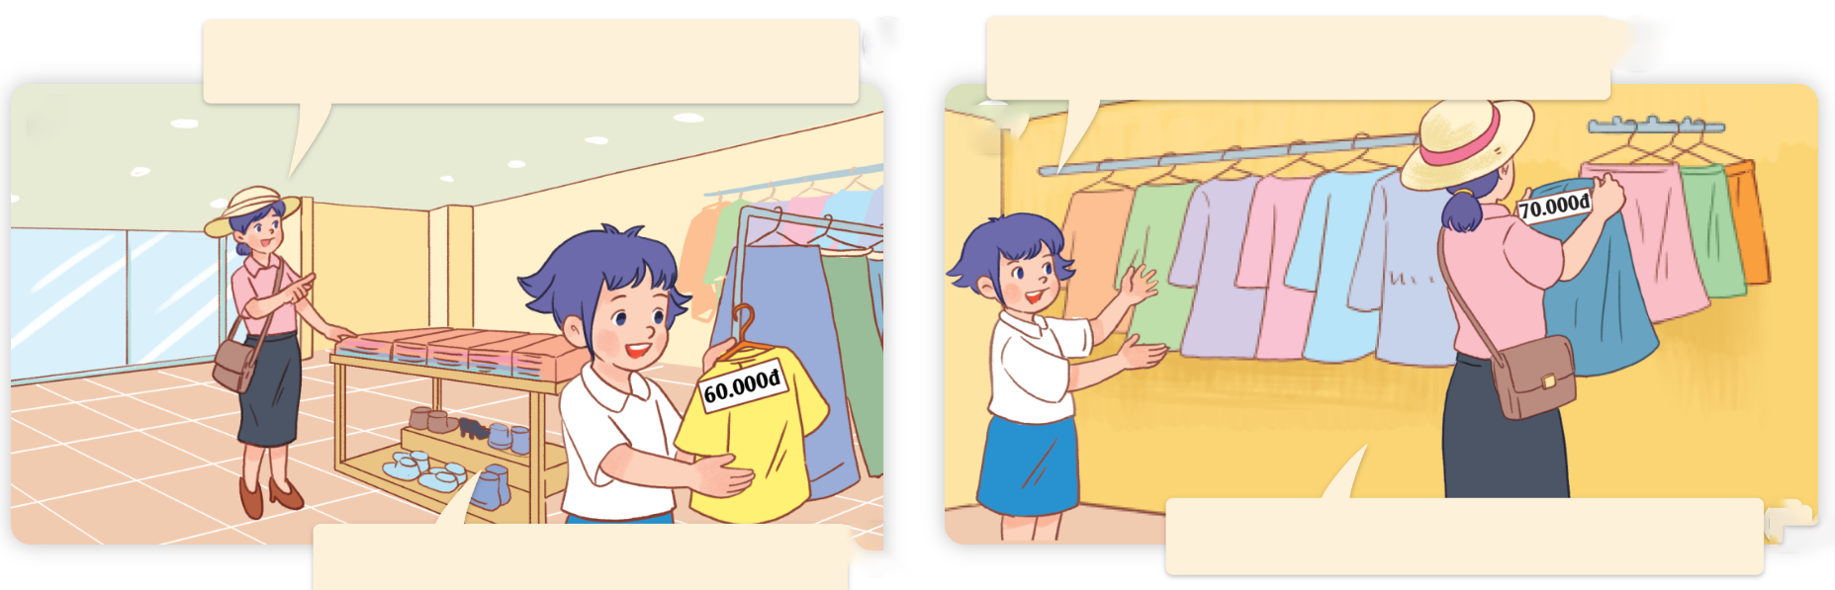
1. Look, listen and repeat.
How much is the T-shirt, Linh?
How much is the skirt, Mum?
a
b
It’s seventy thousand dong.
It’s sixty thousand dong.
What are they talking about?
Where are they?
Who are they?
Click on the speaker / sentences to listen.

Slide 7
Vocabulary

Slide 8
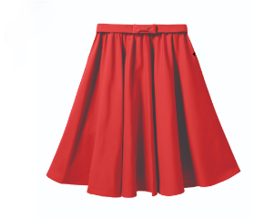
Vocabulary
skirt
/skɜːt/
váy
Click on the English words to listen again.

Slide 9
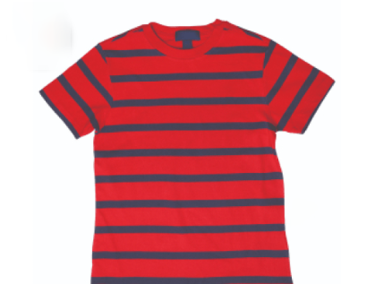
T-shirt
/ˈtiː ʃɜːt/
áo thun

Slide 10
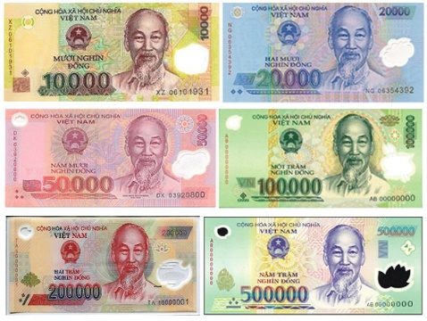
dong
/dɒŋ/
đồng (đơn vị tiền tệ
của Việt Nam)

Slide 11
10.000
thousand
20.000
/ˈθaʊznd/
50.000
90.000
nghìn

Slide 12
Review
10.000
20.000
50.000
90.000
skirt
T-shirt
dong
thousand

Slide 13


Vocabulary
1. skirt
: váy
2. T-shirt
: áo thun
3. dong
: đồng ( đơn vị tiền
tệ Việt Nam)
10.000
20.000
4. thousand
: nghìn
50.000
90.000
Click on the English words to listen.

Slide 14
Match
1. thousand
a. váy
2. T-shirt
b. nghìn
3. dong
c. áo thun
4. skirt
d. đồng

Slide 15
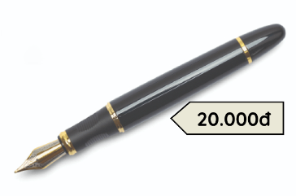
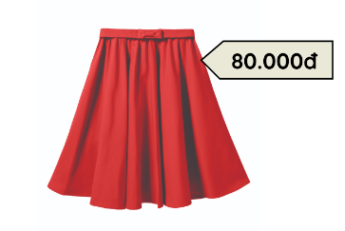
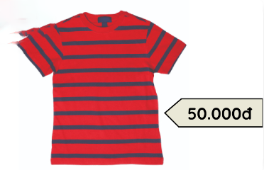
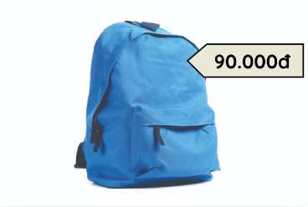
2. Listen, point and say.
a
b
How much is the ____?
pen / twenty thousand dong
skirt / eighty thousand dong
It’s ______.
c
d
T - shirt / fifty thousand dong
school bag / ninety thousand dong

Slide 16


2. Listen, point and say.
a
How much is the _____?
It’s ______.
pen / twenty thousand dong
How much is the pen?
It’s twenty thousand dong.
Click on the sentences to listen.

Slide 17


2. Listen, point and say.
b
How much is the _____?
It’s ______.
skirt / eighty thousand dong
How much is the skirt?
It’s eighty thousand dong.

Slide 18


2. Listen, point and say.
c
How much is the _____?
It’s ______.
T-shirt / fifty thousand dong
How much is the T-shirt?
It’s fifty thousand dong.

Slide 19
2. Listen, point and say.
d
How much is the _____?
It’s ______.
school bag / ninety thousand dong
How much is the school bag?
It’s ninety thousand dong.

Slide 20
Structures

Slide 21




Cách hỏi giá tiền đồ vật (số ít):
How much is the _______?
(________ có giá bao nhiêu?)
It’s ________.
(Nó có giá là ________.)
Ex:
How much is the pen?
It’s twenty thousand dong.

Slide 22


Unit 18 Lesson 2
How much is the _______?
It’s_______.
pen / twenty thousand dong
school bag / ninety thousand dong
skirt / eighty thousand dong
T-shirt / fifty thousand dong

Slide 23
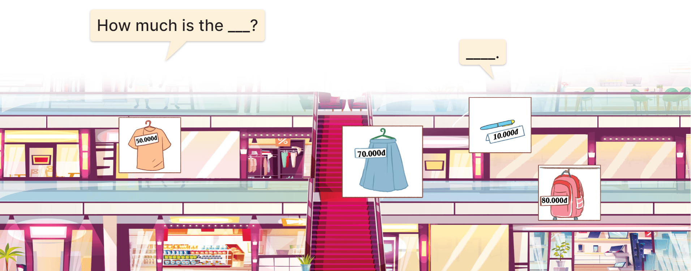
3. Let’s talk.
How much is the ______?
___________________.

Slide 24
3. Let’s talk.
How much is the ______?
T-shirt
___________________.
It’s fifty thousand dong

Slide 25
3. Let’s talk.
How much is the _____?
skirt
______________________.
It’s seventy thousand dong

Slide 26
3. Let’s talk.
How much is the _____?
pen
___________________.
It’s ten thousand dong

Slide 27
3. Let’s talk.
How much is the __________?
school bag
_____________________.
It’s eighty thousand dong

Slide 28
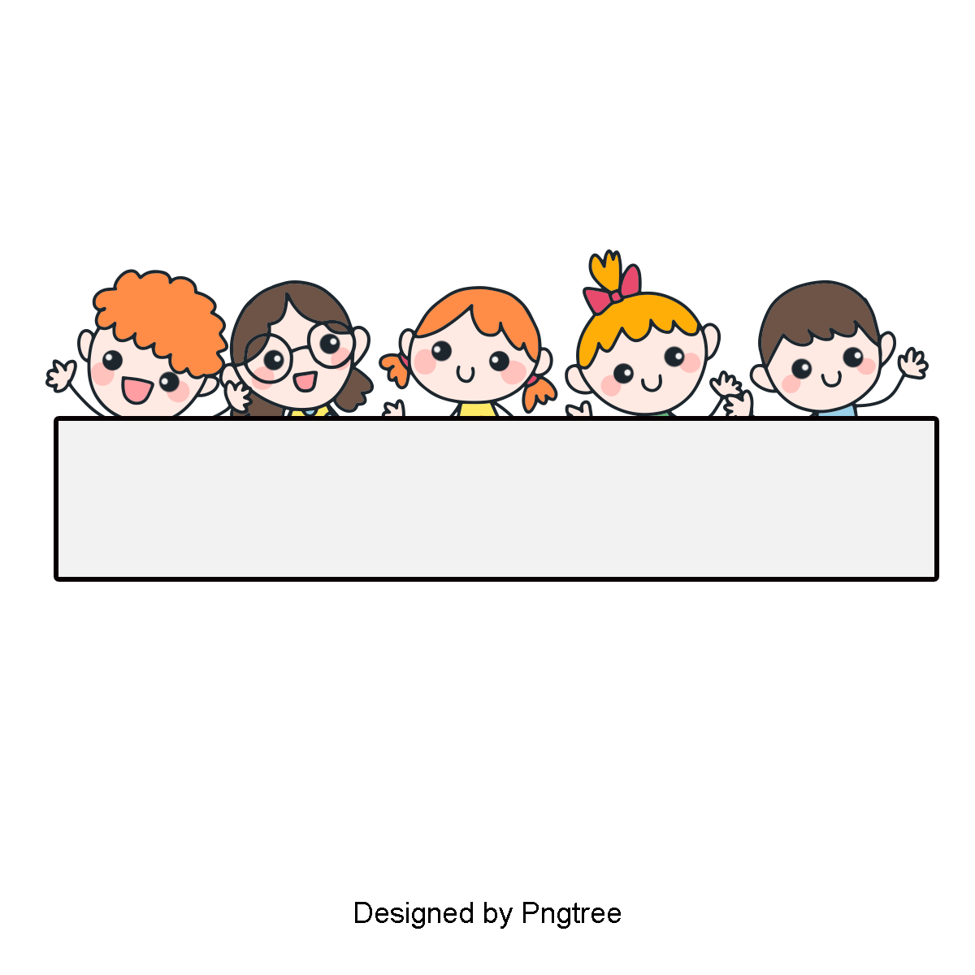
Let’s play

Slide 29

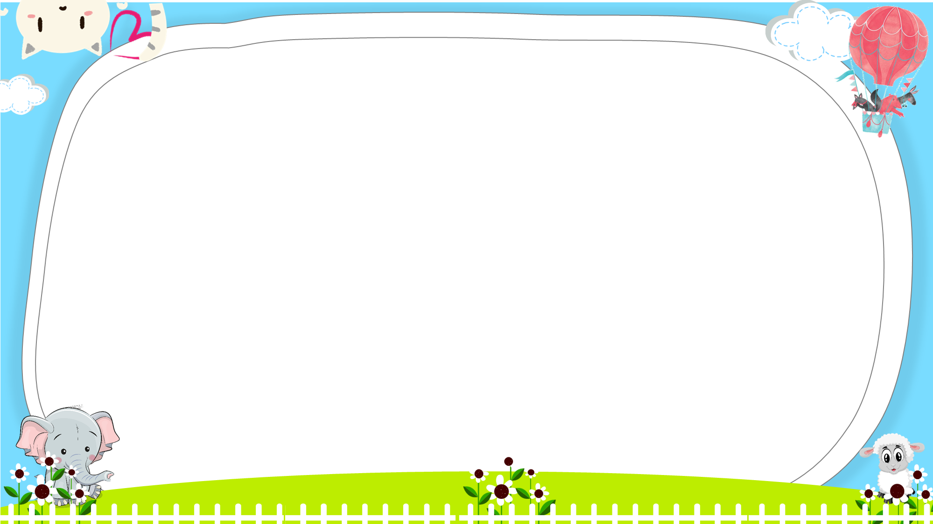




Slide 30





A. T-shirt
B. skirt

Slide 31
A. T-shirt
B. skirt

Slide 32

A. dong
B. thousand

Slide 33
A.
B.

Slide 34
A. True
B. False

Slide 35
A. True
B. False

Slide 36
Mary: How much is the pen?
Ben: It’s __________ dong.
A. twelve thousand
B. twenty thousand

Slide 37
Nam: _______ is the skirt?
Bill: It’s seventy thousand dong.
A. How can
B. How much

Slide 38
Bill: How much is the school bag?
Mai: It’s ninety thousand dong.
A.
B.

Slide 39

Ben: _______________
Mai: It’s ninety thousand dong.
A. What does it say?
B. How much is the pen?

Slide 40


Slide 41
Wrap up

Slide 42
Review
How much is the _______?
It’s_______.
pen / twenty thousand dong
school bag / ninety thousand dong
skirt / eighty thousand dong
T-shirt / fifty thousand dong

Slide 43
Homework
Learn by heart all the new words.
Read again the dialogue in part 1.

Slide 44

Thank you!

