Slide 1


DAI LOC DEPARTMENT OF EDUCATION AND TRAINING
DAI QUANG PRIMARY SCHOOL
WELCOME TO OUR CLASS !
Subject: English 3
Class: 3D
Teacher: Pham Thi My Chau

Slide 2
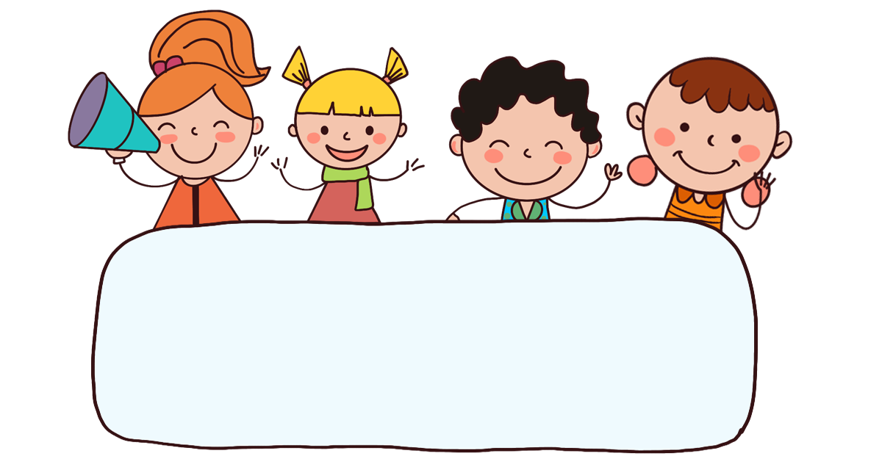
Warm-up

Slide 3


PLAY

Slide 5




B. writing
A. dancing
C.reading

Slide 6
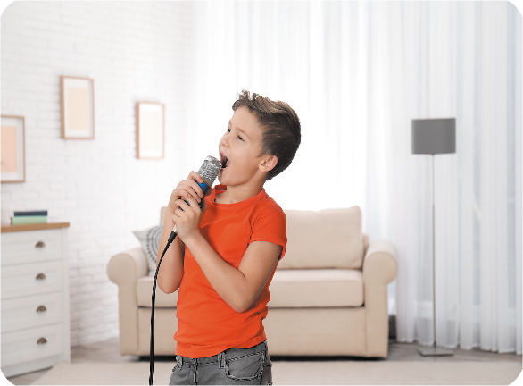
B. reading
A. singing
C.writing

Slide 7

B. ee
ea
C. oa
r__ding

Slide 8
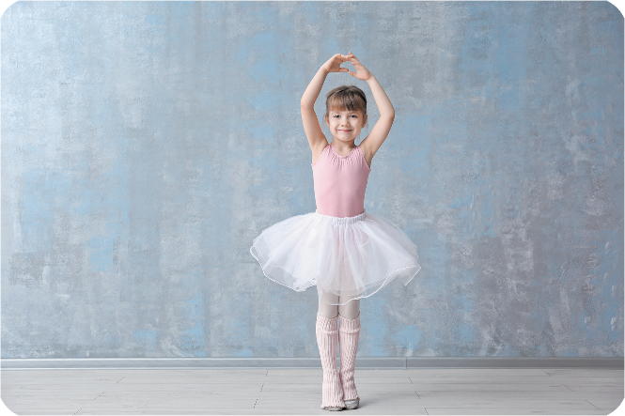
B. on
A. en
C. an
d__cing

Slide 9

B. u
C. i
A. a
Facebook : Bùi Liễu
0968142780
wr_ting

Slide 10

B. reading
A. dancing
C. singing
I’m ______
a book.

Slide 11
B. reading
A. singing
C.writing
I’m _____
a song.

Slide 12
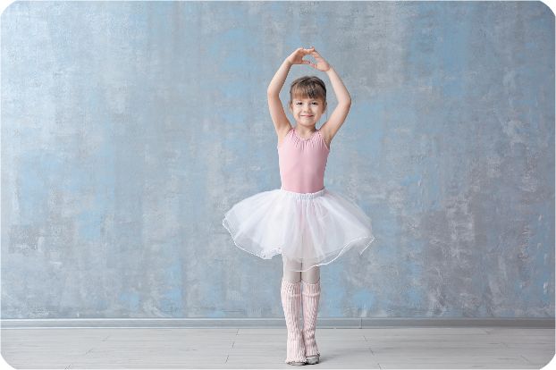
B. reading
dancing
C. writing
Facebook : Bùi Liễu
0968142780

Slide 13





EXIT

Slide 14


Thursday, April 11th, 2024
UNIT 18 : PLAYING AND DOING
*Lesson 2:
Part: 1, 2 & 3

Slide 15

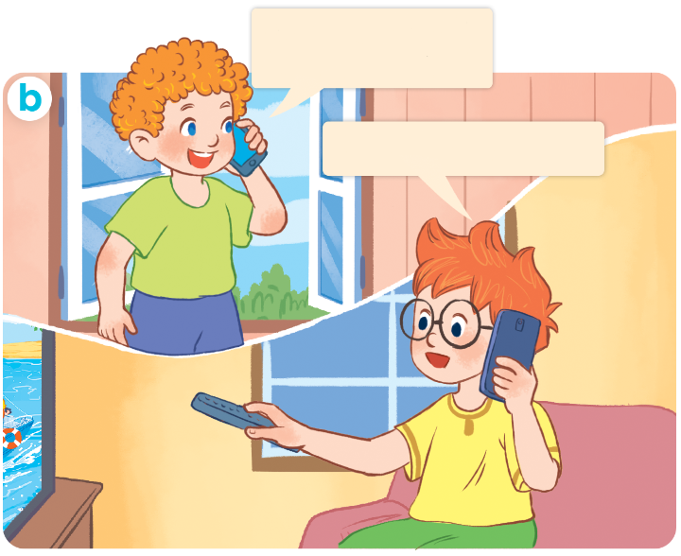
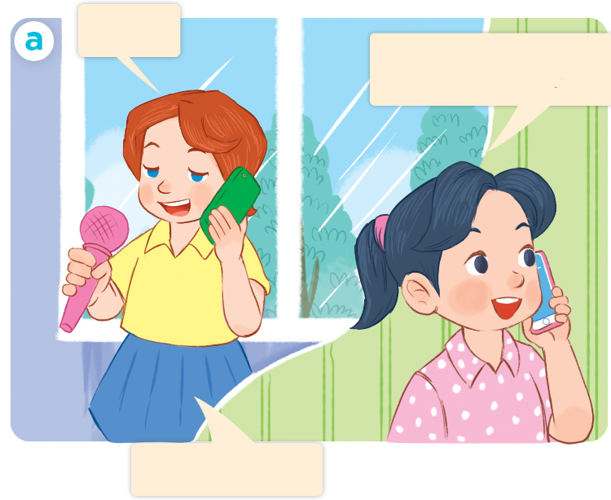
1. Look, listen and repeat.
Hi, Ben. What are
you doing?
Hello.
Hi, Lucy. What are you doing?
I’m watching TV.
I’m singing.
Who are they?
Where are they?
What are they doing?

Slide 16
Vocabulary

Slide 17
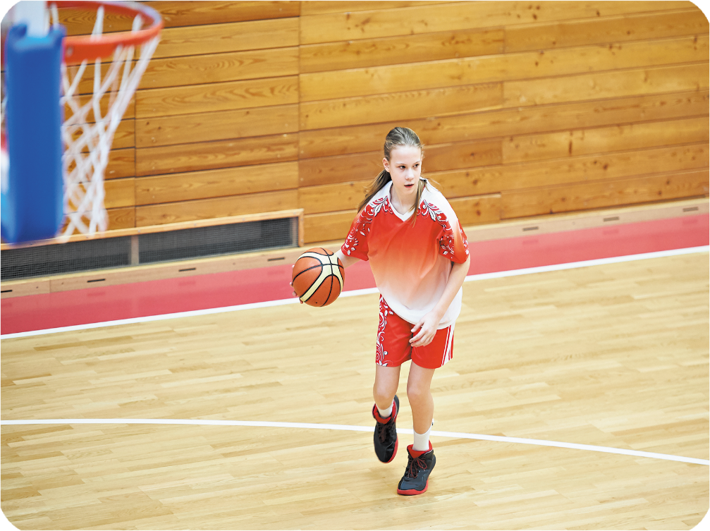

playing basketball
/ˈpleɪɪŋ ˈbɑː.skɪt.bɔːl/
chơi bóng rổ

Slide 18
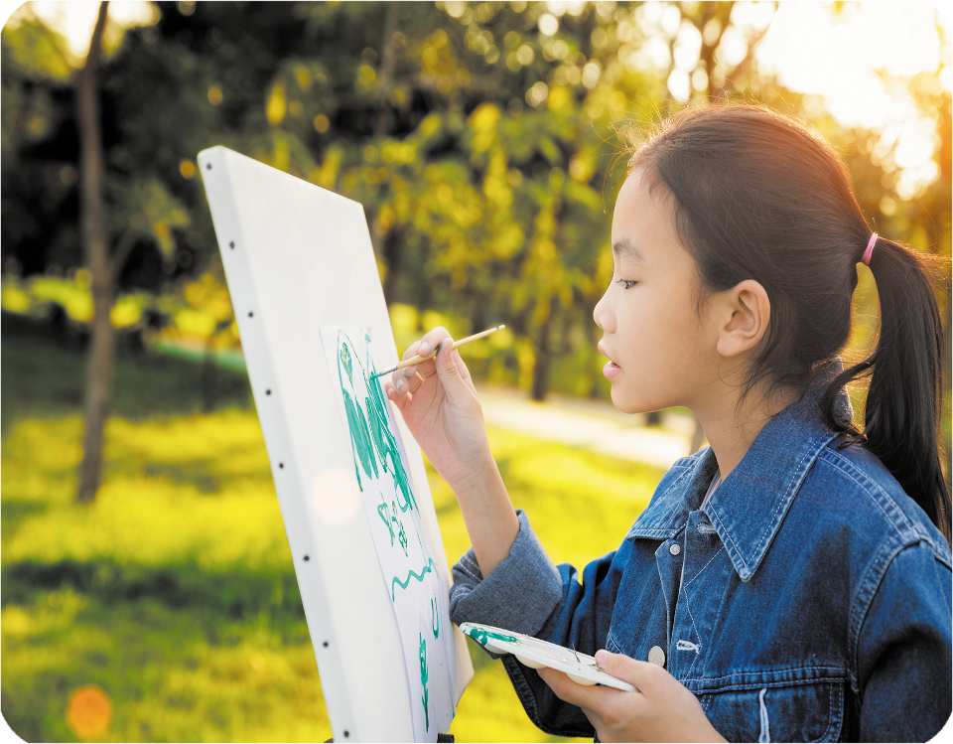
drawing a picture
/ˈdrɔː.ɪŋ əˈpɪk.tʃər/
vẽ tranh

Slide 19
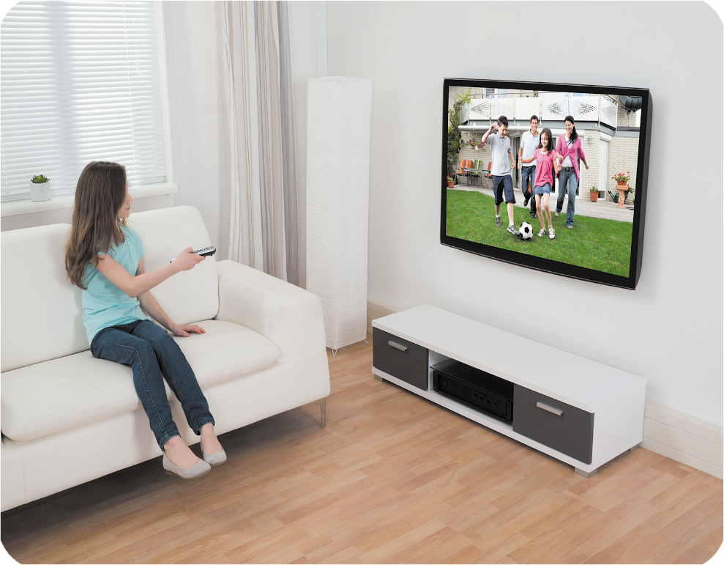
watching TV
/wɒtʃɪŋˌtiːˈviː/
xem TV

Slide 20

listening to music
/ˈlɪs.ənɪŋ tuːˈmjuː.zɪk/
nghe nhạc

Slide 21




Review
playing basketball
drawing a picture
watching TV
listening to music

Slide 22




Checking vocabulary
watching TV
1
a
drawing a picture
2
b
playing basketball
3
c
listening to music
4
d

Slide 23
Structures

Slide 24
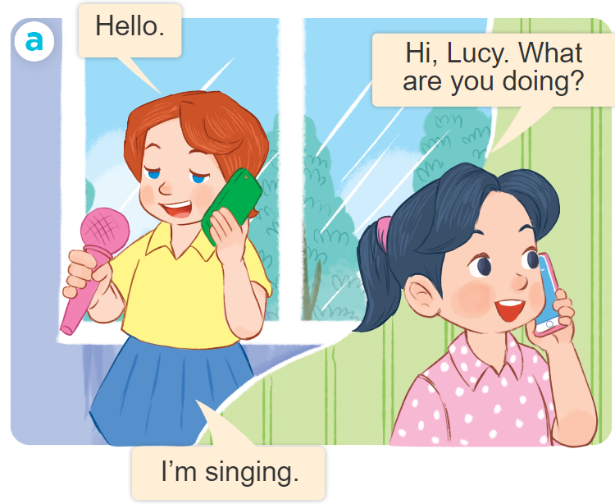
Structures
Để hỏi và trả lời cho câu hỏi: “Bạn đang làm gì vậy”.
What are you doing?
I’m ___________.
I’m = I am

Slide 25




2. Listen, point and say.
a
b
What are you doing?
playing basketball
drawing a picture
I’m ___________.
c
d
watching TV
listening to music

Slide 26
playing basketball

Slide 27
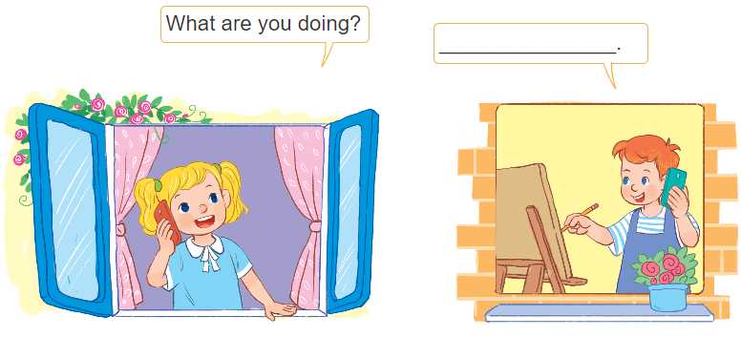
3. Let’s talk.
I’m drawing.

Slide 28
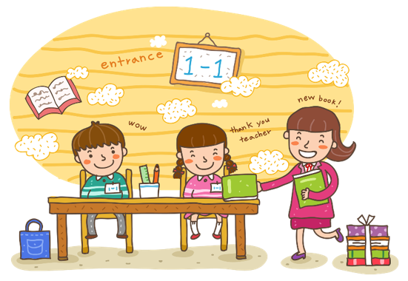
Wrap up

Slide 29
Review
playing basketball
drawing a picture
watching TV
listening to music

Slide 30
Structures
Để hỏi và trả lời cho câu hỏi: “Bạn đang làm gì vậy”.
What are you doing?
I’m ___________.
I’m = I am

Slide 31

Thank you!

